Slide 1

Optimizing code for collaboration
Javy de Koning
@JavydeKoning
Notes:
Welcome to IPsoft everyone
-Name
-Talk about optimizing code for collaboration
-Start of asking who’s is coding mostly solo

Slide 2
About_Javy
Windows Ops @IPsoft
Automation (PS, JS, SH)
PowerShell Checkdev
Find me online:
Twitter : @JavydeKoning
Github : JavydeKoning
Reddit : /u/JavydeKonig
LinkedIn: /in/JavydeKoning
Notes:
-Operations guy in Win-Team
-MSP
--20% Autonomic Res Automation (Remediate Alerts)
--Some check Development (Own Platform, PSR
-Team/Client management tasks
Find me online

Slide 3
Intro
‘WinAdmin’ -ne ‘Dev’
A thing of the past?
Working on code written by someone else can challenging
Collaboration requires:
Tests
Documentation
Rules!!
Version Control
Etc…
Notes:
-Most Windows admin are (or maybe I should say were) not developers.
-We continue to be more involved in the ‘DevOps’ roles
-I Think WinAdmins that are not using PowerShell will be a thing of the past
-you either learn PowerShell or lose your job
--Working on code written by someone else can be challenging.
--IPsoft check dev by Unix People that mostly write perl
-Rules / Guidelines
-Styling curly braces same lines, indents and so on.

Slide 4
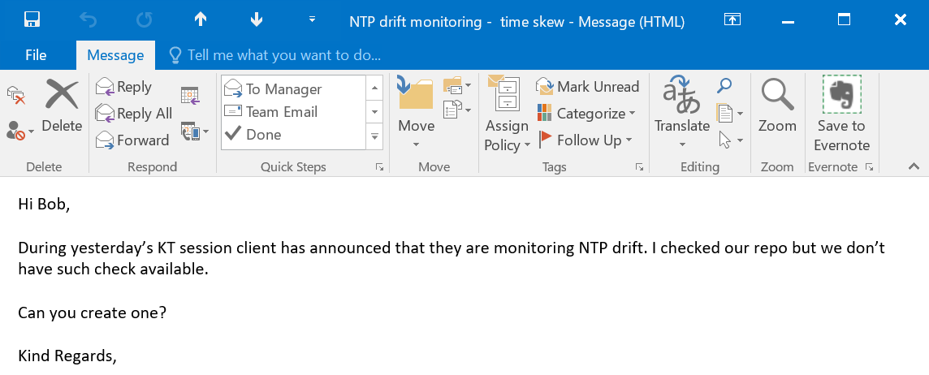
Problem Scenario
Request:
Notes:
-Let’s talk about the problem
-After taking ownership Knowledge transfer session
-Requirement to monitor NTPDrift surfices
-No check, so we need to create one

Slide 5
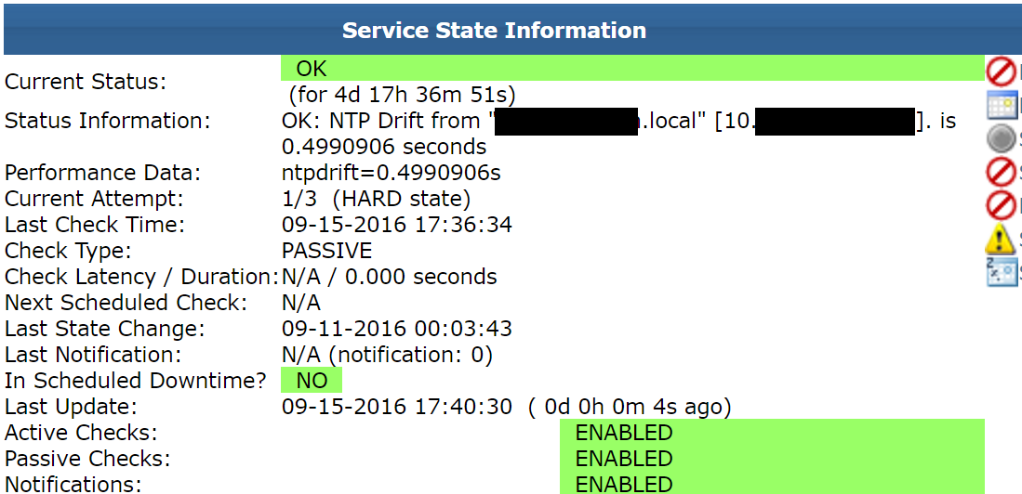
Problem Scenario
Request seems simple -> deliver v0.1:
Notes:
-request sounds simple enough so we create a check and present it to the client.

Slide 6
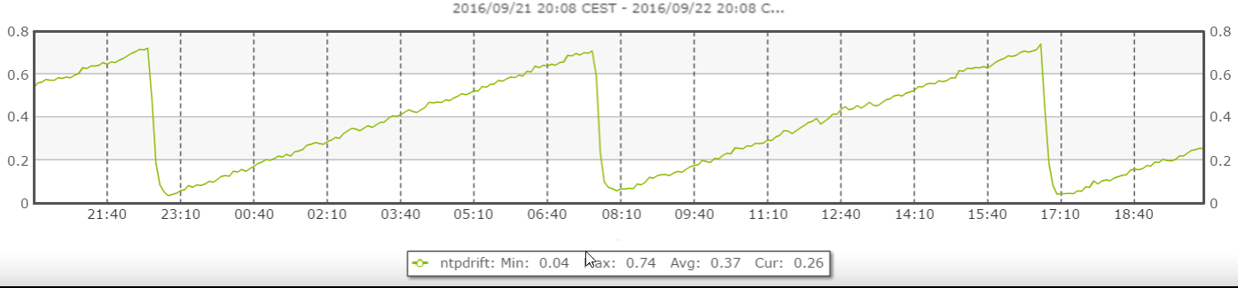
Problem Scenario
Performance Data:
Notes:
-Also included performance data. Client is happy. This is exactly what the wanted.
-Show v0.1

Slide 7
Problem Scenario
Requestor is happy with the fast delivery, but…
Does not want to specify time-source.
More requirements surface:
Want’s to ignore NON-Domain members.
Want’s to ignore ‘Local CMOS Clock’.
Etc…
Bob delivers v1.0
No unit-tests, documentation, repo/vcs
But running production!
Notes:
-Requestor very enthusiastic
-But its lacking features
-This goes back and fort

Slide 8
Thoughts?
?
Notes:
Who here thinks this is a bad approach?
Has anyone seen the TDD by June on PSconfEU?
I partially agree.

Slide 9
Thoughts?
If requirements are unclear:
Deliver MVP
Build -> measure -> learn
No waste!
Improve/Finalize after requirements are met.
Notes:
-Good talk but not always applicable
-No point in shooting a moving target.
-The lean startup, deliver MVP. Go through build, measure, learn cycle
-While we are not a startup we can approach these projects like one. You will most likely do the same when you write something for your self.
-Ideas accumulate overtime.
-Writing Test, Documentation, Comments and so on are all complete waste of resources when the exact requirements are unknown.
-Often not all input is available
-The client, your boss or whoever the requestor is might mean a completely different thing, you might have understood wrong OR the requestor doesn’t even know what he wants.
Depending on your job this might often might be the case. Even if you are writing modules for yourself additional ideas might surface while writing the code.

Slide 10
Improving for collaboration
Adhere Best practices
Comment & Document
Short Focused Units
Include Unit Tests
Use version control
Agree on formatting style
(and stick with it!)
Notes:
Short Focused Units
-easy to read,
-easy to mock.
Opening and closing braces on the same line
Indention of braces
Eqaul signs aligned to the longest variable length.

Slide 11
But how to enforce?
Tests!
PSScriptAnalyzer
CI/CD tools
Regex

Slide 12
Demo
GitHub
Pester tests for:
Parameter help
Comment coverage
Unit size
PSScriptAnalyzer
AppVeyor
Notes:
-Pester tests (PowerShell)
--No deep dive
--Jaap’s slides, June’s (YouTube)
--Pester Wiki
-AppVeyor
--How to use AppVeyor with minimal configuration. And use mostly Powershell

Slide 13
Questions?

