Slide 1
DISEASOME - Network of Rare Immune Diseases
Project by : Jawahar Mahendran
Abhyuday Parihar
Vallari Narsingpurkar
Supervisor : Prof. Dmitriy Leyfer
This presentation is completed as part of BF527 Final Project
12/11/2023

Slide 2
Motivation
Goal: Human Disease Network through Phenotype based associations
Why is this important?
Uncover biological mechanisms among seemingly unrelated diseases.
Better understanding of disease pathways and potential targets for therapeutics.
What are we showing with this network?
Diseases that frequently co-occur or share common features.
Crucial for understanding disease comorbidities.
Can influence treatment strategies and patient management.
Future goals
Could be extrapolated into disease gene associations.
Would indicate the common genetic origin of many diseases.
Notes:
This project work started as an attempt to achieve a Human Disease network.
The goal behind it being we can see clusters of different human diseases and thereby make a correlation of which diseases are closely related to which other ones.
This idea can also be extrapolated to make a Disease-Gene network which would allow to picture the genes which cause a particular phenotype during a disease.

Slide 3
Workflow
Clustering of Diseases
Mapping the disease using p-values. Clustering the diseases using Cytoscape.
03
Rare Immune Diseases
Data from Orphanet database. Common Phenotypes amongst diseases.
Diseasome
01
02
Correlation between Diseases
Hypergeometric test amongst the diseases. Heatmap and correlation matrix to show relation.

Slide 4


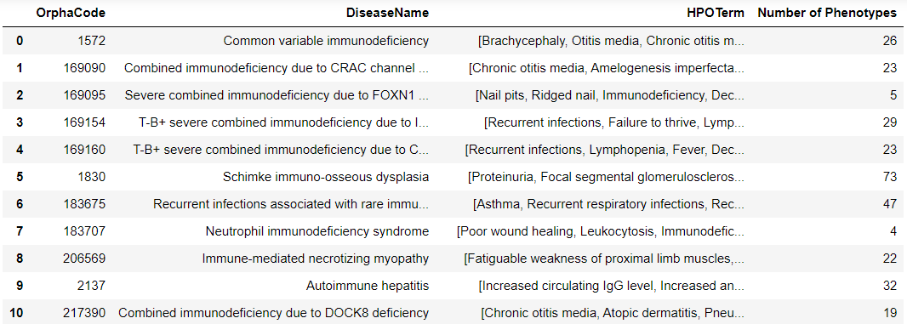
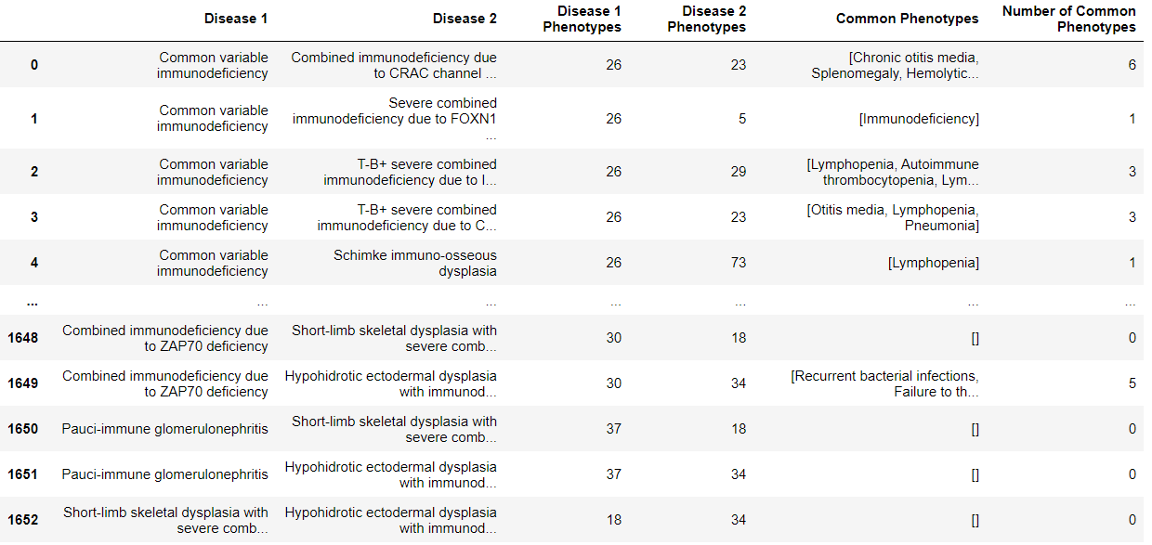
What we did?
Diseases and their phenotypes
Scope:
Rare Human Diseases.
4021 diseases = 8,086,231 permutations
Selection Criteria:
Immune diseases
Dataset Overview:
58 Rare Immune Diseases.
Analysis:
Phenotypes linked to each disease.
Compared the phenotypes amongst diseases to find commonality.
Common Phenotypes between Diseases
Notes:
We can include snippet of code here

Slide 5
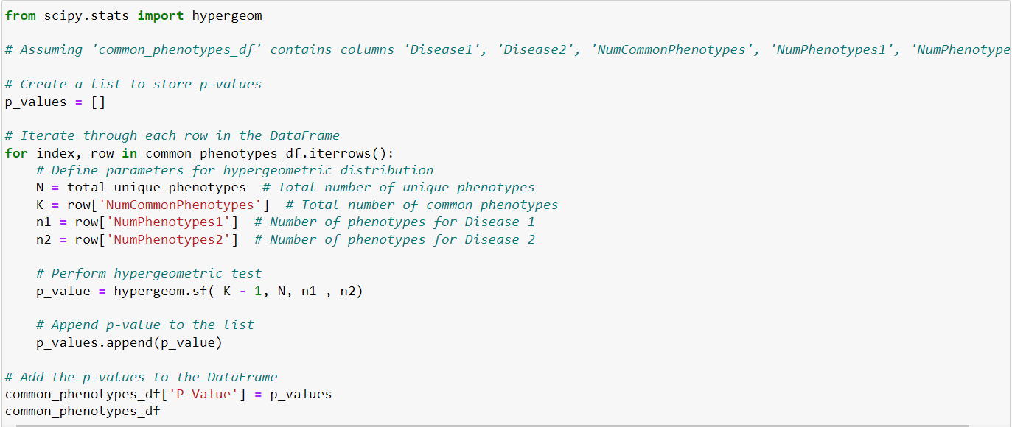
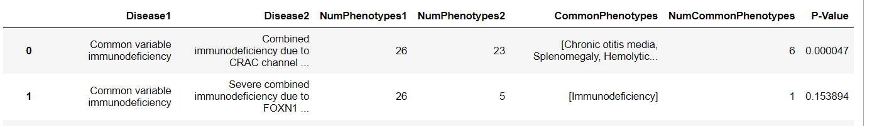
Analysis
HYPERGEOMETRIC TEST FOR P-VALUE
Statistical significance of phenotype overlap between Pairs.
n: Total number of phenotypes
n1:Phenotypes associated with disease 1
n2:Phenotype associated with disease 2
k:Common Phenotypes
Analysis in Python
Notes:
Heat map

Slide 6
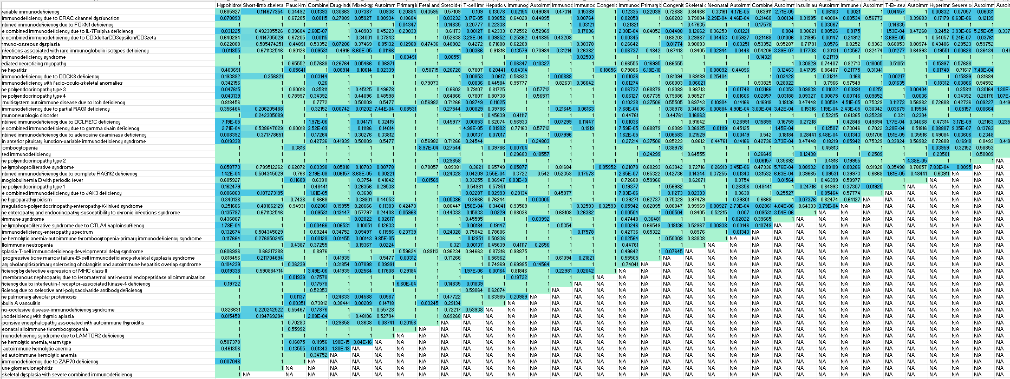
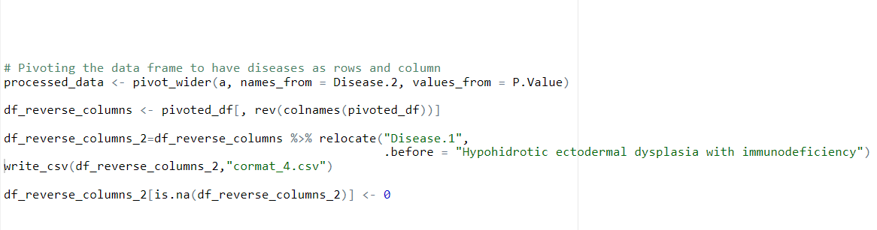
Analysis
CO -Relation Matrix
Data Manipulation in R
All Diseases as Rows and Columns
P- Values as value in the matrix

Slide 7
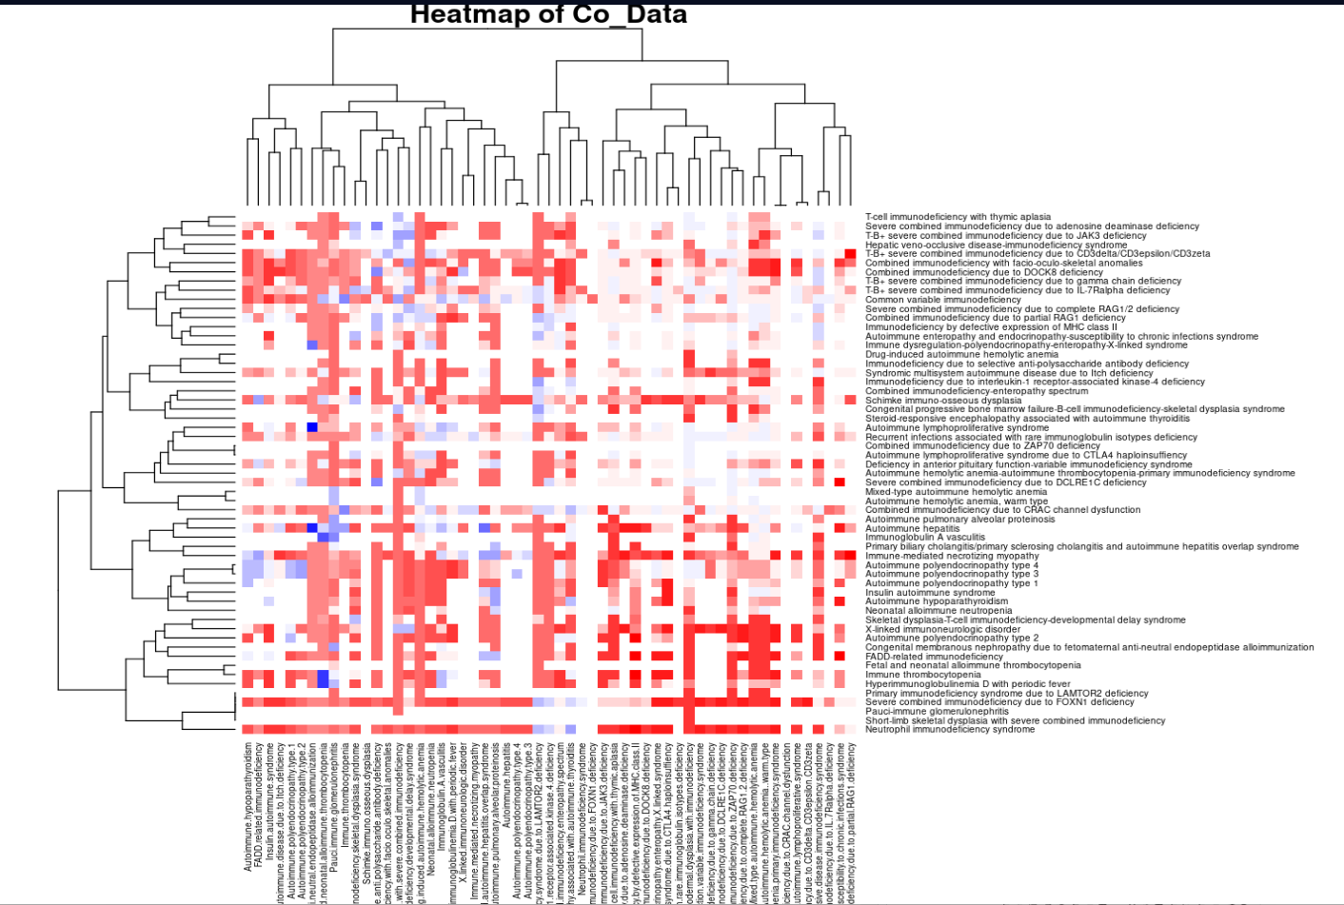
Analysis
HEAT MAP
R for Heat map
More Significant Relation(Lower P-values are in Blue)
Less Significant Relation(Higher P-values in Red)
Visualization for more clear comparison of Relations
Notes:
Cytoscape network

Slide 8
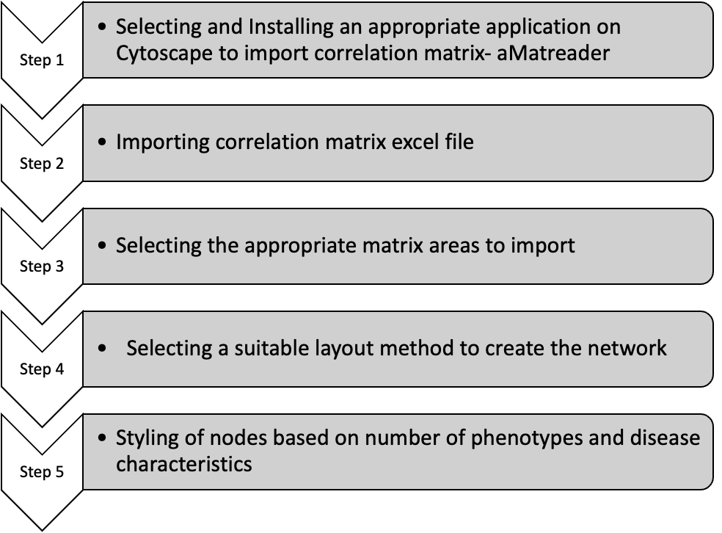
Cytoscape methodology

Slide 9
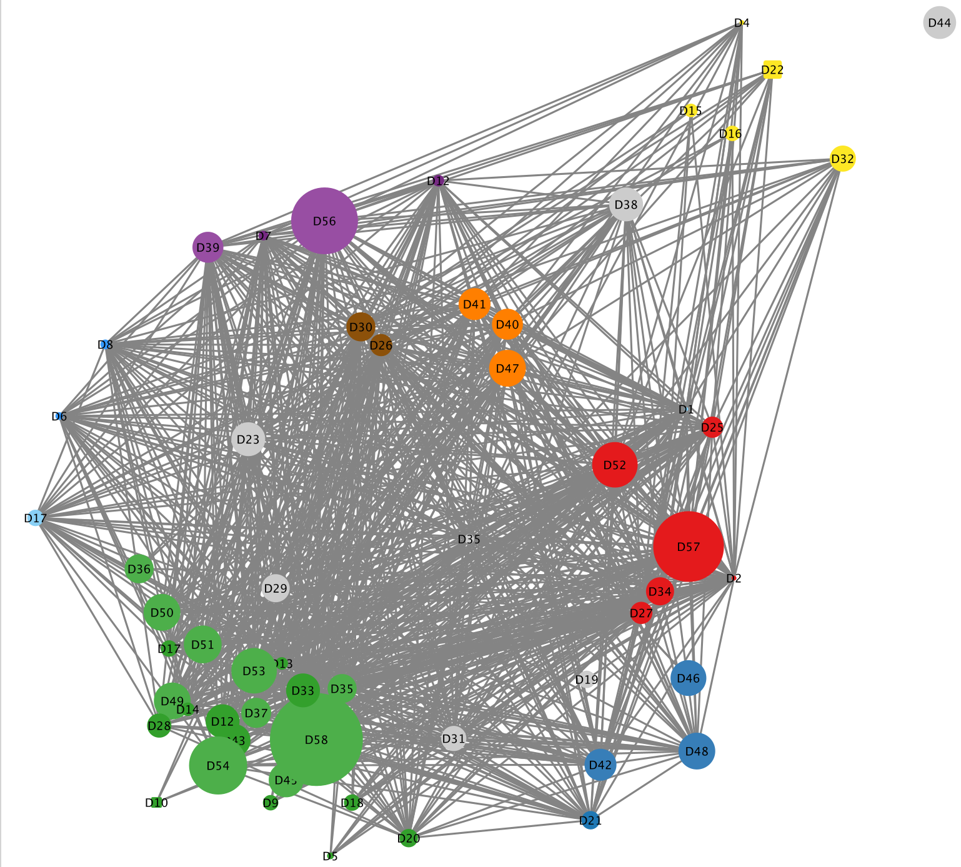

Result from Cytoscape : Visualization of rare immune diseasome.
Node - Disease
Node size - Number of phenotypes in that particular disease
Edge - p value
For example :
D58 - Hypohidrotic ectodermal dysplasia with immunodeficiency
D35 - Autoimmune lymphoproliferative syndrome (ALPS) due to CTLA4 haploinsufficiency
D58- D35 association p value - 0.00017
7 common phenotypes

Slide 10
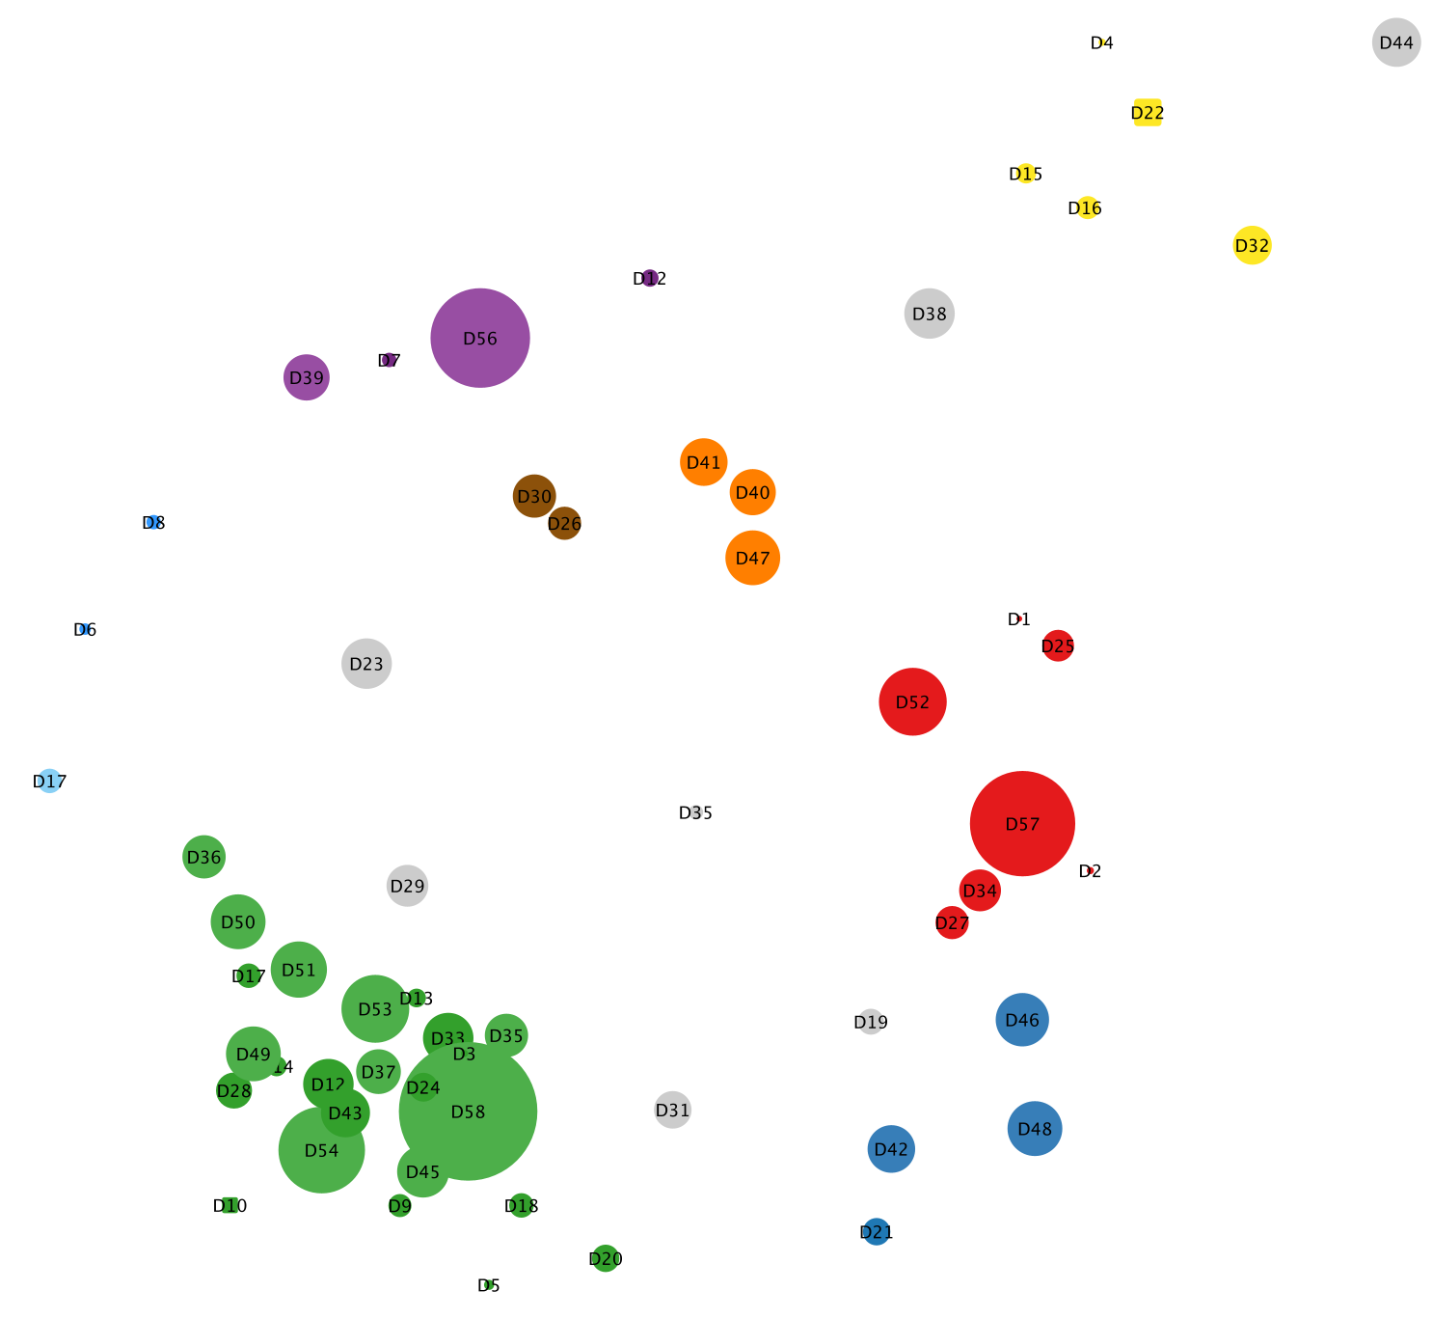
Analysis of Network
GREEN CLUSTERS: (Gene deficiency related)
The diseases combined in this cluster are possibly due to FOXN1 gene deficiency.
The proteins derived from this gene are important factors responsible for conferring adaptive immunity and for maintaining immune homeostasis.
RED CLUSTERS: (Immune system checkpoints failure)
The diseases in this clusters arise due to failure of the immune system checkpoints, leading to dysregulation of immune responses.
OUTLIERS:
Eg: D23

Slide 11
Conclusion
Analysis of relationship between Immune Diseases was taken based on common phenotypes.
Same Project with more computation power can be carried forward to get associations between all human diseases based on common phenotypes.
Another possible extension for this project can be clustering the diseases based on the genes responsible for the particular phenotypes expression. This would give us an association between the diseases, their associated phenotypes and the underlying gene expression

Slide 12
References
https://www.pnas.org/doi/10.1073/pnas.0701361104#sec-1
https://ojrd.biomedcentral.com/articles/10.1186/s13023-021-01741-4
https://my.clevelandclinic.org/health/articles/24291-diagnostic-and-statistical-manual-dsm-5
https://www.sciencedirect.com/science/article/pii/S1673852715002118?via%3Dihub

