Slide 1
Aramark Procurement Analytics
Supplier Concentration, Weather Sensitivity, and Customer Segmentation
CS 562 — Big Data
Jawaad • Tharun • Praneel
Notes:
The project surfaces three major findings that connect to each other: extreme supplier concentration at the distributor layer, measurable weather sensitivity in the procurement mix, and six interpretable customer archetypes surfaced through machine learning. Each finding builds on the previous one — concentration explains operational risk, weather amplifies that risk in HIGH-concentration states, and the customer segmentation reveals which archetypes are most exposed.

Slide 2
The Problem and the Dataset
• Dataset: ~43 million Aramark US procurement transactions across calendar year 2025 (~1 billion cells total)
• Source: a single 9.4 GB CSV file hosted in Google Cloud Storage
• 23 raw columns span time (year, year_month), geography (state, city, zip), entity type, product hierarchy (L1→L4), supplier (distributor + manufacturer IDs), and the spend proxy
• Core analytical set reduced to 11 high-quality columns; additional ones re-introduced selectively in BigQuery
• Three business questions: (1) Where does concentration create risk? (2) Does weather visibly move procurement? (3) Are there hidden customer archetypes?
Notes:
We filtered to eleven analytical columns initially for memory reasons when working in pandas, then pulled additional columns back selectively once we migrated to BigQuery. The business question driving all the analysis is simple: where does supplier concentration create operational risk, does external weather visibly move procurement behavior, and can we surface hidden customer archetypes that would be invisible from top-line aggregations?

Slide 3
Architecture — Cloud-Native Analytics Pipeline
• Source layer: raw CSV in Google Cloud Storage, unchanged
• Warehouse layer: one-time BigQuery load → typed 43M-row table (9.4 GB), explicit schema, correct dtypes
• Aggregation layer: 16 stored BigQuery views materialize common rollups (by state, category, distributor) plus cross-cuts
• A view is a stored SQL query behaving like a table — zero storage cost, cannot drift from source, always current
• Analysis layer: Colab notebooks issue SQL against the views, pull small result sets into pandas for visualization
• External data: NOAA climdiv weather loaded as a second table, joins to spend on (state, year_month)
• Performance gain: full aggregations dropped from ~10 min (pandas chunking) to 2–5 sec (SQL against views)
• ML layer: 500K-row stratified sample pulled via BigQuery TABLESAMPLE for in-memory clustering
Notes:
The architecture is cloud-native and follows a modern analytics engineering pattern with four layers. Layer one is the source: the raw CSV in Google Cloud Storage, left unchanged throughout the project. Layer two is the warehouse: we ran a one-time BigQuery load operation that parsed the CSV into a typed forty-three-million-row table with an explicit schema — STRINGs for identifiers, INTEGER for year_month, FLOAT64 for the spend proxy. The load itself took about three minutes and produced a 9.4 gigabyte columnar table. Layer three is the aggregation layer: sixteen stored BigQuery views materialize common rollups — by state, by category, by distributor, and cross-cuts like category-by-month, distributor-by-state, category-by-entity. A view is a stored SQL query that behaves exactly like a table from the consumer's perspective; every time you query it BigQuery re-executes the underlying SQL against the source. Views cost zero storage and by design cannot drift from the source data. Layer four is the analysis layer: Colab notebooks issue SQL queries against the views and pull small result sets into pandas for visualization, with ML models fit on stratified samples. NOAA- National oceanic and atmospheric administration.

Slide 4
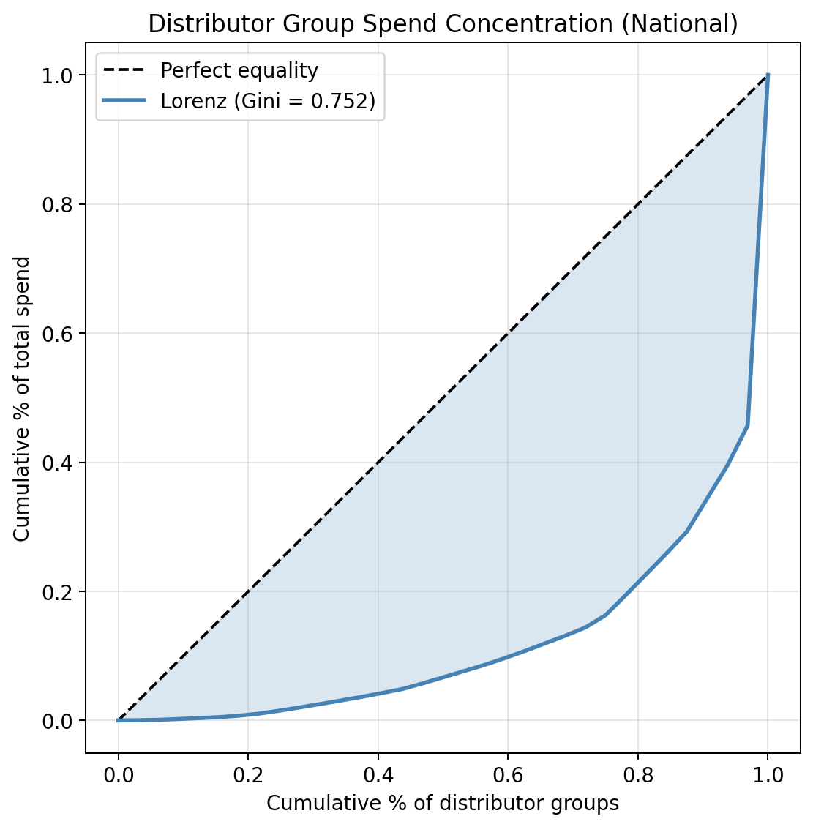
National Concentration is Extreme
• MASTER DISTRIBUTOR handles 54.3% of all US Aramark spend by itself
• Top 3 distributors: 65.6% • Top 5: 74.1% • Top 10: 86.9% of total spend
• The remaining 23 distributor groups combined: only ~13% of spend
• Lorenz curve bows sharply toward the bottom-right — extreme visual departure from the 45° equality line
• Gini coefficient on distributor spend > 0.8 (extreme-concentration band)
• Textbook long-tail pattern: few dominant logistics channels + many tiny specialty distributors
Notes:
Phase 3 quantifies supplier concentration using standard industry metrics. The Lorenz curve is the first visualization shown on the right of this slide — sort all thirty-three distributor groups from smallest to largest by spend, then plot cumulative share of distributors on the x-axis against cumulative share of spend on the y-axis. If every distributor had equal spend the curve would be the forty-five-degree diagonal line. The more the curve bows below that diagonal, the more unequally spend is distributed. In our data the curve is pushed hard toward the bottom-right corner — the bottom seventy percent of distributor groups together account for only a sliver of total spend. The Gini coefficient summarizes this in a single number: G equals one minus twice the area under the Lorenz curve, running from zero for perfect equality to one for a complete monopoly. Our Gini is 0.752, which is the high-concentration band. The top-N share numbers make this concrete and memorable: MASTER DISTRIBUTOR alone handles 54.3 percent of all Aramark spend nationally; the top three distributors together handle 65.6 percent; top five handle 74.1 percent; and the top ten handle 86.9 percent. Translated, the remaining twenty-three distributor groups combined account for only about thirteen percent of spend. A small number of dominant logistics channels with a long tail of tiny specialty distributors underneath.

Slide 5
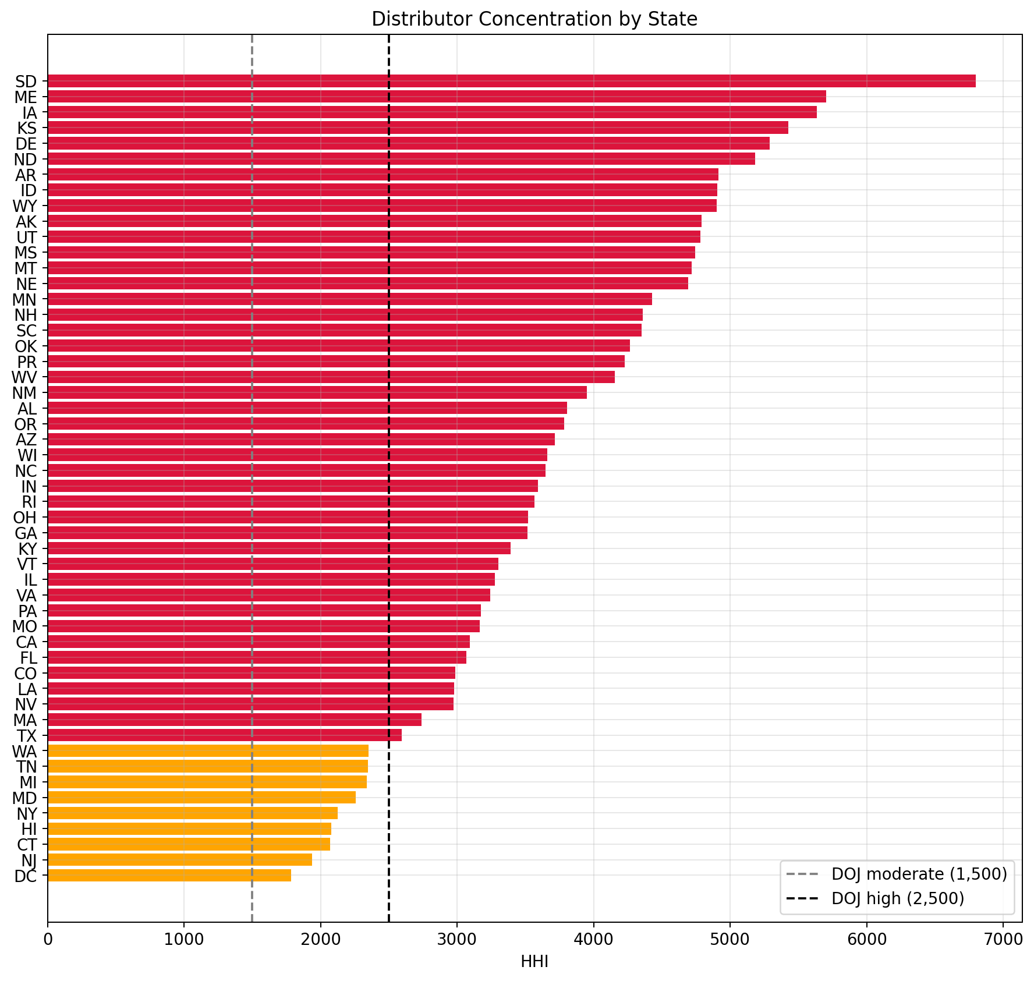
Every US State is Concentrated
• HHI (Herfindahl-Hirschman Index) = sum of squared market shares — DOJ antitrust standard
• Thresholds: <1,500 competitive • 1,500–2,500 moderate • >2,500 HIGHLY CONCENTRATED
• 42 of 52 states HIGH risk • 10 MODERATE • 0 competitive — zero states escape concentration
• Worst: SD (6,798) • ME (5,701) • IA (5,634) • KS (5,425) • DE (5,287) — top-1 share >70%
• MASTER DISTRIBUTOR is the #1 distributor in every single US state, without exception
• Smallest-spend states are most concentrated (fewer distributor relationships to spread across)
Notes:
The Herfindahl-Hirschman Index is the standard measure of market concentration used by the US Department of Justice in antitrust reviews. HHI equals the sum of squared market shares expressed as percentages, so a monopoly with one firm at one hundred percent share produces HHI of ten thousand, while perfect competition with many tiny firms produces HHI near zero. The DOJ defines three specific tiers for antitrust review of mergers: below 1,500 is a competitive market, 1,500 to 2,500 is moderately concentrated, and above 2,500 is highly concentrated and flagged for regulatory scrutiny. We are not doing an antitrust review, but applying the DOJ scale to state-level distributor concentration gives us a defensible, externally-validated cutoff system for describing risk. Results are striking: forty-two of fifty-two states exceed the high-concentration threshold of 2,500, ten states fall into the moderate zone between 1,500 and 2,500, and zero states are classified as competitive. The most concentrated states are small-spend states — South Dakota at HHI 6,798, Maine at 5,701, Iowa at 5,634, Kansas at 5,425, Delaware at 5,287. In each of these, the top-1 distributor share exceeds seventy percent. The least-concentrated states are large urban markets like DC, NJ, CT, HI, and NY, which still sit at HHI 2,000 to 2,500 — moderate but not competitive. The most important detail is what appears on the right edge of every single bar in this chart: MASTER DISTRIBUTOR is the number-one distributor in every single US state.. This means any disruption to MASTER DISTRIBUTOR would affect the entire national procurement network simultaneously, not just one geography.

Slide 6
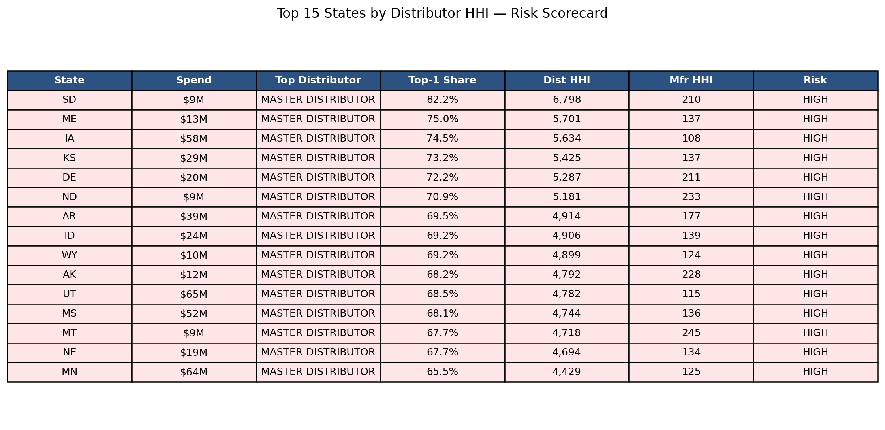
State Risk Scorecard
• Manufacturer HHI is low in nearly every state (<250) — supply SOURCE layer is diversified
• Only Puerto Rico shows high manufacturer HHI (5,140 — tiny sample of 4 manufacturers)
• Critical reframe: risk sits in the LOGISTICS layer, not the SOURCING layer
• If MASTER DISTRIBUTOR were disrupted: products still available from many manufacturers — re-routing challenge, not re-sourcing
• Risk flags: HIGH (dist_hhi > 2,500 OR mfr_hhi > 2,500 OR top-1 > 60%) • MODERATE (1,500–2,500) • LOW
• agg_state_risk_scorecard view integrates all risk metrics per state — reused in Phases 5 and 7
Notes:
This is the reassuring finding of Phase 3 and the critical reframing of the concentration story. MASTER DISTRIBUTOR is a logistics pass-through — it does not manufacture ground beef or paper towels, it moves them. The real upstream concentration measure is manufacturer HHI, computed at the (state, manufacturer_id) grain. Here the picture is completely different: manufacturer HHI is below five hundred in nearly every state, with most states falling in the one-hundred-to-two-hundred-fifty range. That is a healthy, diversified supplier base — many manufacturers competing for Aramark's business. The only outlier is Puerto Rico at HHI 5,140, which reflects PR's tiny sample of only four manufacturers rather than any real upstream concentration. The business implication is critical and reframes the entire concentration story: if MASTER DISTRIBUTOR were disrupted, the products themselves would still be available in the market — alternative distributors could source the same goods from the same manufacturers. The risk is continuity of operations, not continuity of supply. This changes the nature of any mitigation strategy: you invest in logistics redundancy and alternative distribution channels, not in renegotiating manufacturer contracts. The state risk scorecard, shown on the right, combines distributor HHI, manufacturer HHI, top-one share, and a HIGH/MODERATE/LOW risk flag into one row per state. Red highlighted rows are HIGH risk.

Slide 7
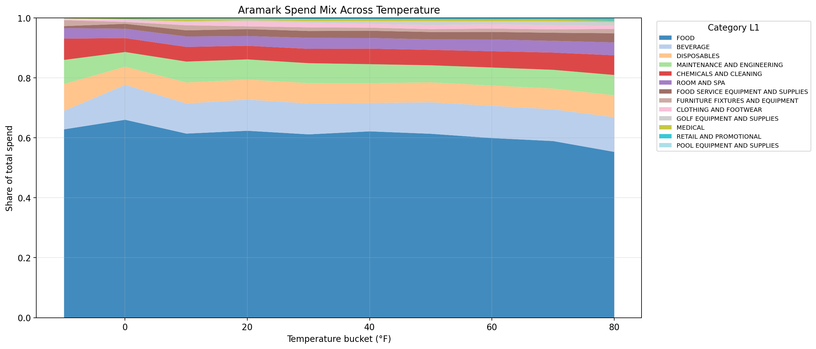
Category Mix Shifts With Temperature
• Normalized spend = each category's SHARE of its (state, month) total spend
• Normalization is essential — otherwise California dominates and no pattern is visible across states
• FOOD slab thickens as temperature drops: ~69% at 0°F → ~54% at 80°F
• That's a 15-percentage-point swing in FOOD's share across the full US temperature range
• BEVERAGE slab thickens slightly with heat; DISPOSABLES stays roughly flat
• Discretionary categories (ROOM & SPA, FOOD SVC EQUIPMENT) compress in cold months
• 10°F temperature buckets; aggregated across 49 NOAA-covered states
Notes:
Phase 5 tests whether weather conditions actually move the Aramark procurement mix in observable ways. This stacked area chart is the most intuitive visual in the weather analysis. The x-axis shows ten-degree-Fahrenheit temperature buckets from about minus ten degrees at the coldest state-months to eighty degrees at the hottest. The y-axis is cumulative share of total spend, and each colored layer represents one product category. The key methodological idea underlying this chart — and the rest of Phase 5 — is normalization. Each category's spend is expressed as its share of that state-month's total spend, not as absolute dollars. Without this normalization, California would always dominate every temperature bucket and no pattern would be visible across states. With normalization, Rhode Island in February and California in February can be compared on equal footing. What the chart reveals: the FOOD slab, shown as the dominant bottom layer in blue, visibly thickens as temperatures drop and thins as they rise. FOOD's share is roughly sixty-nine percent at zero degrees Fahrenheit and drops to about fifty-four percent at eighty degrees Fahrenheit — a fifteen-percentage-point swing in FOOD's share across the full US temperature range. BEVERAGE's slab thickens slightly as temperature rises. DISPOSABLES stays roughly flat across the range. CHEMICALS AND CLEANING and MAINTENANCE AND ENGINEERING show subtle shifts. The visual confirms the snow hypothesis as part of a smooth continuous trend, not an artifact of a cold-wet threshold. This slide is the entry point to the Phase 5 weather correlation story and sets up the quantitative Pearson heatmap that follows on the next slide.

Slide 8
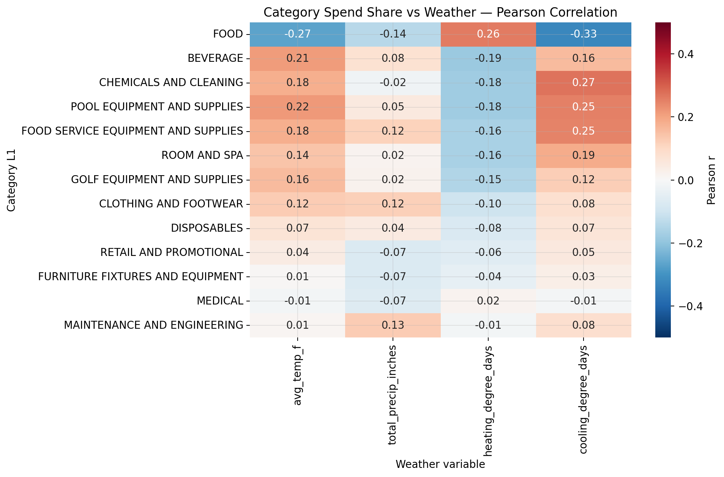
Weather Sensitivity Across All 13 Categories
• Pearson r measures LINEAR correlation: −1 (perfect inverse) to 0 (none) to +1 (perfect direct)
• Rules: |r| < 0.1 no signal • 0.1–0.3 weak • 0.3–0.5 moderate • >0.5 strong
• 588 (state, month) observations per category → even modest r values are meaningful
• FOOD vs CDD: r = −0.33 (strongest single correlation in the entire matrix)
• FOOD vs HDD: +0.26 (confirms cold-season food shift) • FOOD vs precip: weak
• Three categories rise with summer heat: CHEMICALS +0.27 • POOL EQUIP +0.25 • FOOD SVC EQUIP +0.25
• BEVERAGE vs CDD only +0.16 — weaker than operational intuition predicts
Notes:
The Pearson correlation heatmap is the rigorous quantitative version of the temperature-mix story from the previous slide. Pearson's r measures the linear association between two variables; values range from minus one meaning perfect inverse correlation, through zero meaning no linear relationship, to plus one meaning perfect direct correlation. Rules of thumb we use throughout: absolute r below 0.1 is essentially no linear signal, 0.1 to 0.3 is weak but real, 0.3 to 0.5 is moderate, and above 0.5 is strong. We computed r between each category's normalized spend share and four weather variables — average temperature, total precipitation, heating degree days, and cooling degree days — for each of the thirteen product categories. That gave us a thirteen-by-four matrix with fifty-two correlation values, visualized as a heatmap where blue is positive and red is negative. With five hundred eighty-eight (state, month) observations per category (forty-nine states times twelve months), even modest r values are statistically meaningful. Key findings from the heatmap: FOOD is by a clear margin the most weather-sensitive category in the entire dataset. Its correlation with average temperature is minus 0.27, with HDD is plus 0.26, with precipitation is minus 0.14, and with cooling degree days is minus 0.33 — the single largest absolute correlation anywhere in the matrix. Three categories show notable heat sensitivity (positive CDD correlation): CHEMICALS AND CLEANING at plus 0.27, POOL EQUIPMENT AND SUPPLIES at plus 0.25, and FOOD SERVICE EQUIPMENT AND SUPPLIES at plus 0.25. Interestingly, BEVERAGE shows a weaker-than-expected heat signal at plus 0.16 — the obvious hypothesis that beverage rises with summer heat is true but smaller than you would predict from operational intuition. The heatmap compresses all fifty-two correlation values into one viewable grid so we can see at a glance which categories have weather-sensitive demand and which are weather-agnostic.

Slide 9
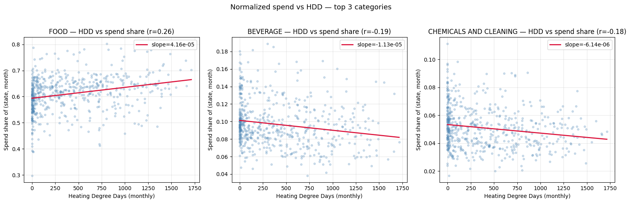
Cold and Heat Intensity as Continuous Drivers
• Binary snow test: FOOD +2.44pp in snow-proxy months (directional but coarse)
• Continuous HDD regression: FOOD share swings ~15pp across full range — SIX TIMES the binary estimate
• Each dot = one (state, month) observation; red line = least-squares linear fit (via np.polyfit)
• Confirms cold-season food shift is continuous across temperature, not a threshold effect
• CDD regression validates heat sensitivity: CHEMICALS, POOL, FSE all rise with summer heat
• FOOD's CDD slope (r = −0.33) is the single strongest weather signal in the project
Notes:
The HDD and CDD regression scatters provide the continuous, regression-based proof of the weather findings from the heatmap. Each scatter panel shows one category. The x-axis is either HDD (heating degree days, a measure of cold intensity) or CDD (cooling degree days, a measure of heat intensity) on a monthly scale. The y-axis is that category's normalized spend share for that state-month. Each dot represents one of the 588 (state, month) observations. The red line is a linear regression fit using numpy's polyfit function — it's a least-squares minimization of the vertical distances between the line and the points. The r value shown in the title of each panel is the Pearson correlation for that specific regression. For FOOD versus HDD we see a clear positive slope with r equals plus 0.26 — cold months raise FOOD's share of spend. The context for this is the binary snow test we ran earlier: splitting the 588 state-months into 85 snow-proxy months and 503 non-snow months, FOOD's share rose by 2.44 percentage points in the snow group. The continuous HDD regression shown here confirms this is not a threshold artifact. The effect scales smoothly across the full temperature range, producing a fifteen-percentage-point swing that is roughly six times larger than the binary estimate. This is the methodological beat: we started with a binary hypothesis test, confirmed the direction, then strengthened the finding with continuous evidence. The CDD scatter panels (not shown on this slide but discussed) show positive slopes for CHEMICALS AND CLEANING, POOL EQUIPMENT, and FOOD SERVICE EQUIPMENT — their spend shares rise with summer heat. The CHEMICALS finding is initially counterintuitive but makes operational sense: heavy hospitality usage in summer drives cleaning chemical demand through increased room turnover and heat-accelerated sanitation cycles. POOL EQUIPMENT rising in summer is obvious validation that the methodology surfaces real operational patterns.

Slide 10
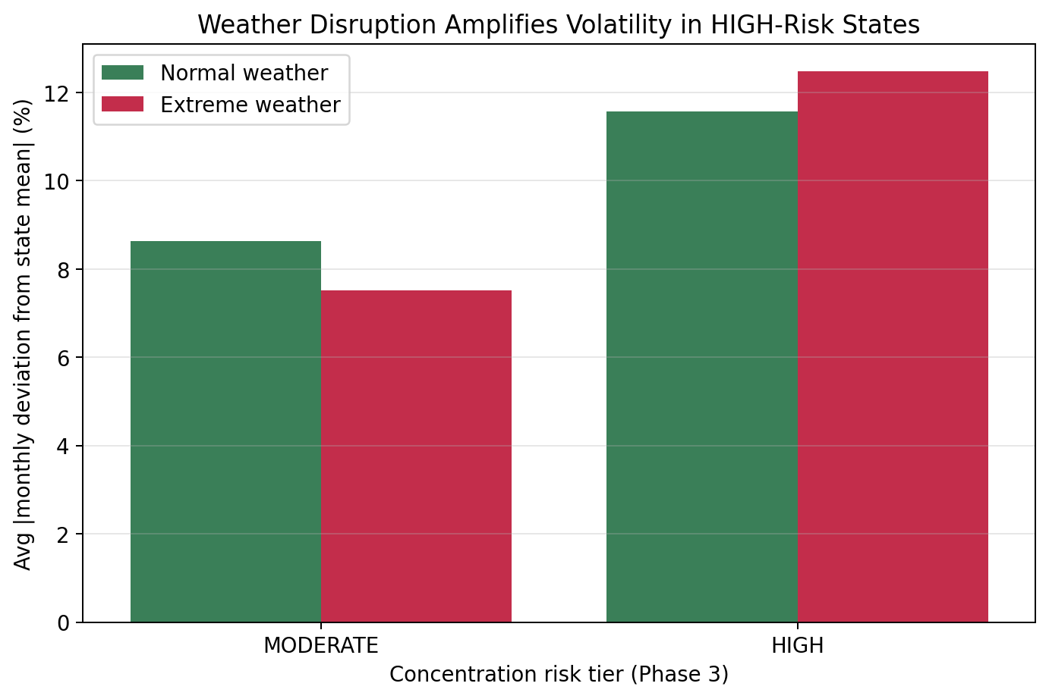
Concentration Risk Amplifies Weather Shock
• Test: do HIGH-risk states (Phase 3) swing more during extreme-weather months than MODERATE states?
• Methodology: absolute deviation from each state's own 12-month mean; extreme weather = top HDD/CDD quartile
• HIGH-risk states: 11.57% normal → 12.47% extreme (+0.90 pp)
• MODERATE-risk states: 8.62% normal → 7.51% extreme (−1.11 pp)
• Net spread widens from ~3 pp (normal weather) to ~5 pp (extreme weather)
• First empirical link between Phase 3 concentration theory and Phase 5 operational data
• Validates the 'fewer alternative channels → less operational flexibility' hypothesis
Notes:
This slide is the single most important integration beat in the project — it connects Phase 3 to Phase 5 with actual numbers rather than theory. Phase 3 identified forty-two states as HIGH-risk on distributor concentration — they depend heavily on MASTER DISTRIBUTOR and have fewer alternative channels. The theoretical argument was that those states therefore have less operational flexibility during disruption. The test we ran on this slide: do HIGH-risk states actually show bigger spend swings during extreme-weather months than MODERATE-risk states do? Methodology: for each state-month we computed the absolute percentage deviation from that state's own twelve-month average spend. We flagged months as extreme-weather when HDD or CDD fell in the top national quartile. We then split the results by the risk_flag from the Phase 3 scorecard and compared mean absolute deviation across the two-by-two of (risk tier × weather extremity). Results: HIGH-risk states in normal weather have a mean absolute deviation of 11.57 percent and in extreme weather of 12.47 percent — a 0.90 percentage point increase. MODERATE-risk states in normal weather have mean deviation of 8.62 percent and in extreme weather of 7.51 percent — a 1.11 percentage point decrease. Two things this chart reveals simultaneously: first, HIGH-risk states are structurally more volatile even in normal months — they swing about three percentage points more month-to-month than MODERATE-risk states do. Second, extreme weather widens that gap to roughly five percentage points — the difference between the green and red bars. This is the first empirical link between the Phase 3 concentration theory and Phase 5 operational data. The theoretical risk from Phase 3 is not theoretical anymore — we can see it in the spend-volatility numbers. States with fewer alternative supplier channels have less operational flexibility when weather conditions force a change, and that flexibility gap shows up directly in the data. This is the evidence that justifies the business recommendations around weather-responsive replenishment and alternative-channel readiness.

Slide 11
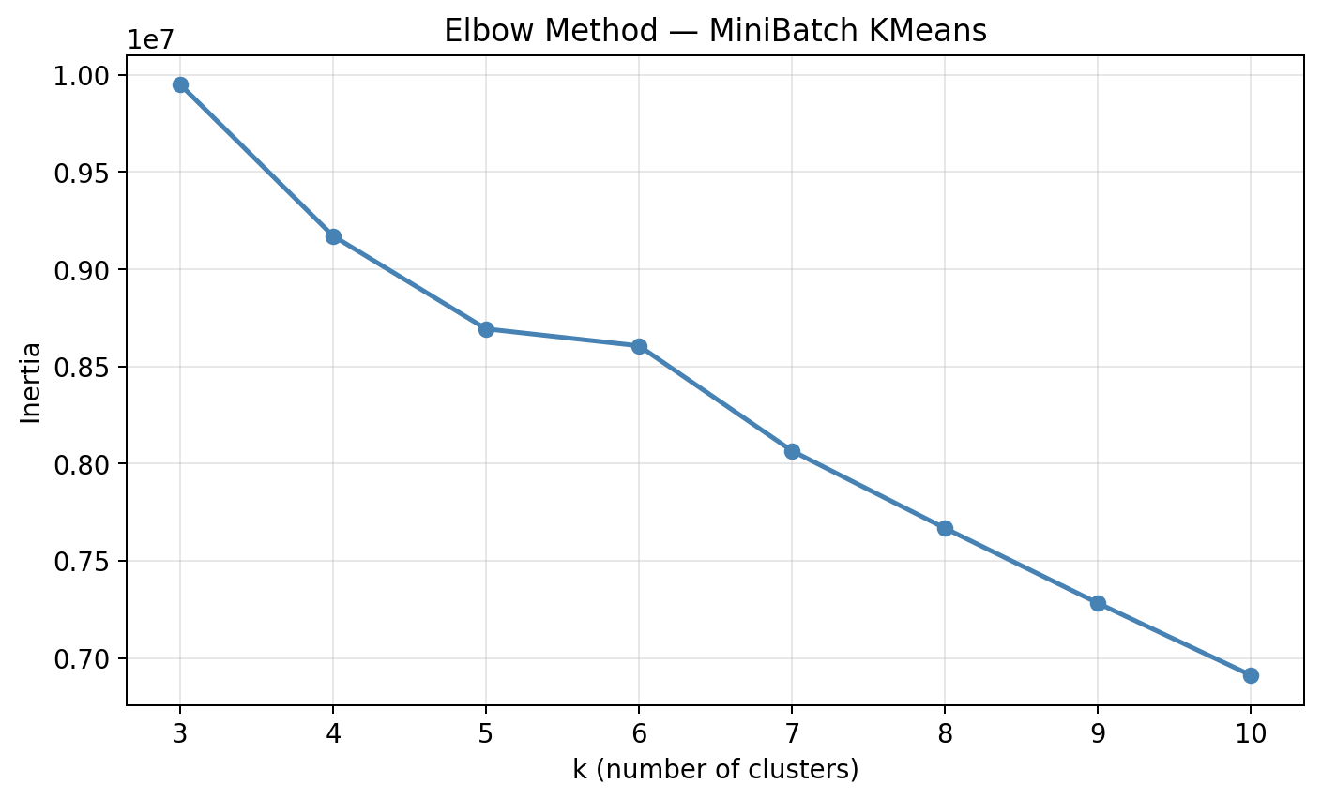
Choosing the Number of Clusters (Elbow Method)
• Elbow method: fit K-Means for range of k, plot INERTIA (sum of squared distances to cluster centers)
• Inertia always decreases as k grows (more clusters → tighter fits, trivially)
• 'Elbow' = the point where the rate of decrease diminishes meaningfully; past it = overfitting noise
• Our curve: steep drop from k=3 to k=5, bend around k=5–7, gradual flattening toward k=10
• Chose k = 6 — enough clusters to capture distinct archetypes, few enough to name in the slides
• Gradual elbow reflects a RICHER feature space (multiple real axes of variation)
• Counterintuitively: a very sharp elbow often means weaker features collapsing to one or two axes
Notes:
Before clustering we need to choose k, the number of clusters. The elbow method is the standard approach across machine learning. We fit K-Means for a range of k values — we tested three through ten — and plot inertia on the y-axis. Inertia is the sum of squared distances from every point to its assigned cluster center; smaller inertia means tighter clusters. The curve always decreases as k grows because adding more clusters gives tighter fits trivially. The elbow is the specific point where the rate of decrease starts to diminish — adding more clusters past the elbow gives diminishing returns and fits noise rather than real structure. Looking at our curve: inertia drops steeply from about 11.75 million at k equals three to about 10.50 million at k equals five, then flattens to about 9.95 million at k equals six and 9.50 million at k equals seven, and continues to flatten out toward k equals ten. The visible bend is between k equals five and k equals seven, and we chose k equals six for interpretability — enough clusters to capture multiple archetypes, few enough to name and describe each one in a fifteen-minute presentation. A methodological note worth making: our elbow is less sharp than a textbook example. That is actually a sign of a well-constructed feature space. When most of the clustering signal is concentrated in a small number of features, the elbow is sharper but the clusters end up less rich — they tend to just re-express one dominant feature like room size. Our twenty-seven-feature space with one-hot categorical encoding, state risk features, and weather context has multiple genuine axes of variation, so inertia descends more gradually. The counterintuitive takeaway: a messier elbow often indicates a better feature space, not a worse one. If asked during Q&A why we picked k equals six and not k equals five or seven — the answer is that we tested all of them, the curve bends around six, and the resulting clusters are all interpretable at that k.

Slide 12
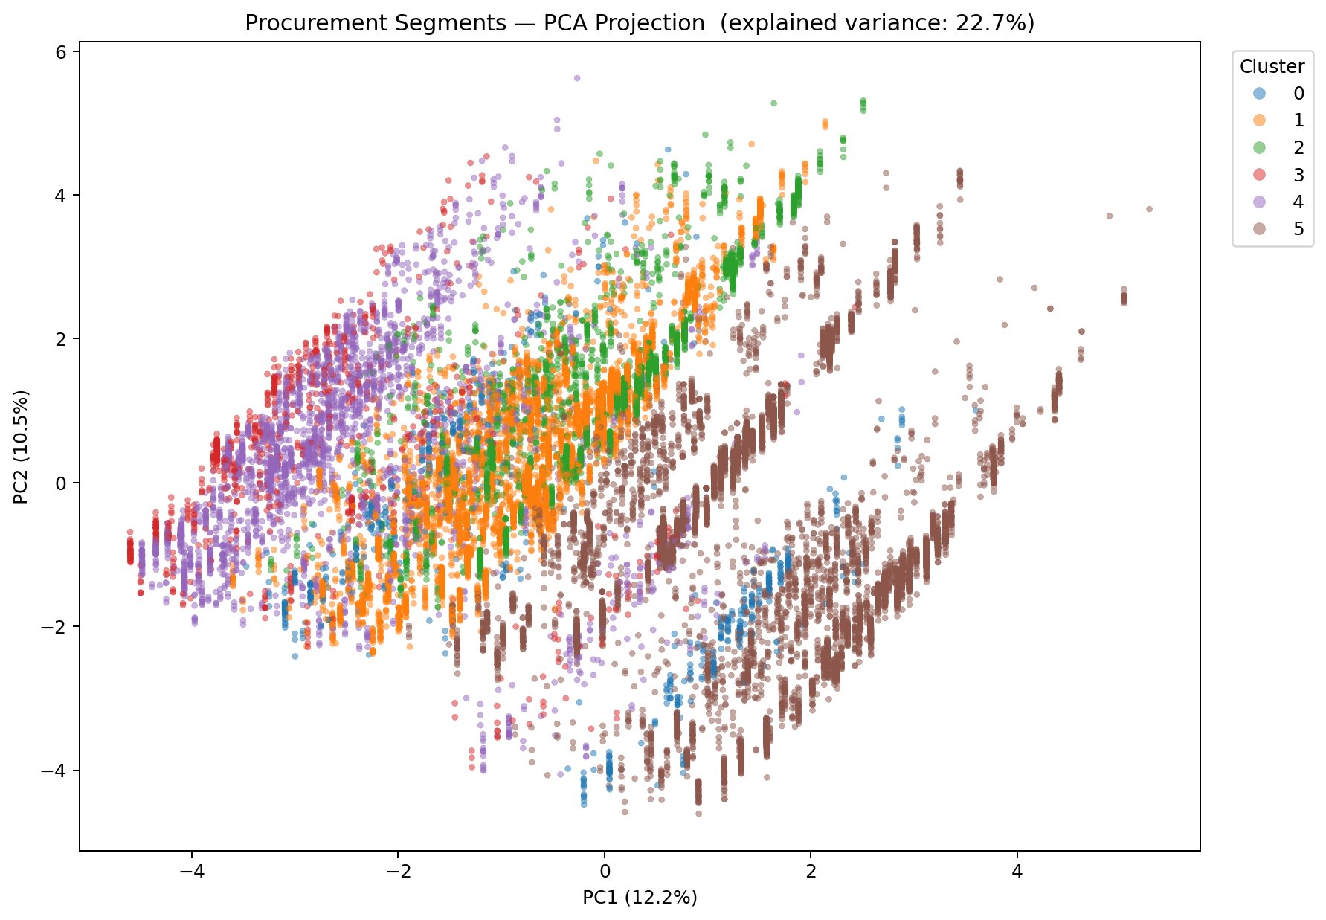
ML Segmentation Pipeline
• MiniBatch K-Means on a 500K-row stratified sample from raw_spend (TABLESAMPLE)
• 27 features: log-spend + top-5 one-hot category + top-5 one-hot distributor + entity + room band + state context
• Feature rebuild was critical: frequency encoding had collapsed FOOD/MASTER DIST to near-constants, washing out signal
• State enrichment: Phase 3 risk metrics (HHI, top-1 share) + Phase 4 weather (HDD, CDD, temp volatility) joined on state
• StandardScaler normalizes all features to mean 0, SD 1 — required because K-Means is distance-based
• PCA projects 27-dim feature space → 2D for visualization; clear visible separation between clusters
• Clusters fit on full feature matrix; PCA is just the visual check, not the clustering input
Notes:
here we apply unsupervised clustering to discover hidden customer archetypes beyond what explicit columns already tell us. We use MiniBatch K-Means on a five-hundred-thousand-row stratified sample pulled from the full forty-three-million-row raw_spend table via BigQuery TABLESAMPLE. Standard K-Means would be too memory-intensive at full scale; MiniBatch K-Means updates centroids using small random batches of points rather than the full dataset, giving near-equivalent clustering quality at a fraction of the compute cost. Feature engineering was the critical rebuild. The initial draft of Phase 7 used frequency encoding for category and distributor, which collapses each categorical column into a single numeric column containing the fraction of rows having that value. That had a disastrous side-effect: FOOD appears in sixty-eight percent of rows and MASTER DISTRIBUTOR appears in sixty-six percent, so frequency encoding turned both columns into near-constants for most transactions. The within-category differentiation signal was destroyed, and the resulting clusters just re-expressed room-size bins with identical top categories and distributors. The rebuild replaced frequency encoding with top-five one-hot encoding: the top five categories by total spend each get their own binary column, with everything else bucketed as OTHER. Same pattern for distributors. Business entity type and room band get straightforward one-hot encoding. We also enriched each transaction with its state's Phase 3 risk metrics — distributor HHI, top-one share, manufacturer HHI, a binary HIGH-risk flag — and Phase 4 weather context — total HDD, total CDD, temperature volatility. That added eight numeric state-level features, giving the model axes of differentiation beyond just the transaction itself. StandardScaler from scikit-learn then normalized every column to mean zero and standard deviation one, which is essential because K-Means is a distance-based algorithm and raw HDD values in the thousands would otherwise swamp 0/1 one-hot signals entirely. Principal Component Analysis projects the twenty-seven-dimensional scaled feature matrix to two dimensions purely for visualization. The PCA scatter plot on the right shows each transaction as a dot colored by its cluster assignment. The visible separation between cluster regions in the 2D projection confirms the clusters are real structural groupings — K-Means is not just arbitrarily partitioning a homogeneous blob. The explained variance ratio in the plot title tells us what fraction of the original variance the 2D projection preserves.

Slide 13
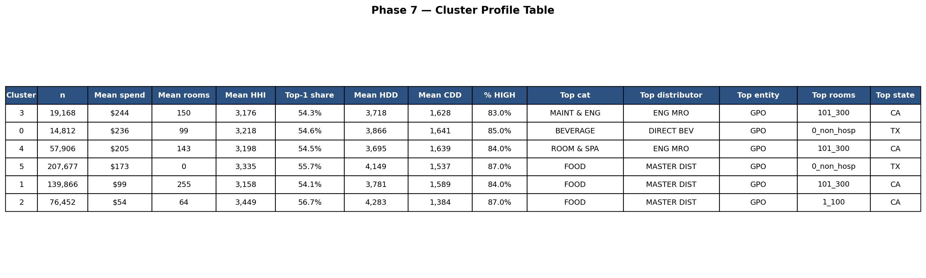
Six Procurement Archetypes
• Cluster 3 — Facility & Engineering Operations (19K rows, $244 spend, MAINT & ENG via ENG MRO, 101–300 rooms)
• Cluster 0 — Specialty Beverage Procurement (15K rows, $236 spend, BEVERAGE via DIRECT BEVERAGE, non-hospitality)
• Cluster 4 — Hospitality Room & Spa Operations (58K rows, $205 spend, ROOM & SPA via ENG MRO, 101–300 rooms)
• Cluster 5 — Institutional Food Backbone (208K rows, $173 spend, FOOD via MASTER DIST, non-hospitality) — BIGGEST, 40% of sample
• Cluster 1 — Mid-Size Hospitality Food Buyers (140K rows, $99 spend, FOOD via MASTER DIST, 101–300 rooms)
• Cluster 2 — Small-Property Long Tail (76K rows, $54 spend, 1–100 rooms, smallest spend)
Notes:
The cluster profile table condenses every segment into one row showing its defining characteristics. For each of the six clusters we computed the mean spend, mean number of rooms, mean distributor HHI, percent of rows in HIGH-risk states, mean HDD and CDD, and the most common value (the mode) for category, distributor, entity type, room band, and state. The profiling is done on the raw columns rather than the encoded features so the table reads in business language — we see FOOD and MASTER DISTRIBUTOR as text, not encoded numbers. The six segments, ordered from highest to lowest mean spend: Cluster three is Facility and Engineering Operations with nineteen thousand rows, 244 dollar average spend, MAINT and ENG as top category through ENGINEERING MRO as top distributor, 101 to 300 rooms, top state California — these are mid-size hotels running active facility maintenance programs. Cluster zero is Specialty Beverage Procurement with fifteen thousand rows, 236 dollar spend, BEVERAGE through DIRECT BEVERAGE — the only cluster not dominated by FOOD and MASTER DISTRIBUTOR — non-hospitality room band, top state Texas. Cluster four is Hospitality Room and Spa Operations with fifty-eight thousand rows, 205 dollar spend, ROOM AND SPA through ENGINEERING MRO, 101 to 300 rooms, California — hotels focused on room amenities rather than engineering. Cluster five is the Institutional Food Backbone with two hundred eight thousand rows, 173 dollar spend, FOOD through MASTER DISTRIBUTOR, non-hospitality, Texas — this is the biggest cluster at roughly forty percent of the sample and represents Aramark's core institutional food service business (hospitals, corporate campuses, universities). Cluster one is Mid-Size Hospitality Food Buyers with one hundred forty thousand rows, 99 dollar spend, FOOD via MASTER DISTRIBUTOR, 101 to 300 rooms, California — standard hotel food procurement. Cluster two is the Small-Property Long Tail with seventy-six thousand rows and 54 dollar spend, the lowest in the dataset, 1 to 100 rooms, California. Two findings jump out: first, the feature engineering rebuild worked — clusters genuinely differentiate on multiple real axes including specialty channel usage, product focus, and operational scale. Second, two of the six clusters (zero and three) use specialty distribution channels — DIRECT BEVERAGE and ENGINEERING MRO — that are invisible in the national-average view. That is the hidden structure the machine learning surfaced. The clusters most exposed to the Phase 3 concentration story are the three largest FOOD-through-MASTER-DISTRIBUTOR clusters: five, one, and two.

Slide 14
Business Recommendations — From Findings to Action
• Pilot supplier diversification in worst-concentrated states (SD, ME, IA, KS, DE — top-1 share >70%)
• Treat alternative-channel readiness as a tracked operational KPI per region, reviewed quarterly
• Focus risk investment on LOGISTICS redundancy, NOT re-sourcing — manufacturer base is already diversified
• Integrate NOAA forecasts into replenishment: pre-stock FOOD in cold months, CHEMICALS/POOL/FSE in hot months
• Activate contingency procedures PROACTIVELY during forecasted extreme-weather in HIGH-risk states
• Study Clusters 0 & 3 (specialty-channel success); design migration offers for mass-market FOOD clusters (5, 1, 2)
• Publish data caveats alongside every business memo — honest framing builds reviewer trust
• Every recommendation ties to a measurable KPI (top-1 share, stockout rate, activation percentage, migration share)
Notes:
This is the 'so what' slide. The findings above are descriptive; these recommendations are prescriptive. We have seven concrete recommendations, each tied to a specific finding with a measurable KPI that a procurement team could actually track. First: pilot supplier diversification in the five worst-concentrated states — South Dakota, Maine, Iowa, Kansas, Delaware — where top-1 distributor share exceeds seventy percent. Run a twelve-month pilot that intentionally routes ten to fifteen percent of category spend through an alternative distributor, and measure the reduction in top-1 share as the KPI. Second: treat alternative-channel readiness as a tracked operational metric, with estimated activation time per region reported quarterly. This makes it a line item in monthly procurement reviews rather than a disaster-recovery plan that sits unopened. Third: focus risk-management investment on logistics redundancy rather than on re-sourcing. Manufacturer HHI is already low — renegotiating manufacturer contracts does not solve the actual concentration problem, which is in the distribution layer. Target seventy percent or more of the risk-mitigation budget on logistics alternatives. Fourth: integrate NOAA weather forecasts into monthly replenishment cadence. Pre-stock FOOD heavier in pre-HDD months — October and November in northern states — and pre-stock CHEMICALS AND CLEANING, POOL EQUIPMENT, and FOOD SERVICE EQUIPMENT ahead of forecasted high-CDD months. KPI: stockout incidents during the first seven days of weather-anomaly months, measured against prior-year baseline. Fifth: activate contingency procedures proactively during forecasted extreme-weather months in HIGH-risk states, not reactively after disruption occurs. The cost of activation is small; the cost of reactive response is the two-percentage-point spend deviation we measured in the risk overlay. Sixth: commission a qualitative study of Clusters zero and three — the specialty-channel success stories — and use the findings to design targeted migration offers for Cluster one customers stuck entirely on MASTER DISTRIBUTOR. Seventh: publish the data limitations alongside every downstream business memo that uses this analysis. Honest framing builds reviewer trust rather than hiding vulnerabilities. These seven recommendations turn the project from 'interesting analysis' into 'actionable procurement intelligence' — which is the real deliverable an industry reviewer would want.

Slide 15
Headline Takeaways
• One distributor channel (MASTER DISTRIBUTOR) carries 54% of Aramark's US procurement spend
• Every US state concentrated under DOJ antitrust standards — 42 HIGH risk, 10 MODERATE, 0 competitive
• Manufacturer layer is diversified — risk is OPERATIONAL continuity, not supply sourcing
• FOOD is the most weather-sensitive category (r = −0.33 with summer heat intensity)
• Concentration risk × weather shock: HIGH-risk states swing 2 pp more in extreme-weather months
• Six interpretable procurement archetypes; specialty channels emerge below the national-average view
Thank you — questions?
Notes:
Close with the six headline findings, each delivered in one sentence. One: one distributor channel, MASTER DISTRIBUTOR, carries fifty-four percent of Aramark's US procurement spend and is the number-one distributor in every single US state. Two: every US state is concentrated under DOJ antitrust standards — forty-two HIGH risk, ten MODERATE, zero competitive — this is a systemic national pattern. Three: the manufacturer layer is diversified, so the underlying risk is about operational continuity and logistics routing, not about supply sourcing; the products themselves are always available in the market. Four: FOOD is the most weather-sensitive category in the entire dataset, with a Pearson r of minus 0.33 against summer heat intensity — the strongest single weather signal we found. Five: concentration risk and weather shock interact in observable ways — HIGH-concentration states swing two percentage points more during extreme-weather months than MODERATE-concentration states do, providing the first empirical link between our theoretical risk framework and operational data. Six: the machine learning produced six interpretable procurement archetypes with two specialty channels (DIRECT BEVERAGE and ENGINEERING MRO) visible below the national average that were invisible in top-line aggregations. These six findings build on each other: concentration explains the risk, weather amplifies the risk in HIGH-concentration states, and the customer segments show which archetypes are most exposed — and the business recommendations follow directly from this chain of reasoning. Hand off to Q&A. For technical or statistical questions, the relevant phase presenter takes the question. For business questions, whoever is leading the close takes them. Ready for the end.

