Slide 1
Linux Process Management
Understanding and Controlling Processes in Linux

Slide 2
What is a Process?
- A program in execution
- Each process = unique PID
- May create child processes

Slide 3
Viewing Processes
ps – we can use this command to list processes each process is assigned a PID
ps –aux ->will give us more info
We use the process ID for any action we want to do

Slide 4
Understanding `ps aux` Output
- USER – Who owns it
- PID – Process ID
- %CPU – CPU usage
- %MEM – Memory usage
- COMMAND – What it's running
Use grep to look for the process we want
Ps –aux | grep <process name>.

Slide 5
Finding greediest processes using top command :
Since the processes are ordered by PID we use the <top> command to order them by resource used.
Here you can monitor processes every 10 seconds dynamically with resources used.

Slide 6
Changing process priority with nice
We can control the priority for process
Low nice-> high priority
High nice-> low priority
You can only lower the priority (higher nice)
<nice> values ranges between -20 & +19

Slide 7
Better use the <renice> command because it is easier to deal with.
Set the level to the number given rather than increment or decrement.
Ranges between -20 & 19(depends on PID)
renice 15 <PID for the process>

Slide 8
Controlling Processes
- Kill process: kill PID
- Force kill: kill -9 PID
- Send signal: kill -SIGTERM PID
Useful when a process freezes

Slide 9
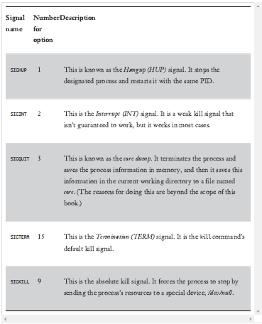

Slide 10
Background & Foreground
- Run in foreground:<process>
- Run in background: <process>&
- Bring back: fg
- List jobs that are in background: jobs

Slide 11
Summary
What you learned:
- How to view & manage processes
- Commands: ps, top, kill, nice
- Foreground vs Background jobs
- Adjusting priority

Slide 12
Tasks
Search for command at and what it does

