Slide 1
Lecture 10th Absolute Dependent Motion Analysis of Two Particles

Slide 2
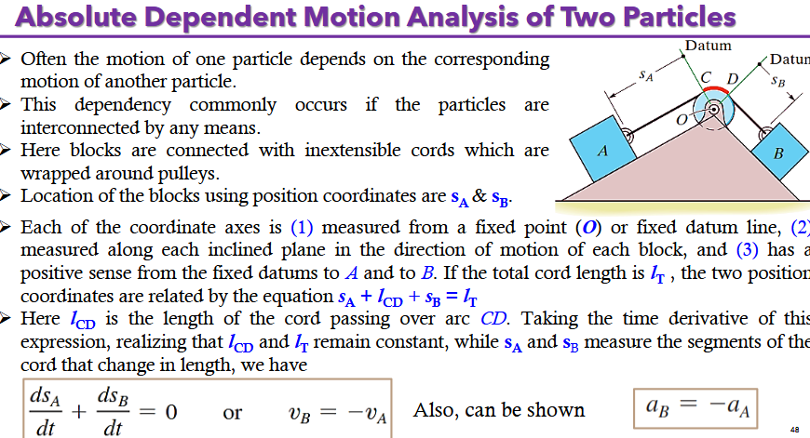

Slide 3
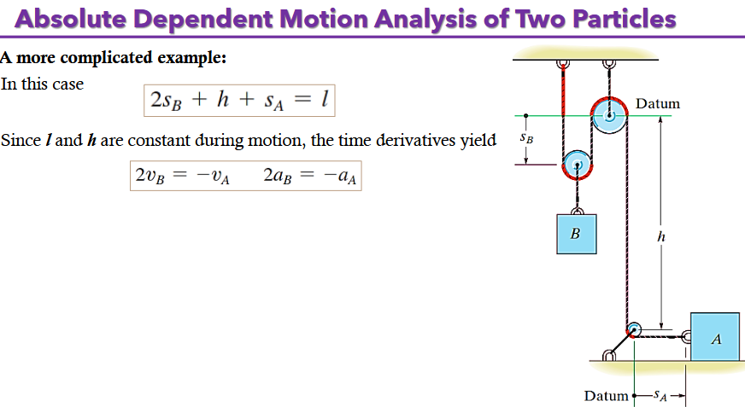

Slide 4
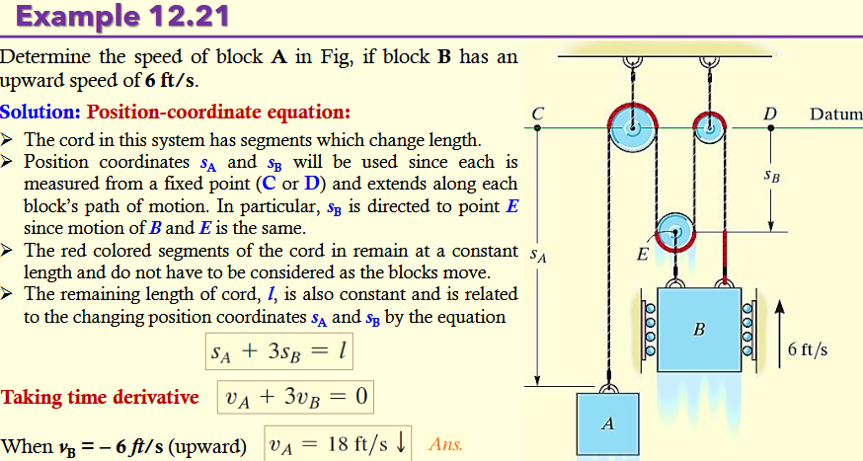

Slide 5
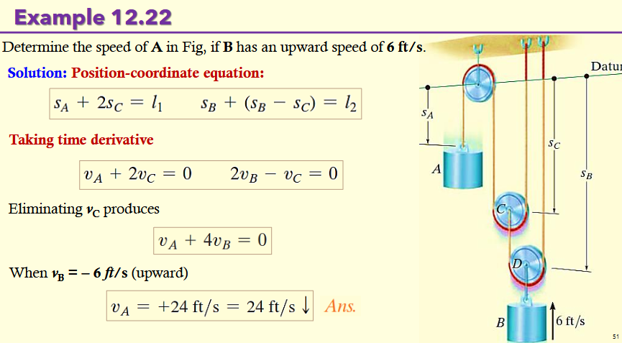

Slide 6
