Slide 1

SYNTACTICAL ISSUES
IN
JAVA DATA BASE CONNECTIVITY
An ISAS Presentation
By
ANKUR ISRANI

Slide 2
Interface hierachy in JDBC
Object
(java.lang)
Connection
(java.sql)
Driver
(java.sql)
Statement
(java.sql)
ResultSet-
MetaData
(java.sql)
Database-
MetaData
(java.sql)
ResultSet
(java.sql)
PreparedStatement
(java.sql)
CallableStatement
(java.sql)

Slide 3

SEVEN STEPS TO JDBC
Import the java.sql package
Load and register the driver
Establish a connection to the database server
Create a statement
Execute the statement
Retrieve the results
Close the statement and the connection

Slide 4
Import the java.sql package
import java.sql.*;
Loading the driver
→Class.forName(“sun.jdbc.odbc.JdbcOdbcDriver”);
→Class.forName(“weblogic.jdbc.oci.Driver”);
→The Class.forName( ) method takes the complete package name of the driver as its argument
Registering the driver
→All drivers are required to register themselves at load time
→The driver itself calls the DirverManager.registerDriver( ) method to ensure that the driver is properly registered.
→The DriverManager.registerDriver( ) method should not have to be called explicitly by an application

Slide 5
Establishing the connection
→Connection con=DriverManager.getConnection(“jdbc”odbc:ankur_dsn”,”sa”,””);
The getConnection( ) method takes atleast two arguments ,
First is the URL of the database followed by a set of login properties such as username and password.
→ The username and password can be that of the database server of that used at the time of windows authentication

Slide 6
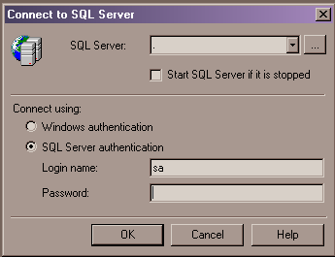
Authentication

Slide 7
Create a statement
→Statement st=con.createStatement( );
→PreparedStatement ps=con.prepareStatement( );
→CallableStatement cs=con.preparecall(“exec proc1”);
Execute the statement
→ResultSet rs=st.executeQuery(“select * from stores”);
→int I = st.executeUpdate(“insert into stores values(‘storid’,’stor_name’,’city’,’state’,’zip’)”);
→boolean b = st.execute(“insert into stores values(‘storid’,’stor_name’,’city’,’state’,’zip’)”);

Slide 8
executeQuery( ) returns a ResultSet Object and is used to execute static queries i.e. those queries whose values are supplied at coding time and not at run time.
executeUpdate( ) returns an integer which signifies the number of rows affected after the execution of the query.
executeUpdate( ) is used only to implement DML(Data Manipulation Language i.e. insert ,update, delete) statements only and not any select statements.
The execute() method is used to execute any type of query which return multiple results and it returns a boolean object
→Class.forName("sun.jdbc.odbc.JdbcOdbcDriver");
→Connection con=DriverManager.getConnection("jdbc:odbc:ankur_db","sa","");
→Statement st=con.createStatement( );
→boolean bst.execute("exec p3")

Slide 9
The execute( ) method is used to execute any type of query which return multiple results
→Class.forName("sun.jdbc.odbc.JdbcOdbcDriver");
→Connection con=DriverManager.getConnection("jdbc:odbc:ankur_db","sa","");
→Statement st=con.createStatement( );
st.execute("exec p3")
Retrieve the results
ResultSet rs=st.executeQuery("select * from t1");
while(rs.next( ))
{ System.out.println(rs.getString("first"));
System.out.println(rs.getInt("middle"));
System.out.println(rs.getFloat("last")); }

Slide 10

Close the connection and statement
Statement st;
Connection con;
st.close( )
con.close( )

Slide 11
Static Query
Class.forName("sun.jdbc.odbc.JdbcOdbcDriver");
Connection Con=DriverManager.getConnection("jdbc:odbc:ankur_db","sa","");
Statement st=con.createStatement();
int i=st.executeUpdate("insert into t1 values('test1','test2','test3')");

Slide 12
Dynamic Query
Class.forName("sun.jdbc.odbc.JdbcOdbcDriver");
Connection con=DriverManager.getConnection("jdbc:odbc:ankur_db","sa","");
PreparedStatement ps=con.prepareStatement("insert into t1 values(?,?,?)");
ps.setString(1,text1.getText());
ps.setString(2,text2.getText());
ps.setString(3,text3.getText());
ps.executeUpdate();

Slide 13
Display Results
Class.forName("sun.jdbc.odbc.JdbcOdbcDriver");
Connection con=DriverManager.getConnection("jdbc:odbc:ankur_db","sa","");
Statement st=con.createStatement();
ResultSet rs=st.executeQuery("select * from t1");
while(rs.next())
{
System.out.println(rs.getString("first"));
System.out.println(rs.getString("middle"));
System.out.println(rs.getString("last"));
}

Slide 14
DatabaseMetaData
DatabaseMetaData dbm=con.getMetaData( )
dbm.getDatabaseProductName( )
dbm.getDatabaseProductVersion( )
dbm.getUserName( )
→The DatabaseMetaData interface is used to obtain information about a database such as a list of all tables in the database,system functions,keywords,database product name,and the name of the JDBC driver supported by the database

Slide 15
ResultSetMetaData
ResultSet rs=st.executeQuery(“select * from stores”)
ResultSetMetaData rmd=rs.getMetaData( )
Int I = rmd.getColumnCount( )
String str =getColumnName(int i)
Int I =rmd.getColumnSize(int i)
String str = getColumnType(int i)

Slide 16
Procedures→ without parameters
procedure → create a new procedure
Class.forName("sun.jdbc.odbc.JdbcOdbcDriver");
Connection con=DriverManager.getConnection("jdbc:odbc:ankur_db","sa","");
Statement st=con.createStatement();
boolean i=st.execute("create procedure p4 as begin insert into t1 values('1','2','3') end");
OR
Class.forName("sun.jdbc.odbc.JdbcOdbcDriver");
Connection con=DriverManager.getConnection("jdbc:odbc:ankur_db","sa","");
Statement st=con.createStatement();
int i=st.executeUpdate("create procedure p4 as begin insert into t1 values('1','2','3') end");

Slide 17
Procedures→ with IN/OUT parameters
create table t2
(
val1 int,
val2,int,
ename varchar(10)
)
----------------------------------------------------
create procedure p5
@ans int output,
@name varchar(10),
@v1 int output,
@v2 int output
as
begin
select @v1=val1,@v2=val2 from t2 where ename=@name
select @ans=@v1+@v2
return @ans
end
declare @ans int,@v1 int,@v2 int
exec p5 @ans output,'gopal',@v1 output,@v2 output
select @ans

Slide 18
Procedures→ with IN/OUT parameters contd…
Class.forName("sun.jdbc.odbc.JdbcOdbcDriver");
Connection con=DriverManager.getConnection("jdbc:odbc:ankur_db","sa","");
CallableStatement cs=con.prepareCall("exec p5 ?,?,?,?");
ResultSet rs=cs.executeQuery();
cs.registerOutParameter(1, INTEGER);
cs.setString(2,"ankur");
cs.registerOutParameter(3,INTEGER);
cs.registerOutParameter(4,INTEGER);
int i=cs.getInt(1);

Slide 19

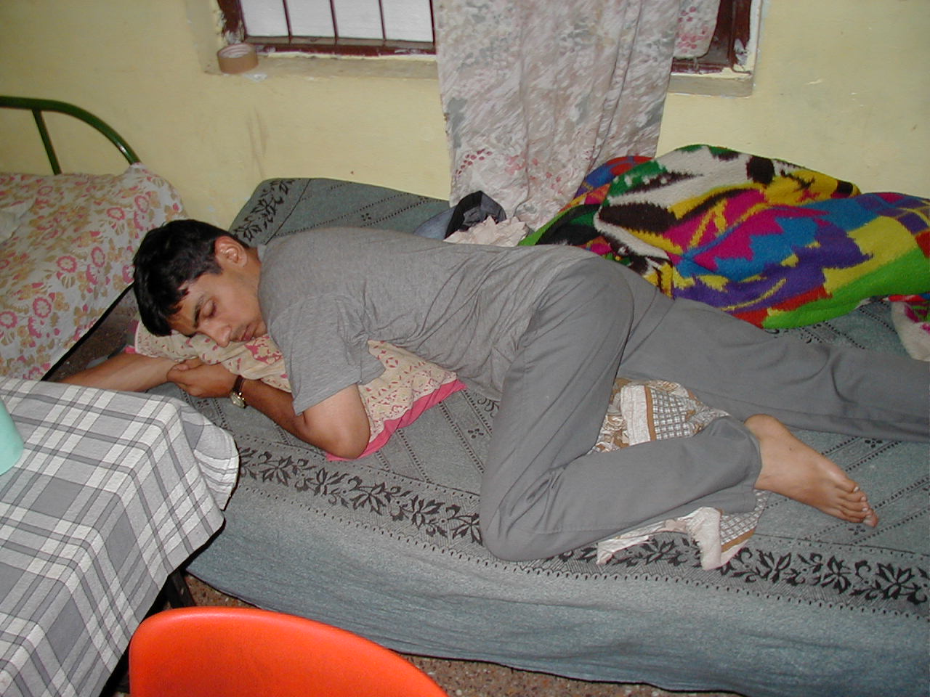
Bibliography
http://splash.javasoft.com/jdbc
http://www.weblogic.com
Database Programming by Matthew Sipple

