Slide 1
Basic Commands
pwd
ls
cp
rm
chown
chmod
chgrp
touch
file
grep

Slide 2
Commands | Description
pwd (present working directory) | Displays the absolute path of the current directory.
ls | Lists the Files and Directories within the current directory. Options: -l List file with permission. -a List hidden file. -R List directories , sub directories
cp | Known for copying files and directories.
cat | Creates and view files
rm | Used to remove files
chmod | Change permissions
touch | Used to create empty files, multiple empty files, update time stamp of a file
file | Used to check the file content.
grep | It searches the named input files for lines containing a match to the given pattern

Slide 3
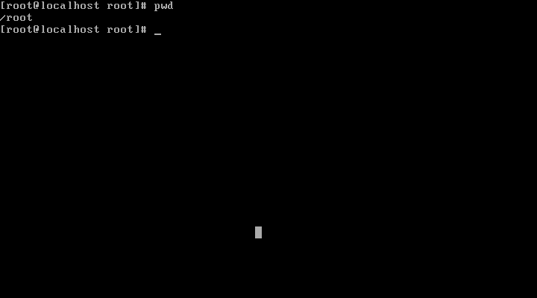
Pwd
The absolute path of the root directory is displayed.

Slide 4
ls
ls :
List the Files and Directories within the current directory.
Syntax:
ls [options]
Options:
-l List file with permission.
-a List hidden file.
-i List files and inode number.
-R List directories , sub directories

Slide 5
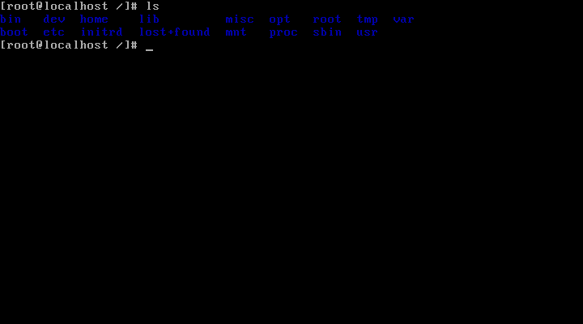
ls
Lists the files and directories in the present directory.

Slide 6
mkdir
mkdir :
Make directory (or) To create a directory
Syntax : mkdir <dirname>

Slide 7
cd
cd
Change directories
Syntax : cd <directory name>
cd .. To a directory one level up (parent directory)
cd - To your previous working directory
cd / To the / (slash) directory

Slide 8
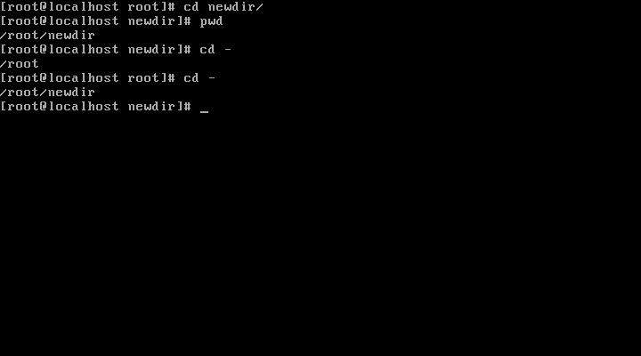
cd –
Here the current directory is newdir when we enter cd -, it takes to the previously worked directory.
Again cd - is given as shown. Now it will take to the previously worked directory i.e., (newdir)
cd -
command will take you to the previous working directory

Slide 9
cat
cat
it is the command to create and view files
Syntax:
cat [options] [filename]
cat > [filename] → To create a file
cat [filename] → To view a file
cat >> [filename] → To append text to a file

Slide 10
touch
touch command is used to update the time stamps of a file.
touch is also used to create empty file.
Syntax : touch [filename]
touch can create multiple empty file too.
Syntax : touch [filename1] [filename2]

Slide 11
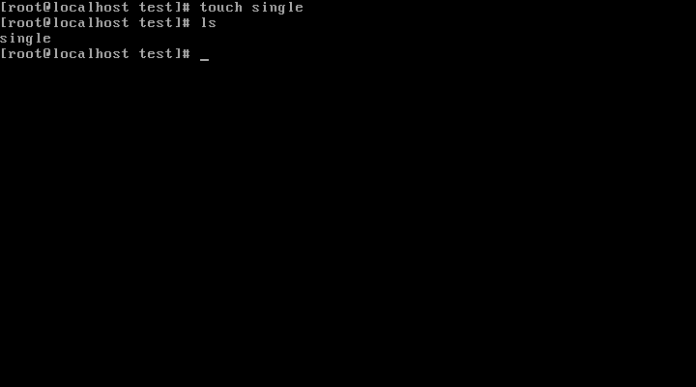
touch
Here the empty file is created

Slide 12
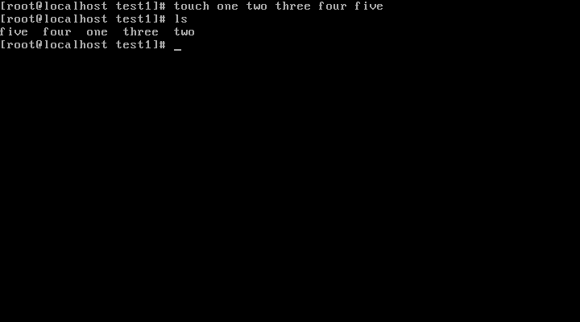
touch
Multiple files are created using touch command

Slide 13
Copy Command
cp : cp command is known for copying files and directories.
Syntax : cp [options] source destination
Options :
-r recursively copy an entire directory tree
-p preserve permissions, ownership, and time stamps
Example :
cp File1 File2

Slide 14
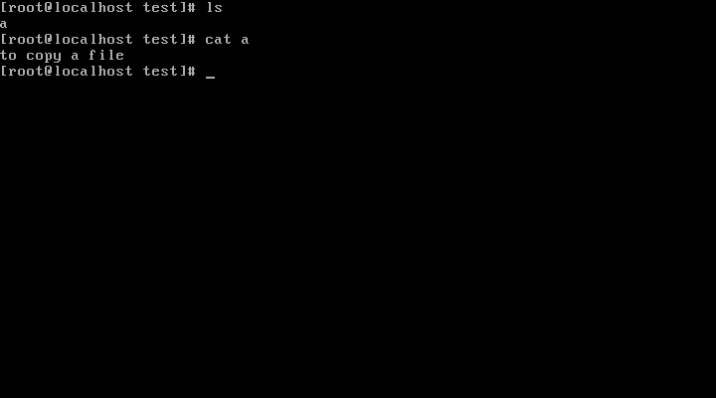
Copy Command
There is a file named ‘a’ in the directory test .

Slide 15
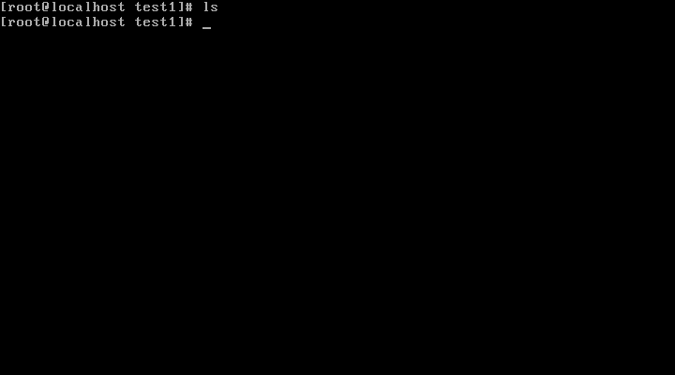
Copy Command
Here we notice that test1 is a empty directory. Let us copy the file ‘a’ into this directory.

Slide 16
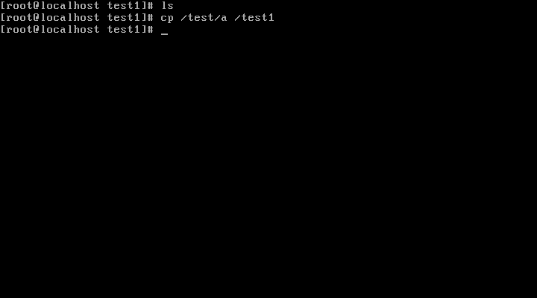
Copy Command
Cp copies the file ‘a’ from the directory test to the directory test1.

Slide 17
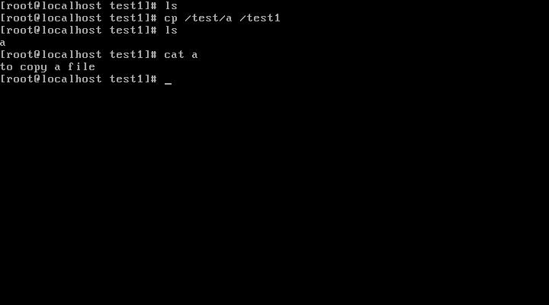
Copy Command
Thus the file ‘a’ is copied to the test1 directory.

Slide 18
rm and rmdir command
rm : This command is used to remove files
Syntax: rm <filename>
Example :
rm file1
rmdir : This command is used to remove directories.
Syntax: rmdir <directory name>
Example :
rmdir linux

Slide 19
File command
The file command is used to check the file content.
Syntax : file <filename>
Example: file f1 (f1 is a file. File will show the format)
file /dev/fd0 (The output shows that the fd0 is a block special file)

Slide 20
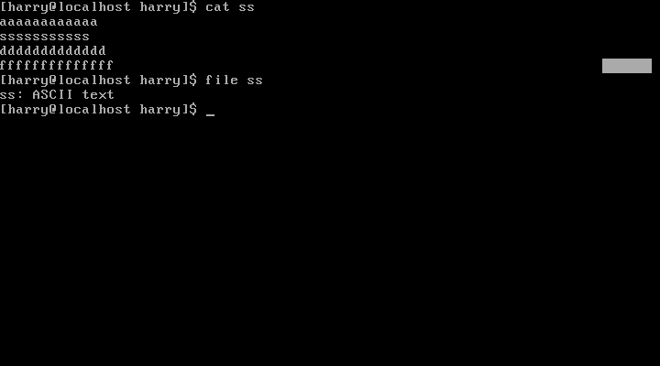
File format
The file along with file name (ss) shows the file format

Slide 21
vi & vim editor
Vi is known as the visual editor.
It is a standard editor under Linux and Unix system.
Vim is the improved version of vi editor
Vi have three modes of operation
Command mode
Insert mode
Esc mode

Slide 22
vi Modes
Command mode:
Operations such as cut, copy, paste, delete, undo, redo etc., are done in this mode.
Insert mode:
Type in new text
Ex-mode :
Extended commands for saving, exiting, search-and-replace can executed here

Slide 23
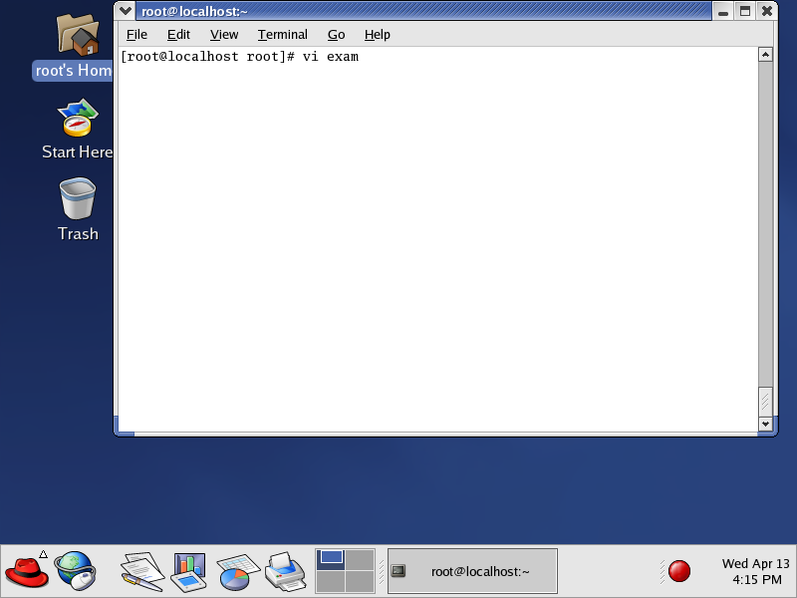
Working with vi editor
exam is a file created or opened with the vi editor.

Slide 24

Command Mode
Press ‘i’ to get into the insert mode

Slide 25
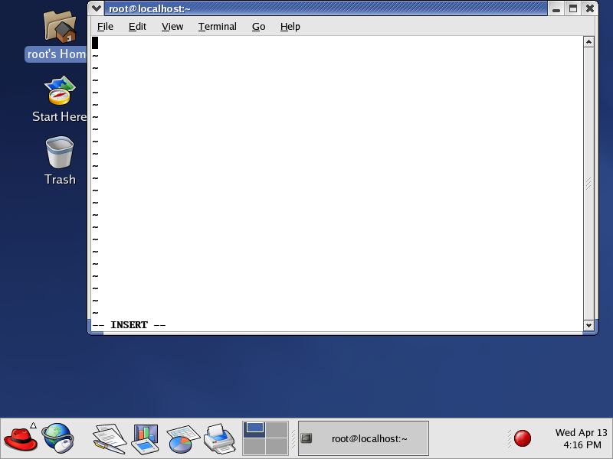
Insert Mode
This is the insert mode

Slide 26
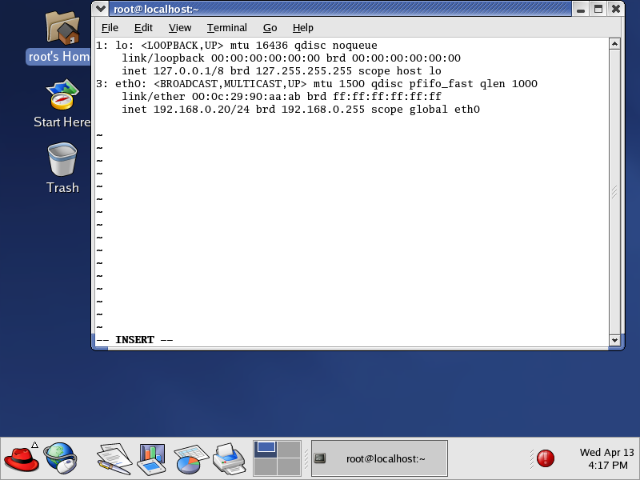
Insert Mode
After typing the data’s hit escape to get into command mode

Slide 27

Ex- Mode
Press :wq to write and quit

Slide 28
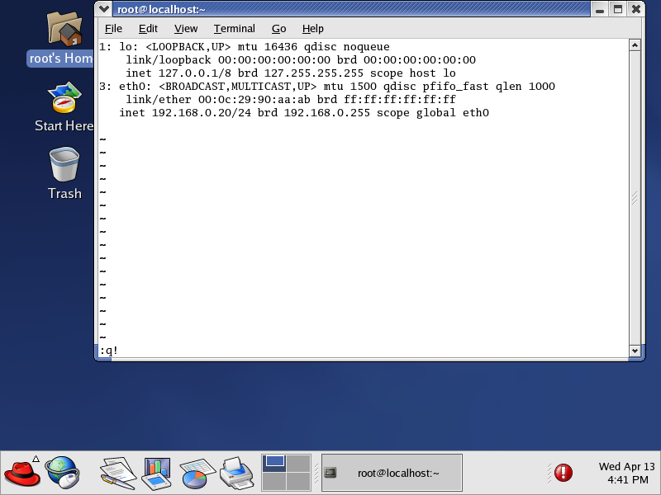
Ex- Mode
Press q! to quit without saving the data

Slide 29
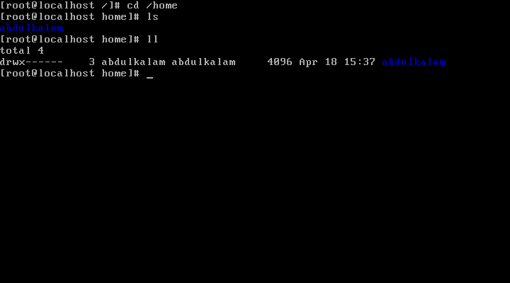
User home directory
When new user account is created ,a login directory for the user is created in /home dir.

Slide 30
Permissions
There are 3 basic permissions
Read (r)
Write (w)
Execute (x)
How to find them
ls -l
How to change them
chmod +/- r/w/x <filename>

