Slide 1
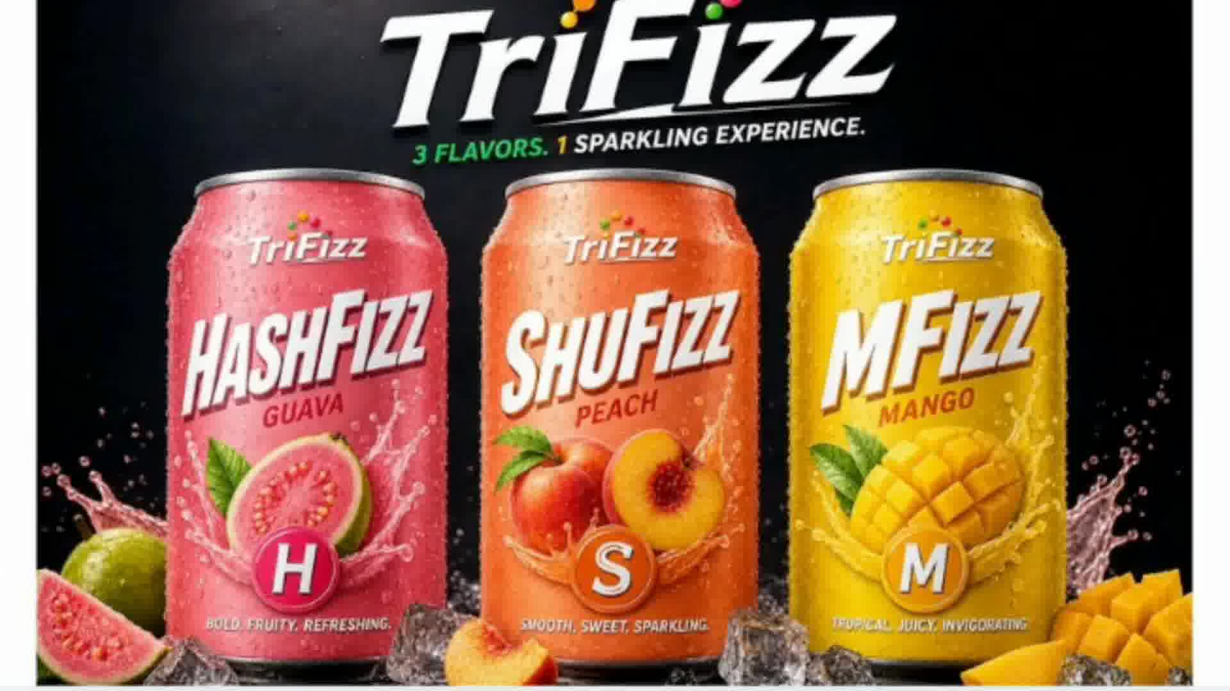
INTRODUCING
TriFizz
3 FLAVORS. 1 SPARKLING EXPERIENCE.
HashFizz Guava · ShuFizz Peach · MFizz Mango
The sparkling fruit drink redefining refreshment.

Slide 2
THE BRAND
Fruit-Forward
One Brand.
Three Worlds
of Flavour.
Real tropical fruit flavours at the heart of every can.
Sparkling & Bold
Perfectly carbonated for a lively, fizzy experience.
TriFizz is a bold new sparkling beverage brand built around the idea that one refreshing moment can hold three extraordinary flavour experiences — each vibrant, effervescent, and unmistakably its own.
Three in One
A family of flavours united under one iconic brand.

Slide 3
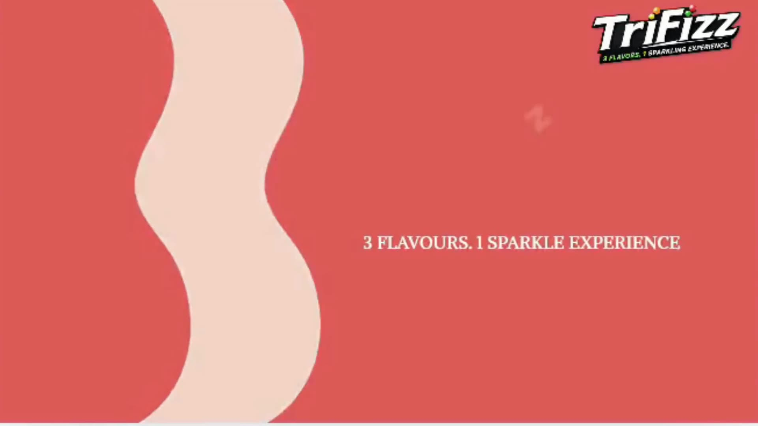
H
HASHFIZZ
GUAVA
Bold
Fruity
Refreshing
HashFizz Guava bursts onto the scene with the bold, tropical intensity of ripe guava fruit. Every sip is an explosion of vibrant colour and refreshing fizz — the perfect pick for those who live life boldly.
3 FLAVOURS. 1 SPARKLE EXPERIENCE.

Slide 4
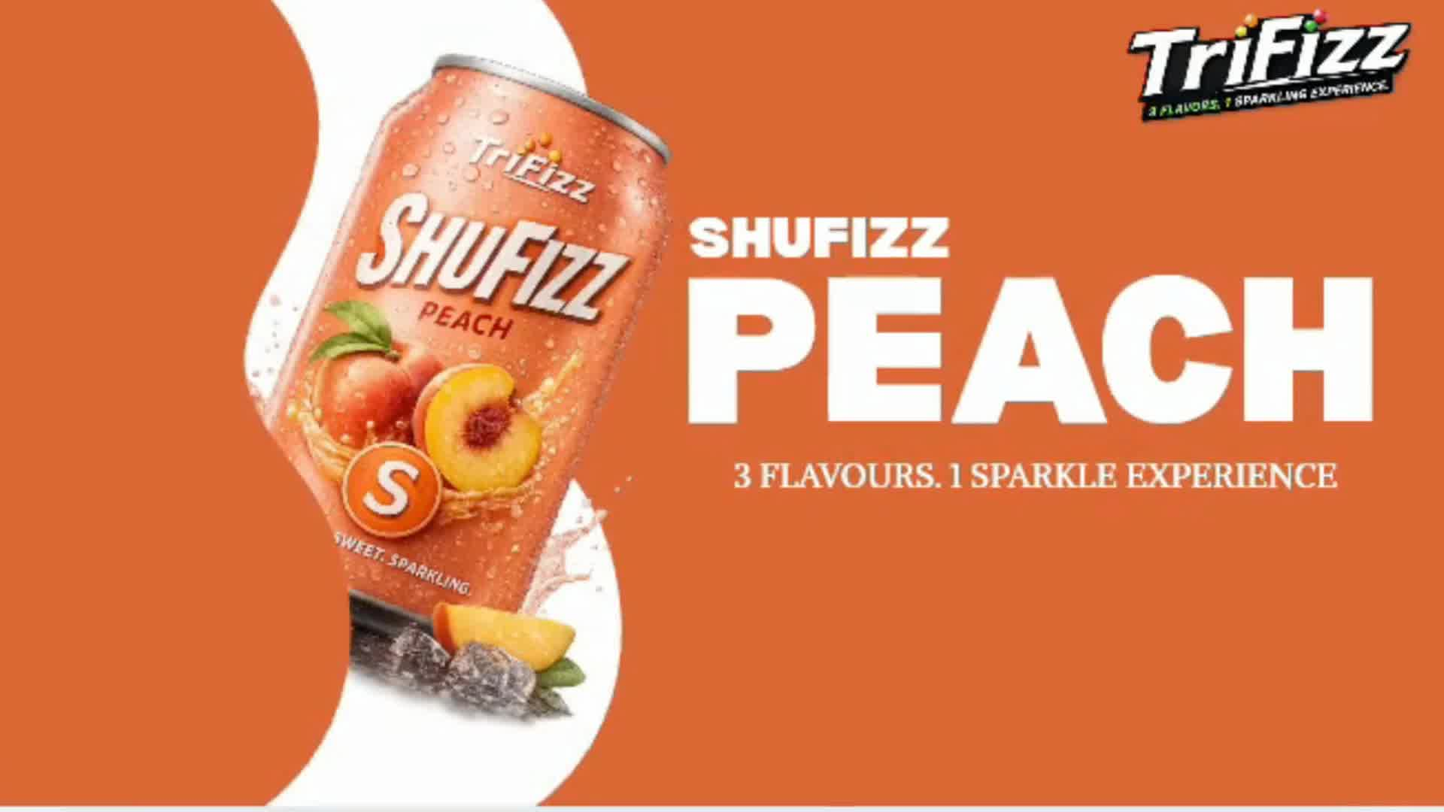
SHUFIZZ
PEACH
Smooth · Sweet · Sparkling
ShuFizz Peach captures the smooth sweetness of sun-ripened peaches in every sparkling sip. Delicate yet vibrant, it's the flavour that feels like summer — anytime, anywhere.
S
S
S
Sweet
Sparkling
Smooth

Slide 5
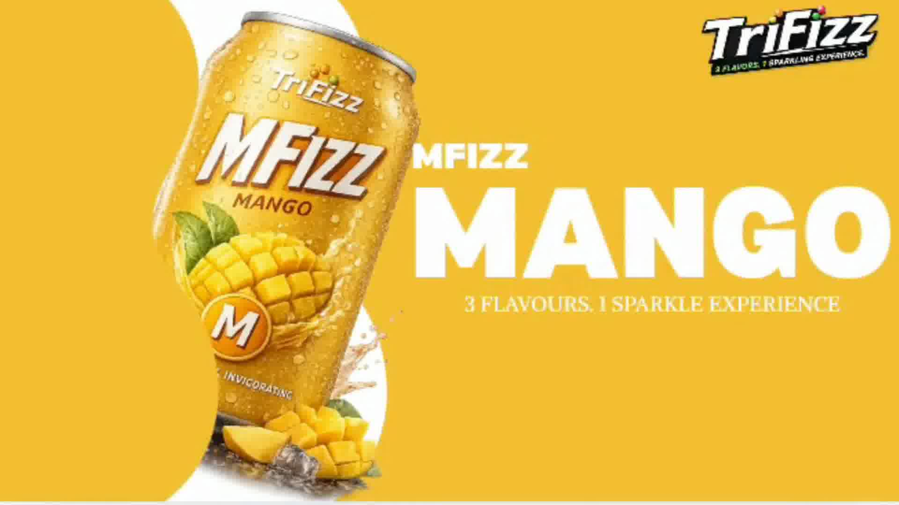
MFIZZ
MANGO
Tropical · Juicy · Invigorating
MFizz Mango unleashes the luscious, sun-drenched flavour of tropical mangoes in a sparkling rush. Invigorating and unapologetically bold, it's your go-to for a tropical escape in every can.
T
J
I
Tropical
Juicy
Invigorating

Slide 6
THE FULL RANGE
3 Flavours. 1 Sparkling Experience.

Slide 7
WHY TRIFIZZ?
Bold Flavours. Real Refreshment. Zero Compromise.
🌿 Tropical Real-Fruit Flavours
✨ Premium Carbonation
Inspired by Africa's most beloved fruits — guava, peach, and mango — TriFizz brings nature's best in every can.
Crafted for the perfect fizz level — enough sparkle to refresh, smooth enough to enjoy every drop.
🎨 Vibrant Brand Identity
🧊 Best Served Cold
Three distinct colours, three distinct personalities — one unmistakable family of flavour.
Designed to be enjoyed chilled, on the go, or as the star of any social occasion.

Slide 8
MARKET OPPORTUNITY
The Sparkling Drinks Market Is Booming
$32B
8.3%
#1
Global sparkling water & drinks market
Annual growth rate (CAGR)
Consumer trend
Projected 2027 value
Fastest in beverage category
Fruit-flavoured sparkling drinks
TriFizz is perfectly positioned to capture the growing appetite for fruit-forward, sparkling drinks — especially among young, taste-driven consumers across Africa and beyond.

Slide 9
TARGET AUDIENCE
Who Loves TriFizz?
Gen Z & Millennials (16–35)
Urban Consumers
🎯
🌍
Trend-driven, socially active consumers seeking exciting new flavours and shareable experiences.
City dwellers who value premium, refreshing beverages that keep pace with their lifestyle.
Social Occasion Drinkers
Active & Health-Conscious
🎉
🏃
Those who want a vibrant, non-alcoholic alternative at parties, events, and everyday moments.
Individuals choosing fruit-flavoured sparkling drinks as a refreshing, mood-lifting choice.

Slide 10
CAMPAIGN CONCEPT
"Pick Your Fizz"
A campaign built around self-expression and flavour identity.
📱 Social Media
⭐ Influencer Seeding
🎪 Sampling Events
"Which TriFizz are you?" personality quizzes and flavour-filter stories driving UGC and virality.
Partnering with lifestyle and food creators to showcase all three flavours across platforms.
Pop-up activations in malls, concerts and campuses — letting consumers taste all 3 in one session.
🖼 OOH & Digital
🛒 Retail Display
✨ Limited Editions
Bold, colour-coded creative driving flavour recognition in high-traffic areas and digital channels.
Vibrant tri-colour shelf displays and point-of-sale material that make the range unmissable in-store.
Seasonal or limited-edition can designs to maintain freshness and collectability.

Slide 11
TriFizz
3 FLAVORS. 1 SPARKLING EXPERIENCE.

