Slide 1

CYBERSECURITY AWARENESS FOR STUDENTS
Staying Safe in the Digital World

Slide 2


WHAT IS CYBERSECURITY?
Protecting our devices, accounts, and personal information from online dangers.
THE HOME LOCK ANALOGY
Just like you lock your front door to keep your home safe, you use cybersecurity to keep your digital "home" safe.

Slide 3


WHY IT MATTERS
SOCIAL MEDIA SCAMS
GAMING REWARDS
Fake accounts trying to trick you into sharing personal info.
"Free" currency or items that steal your login credentials.
HACKED ACCOUNTS
ONLINE FRAUD
Losing access to your photos, messages, and digital identity.
Scammers trying to steal money or your identity.

Slide 4






STRONG VS. WEAK PASSWORDS
WEAK
STRONG
123456
Ali@2026Game
password
S3cur3!P@ss
ali_2008
At least 12 characters
Easy to guess or crack in seconds.
Mix A, a, 1, and @#$
Unique for every account

Slide 5
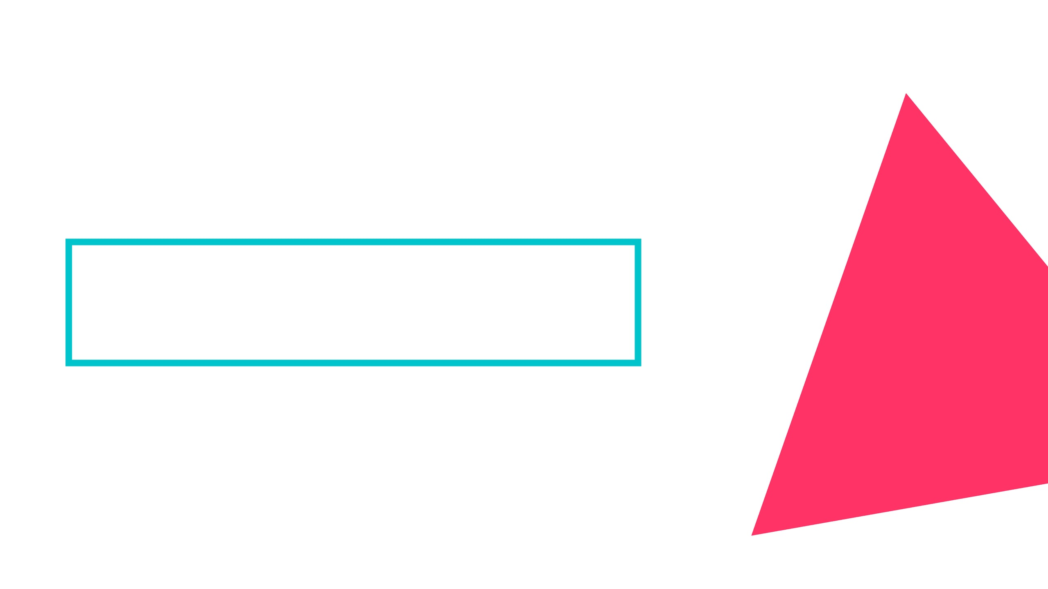




PHISHING & ONLINE SCAMS
Fake messages or websites designed to steal your passwords, OTPs, or personal information.
Urgent Language: "Act now or your account will be deleted!"
Suspicious Links: Websites that look real but have weird URLs.
Too Good to be True: "You won a free iPhone! Click here."

Slide 6





SOCIAL MEDIA SAFETY
PRIVACY FIRST
FRIEND REQUESTS
Keep profiles private. Don't share your address, school, or phone number publicly.
Only accept people you know in real life. Strangers aren't always who they say they are.
DIGITAL FOOTPRINT
LOCATION SHARING
THINK BEFORE YOU POST
What you post stays online forever. Even "deleted" posts can be saved by others.
Turn off location services for apps. Don't tag your exact location in real-time.

Slide 7
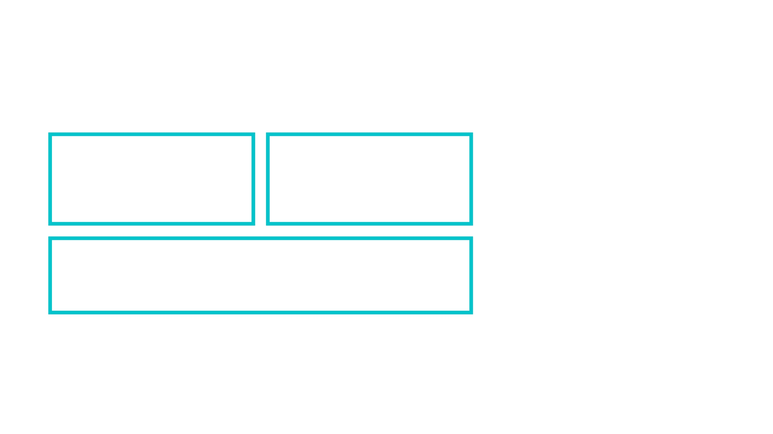

CYBERBULLYING
BLOCK
REPORT
Stop the person from contacting you immediately.
Use the app's tools to flag hurtful comments or accounts.
INFORM
Tell a trusted adult, parent, or teacher about what's happening.
Be kind online and support those being targeted.

Slide 8





ONLINE GAMING RISKS
FAKE GENERATORS
VOICE CHAT
Beware of sites promising "Free UC" or "Free Diamonds"—they are usually phishing scams.
Be careful talking to strangers; never share your real name, location, or school.
PLAY SAFE, STAY SECURE: YOUR ACCOUNT IS YOUR DIGITAL IDENTITY.
ACCOUNT TRADING
USE 2FA
Buying or selling accounts is against most rules and often leads to getting scammed.
Always enable Two-Factor Authentication on your gaming accounts for extra protection.

Slide 9






1
THINK BEFORE CLICKING
5 GOLDEN CYBER SAFETY RULES
2
NEVER SHARE PASSWORDS
3
USE STRONG PASSWORDS
4
DON'T TRUST STRANGERS
5
ASK ADULTS WHEN UNSURE

Slide 10





CAREERS IN CYBERSECURITY
ETHICAL HACKER
CYBERSECURITY ANALYST
ONE OF THE FASTEST-GROWING CAREERS IN THE WORLD.
DIGITAL FORENSICS EXPERT
SECURITY ENGINEER

Slide 11







INTERACTIVE QUIZ
SHOULD YOU EVER SHARE YOUR OTP?
NO! Never share it with anyone.
IS "123456" A STRONG PASSWORD?
NO! It's one of the weakest passwords.
TEST YOUR KNOWLEDGE!
WHAT IF A STRANGER ASKS FOR YOUR ADDRESS?
BLOCK them and tell a trusted adult!

Slide 12

THANK YOU!
Stay Smart • Stay Safe • Stay Secure
CHALLENGE: GO UPDATE ONE WEAK PASSWORD TODAY!

