Slide 1
Layering in Networked computing
OSI Model
TCP/IP Model
Protocols at each layer

Slide 2
Learning outcomes
Understand the need of layering in Networked computing
Understand the OSI model and the tcp/ip model
Understand the function protocols and their role at each layer.
TCP protocol
UDP protocol
Understand the role of header in communication between layers
Understand how data sent from one host arrive to the target host.

Slide 3
What is layering in Networked computing?
Breaks down communication into smaller, simpler parts.

Slide 4
Why a layered model?
Easier to teach communication process.
Speeds development, changes in one layer does not affect how the other levels works.
Standardization across manufactures.
Allows different hardware and software to work together.
Reduces complexity

Slide 5
The OSI Reference Model
OSI

Slide 6
The OSI Model
OSI “ Open Systems Interconnection".
OSI model was first introduced in 1984 by the International Organization for Standardization (ISO).
Outlines WHAT needs to be done to send data from one computer to another.
Not HOW it should be done.
Protocols stacks handle how data is prepared for transmittal (to be transmitted)
In the OSI model, The specification needed
are contained in 7 different layers that interact with each other.

Slide 7
What is “THE MODEL?”
Commonly referred to as the OSI reference model.
The OSI model
is a theoretical blueprint that helps us understand how data gets from one user’s computer to another.
It is also a model that helps develop standards so that all of our hardware and software talks nicely to each other.
It aids standardization of networking technologies by providing an organized structure for hardware and software developers to follow, to ensure there products are compatible with current and future technologies.

Slide 8
7 Layer OSI Model
Why use a reference model?
Serves as an outline of rules for how protocols can be used to allow communication between computers.
Each layer has its own function and provides support to other layers.
Other reference models are in use.
Most well known is the TCP/IP reference model.
We will compare OSI and TCP/IP models
As computing requirements increased, the network modeling had to evolve to meet ever increasing demands of larger networks and multiple venders.

Slide 9
Evolution of the 7-Layers
Single Layer Model - First Communication Between Computer Devices
Dedicated copper wire or radio link
Hardware & software inseparably tangled
Single specification for all aspects of communication
Hardware
&
Software
Hardware
&
Software
¹
DEVICE A
DEVICE B

Slide 10
Evolution of the 7-Layers (2)
Application
Application
Technical
Standards
Technical
Standards
Two Layer Model
Problem: Applications were being developed to run over ever-increasing number of media/signaling systems.
Solution: Separate application aspects from technical (signaling and routing) aspects
Application Layer: Concerned with user interface, file access and file transfer
¹

Slide 11
Evolution of the 7-Layers (4)
Application
Application
Network
Network
Data-Link
Data-Link
Physical
Physical
Four Layer Model - Network connectivity inherently requires travel over intermediate devices (nodes)
Technical Standards Level divided into Network, Data-link and Physical Layers
¹

Slide 12
Evolution of the 7-Layers (3) cont.
Physical Layer
Describes physical aspects of network: cards, wires, etc
Specifies interconnect topologies and devices
Network Layer
Defines a standard method for operating between nodes
Address scheme is defined (IP)
Accounts for varying topologies
Data-Link
Works with Network Layer to translate logical addresses (IP) into hardware addresses (MAC) for transmission
Defines a single link protocol for transfer between two nodes

Slide 13
Evolution of the 7-Layers (4)
Application
Application
Transport
Transport
Network
Network
Data-Link
Data-Link
Physical
Physical
Five Layer Model – Increase Quality of Service (QOS)
Variable levels of data integrity in network
Additional data exchanges to ensure connectivity over worst conditions
Became the Transport Layer

Slide 14
Evolution of the 7-Layers (5)
Application
Application
Session
Session
Transport
Transport
Network
Network
Data-Link
Data-Link
Physical
Physical
Six Layer Model - Dialogue Control and Dialogue Separation
Means of synchronizing transfer of data packets
Allows for check pointing to see if data arrives (at nodes and end stations)
Became Session Layer

Slide 15
Evolution of the 7-Layers (6)
Application
Application
Presentation
Presentation
Session
Session
Transport
Transport
Network
Network
Data-Link
Data-Link
Physical
Physical
The Seven Layer OSI Model - Addition of Management and Security
Standardizing notation or syntax for application messages (abstract syntax)
Set of encoding rules (transfer syntax)
Became the Presentation Layer

Slide 16
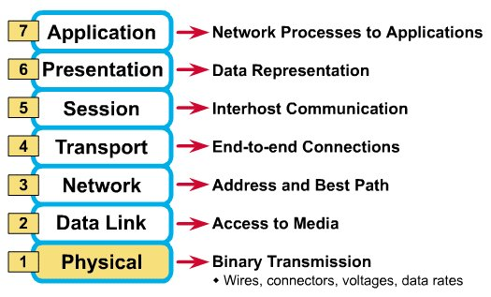
What Each Layer Does?
²

Slide 17
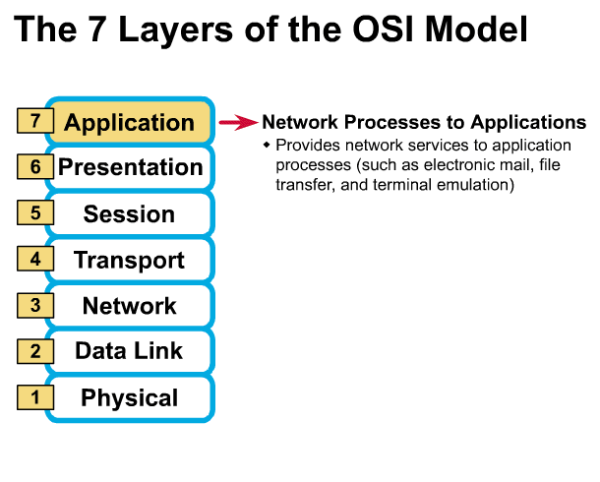
Application Layer
Gives end-user applications access to network resources
Where is it on my computer?
Workstation or Server Service in MS Windows
Protocols
HTTP/S, FTP, SMTP

Slide 18
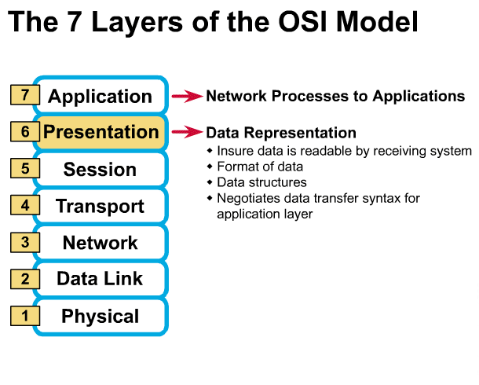
Presentation Layer
Data Translation
From ASCII to EBCDIC
Data Compression
For fast transfer of data
Lossy or lossless
Encryption
For security of data
SSL
³

Slide 19
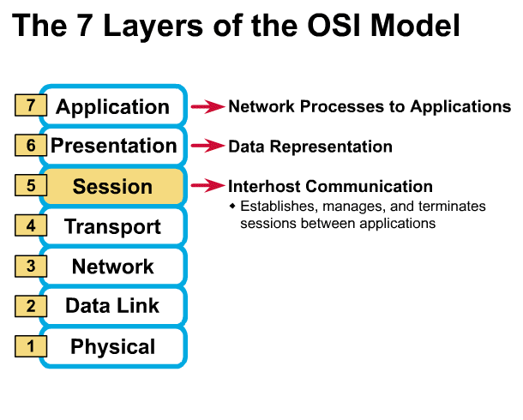
Session Layer
Allows applications to maintain an ongoing session
Authentication
Authorization
Session Management
³

Slide 20
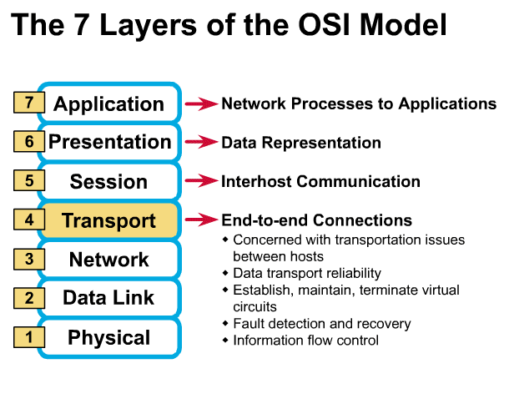
Transport Layer
Provides reliable data delivery
TCP or UDP
Segmentation
Receives info from upper layers and segments it into packets
Error Correction
Can provide error detection and correction
Flow Control
³

Slide 21
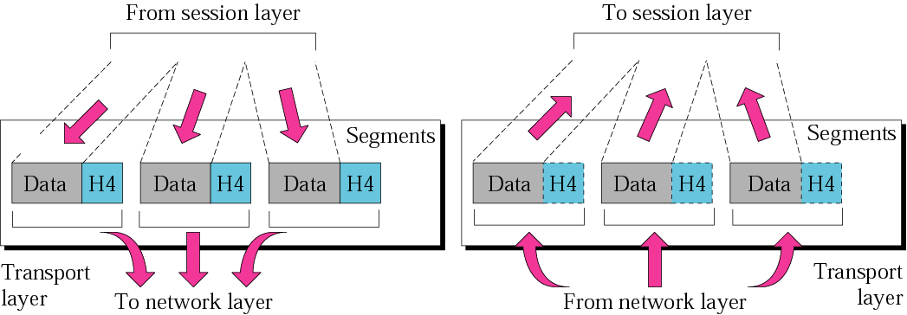
Transport Layer
Data unit in transport layer are called segments

Slide 22
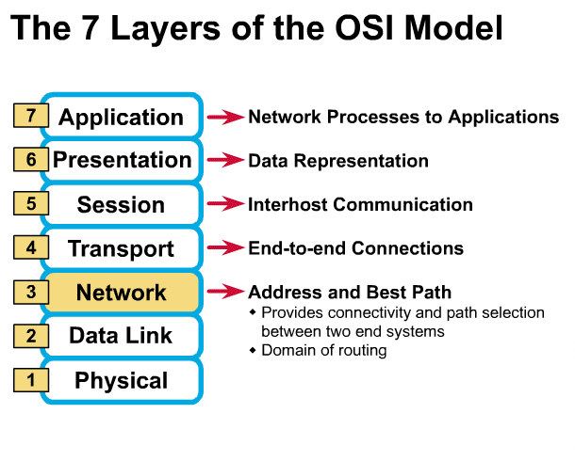
Network Layer
Provides network-wide addressing and a mechanism to move packets between networks (routing)
Responsibilities:
Logical addressing
Routing
Path Determination
IP addressing
Source Destination
OSPF, BGP

Slide 23
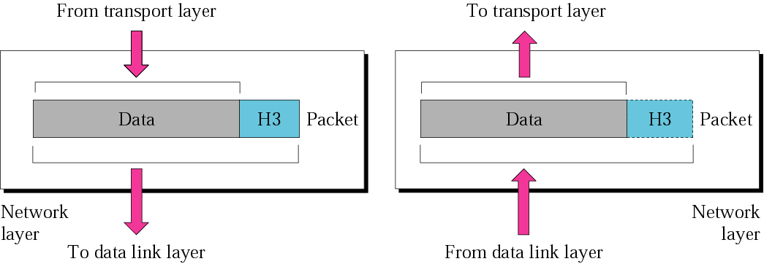
Network Layer
The network layer is responsible for the delivery of each packets from the source to the destination. Data unit in network layer are called packets.

Slide 24
Network Addresses
Network-wide addresses
Used to transfer data across subnets
Used by routers for packet forwarding
Example:
IP Address
Where is it on my computer?
TCP/IP Software

Slide 25
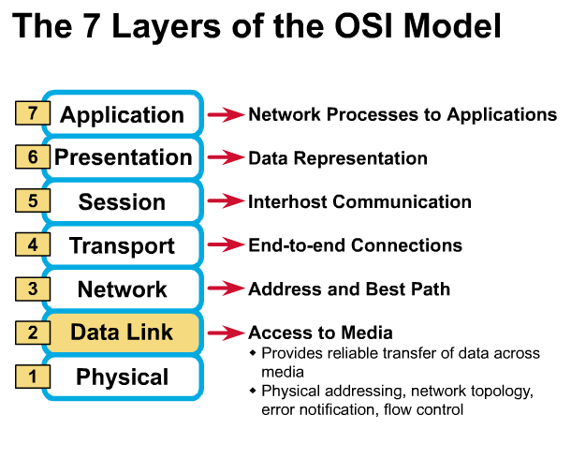
Data Link Layer
Places data and retrieves it from the physical layer
Physical Addressing
Framing
Media access control
CSMA
Error Detection

Slide 26
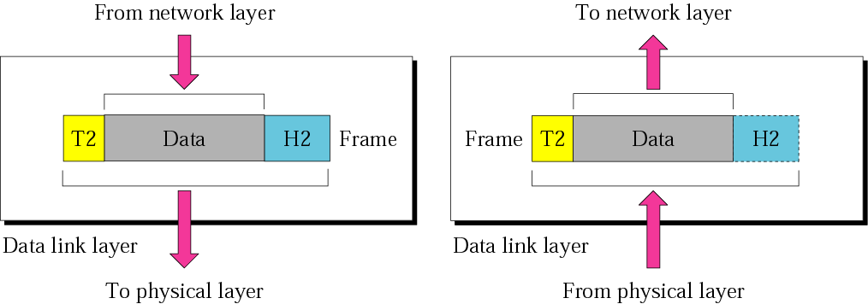
Data Link Layer
The data link layer is responsible for moving data from one hop (node) to the next. Data unit in data link layer are called frames.

Slide 27
Sub-layers of the Data Link Layer
MAC (Media Access Control)
Gives data to the NIC
Controls access to the media through:
CSMA/CD Carrier Sense Multiple Access/Collision Detection
Token passing
LLC (Logical Link Layer)
Manages the data link interface (or Service Access Points (SAPs))
Can detect some transmission errors using a Cyclic Redundancy Check (CRC). If the packet is bad the LLC will request the sender to resend that particular packet.

Slide 28
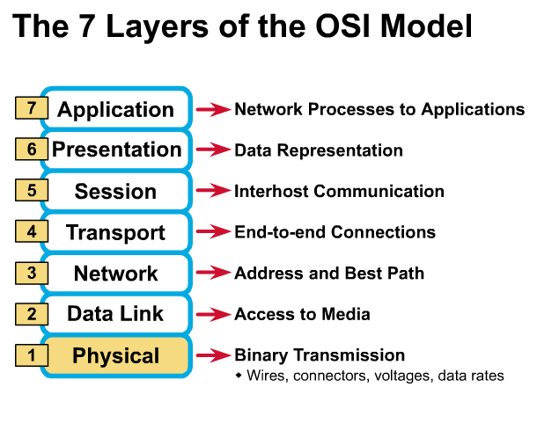
Physical Layer
Determines the specs for all physical components
Cabling
Interconnect methods (topology / devices)
Data encoding (bits to waves)
Electrical properties
Examples:
Ethernet (IEEE 802.3)
Optical fiber (ITU- 652)
Wireless (IEEE 802.11b)

Slide 29
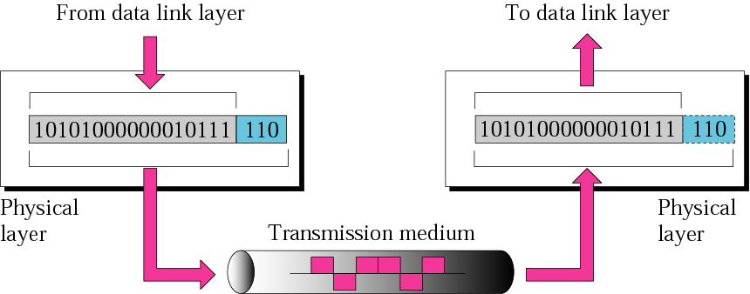
Physical Layer
The physical layer is responsible for the movement of individual bits from one hop (node) to the next.

Slide 30
Physical Layer
What are the Physical Layer components on my computer?
NIC
Network Interface Card
Has a unique 12 character Hexadecimal number permanently burned into it at the manufacturer.
The number is the MAC Address/Physical address of a computer
Cabling
Twister Pair
Fiber Optic
Coax Cable

Slide 31
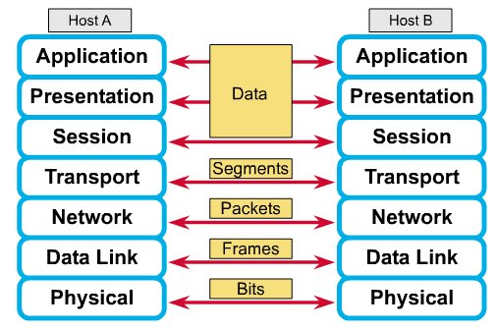
How Does It All Work Together
Each layer contains a Protocol Data Unit (PDU)
PDU’s are used for peer-to-peer contact between corresponding layers.
Data is handled by the top three layers, then Segmented by the Transport layer.
The Network layer places it into packets and the Data Link frames the packets for transmission.
Physical layer converts it to bits and sends it out over the media.
The receiving computer reverses the process using the information contained in the PDU.
²

Slide 32
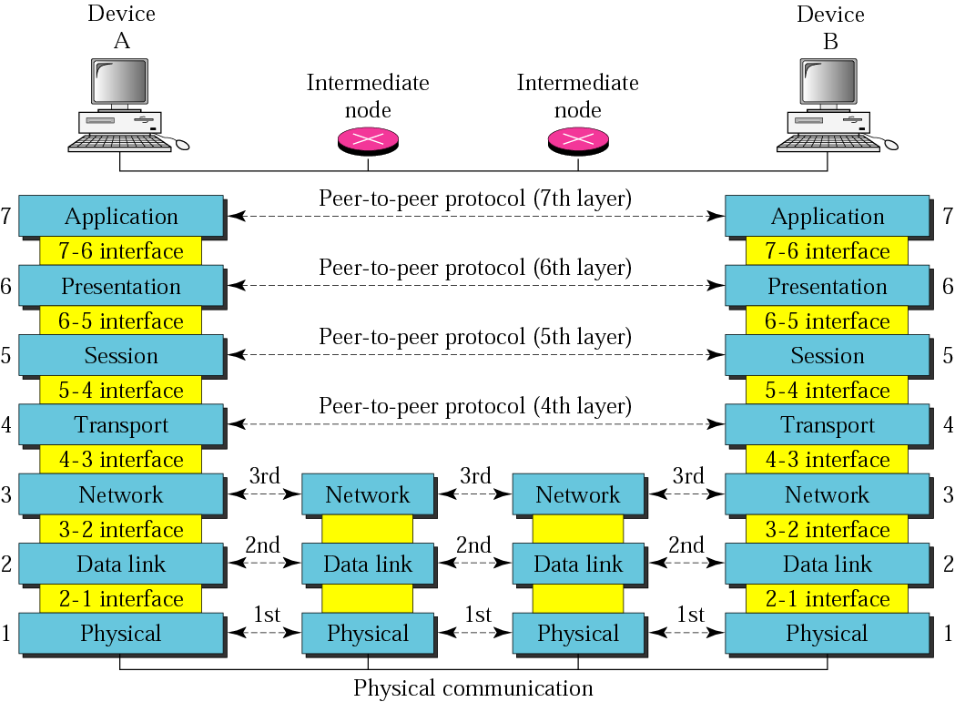
The OSI Model

Slide 33
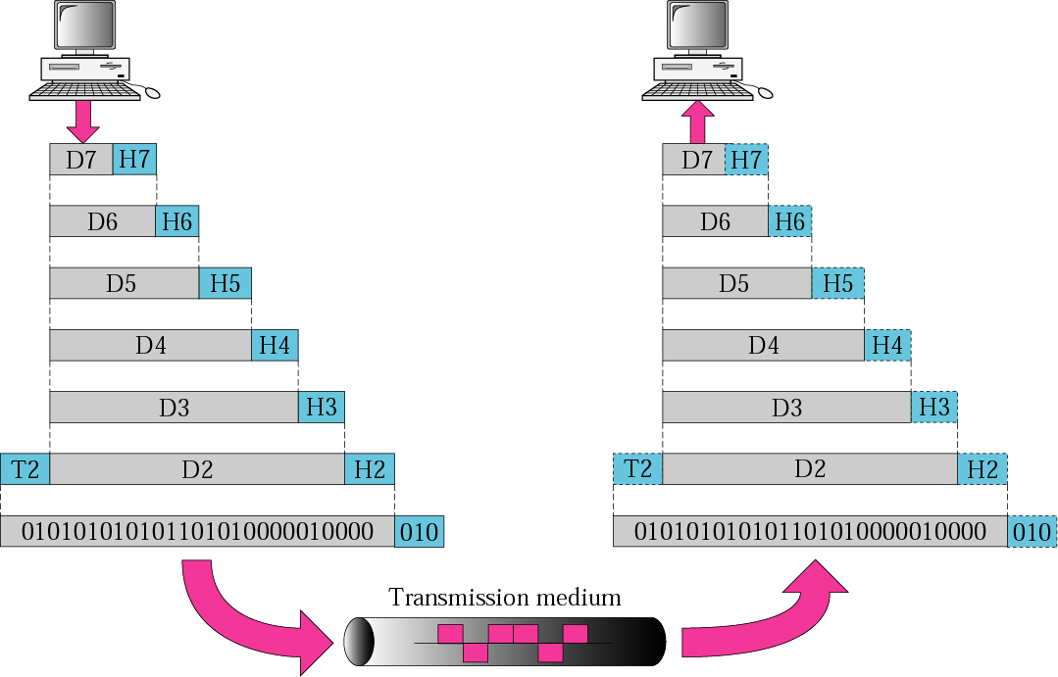
An exchange using the OSI model

Slide 34
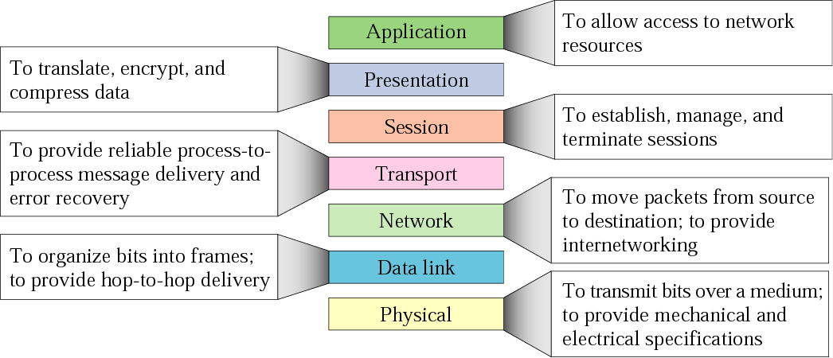
Summary of layers

Slide 35
The Postal Analogy
How would the OSI compare to the regular Post Office
Application
A- Write a 20 page letter to a foreign country.
P- Translate the letter so the receiver can read it.
S- Insure the intended recipient can receive letter.
T- Separate and number pages. Like registered mail, tracks delivery and requests another package if one is “lost” or “damaged” in the mail.
N- Postal Center sorting letters by zip code to route them closer to destination.
D- Local Post Office determining which vehicles to deliver letters.
P- Physical Trucks, Planes, Rail, autos, etc which carry letter between stations.
Presentation
Session
Transport
Network
Data-Link
Physical

Slide 36
Remembering the 7 Layers
7 - Application All
6 - Presentation People
5 - Session Seem
4 - Transport To
3 - Network Need
2 - Data Link Data
1 - Physical Processing

Slide 37
TCP/IP model development
The late-60s The Defense Advance Research Projects Agency (DARPA) originally developed Transmission Control Protocol/Internet Protocol (TCP/IP) to interconnect various defense department computer networks.
The Internet, an International Wide Area Network, uses TCP/IP to connect networks across the world.

Slide 38
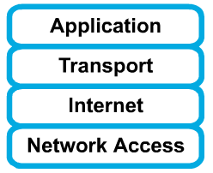
4 layers of the TCP/IP model
Layer 4: Application
Layer 3: Transport
Layer 2: Internet
Layer 1: Network access
It is important to note that some of the layers in the TCP/IP model have the same name as layers in the OSI model.
Do not confuse the layers of the two models.

Slide 39
The network access layer
Concerned with all of the issues that an IP packet requires to actually make the physical link. All the details in the OSI physical and data link layers.
Electrical, mechanical, procedural and functional specifications.
Data rate, Distances, Physical connector.
Frames, physical addressing.
Synchronization, flow control, error control.

Slide 40
The internet layer
Send source packets from any network on the internetwork and have them arrive at the destination independent of the path and networks they took to get there.
Packets, Logical addressing.
Internet Protocol (IP).
Route , routing table, routing protocol.

Slide 41
The transport layer
The transport layer deals with the quality-of-service issues of reliability, flow control, and error correction.
Segments, data stream, datagram.
Connection oriented and connectionless.
Transmission control protocol (TCP).
User datagram protocol (UDP).
End-to-end flow control.
Error detection and recovery.

Slide 42
TCP/IP Reference Model (cont)
3. Transport layer (layer 3)
Allows end-to-end communication
Connection establishment, error control, flow control
Two main protocols at this level
Transmission control protocol (TCP),
Connection oriented
Connection established before sending data
Reliable
user datagram protocol (UDP)
Connectionless
Sending data without establishing connection
Fast but unreliable

Slide 43
The application layer
Handles high-level protocols, issues of representation, encoding, and dialog control.
The TCP/IP combines all application-related issues into one layer, and assures this data is properly packaged for the next layer.
FTP, HTTP, SMNP, DNS ...
Format of data, data structure, encode …
Dialog control, session management …

Slide 44
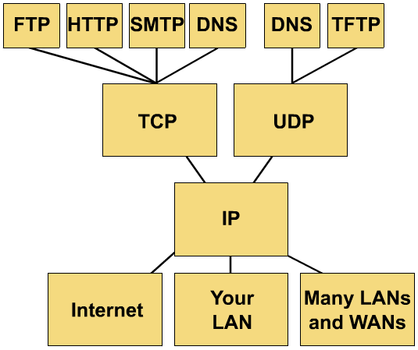
TCP/IP protocol stack

Slide 45
TCP/IP Reference Model
Layer
Protocols
Application
HTTP
TELNET
FTP
SMTP
SNMP
Transport
TCP
UDP
Internet
IP
ICMP
Network Access (Host-to-network)
ETHERNET
PACKET RADIO

Slide 46
Protocols at the application layer
HTTP:
browser and web server communicatin
FTP :
file transfer protocol
TELNET:
remote login protocol
POP3: Retrieve email
POP3 is designed to delete mail on the server as soon as the user has downloaded it
IMAP (Internet Message Access Protocol )
Retrieve emails,
retaining e-mail on the server and for organizing it in folders on the serve

Slide 47
Protocols at the transport layer
Transmission control protocol (TCP),
Connection oriented
Connection established before sending data
Reliable
user datagram protocol (UDP)
Connectionless
Sending data without establishing connection
Fast but unreliable

Slide 48
Protocol at the network layer
IP
Path selection ,
routing and addressing
ICMP (Internet Control Message Protocol )
sends error messages relying on IP
a requested service is not available
a host or router could not be reached

Slide 49
Protocols at the link layer
Ethernet
Uses CSMA/CD
Token Ring

Slide 50
Data Formats
Application data
message
application
layer
transport
layer
TCP
header
data
TCP
header
data
TCP
header
data
segment
network
layer
IP
header
TCP
header
data
packet
data link
layer
Ethernet
header
IP
header
TCP
header
data
Ethernet
trailer
frame

Slide 51
Data Encapsulation In TCP/IP
At each layer in the TCP/IP protocol stack
Outgoing data is packaged and identified for delivery to the layer underneath
PDU – Packet Data Unit – the “envelop” information attached to a packet at a particular TCP/IP protocol
e.g. header and trailer
Header
PDU’s own particular opening component
Identifies the protocol in use, the sender and intended recipient
Trailer (or packet trailer)
Provides data integrity checks for the payload

Slide 52
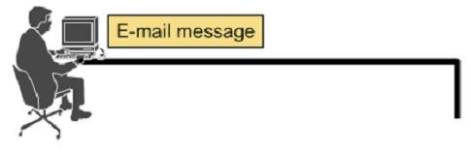




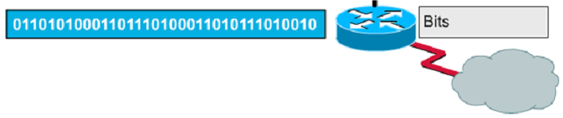
Encapsulation example: E-mail

Slide 53
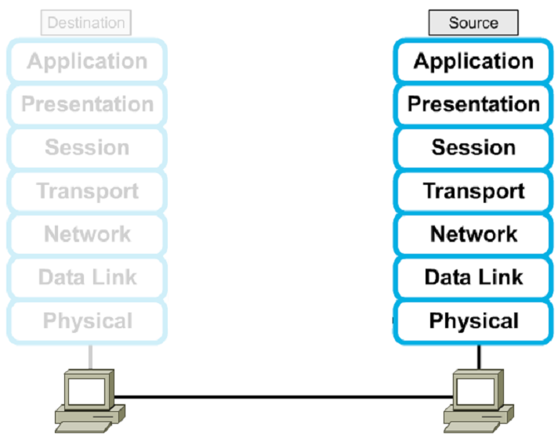




Encapsulation

Slide 54
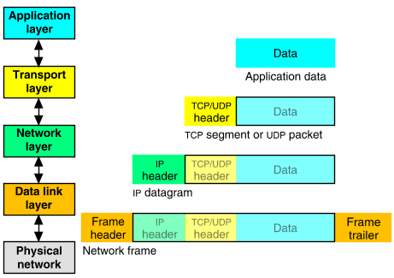
Packet Encapsulation (TCP/IP)
The data is sent down the protocol stack
Each layer adds to the data by prepending headers
22Bytes
20Bytes
20Bytes
4Bytes
64 to 1500 Bytes

Slide 55
How the OSI and TCP/IP Models Relate in a Networking Environment

Slide 56
Internet applications
TCP/IP takes care of the hard problems
Location of the destination host
Making sure the data is received in the correct order and error free
Coding Internet applications
Turns out to be straightforward.
The key concept of Internet programming is
The client-server model

Slide 57
Client-Server model
Client and server processes operate on machines which are able to communicate through a network:
The Server waits for requests from client
When a request is received
The server lookup for the requested data
And send a response the client
Sockets and ports
A socket is and end-point of way communication link between two programs
A port number bound to a socket specifies the protocol need the be used at the receiving end
Example of servers
File servers
Web servers
Example of client applications
Browsers
Email clients

Slide 58
Protocols
For a great graphic of protocol stacks in relationship to the OSI model, visit http://www.lex-con.com/osimodel.htm
For more information on the OSI model, including an animated graphic and various protocol information, visit http://www.certyourself.com/OSIguide.shtml

Slide 59
Reading
http://www.howtheosimodelworks.com , Charles C. Botsford, 2001.
https://cisconetacad.net, Cisco Academy Connection Editors, 2002.
http://www.hawkclan.com/zxonly/iso/slide2.html
http://www.pku.edu.cn/academic/research/computer-center/tc/html/TC0102.html, William L. Whipple & Sharla Riead, 1997.
http://www.lex-con.com/protocols/ip.htm, Lexicon Computing, Dallas TX, 2002

