Slide 1



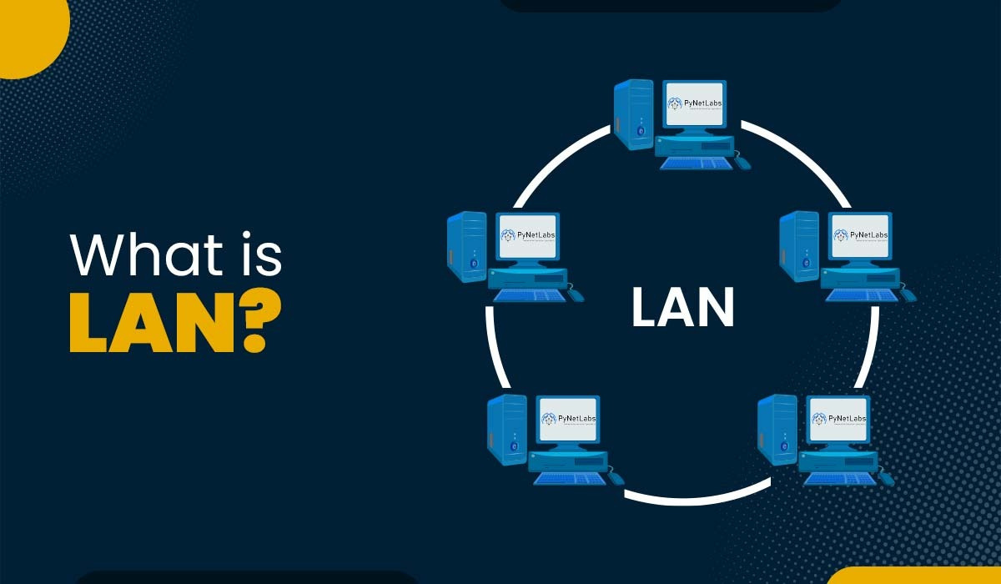
LAN
NEXT SLIDE
LAN
By Jawad Ahmed
PAGE 01
Notes:
Good morning, everyone. Today, I’m going to talk about LAN, which stands for Local Area Network. Let’s get started!"

Slide 2
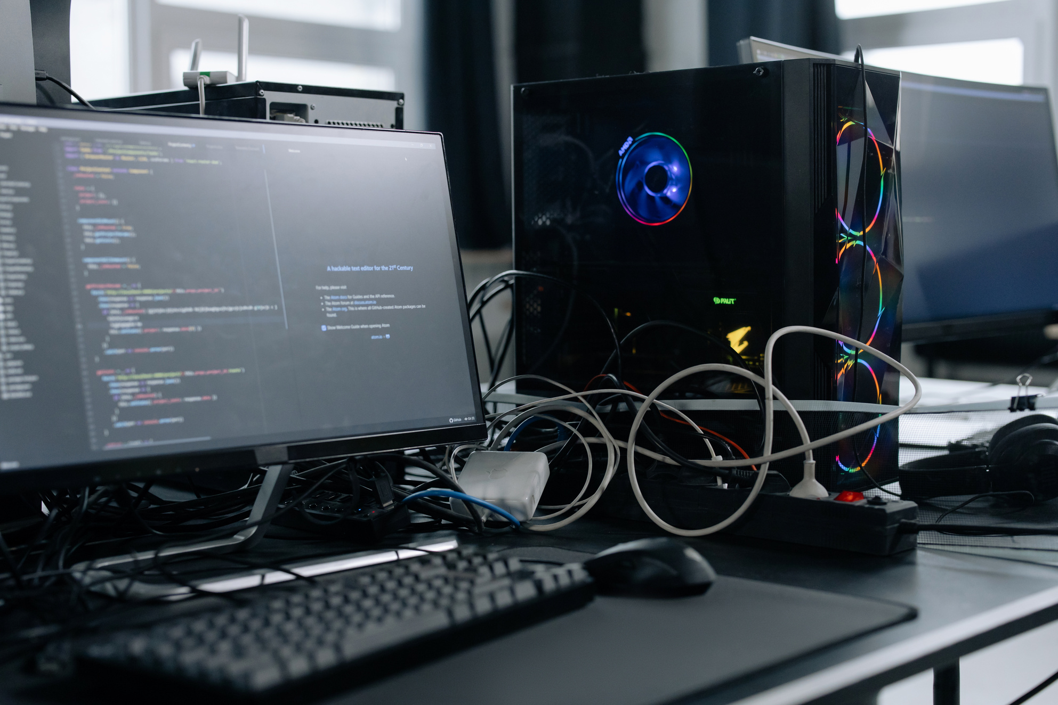
LAN
NEXT SLIDE
INTORDUCTION
Connects devices in a limited area
Uses cables or wireless (Wi-Fi)
High speed and low cost
Common in homes, schools, offices
PAGE 02
Notes:
A LAN connects computers and devices within a limited area like a room, building, or campus. It allows users to share resources and data at high speeds. Most LANs use Ethernet cables or Wi-Fi.
Imagine your home Wi-Fi network. All the devices connected to it, like your computer, phone, or smart TV, form a LAN. They can share files, printers, and internet access, making it easy to work and play together.

Slide 3
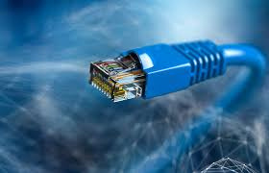
LAN
NEXT SLIDE
COMPONENTS OF LAN
Computers and other devices
Network Interface Cards (NICs)
Switches and hubs
Routers (for internet)
PAGE 03
Notes:
These are the main components needed to build a LAN. Each device has a NIC, and a switch is used to connect multiple devices. Routers connect LANs to the internet.

Slide 4
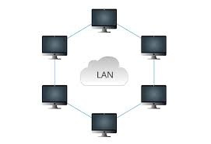
LAN
NEXT SLIDE
ADVANTAGES OF
LAN
Share files and printers
Centralized data access
Internet sharing
Secure and fast communication
PAGE 04
Notes:
LANs are ideal for resource sharing. For example, in an office, multiple computers can use the same printer and access shared folders efficiently.

Slide 5
LAN
NEXT SLIDE
DISADVANTAGES OF
LAN
Limited to small areas
Hardware costs
Maintenance needed
Can fail if central device fails
PAGE 05
Notes:
Despite the benefits, LANs do have downsides. They're confined to local areas and need some technical maintenance. Also, if the central switch fails, the network can go down.

Slide 6

LAN
BACK
THANKS!
Thanks for focusing on the Presentaion.

