Slide 1
BIOINFORMATICS 1 - PROJECT 3
Shared Genetic Architecture between Bacterial Pneumonia and Cardiovascular Disease
A GWAS-eQTL colocalization analysis - Pneumonia pilot
Jaouad El Morabit (Data & QC) - C. Taha - L. Celistin - H. Arbaoui
Supervisor: Prof. Cherng Yang - 16 July 2026

Slide 2
ROADMAP
What this talk covers
1
Background & hypothesis
Why link infection and CVD
2
Concepts
GWAS, eQTL, colocalization (PP.H0-H4)
3
Workflow & data
FinnGen GWAS x GTEx eQTL, QC, harmonization
4
Colocalization results
Four pneumonia loci tested
5
CVD gene overlap
Candidate genes, Venn diagram
6
Interpretation & conclusion
Biology, limitations, next steps
Pneumonia-CVD colocalization | Bioinformatics 1 - Project 3
2

Slide 3
BACKGROUND
Two disease burdens, one possible genetic root
The observation
The question
Bacterial infections (pneumonia, sepsis...) and cardiovascular disease are leading causes of death worldwide.
Epidemiology links them: infection raises short- and long-term cardiovascular risk.
Both involve immune activation and inflammation - shared biology is plausible.
Do infection susceptibility and CVD share CAUSAL genetic variants?
If a variant drives both, it likely acts through immune / inflammatory gene regulation.
Testable with genetics: overlap between GWAS signals and expression QTLs (eQTL).
Pneumonia-CVD colocalization | Bioinformatics 1 - Project 3
3

Slide 4
HYPOTHESIS
Central hypothesis and analytical logic
Hypothesis: bacterial-infection susceptibility and CVD share causal variants acting through immune and inflammatory pathways, detectable as overlap between GWAS signals and tissue-specific eQTLs.
Infection
GWAS signal
>
Colocalizes
with tissue eQTL
>
Implicates a
candidate gene
>
In CVD
gene list?
>
Biological
interpretation
Scope (supervisor's brief): build ONE complete, robust pipeline on pneumonia first; extend the same workflow to other traits only if it works. The deliverable is a presentation, not software.
Pneumonia-CVD colocalization | Bioinformatics 1 - Project 3
4

Slide 5
STUDY DESIGN
Six infection traits, tissue-specific eQTLs
Every trait: whole blood + one trait-relevant tissue (fixed by the supervisor). Pneumonia is the pilot.
Infection trait | Tissue 1 | Tissue 2
Pneumonia (pilot) | Whole blood | Lung
Infective endocarditis | Whole blood | Artery (tibial)
Sepsis | Whole blood | Liver
Periodontitis | Whole blood | Artery (tibial)
H. pylori | Whole blood | Stomach
Tuberculosis | Whole blood | Lung
Pilot tissue rationale: lung = primary infection site; whole blood = shared immune readout for all traits.
Pneumonia-CVD colocalization | Bioinformatics 1 - Project 3
5

Slide 6
CONCEPTS (1/2)
GWAS and eQTL - the two signals we compare
G
GWAS
E
eQTL
Associates each SNP with a trait (here: pneumonia case/control).
Output per SNP: effect size, standard error, p-value, allele frequency.
Tells us WHERE on the genome disease risk sits - not which gene.
Associates each SNP with the expression of a nearby gene, in a given tissue.
Source: GTEx v8 (whole blood, lung).
Tells us which gene a variant REGULATES, and in which tissue.
Pneumonia-CVD colocalization | Bioinformatics 1 - Project 3
6

Slide 7
CONCEPTS (2/2)
Colocalization: five competing hypotheses
For a region, coloc.abf returns posterior probabilities PP.H0-PP.H4 that sum to 1:
H0
No association with either trait
H1
Association with GWAS only
H2
Association with eQTL only
H3
Both associated - DIFFERENT causal variants
H4
Both associated - SAME (shared) causal variant
We keep a colocalization when PP.H4 > 0.5. H4 = shared cause (interesting); H3 = same region, different variants (not shared).
Pneumonia-CVD colocalization | Bioinformatics 1 - Project 3
7

Slide 8
THE WORKFLOW
Prof. Yang's pipeline, applied end-to-end
1
GWAS prep & QC
2
Fetch eQTL
3
Harmonize
4
Colocalize
FinnGen DF13, confirm hg38
GTEx v8 blood + lung (EBI API)
SNP match, allele align, filter
coloc.abf per gene x tissue
5
Candidate genes
6
CVD overlap
7
Interpret
+ tissues, PP.H0-H4 table
intersect gene list + Venn
biology: inflammation, immunity, vasculature
Threshold set by supervisor: PP.H4 > 0.5
Pneumonia-CVD colocalization | Bioinformatics 1 - Project 3
8

Slide 9
DATA
Three inputs - and why
Input | Source | Why
Pneumonia GWAS | FinnGen Data Freeze 13 (J10_PNEUMONIA) | European ancestry (matches GTEx); hg38; 21.3M variants
eQTL (blood, lung, liver) | EBI eQTL Catalogue v2 (GTEx v8) | Region-queryable API; liver added for CRP/HNF1A (D3)
CVD gene list | cvd_genes.txt (supervisor) | 4,309 HGNC symbols for gene-level overlap
Coloc parameters (locked): N = 500,186 | cases = 84,364 | s = 0.1687 | case-control. Both datasets hg38 -> no liftOver.
Pneumonia-CVD colocalization | Bioinformatics 1 - Project 3
9

Slide 10
QUALITY CONTROL
Genome build - the #1 failure point
The risk
Our check
GWAS and eQTL must be on the SAME genome build.
Mixing hg19 and hg38 shifts positions by thousands of bp - SNPs silently mis-match.
coloc then compares the wrong variants.
FinnGen DF13 = hg38. GTEx v8 = hg38.
Same build -> no liftOver needed (verified on a shared lead SNP).
MAF from allele frequency; ambiguous strand SNPs handled at harmonization.
Pneumonia-CVD colocalization | Bioinformatics 1 - Project 3
10

Slide 11
QUALITY CONTROL
Harmonization - three checks per SNP
1
Match SNPs
by chromosome + position + sorted allele pair, per gene region
2
Align effect allele
flip the eQTL beta sign when ref/alt are swapped vs the GWAS
3
Drop ambiguous SNPs
remove A/T and C/G variants near MAF 0.5 (strand-flip risk)
Kept per region: only SNPs present in BOTH datasets. Late fix: coloc.abf needs unique SNPs -> duplicate multiallelic keys removed first.
Pneumonia-CVD colocalization | Bioinformatics 1 - Project 3
11

Slide 12
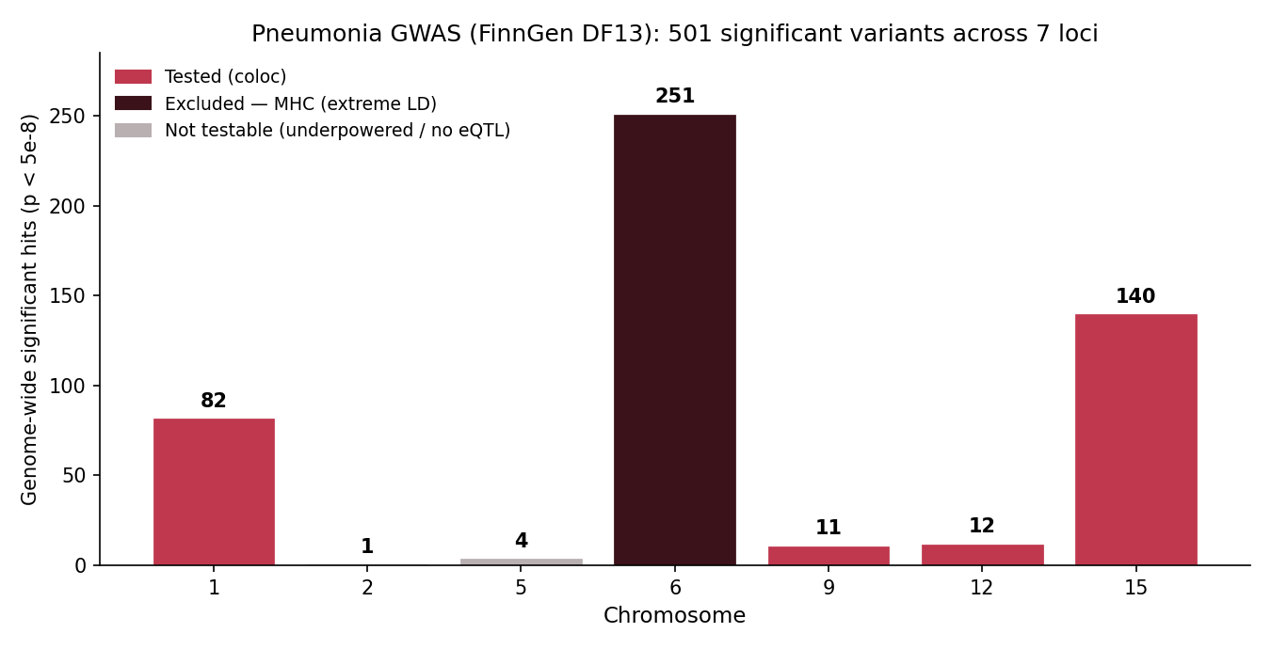
RESULTS (1)
GWAS scan: where are the signals?
Read-out
501 genome-wide significant variants.
7 loci across the genome.
chr6 (MHC) largest but excluded.
4 clean loci taken forward.
Pneumonia-CVD colocalization | Bioinformatics 1 - Project 3
12

Slide 13
RESULTS (2)
Does the pipeline work? Recover known genes
Published pneumonia GWAS report...
...our pipeline recovers
UK Biobank + FinnGen meta-analysis: two chr15 loci, HYKK and smoking genes CHRNA3 / CHRNA5.
Nature Communications 2022: MUC5AC, TNFRSF1A (fine-mapped).
chr15 lead: HYKK, CHRNA3, CHRNA5 (recovered)
Same 15q25 locus as the published studies.
MUC5AC / TNFRSF1A not recovered - different study, larger N, nearest-gene limits.
Recovering HYKK + CHRNA3/5 confirms the pipeline reproduces established biology.
Pneumonia-CVD colocalization | Bioinformatics 1 - Project 3
13

Slide 14
RESULTS (3)
Loci taken to colocalization
Locus | Hits | Decision
chr15 (15q25) | 140 | Tested - blood + lung
chr1 (CRP) | 82 | Tested - blood + lung
chr12 (HNF1A) | 12 | Tested - blood + lung
chr9 (TNFSF15) | 11 | Tested - blood + lung
chr2 (IFIH1) | 1 | Not testable - no IFIH1 eQTL
chr5 (CDH6) | 4 | Skipped - underpowered
chr6 (MHC) | 251 | Excluded - extreme LD
Selection rule
Enough GWAS signal to define a peak.
A cis-eQTL available in blood/lung.
Not in the MHC.
4 loci qualify.
Pneumonia-CVD colocalization | Bioinformatics 1 - Project 3
14

Slide 15
RESULTS (4) - CHR15
15q25: the smoking / immune locus
Candidate genes (both signals present)
Colocalization outcome
CTSH (cathepsin H) - candidate #1, both tissues, immune gene
IREB2, CIB2, TBC1D2B (blood); RASGRF1 (lung)
140 GWAS hits; strong eQTLs alongside
PP.H3 approx 1 for every strong gene
PP.H4 max approx 0.02 - no colocalization
Two real signals, different causal variants
15q25 is a known MULTI-signal (smoking) locus - a first hint that single-variant coloc may be limited here.
Pneumonia-CVD colocalization | Bioinformatics 1 - Project 3
15

Slide 16
RESULTS (5) - CHR1
CRP: the inflammation locus
Candidate genes (both signals present)
Colocalization outcome
SLAMF8, IGSF8, COPA, NCSTN, AIM2, MNDA
Region dense with immune / inflammatory genes
CRP gene itself has no blood/lung eQTL (liver gene)
PP.H3 approx 1 across strong genes
PP.H4 max 0.10 (H1-driven, not shared)
No colocalization
Biologically rich region for the hypothesis - but still distinct causal variants.
Pneumonia-CVD colocalization | Bioinformatics 1 - Project 3
16

Slide 17
RESULTS (6) - CHR12
HNF1A: an inflammation-to-CVD bridge
Candidate genes (both signals present)
Colocalization outcome
P2RX4 - purinergic receptor, inflammation & endothelial function
COQ5, C12orf43, KDM2B
HNF1A regulates CRP; no HNF1A eQTL in blood/lung
PP.H3 approx 1 (incl. P2RX4)
PP.H4 max 0.29 - highest of the study, still < 0.5
No colocalization
Best PP.H4 anywhere (0.29) is a non-coding RNA - not a shared-cause signal.
Pneumonia-CVD colocalization | Bioinformatics 1 - Project 3
17

Slide 18
RESULTS (7) - CHR9
TNFSF15: testing the hypothesis gene directly
Candidate genes (both signals present)
Colocalization outcome
TNFSF15 itself HAS a strong blood eQTL - ideal test
ORM1 (orosomucoid, acute-phase protein)
Lung underpowered here (GWAS p only ~1e-3)
TNFSF15: PP.H3 = 0.999 (blood)
Even the ideal gene -> distinct causal variants
No colocalization
The clearest possible on-hypothesis test still returns H3, not H4.
Pneumonia-CVD colocalization | Bioinformatics 1 - Project 3
18

Slide 19
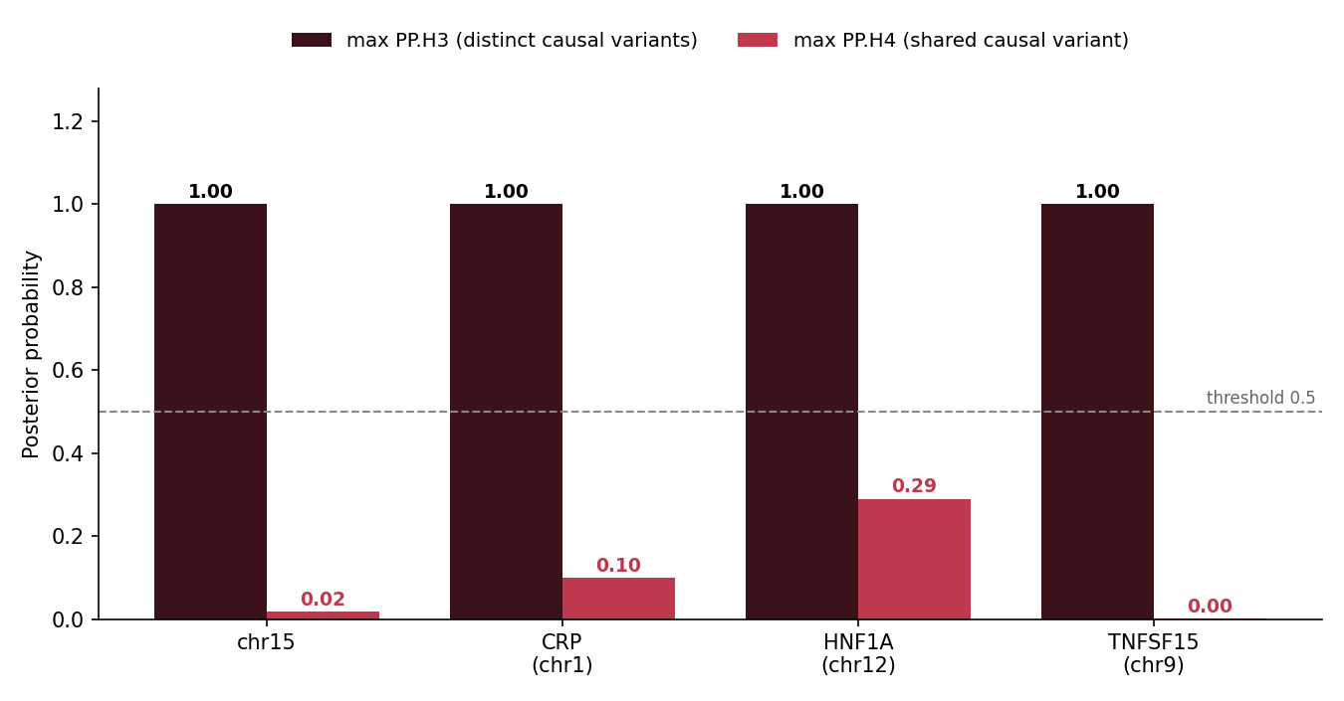
RESULTS (8)
The result, in one figure
Master result
74 gene x tissue tests (3 tissues).
0 colocalizations (no PP.H4 > 0.5).
PP.H3 approx 1 wherever both signals are strong.
Pneumonia-CVD colocalization | Bioinformatics 1 - Project 3
19

Slide 20
INTERPRETATION (1)
Why H3 everywhere? Two readings
Reading A - biological
Reading B - methodological
Pneumonia risk at these loci is NOT mediated by cis-expression of these genes in blood/lung.
Real, interpretable result - the signals simply are not the same variant.
coloc.abf assumes ONE causal variant per region.
chr15, CRP, HNF1A are multi-signal -> H3 can mask a hidden colocalization.
coloc.susie handles multiple signals (needs an LD panel) - the rigorous next step.
Pneumonia-CVD colocalization | Bioinformatics 1 - Project 3
20

Slide 21
INTERPRETATION (2)
Honest limits: loci we could not test
chr2 - IFIH1
Only 1 GWAS hit AND no cis-eQTL for IFIH1 in blood/lung. Colocalization is impossible - the data does not exist in these tissues.
chr5 - CDH6
Too few hits (4) - underpowered to define a peak for coloc.
chr6 - MHC
Excluded by design: extreme, extended LD makes colocalization uninterpretable across immune traits.
Pneumonia-CVD colocalization | Bioinformatics 1 - Project 3
21

Slide 22
FOLLOW-UP - LIVER (SUPERVISOR'S D3)
Does liver rescue CRP / HNF1A?
Why liver?
What we found
CRP and HNF1A are primarily LIVER-expressed and had no blood/lung eQTL.
Liver is the natural tissue to test them - added on the supervisor's suggestion (D3).
GTEx v8 liver eQTL (EBI Catalogue) fetched for the CRP and HNF1A loci.
CRP and HNF1A still have NO cis-eQTL in liver -> lead genes remain untestable.
Where a neighbouring gene was testable -> PP.H3 approx 1 again.
No colocalization in liver either.
Take-away: the result holds across THREE tissues (blood, lung, liver). The limitation is confirmed, not resolved - a robust, honest finding.
Pneumonia-CVD colocalization | Bioinformatics 1 - Project 3
22

Slide 23
CVD OVERLAP (1)
Candidate genes and tissues
26 candidate genes (a GWAS AND an eQTL signal) across the four loci. * = also in the CVD list.
Locus | Candidate genes (double signal) | Tissue
chr15 | CTSH*, IREB2, CIB2, TBC1D2B, RASGRF1 | blood + lung
chr1 (CRP) | IGSF8*, PIGM*, CASQ1*, SLAMF8, COPA, NCSTN | blood + lung
chr12 (HNF1A) | P2RX4*, COQ5*, C12orf43, POP5, KDM2B | blood + lung
chr9 (TNFSF15) | TNFSF15, ORM1*, WHRN | blood
* gene is also in the CVD list (cvd_genes.txt).
Pneumonia-CVD colocalization | Bioinformatics 1 - Project 3
23

Slide 24
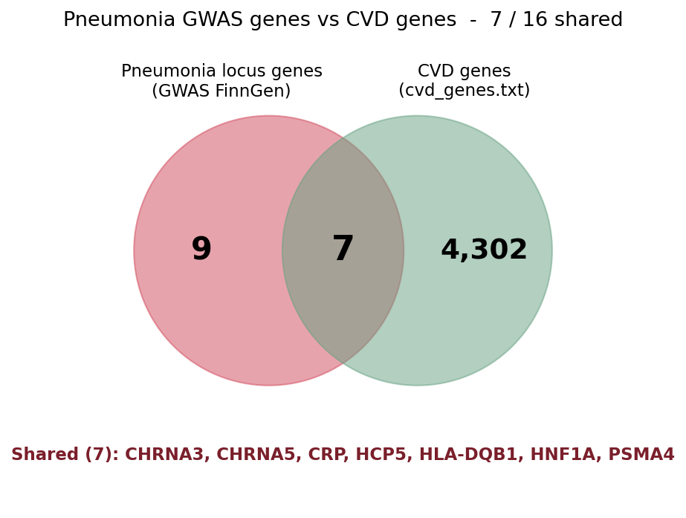
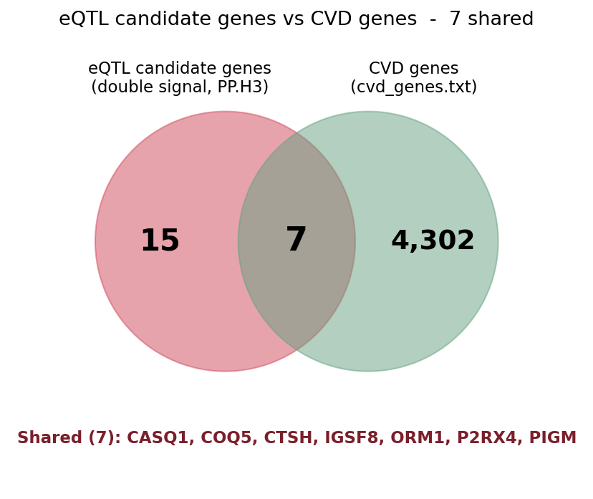
CVD OVERLAP (2)
Gene-level overlap with CVD
Caveat (stated honestly): the CVD list has 4,309 genes (~20% of protein-coding genes) - some overlap is expected by chance. A hit is suggestive, not proof; strengthened only by high PP.H4 (we have none) or clear biology.
Pneumonia-CVD colocalization | Bioinformatics 1 - Project 3
24

Slide 25
INTERPRETATION (3)
Biology of the shared genes
P2RX4
Purinergic receptor - inflammation (NLRP3) & endothelial / vascular function
CTSH
Cathepsin H - antigen processing, immunity; present in both tissues
ORM1
Orosomucoid - acute-phase inflammation protein
CRP / HNF1A
Direct inflammation-to-CVD links (CRP level, cardiometabolic regulator)
These sit on the inflammation / immunity axis of the hypothesis - but colocalization did not confirm a shared causal variant.
Pneumonia-CVD colocalization | Bioinformatics 1 - Project 3
25

Slide 26
CONCLUSION
Shared genes, but not shared causal variants
Pneumonia and CVD SHARE loci and genes: 7/16 GWAS-locus genes and 7 candidate genes are CVD genes (incl. CRP, HNF1A, P2RX4).
But colocalization finds NO shared causal variants: PP.H3 approx 1 across all four loci.
The overlap is at the gene / region level, not the causal-variant level - under coloc.abf's single-variant assumption, in blood, lung and liver.
A consistent, reproducible result - and a validated, reusable pipeline for the other five traits.
Pneumonia-CVD colocalization | Bioinformatics 1 - Project 3
26

Slide 27
LIMITATIONS & PERSPECTIVES
What would strengthen this
Limitations
Perspectives
Single-causal-variant assumption at multi-signal loci.
Three tissues tested (blood, lung, liver) - lead genes still lack cis-eQTL.
No cis-eQTL for lead genes CRP, IFIH1, HNF1A.
Broad CVD list -> chance overlap.
coloc.susie on multi-signal loci (with 1000G LD).
Add further disease-relevant tissues (artery, stomach).
Report PP.H4 at 0.5 and 0.8 (sensitivity).
eQTLGen (~31k) as a whole-blood supplement.
Extend the pipeline to the other 5 traits.
Pneumonia-CVD colocalization | Bioinformatics 1 - Project 3
27

Slide 28
TEAM & ACKNOWLEDGEMENTS
Thank you
Jaouad El Morabit
Cheikh Taha
Loua Celistin
Hamza Arbaoui
Data & QC Lead
Colocalization Lead
Visualization Lead
Interpretation & Writing
Supervisor: Prof. Cherng Yang - Pipeline based on his Project 3 workflow.
Data: FinnGen DF13 - GTEx v8 via EBI eQTL Catalogue - coloc (R). Validation: Nat Commun 2022; UKB+FinnGen meta-analysis.
Questions & discussion
Pneumonia-CVD colocalization | Bioinformatics 1 - Project 3
28

