Slide 1

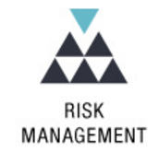
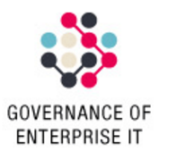


Cyber Security, Governance, Risk and Conformance
Customer Centric
Sales Focused
Business Driven
Presenters:
Khalid Bin Waleed
Diploma in AIOPS
EduQual Level 6

Slide 2
Table of Contents
Goal statement
Additional Benefits = increased Operations Maturity
Value of the Unified Integrated Management System framework
Operating as ONE

Slide 3
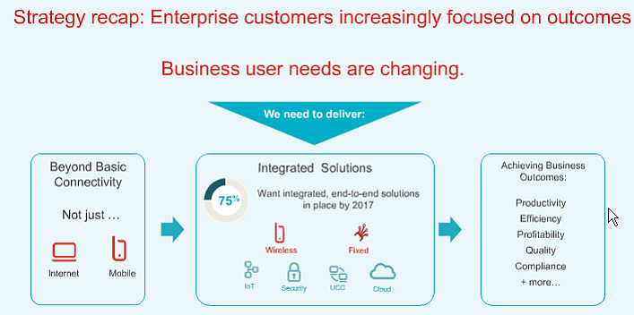
Goal Statement
Strengthening Acme Telco competitive position and increasing revenue with the existing client base and new customers enabled by meeting compliance requirements
“The future belongs to those who prepare for it today”
1

Slide 4
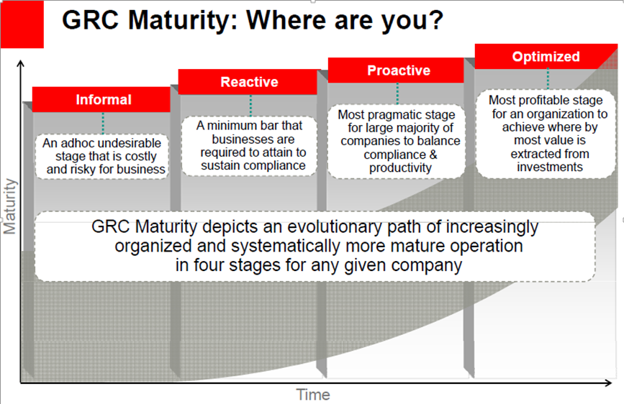
Additional Benefits = increased Operations Maturity
2027
2025
2026
2024
-From commodity to as-a-Service
XaaS
2

Slide 5
Value of the Unified Integrated Management System framework
Measurement system is clearly aligned to the organization’s key business strategy outcomes
Position management for a
greater consistency in the delivery of service commitments through robust operational reporting and timely responses to changing demands.
Governance is clearly defined, documented and monitored to inform key decisions and adjustment requirements.
1
2
Brand Enhancement !
Strategic focus
Operational Sustainment
Decision Enabling Governance
8
3
Measurement framework is adaptable to
evolving industry requirements
Active Quality Management
Evidence of independent quality assurance over the delivery of products and service commitments.
Agile Change Control
Achieve strategic business transformation objectives
Integrated compliance framework
7
High Performing Teams
4
Managed Risks and Opportunities
Clear accountabilities to support business desired outcomes and achieve customer commitments.
Integrated Suppliers
Enables the monitoring and management of risks by providing focus on key business outcomes and performance indicators. Indication of risks awareness and appropriate gear to address them.
6
5
Efficiencies and Savings in audit fees !
Supports effective vendor management by defining and rigorously measuring contractual obligations.

Slide 6
Operating as ONE
The GRC roadmap development will be collaborative …
Development of Governance Roadmap
UIMS Risk & Controls Assessment and Gaps Analysis
UIMS Technology Needs Assessment and Deployment
UIMS Continuous Controls Monitoring Program Development
Service Organization Controls Audit
Identify the certification /compliance frameworks to be in scope.
Identify services and related systems to be included in the UIMS.
Develop the communications and awareness strategy for the UIMS program.
Identify the current processes and controls that would support the UIMS.
Implement a GRC solution to support the UIMS.
Implement automation and analytics tool.
Implement UIMS Continuous Controls Monitoring program.
Develop program design for sustainable integrated third party audit program.
Update the communications and awareness strategy for the UIMS program.
Specify the controls from the UIMS to support the Managed Services/COE, and Wireless/Wireline Services.
Select the Assurance Framework- Trust Services principles and criteria to be used.
PwC Acme Telco
RACI Definition and Ownership
Provide advice on other certification and compliance frameworks used in industry applicable for the UIMS.
Discuss and agree with the EBU team on the services and related systems to be included in the UIMS.
Support the development of the overall communications and awareness strategy to be developed and rolled out by the EBU team.
Perform detailed process walkthroughs in order to understand the current state of processes and controls that would support the UIMS.
Document “as-is” existing policies and procedures aligned to the UIMS.
Identify risks and control gaps in meeting the UIMS requirements and advise on remediation plans to prepare for readiness against compliance and audit requirements.
Provide support on requirements analysis for a GRC solution in considerations for UIMS drivers.
Provide advice on requirements analysis for automation and analytics tool (machine learning capabilities) to be deployed in EBU contract analysis.
Provide support and advice on the organization design, process, technology solutions development to roll out a sustainable UIMS Continuous Controls Monitoring program.
Support the updating of the communications and training strategy.
Perform SOC 2 audit on the controls supporting Acme’ Managed Services/ COE and wireless/ wireline services provided to Acme’ customers.
Perform SOC 2 integrated (multi customer) audit on the security and availability controls supporting Acme’ Wireless/Wireline Services provided to Acme’ customers.
4

Slide 7
Operating as ONE
The GRC roadmap development will be collaborative …
Development of Governance Roadmap
UIMS Risk & Controls Assessment and Gaps Analysis
UIMS Technology Needs Assessment and Deployment
UIMS Continuous Controls Monitoring Program Development
Service Organization Controls Audit
Identify the certification /compliance frameworks to be in scope.
Identify services and related systems to be included in the UIMS.
Develop the communications and awareness strategy for the UIMS program.
Identify the current processes and controls that would support the UIMS.
Implement a GRC solution to support the UIMS.
Implement automation and analytics tool.
Implement UIMS Continuous Controls Monitoring program.
Develop program design for sustainable integrated third party audit program.
Update the communications and awareness strategy for the UIMS program.
Specify the controls from the UIMS to support the Managed Services/COE, and Wireless/Wireline Services.
Select the Assurance Framework- Trust Services principles and criteria to be used.
PwC Acme Telco
RACI Definition and Ownership
Provide advice on other certification and compliance frameworks used in industry applicable for the UIMS.
Discuss and agree with the EBU team on the services and related systems to be included in the UIMS.
Support the development of the overall communications and awareness strategy to be developed and rolled out by the EBU team.
Perform detailed process walkthroughs in order to understand the current state of processes and controls that would support the UIMS.
Document “as-is” existing policies and procedures aligned to the UIMS.
Identify risks and control gaps in meeting the UIMS requirements and advise on remediation plans to prepare for readiness against compliance and audit requirements.
Provide support on requirements analysis for a GRC solution in considerations for UIMS drivers.
Provide advice on requirements analysis for automation and analytics tool (machine learning capabilities) to be deployed in EBU contract analysis.
Provide support and advice on the organization design, process, technology solutions development to roll out a sustainable UIMS Continuous Controls Monitoring program.
Support the updating of the communications and training strategy.
Perform SOC 2 audit on the controls supporting Acme’ Managed Services/ COE and wireless/ wireline services provided to Acme’ customers.
Perform SOC 2 integrated (multi customer) audit on the security and availability controls supporting Acme’ Wireless/Wireline Services provided to Acme’ customers.
4

Slide 8
Thank you!

