Slide 1

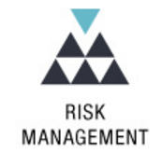



Cyber Security, Governance, Risk and Conformance
Customer Centric
Sales Focused
Business Driven
Presenters:
Khalid Bin Waleed
Diploma in AIOPS
EduQual Level 6

Slide 2
Table of Contents
Goal statement
Additional Benefits = increased Operations Maturity
Value of the Unified Integrated Management System framework
Operating as ONE

Slide 3
Table of Contents
Goal statement
Additional Benefits = increased Operations Maturity
Value of the Unified Integrated Management System framework
Operating as ONE

Slide 4
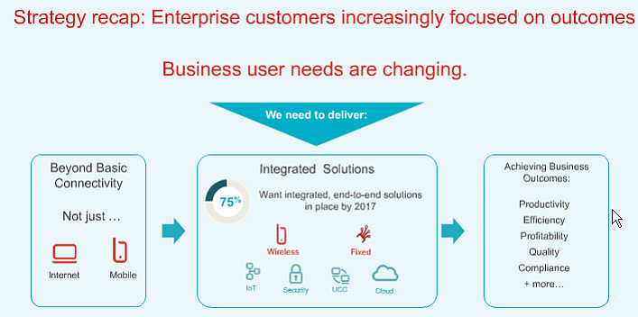
Goal Statement
Strengthening Acme Telco competitive position and increasing revenue with the existing client base and new customers enabled by meeting compliance requirements
“The future belongs to those who prepare for it today”
1

Slide 5
Goal Statement
Strengthening Acme Telco competitive position and increasing revenue with the existing client base and new customers enabled by meeting compliance requirements
“The future belongs to those who prepare for it today”
1

Slide 6
Goal Statement
Strengthening Acme Telco competitive position and increasing revenue with the existing client base and new customers enabled by meeting compliance requirements
“The future belongs to those who prepare for it today”
1

Slide 7
Table of Contents
Goal statement
Additional Benefits = increased Operations Maturity
Value of the Unified Integrated Management System framework
Operating as ONE

Slide 8
Table of Contents
Goal statement
Additional Benefits = increased Operations Maturity
Value of the Unified Integrated Management System framework
Operating as ONE

Slide 9
Goal Statement
Strengthening Acme Telco competitive position and increasing revenue with the existing client base and new customers enabled by meeting compliance requirements
“The future belongs to those who prepare for it today”
1

Slide 10
Goal Statement
Strengthening Acme Telco competitive position and increasing revenue with the existing client base and new customers enabled by meeting compliance requirements
“The future belongs to those who prepare for it today”
1

Slide 11
Goal Statement
Strengthening Acme Telco competitive position and increasing revenue with the existing client base and new customers enabled by meeting compliance requirements
“The future belongs to those who prepare for it today”
1

Slide 12
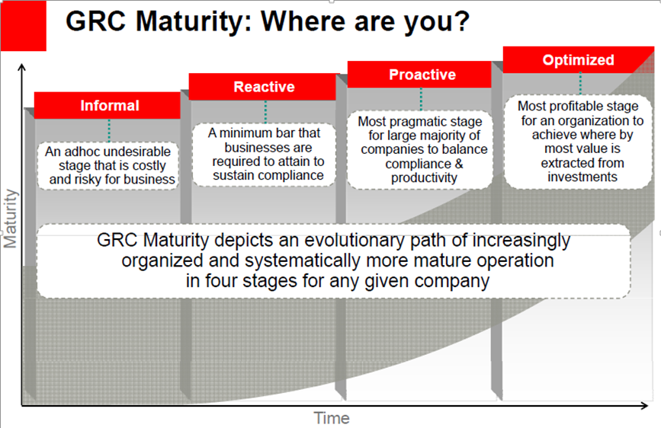
Additional Benefits = increased Operations Maturity
2027
2025
2026
2024
-From commodity to as-a-Service
XaaS
2

Slide 13
Table of Contents
Goal statement
Additional Benefits = increased Operations Maturity
Value of the Unified Integrated Management System framework
Operating as ONE

Slide 14
Table of Contents
Goal statement
Additional Benefits = increased Operations Maturity
Value of the Unified Integrated Management System framework
Operating as ONE

Slide 15
Table of Contents
Goal statement
Additional Benefits = increased Operations Maturity
Value of the Unified Integrated Management System framework
Operating as ONE

Slide 16
Table of Contents
Goal statement
Additional Benefits = increased Operations Maturity
Value of the Unified Integrated Management System framework
Operating as ONE

Slide 17
Table of Contents
Goal statement
Additional Benefits = increased Operations Maturity
Value of the Unified Integrated Management System framework
Operating as ONE

Slide 18
Table of Contents
Goal statement
Additional Benefits = increased Operations Maturity
Value of the Unified Integrated Management System framework
Operating as ONE

Slide 19
Table of Contents
Goal statement
Additional Benefits = increased Operations Maturity
Value of the Unified Integrated Management System framework
Operating as ONE

