Slide 1
API
Application Program Interface

Slide 2

What is an Application Programming Interface (API)
An API acts as a middle man between two different entities
In this weeks readings we’ll see from one of the videos that API’s improve our connectivity in the internet.
They act a lot like a waiter at a restaurant.
  At a restaurant a customer will sit down and look at a menu and make an order.
  The order comes from the kitchen, but through a waiter. Without the API, or waiter, we would never get our order.

Slide 3
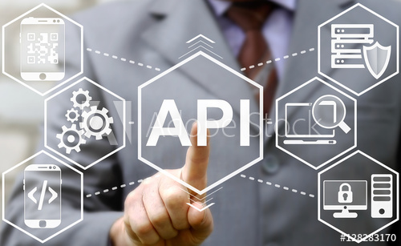
Application Program Interface
An API is a user-interface for a machine.
Just as a smart phone app can act as a user-interface for a human, an API is an interface for a computer
  It could be a smartphone accessing a server on the network
  It could be two servers talking to each other through an API

Slide 4
API Consumer vs. API Provider
An API consumer is a developer who is using or incorporating an API for the development of their particular program.
An API provider is person or organization who creates an API and makes it available for others to use.
For example, the Google Maps API was developed and made available by Google (provider) and can be used and incorporated by you (consumer) to be used in your weather website.

Slide 5
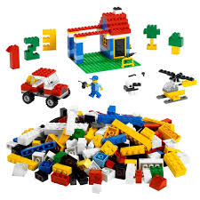
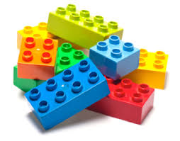
API Metaphors

Slide 6
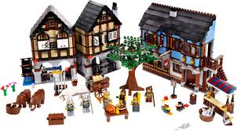
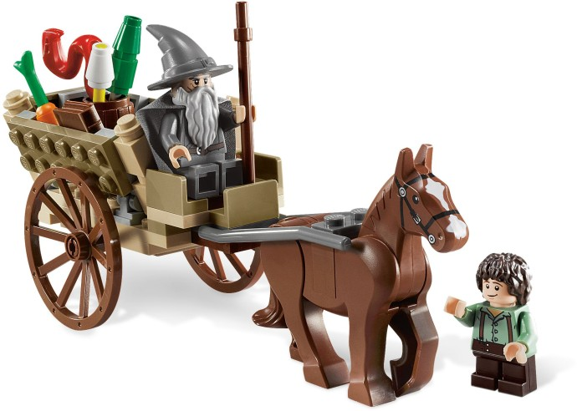
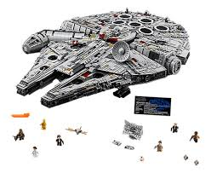
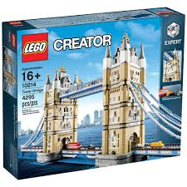
API Metaphors

Slide 7
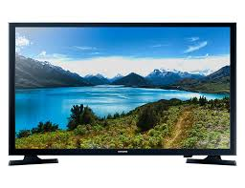

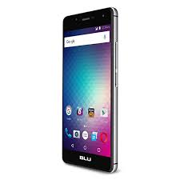
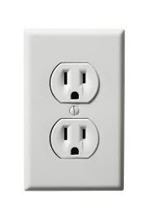
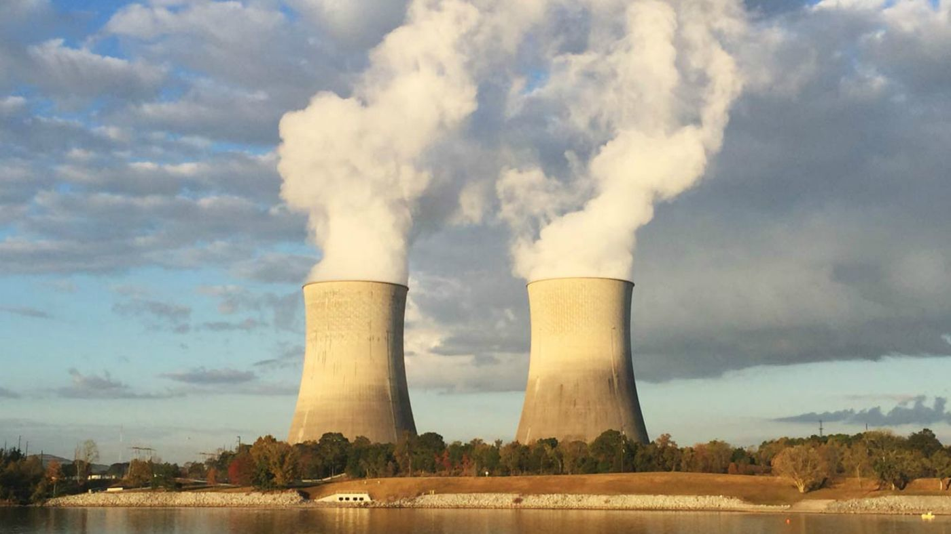

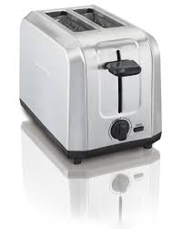

API Metaphors Continued

Slide 8

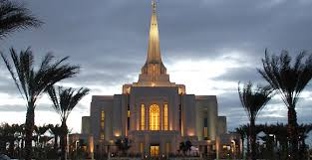
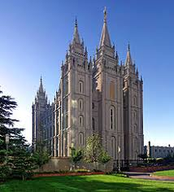

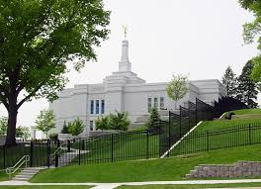

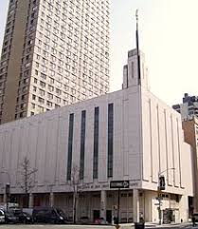

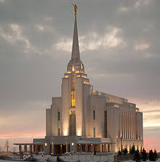

API Metaphor Continued

