Slide 1



FINAL VIVA -VOICE
SMART METER WITH GATEWAY COMMUNICATION
MASTER OF COMPUTER APPLICATION
Guided by :
G. Muthulakshmi MCA
Assissant Professor
MCA
Presented by:
Jawahar R II-MCA
(23205024)
Notes:
<number>

Slide 2


OUTLINE
INTRODUCTION
EXISTING SYSTEM
PROPOSED SYSTEM
HARDWARE USED
SOFTWARE USED
ER DIAGRAM
NUMBER OF MODULES
DATA COLLECTION
TERMINAL OUTPUTS
CONNECTION DIAGRAM
REFERENCES
CODE SNIPPET
CONCLUSION
<number>

Slide 3
INTRODUCTION:
Advanced energy monitoring system
Accurately measures voltage and current usage
Real-time data acquisition
Sensors capture data and display it on an LCD.
Remote monitoring
Ethernet transmits data to the cloud.
Reliable processing and communication
Uses STM32F446RE microcontroller and A5D2X board.
Improved energy efficiency
Real-time tracking helps optimize consumption.
<number>

Slide 4
EXISTING SYSTEM:
Traditional energy meters measure power consumption but lack the ability to communicate data in real time. Most systems require manual readings, leading to inaccuracies, delays, and inefficiencies in billing and power usage tracking. Moreover, existing systems may not provide data analysis or remote monitoring capabilities, limiting the user's ability to make informed decisions regarding energy consumption.
<number>

Slide 5
PROPOSED SYSTEM:
Accurate Measurement & Real-Time Data Acquisition
Sensors measure voltage and current usage, providing real-time monitoring of energy consumption.
Local Display & Cloud Monitoring
Data is displayed on an LCD screen and sent to the cloud via a Ethernet module for remote tracking
STM32F446RE for Data Processing
The STM32F446RE microcontroller handles data acquisition and sensor communication
Rugged A5D2X Board for Reliable Communication
Ensures robust communication and operation in various environmental conditions.
Improved Energy Efficiency & Monitoring
Enables users to track and optimize energy usage for better efficiency.
<number>

Slide 6
HARDWARE’S USED
STM32 Board (STM32F446RE) – For sensing and processing data
A5D2X Rugged Board – For additional processing and communication
Voltage Sensor (ZMPT101B) – For voltage measurement
Current Sensor (ACS712) – For current measurement
LCD Display – To show real-time voltage, current, and power data
Motor – To measure the current values

Slide 7
SOFTWARE’S USED
STM32CubeIDE – Development and debugging environment
STM32 HAL Library – Hardware abstraction layer for sensor communication
Sensor Libraries – For voltage sensor (ZMPT101B) and current sensor (ACS712)
USART Communication – For data transfer between STM32 and A5D2X rugged board
MQQT Protocol– Used for sending Values securly to the Cloud

Slide 8
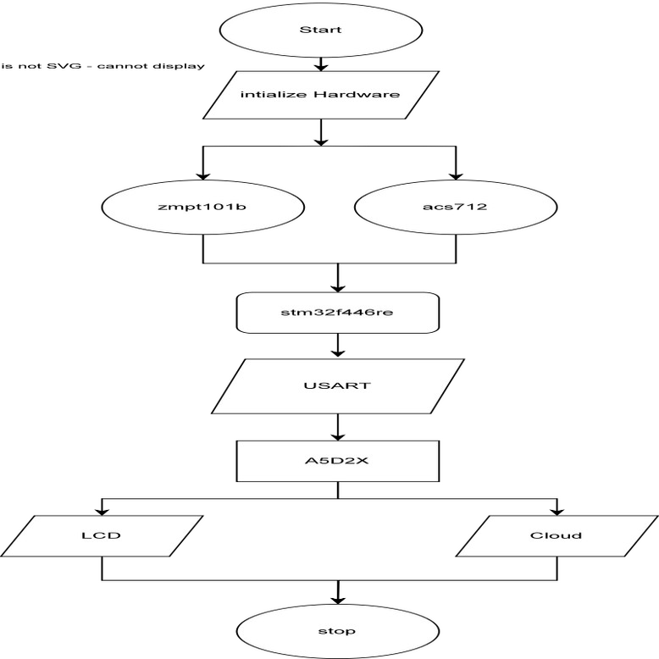
ER diagram:

Slide 9
NUMBER OF MODULES :
voltage and Current Sensing Module
Utilizes ZMPT101B and ACS712 sensors to measure voltage and current, respectively, providing input to the STM32F446RE microcontroller.
Data Processing and Communication Module
The STM32F446RE processes the sensor data and sends it via USART to the rugged A5D2X board, which manages communication between components.
Display and Monitoring Module
Data is displayed in real-time on an LCD screen connected to the A5D2X board, allowing users to monitor energy usage locally.
Cloud Connectivity Module
Uses a Wi-Fi module connected to the A5D2X board to send energy data to a cloud server, enabling remote monitoring and data storage for analysis.
9

Slide 10
Data Collection
Sensor-Based Data Acquisition:
Sensors collect raw data continuously at regular intervals (e.g., every 1 seconds).
The STM32F446RE reads values using I2C, UART, GPIO communication.
Real-Time Data Storage & Transmission:
The Ethernet Module sends data to a cloud server or a local database.
Data is formatted in JSON or CSV for easy analysis.
<number>

Slide 11
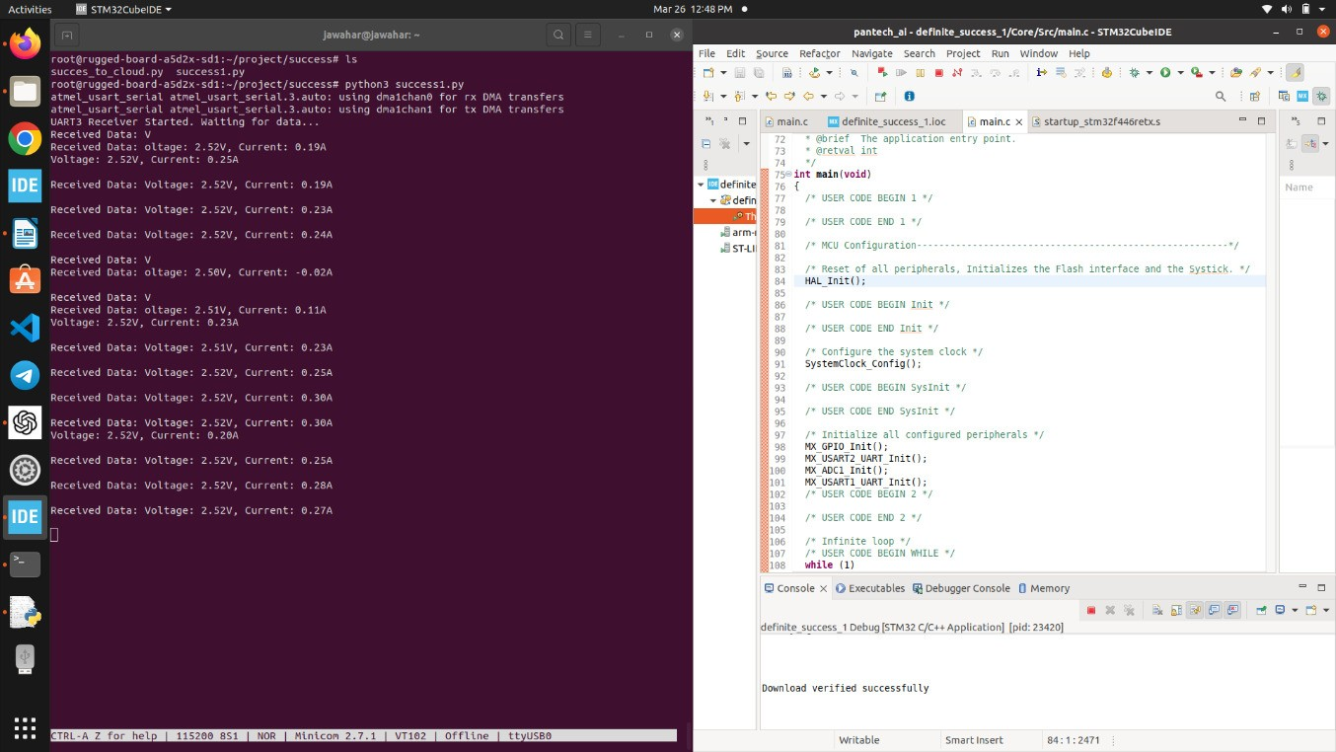
Terminal Output
<number>
Notes:
11

Slide 12
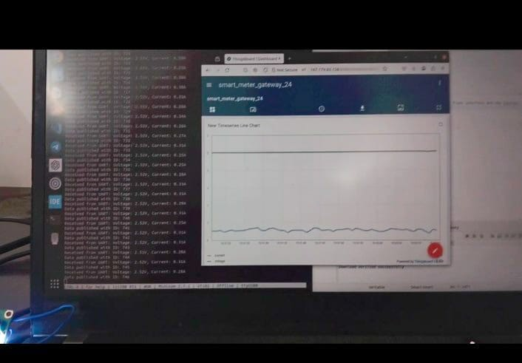
Cloud Output
<number>
Notes:
12

Slide 13
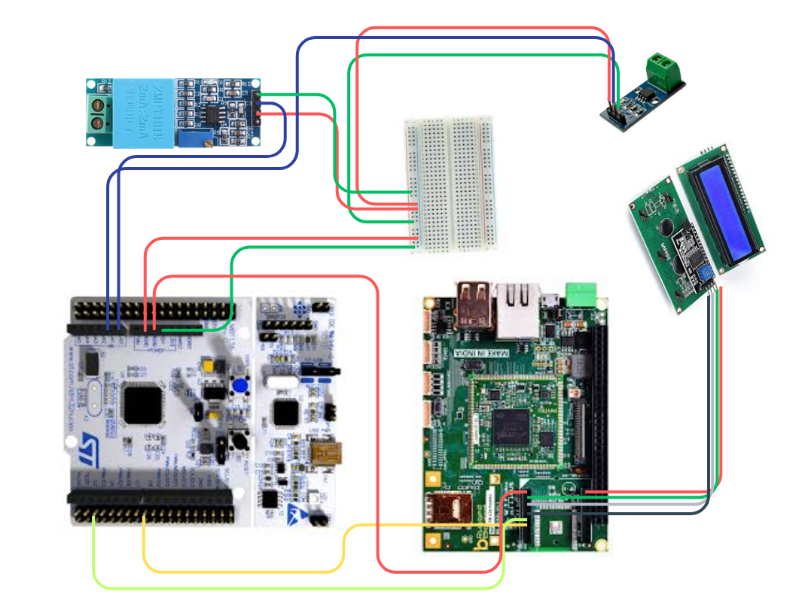
Connection Diagram
<number>
Notes:
13

Slide 14
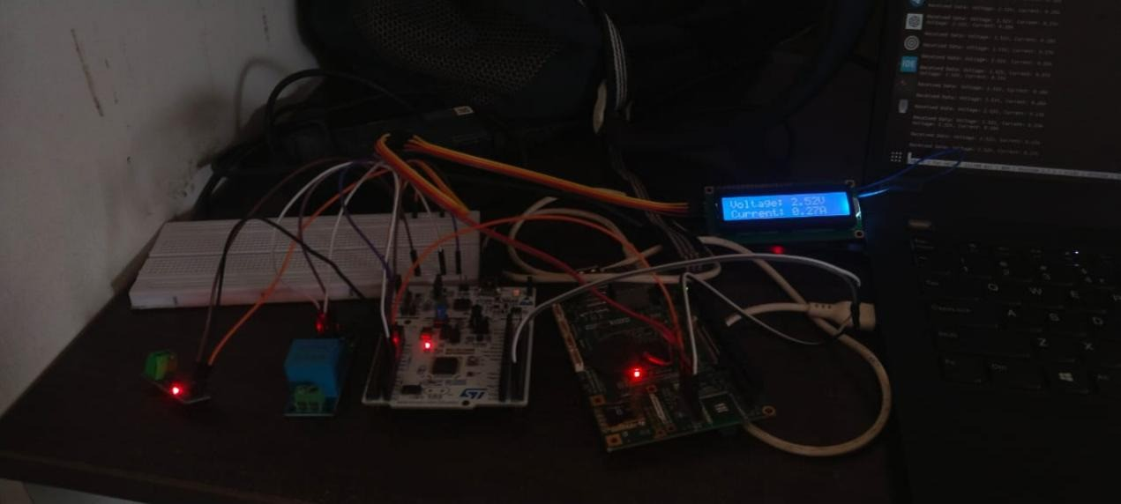
Connection Diagram
<number>
Notes:
14

Slide 15
REFERENCES
Voltage and Current Sensor Integration
Smith, R., & Zhang, L. (2023). Advanced Applications of Voltage and Current Sensors in Smart Energy Systems. IEEE Access.
Communication Protocols in Embedded Systems
Patel, A., & Gupta, S. (2022). Modern Embedded System Communication: Implementing UART, I2C, and SPI for IoT Devices. Embedded Computing Systems.
Energy Monitoring Systems
Li, J., & Kumar, R. (2023). Next-Generation Smart Meters: Design and Implementation of Voltage and Current Sensors in Energy Monitoring Systems. International Journal of Smart Energy Grids.
<number>
Notes:
15

Slide 16
REFERENCES
Books and Textbooks:
ahga, A., & Madisetti, V. (2019). Internet of Things: A Hands-On Approach.
Universities Press.
Buyya, R., & Dastjerdi, A. V. (2021). Internet of Things: Principles and
Paradigms. Elsevier.
Raj, P., & Raman, A. C. (2020). The Internet of Things: Enabling Technologies,
Platforms, and Use Cases. CRC Press.
Journals and Research Papers:
Kumar, P., & Sharma, R. (2023). Secure Communication in IoT-Based Smart
Metering Systems Using MQTT and Edge Computing. International Journal of
Computer Science & Network Security.
Singh, R., & Agarwal, N. (2023). Implementation of Wireless Sensor Networks
in Smart Energy Metering Using STM32 Microcontrollers. IEEE Transactions
on Industrial Informatics.
<number>
Notes:
16

Slide 17
Code Snippet- 1
while (1)
{
HAL_ADC_Start(&hadc1);
HAL_ADC_PollForConversion(&hadc1, HAL_MAX_DELAY);
adc_value = HAL_ADC_GetValue(&hadc1);
voltage = (adc_value * 3.3) / 4095.0;
HAL_ADC_PollForConversion(&hadc1, HAL_MAX_DELAY);
adc_value = HAL_ADC_GetValue(&hadc1);
float sensor_voltage = (adc_value * 3.3) / 4095.0;
current = (sensor_voltage - 2.5) / 0.066;
snprintf(buffer, sizeof(buffer), "Voltage: %.2fV, Current: %.2fA\n", voltage,
current);
HAL_UART_Transmit(&huart1, (uint8_t*)buffer, strlen(buffer),
39HAL_MAX_DELAY); // Corrected function
HAL_Delay(1000);
<number>
Notes:
17

Slide 18
Code Snippet- 2
while True:
if ser.in_waiting > 0:
data = ser.readline().decode('utf-8').strip()
print("Received from UART: %s" % data)
voltage, current = parse_uart_data(data)
//if voltage is not None and current is not None:
51lcd_string("Voltage: {:.2f}V".format(voltage), LCD_LINE_1)
lcd_string("Current: {:.2f}A".format(current), LCD_LINE_2)
telemetry_data = {'voltage': voltage, 'current': current}
mqtt_client.publish('v1/devices/me/telemetry', str(telemetry_data))
time.sleep(1)
<number>
Notes:
18

Slide 19
CONCLUSION
This project successfully demonstrates a real-time IoT-based smart energy monitoring system using STM32F446RE and RuggedBoard A5D2X. The integration of voltage and current sensors, UART-based data transmission, LCD display, and Ethernet-enabled MQTT cloud communication results in a scalable and efficient energy management solution. It enhances operational visibility, enables remote access to energy data, and supports offline monitoring through local display and database logging. By leveraging embedded systems and reliable communication protocols, the system reduces manual effort and improves accuracy in energy tracking. Future improvements may include mobile applications, AI-powered analytics, billing system integration, and expanded sensor networks for broader applications in smart grids and industrial energy management.
<number>
Notes:
19

Slide 20

THANK YOU
<number>

