Slide 1
Predict time to fill truck load

Slide 2
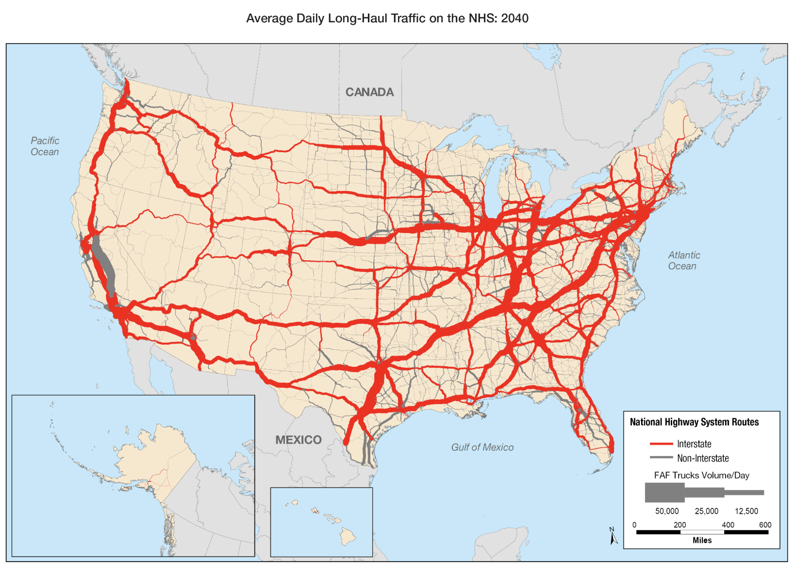
Notes:
US DOT 2040 forecast 590 million miles daily

Slide 3
US annual freight volume $800 billion
projected to increase to $1.5 trillion by 2030
American Trucking Association

Slide 4
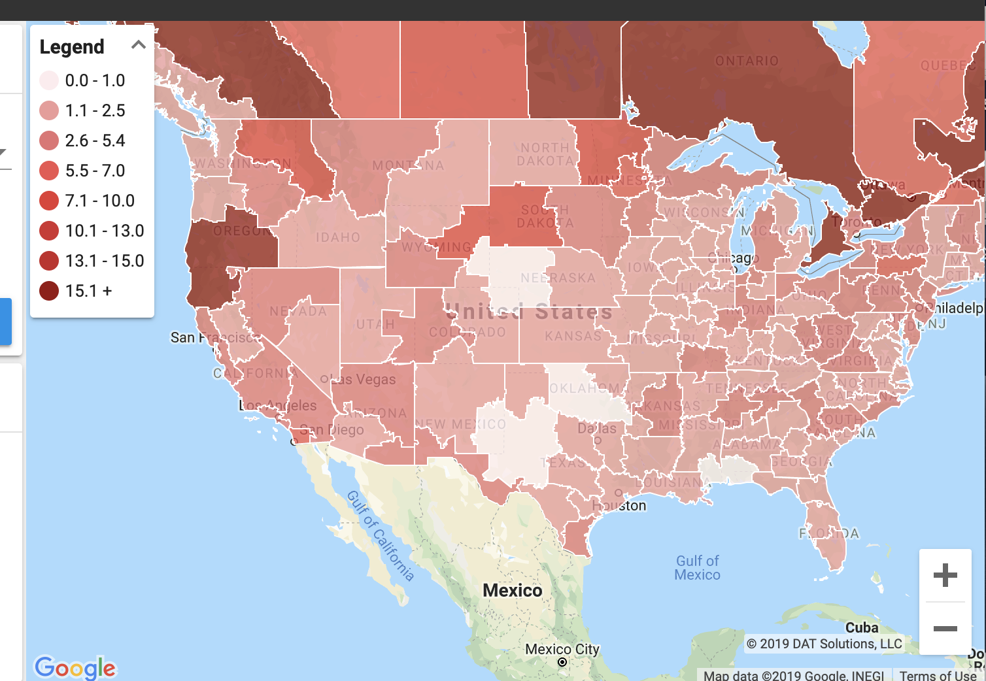

Slide 5
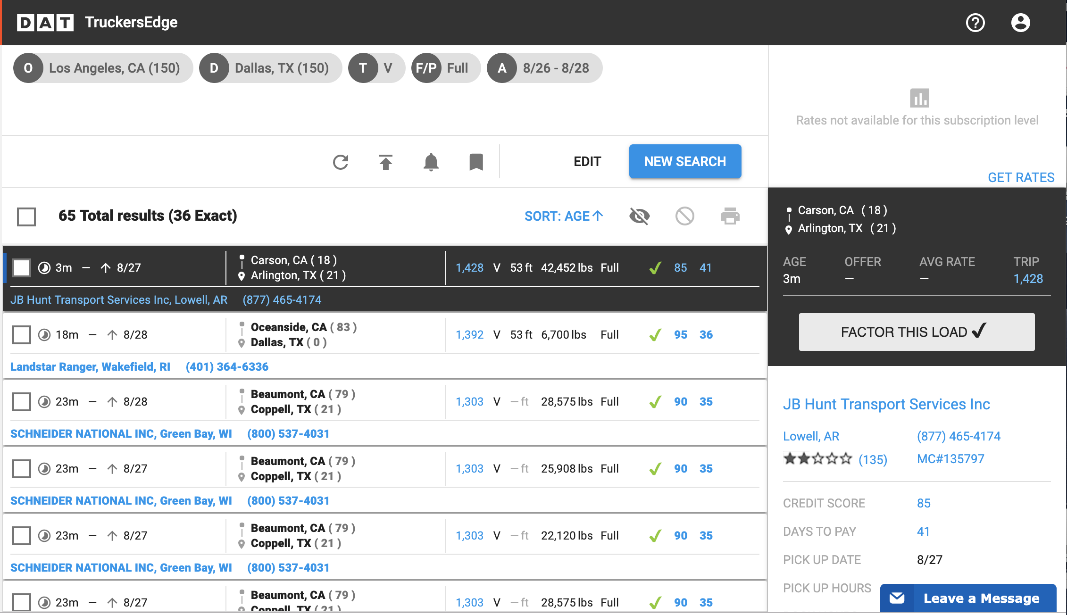

Slide 6
Scraped load data for one lane LA to Dallas from dat.com
with Selenium
Could not automate scrape because of time constraint

Slide 7
Linear regression model to predict target fill time
Features: posted time, distance, weight

Slide 8
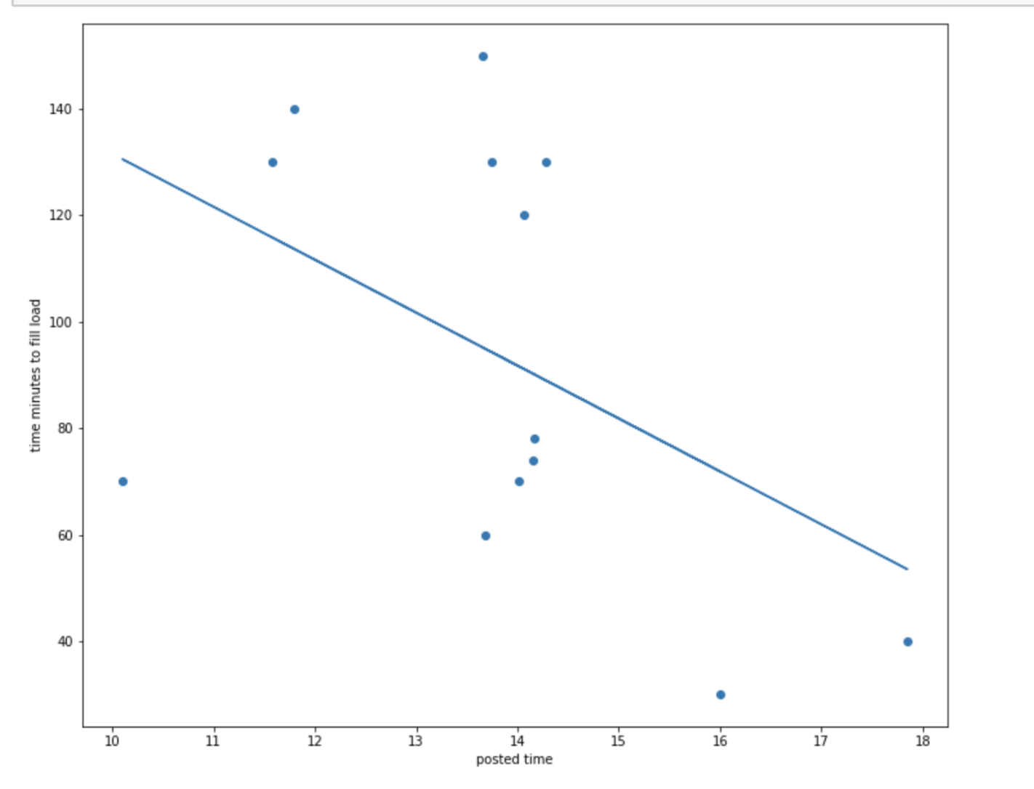

Slide 9
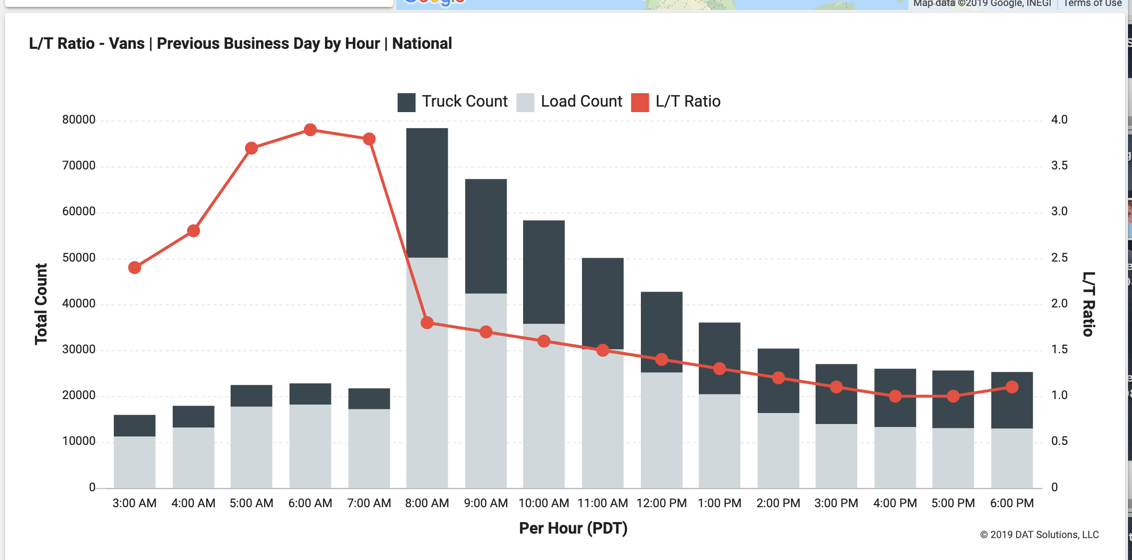

Slide 10
Conclusion:
dat.com load data is not adequate to predict fill time,
Require additional data such as truck and driver availability, traffic and weather conditions, previous loads

