Slide 1

Sales dashboard
Avanti Jawake

Slide 2

Contents
About Data & Preprocessing
Dashboard
Findings

Slide 3
About Data
Variables
Data is for 10 days (from Jan 01, 2023 to Jan 10, 2023)
Region : East, West, North, South
Product : 3
Sales_Amount
Cost
Profit
Customer_Id (Unique Key)
Customer_Segment : 2 (Retail and Wholesale)
Sales_Channel : 2 (Offline and Online)
Disount
Return

Slide 4
Data cleaning & Preprocessing
Data cleaning and aggregating in SQL
Checked for Null values (no null values)
Checked for Duplicate values (no duplicate values)
Aggregating sales by Day, Region, Product, Customer_Id, Customer_Sement, Sales_Channel

Slide 5
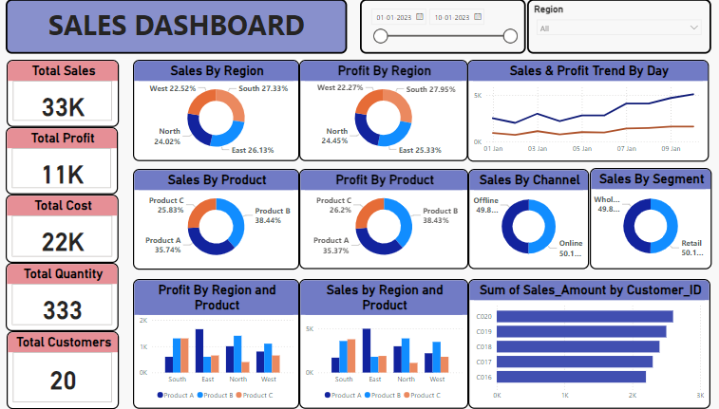
dashboard
Made with power bi

Slide 6
Findings & Recommendation
South contributes highest to the sales and Profits followed by East
Sale and Profit have stead continuous growth over the next 10 days
Product B contributes highest to the sales and growth
Retail and wholesale channel contributes equally to sales
For South : Product B and C are high in demand. Reasons for low performance of Product A should be reviewed
For East : Only Product A have the market. Study for lesser sale of B and C should be done
For North and West : Product B performs the best followed by A, different strategy to be worked out
Product C has lowest sale in East, North and West. Customer study, market and competition should be done for Product C, if required pricing strategy, product repositioning, special incentives to customers and sales team, like strategies should be implemented to increase the sales
Top 5 customers contributing to sales should be incentivized for more purchase or exclusive discount to retain their loyalty and increase repeat purchase and sales amout
Other KPI’s are also mentioned in the dashboard

Slide 7
Thank you Avanti Jawake Project 3

