Slide 1

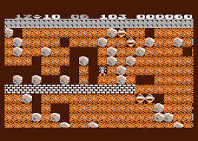
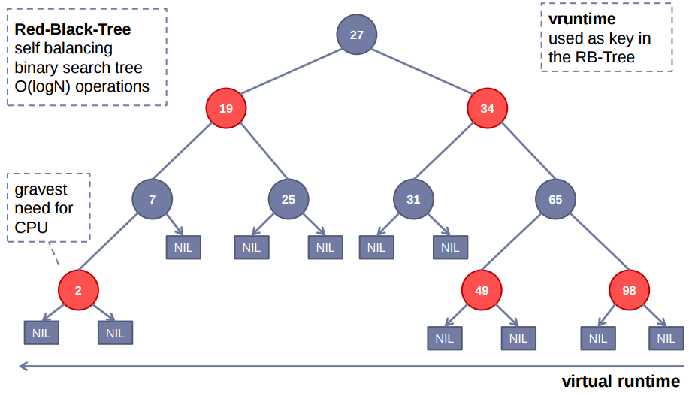
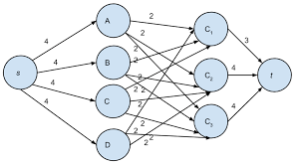
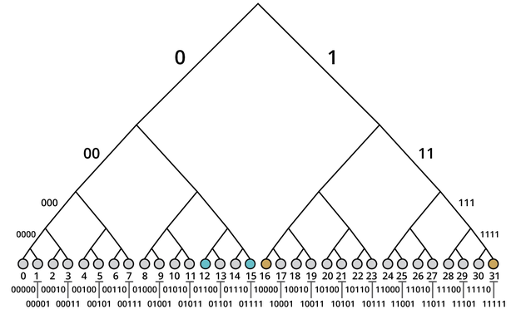
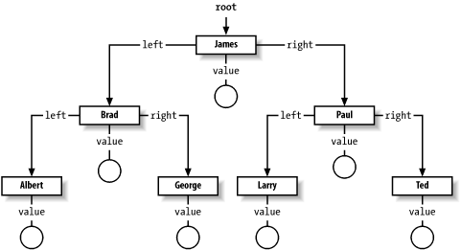
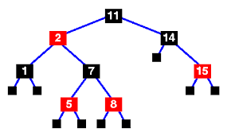
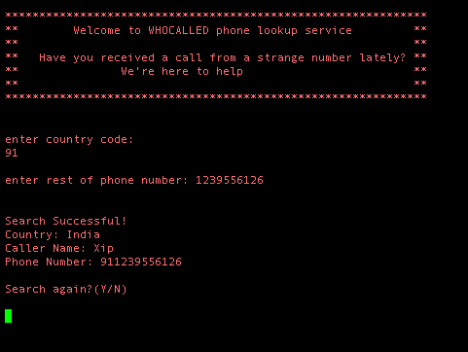
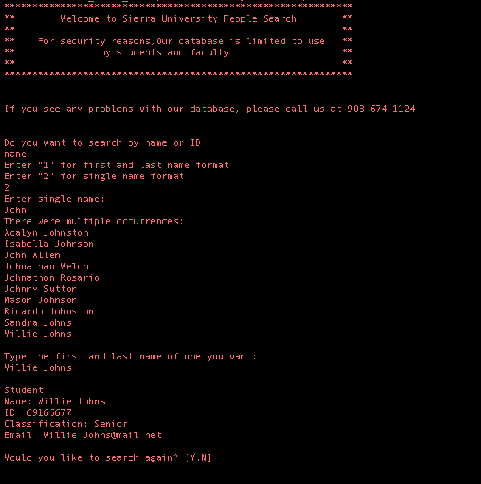
An Exploration of Red Black Trees and Their Applications
KD Adkins, Bethany Norton, Omar Batyah, Walter Hufstetler, Joanne Wardell
Faculty Mentor: Anurag Dasgupta, PhD
Abstract
Linux Completely Fair Scheduler
Discussion
A red black tree is a self balancing binary tree. Our research included the study of red black trees and their applications in real-world systems. One such system was a phone number lookup service that gave the user the ability to identify a caller from a phone number. We also used the data structure to model a school database. During this project, we explored the practical uses of red black trees, as well as their limitations in real-world systems. Our work with the red black trees allowed us to formulate opinions regarding additional applications in specific environments and systems. We also proposed ways for improving the implementation of the red black trees and object-oriented system that we utilized throughout the project.
Tasks that are in most need of the processor wait on the left side of the tree
Tasks that are in least need of the processor wait on the right side of the tree
Left most node chosen to run, then inserted back into the tree after time is up
Virtual runtime used as “key” to sort on
Places RB Trees could be used:
Projects
a. Graphics
b. Networking
II. Data Structures
a. Maps
b. Sets
III. Games
a. Caves
b. Terrain
c. Mazes
IV. Math Problems
a. Graph Theory
b. Combinatorics
Introduction
A red black tree is a self balancing binary tree. The nodes on a red black tree have an extra attribute which signifies their color. There are two colors which are used in Red Black trees. The color attribute per node is used as a tool for completing an approximate balancing of the tree. Some properties of RB trees are as follows:
Every node is either red or black.
The root is always black.
All terminal leaves are black.
The children of red nodes are black.
Any path from a given node to a leaf contains the same number of black nodes.
Theoretical Calculations: RB trees compared to BST or AVL
Input size: 2000 lines
Linear Data Structure: O(N) = 2000 comparisons
RB Tree: O(log_2(N)) ≈ 11 comparisons
Implementing Data Structures using RB Trees
Programming Languages use Red Black Trees to implement other data structures.
Java – Tree Maps, Tree Sets
balances the tree
eliminates duplicates
C++ – STL sets and maps
*balances sets and maps
*prevents duplicates and degeneration
Conclusions
RB Trees are used in real world systems to make searching and sorting easier, faster, and more efficient. Red Black trees are often times the most efficient tree-like data structure to use in the appropriate context. The Red Black Tree can also be used to implement other data structures in the most efficient way possible. Although RB Trees are generally very efficient in terms of time complexity, they are sometimes less efficient than other data structures because of memory over head. We’ve found that Red Black Trees work well along side Hash-like and Map data structures. We hope to see more Red Black Tree projects in the future. We hope to design and study more RB Tree systems and share our results.
Our Group’s Applications
School Database
Used Red-Black Trees to organize students and faculty in a school database
The student or faculty’s ID number was used as a key and a Person object was used as the value
Phone Lookup Service
Designed a system that returned country (and possibly identity) of caller
Phone number was key and the value was an array list of information
Useful as a real-world implementation because it allowed phone numbers from certain countries to be grouped together
Contact
References
Joanne Wardell, KD Adkins, Austin Hufstetler, Omar Batyah, Beth Norton
Valdosta State University, Computer Science Department
1500 North Patterson Street
{jawardell, dsadkins, wahufstetler, obatyah, banorton} @valdosta.edu
229-245-2496
Luo, L., Ng, M., Lee, A. and Ang, W. (n.d.). Data Structures and Algorithms: Red-Black Trees. [online] Cs.auckland.ac.nz. Available at: https://www.cs.auckland.ac.nz/software/AlgAnim/red_black.html [Accessed 31 Mar. 2018].
Patil, Pooja & Dhotre, Sunita & Shankar, Rucha. (2016). A Survey on Fairness and Performance Analysis of Completely Fair Scheduler in Linux Kernel. International Journal of Control Theory and Applications. 9. 495-501.
Jones, M. (2009). Inside the Linux 2.6 Completely Fair Scheduler. [online] Ibm.com. Available at: https://www.ibm.com/developerworks/linux/library/l-completely-fair-scheduler/ [Accessed 20 Mar. 2018].
cpphamza (n.d.). An Introduction to Binary Search and Red-Black Trees – topcoder. [online] Topcoder.com. Available at: https://www.topcoder.com/community/data-science/data-science-tutorials/an-introduction-to-binary-search-and-red-black-trees/ [Accessed 25 Mar. 2018].

