Slide 1

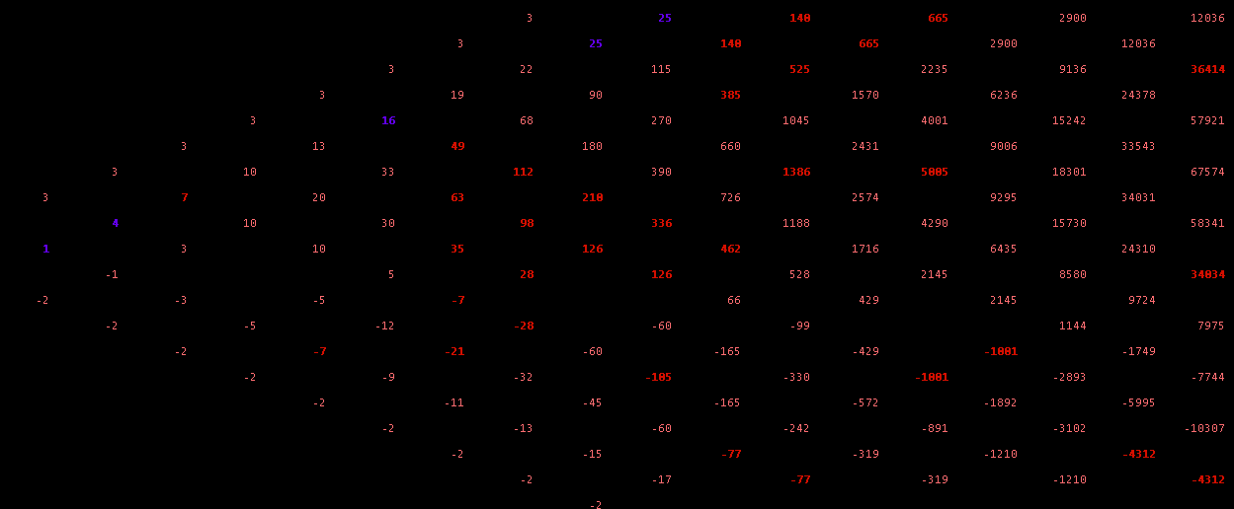
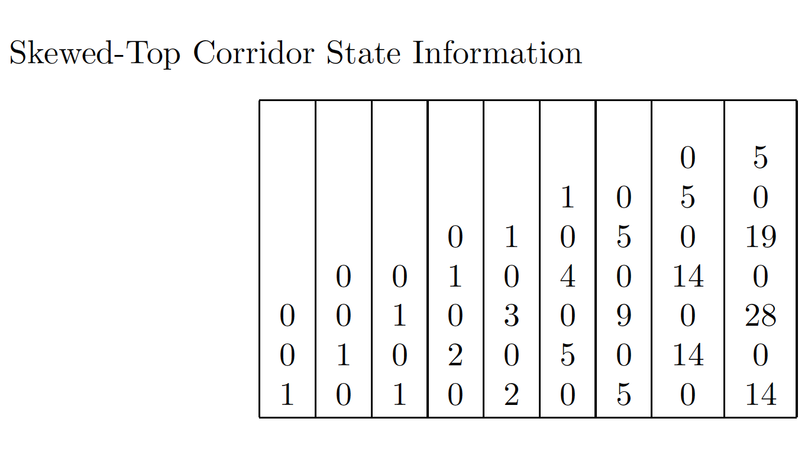
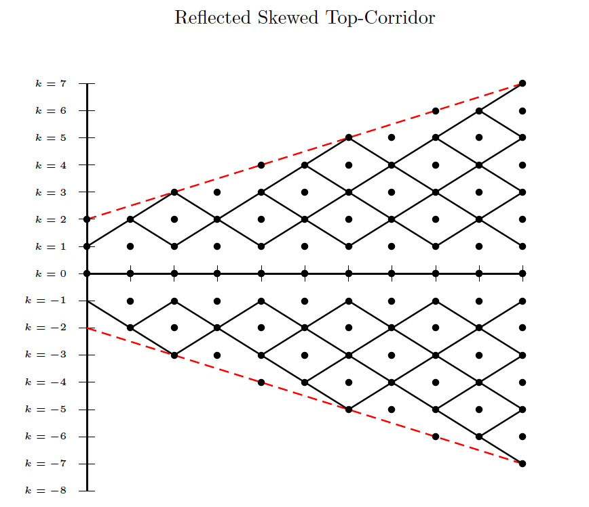
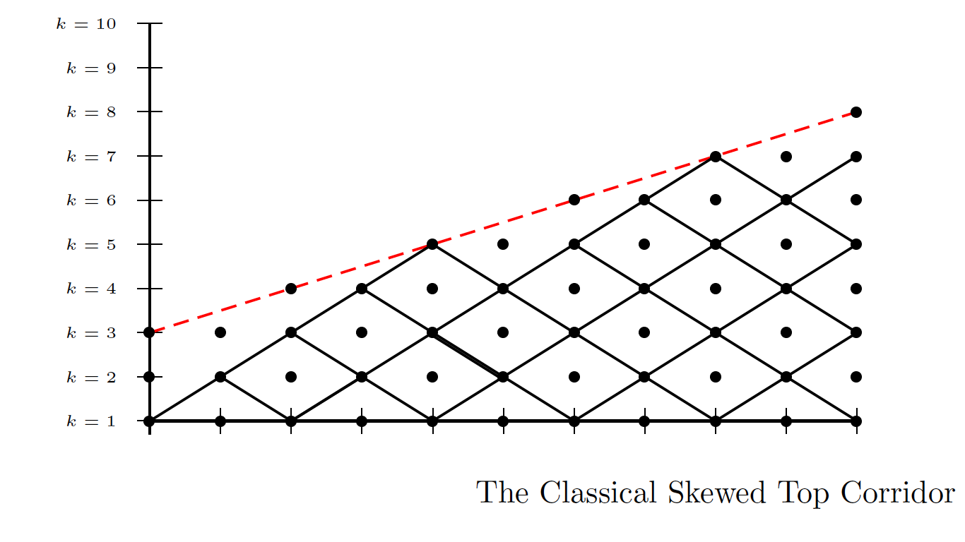
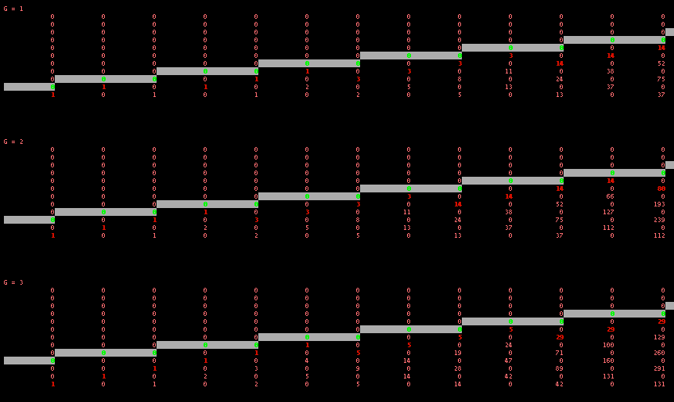
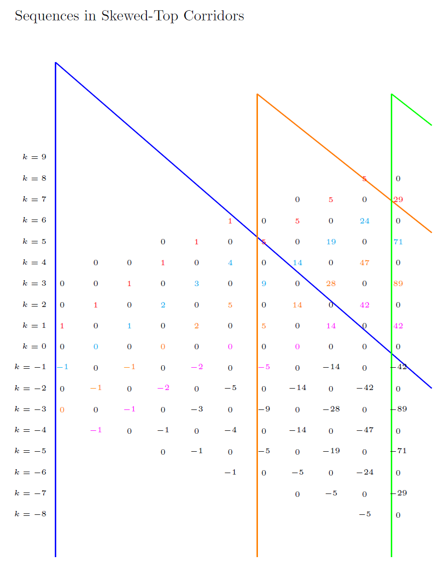
Toward an Understanding of Skewed Top Corridors
Joanne Wardell, Computer Science Department | Shaun Ault, Mathematics Department
Abstract and Research Questions
A lattice is the set of all points Z², where Z is the set of integers. The lattice paths that we study are the set of movements on a lattice with restrictions of up-right and down-right moves. The paths that we are studying reside within an upper and lower boundary. We call this structure a corridor.
In a classic corridor, the top and bottom boundary lines have a slope of zero. In a different model, we allow the upper boundary line to vary with a non-zero slope. We call this model the skewed-top corridor. Currently, a closed-form formula for skewed-top corridor numbers remains unknown.
How does the data set differ in skewed-top corridors based on different combinations of parameters?
What observations are there to be made about the varying data within this skewed-top model?
What mathematical relationships exist within skewed-top corridors?
Corridor Recursive Formula
Let V be a function accepting input from the set of points Z². Its output is an integer and lies within the set of natural numbers.
Let x and y be values that lie within the corridor.
A recursive formula for generating values in the corridor is:
V(x, y) = V(x-1, y-1) + V(x-1, y+1)
A diagonal in the corridor begins at some value on the lattice and moves up-right at some slope through the corridor. This formula states that the first non-zero diagonal at position (k+1, k) is k.
2 ≤ k ≤ 2g, V(k+1, k) = k
Corridor Diagonal Sequences
Follow the diagonal sequences of numbers in a one of the corridors. One will notice various intriguing patterns that appear on the diagonal. Some patterns are obvious to spot and others are slightly more difficult to notice.
The first diagonal in the corridor can be expressed as start and end points:
Start: (0, 1) End: (2g, 2g-1)
Other diagonals from the initial can be computed in the following way, where D is the diagonal number in the corridor:
Start:(2g-D, 2g+D) End:(2g-D+4, 2g+D+4)
Methodology
We wrote programs in Java and Python to generate and analyze the skewed-top corridor dataset. The following is pseudocode describing the program used to calculate the corridor numbers.
procedure create_grid
create work space with row+1 * col+1 entries
make all values zero
place start value
####create sentinel line####
for every column in corridor
for every row in corridor
if col modulo slope_run is 0
draw line
increase vertical position
increase horizontal position
end if
else
draw line
increase horizontal position
end else
####generate values####
for every column in corridor
for every row in corridor
corridor[row][col] = corridor[row-1][col-1] + corridor[row-1][col+1]
end for
end for
Discussions and Conclusions
We’ve concluded that there are sequences of degree n within the corridor and contribute to each other to create new sequences of degree n+1, n+2, ... Just as integration of a polynomial increases its degree by 1, the segments of diagonal sequences increase in degree going down the corridor. Each segment is the cumulative sum of the segment directly above it.
This behavior has been noticed in the corridors’ diagonals. If one chooses a diagonal with starting point at (0, 2k + 1), the sequence will degrade into a linear sequence by the time the diagonal reaches the upper boundary line.
In addition, comparing the linear sequences that appear near the surface of the sentinel lines of corridors as the gap size increases reveal another relationship. With a fixed slope of one-half, 4-element linear sequences appear near the sentinel lines. As the gap size increases in these fixed corridors, the values of these 4-element sequences are part of degree n sequences as well.
We hope to carry the results that we’ve found by fixing three of the four corridor parameters into corridors with several varying parameters.
The integer sequences that we’ve noticed are compelling and are not listed in the OEIS. We will further investigate the skewed-top corridor sequences and the information that they might encode.
Observations
The diagonals consist of segments of n^{th} degree subsequences, and the degrees of these segments increase predictably as one moves down the corridor.
When generating the corridors, we fix 3 out of 4 of our initial conditions. With these parameters set, the numbers that we calculate are called a classic-case skewed top corridor. Below are some of the corridor structures generated with various fixed parameters.
Sources
1. Shaun Ault and Charles Kicey Counting Lattice Paths Using Fourier Methods
2. Kenneth H. Rosen Discrete Mathematics and Its Applications
3. Richard A. Brualdi Introductory Combinatorics
4. The On-Line Encyclopedia of Integer Sequences
Classic-Case Skewed Top Corridors 1 - 3

