Slide 1
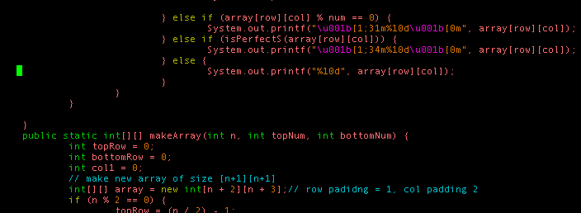
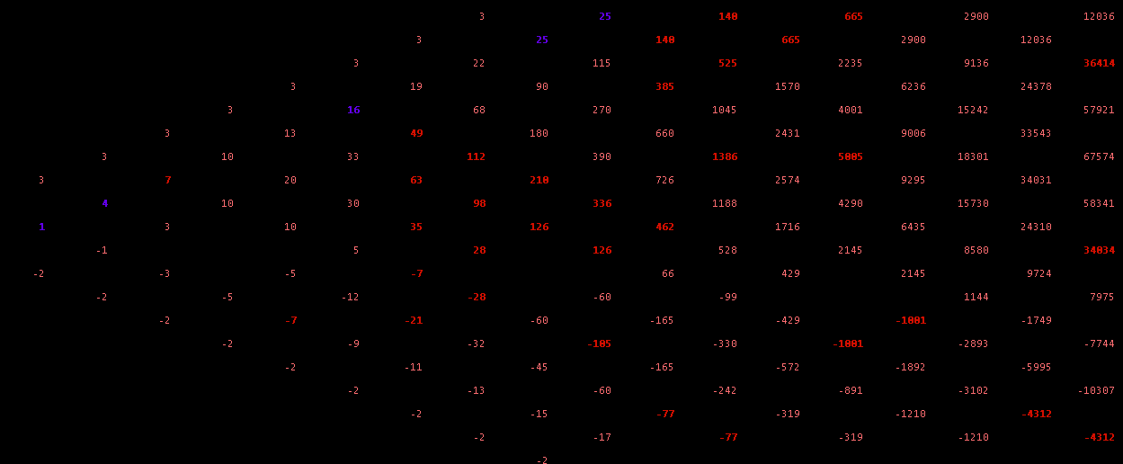
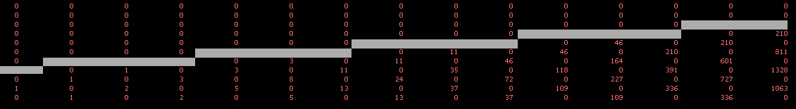
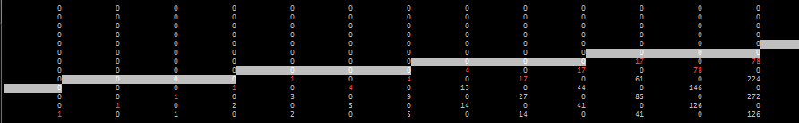
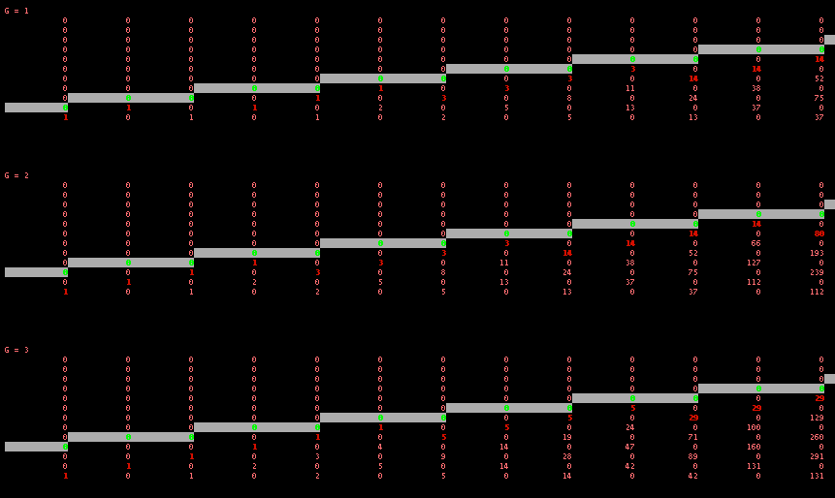
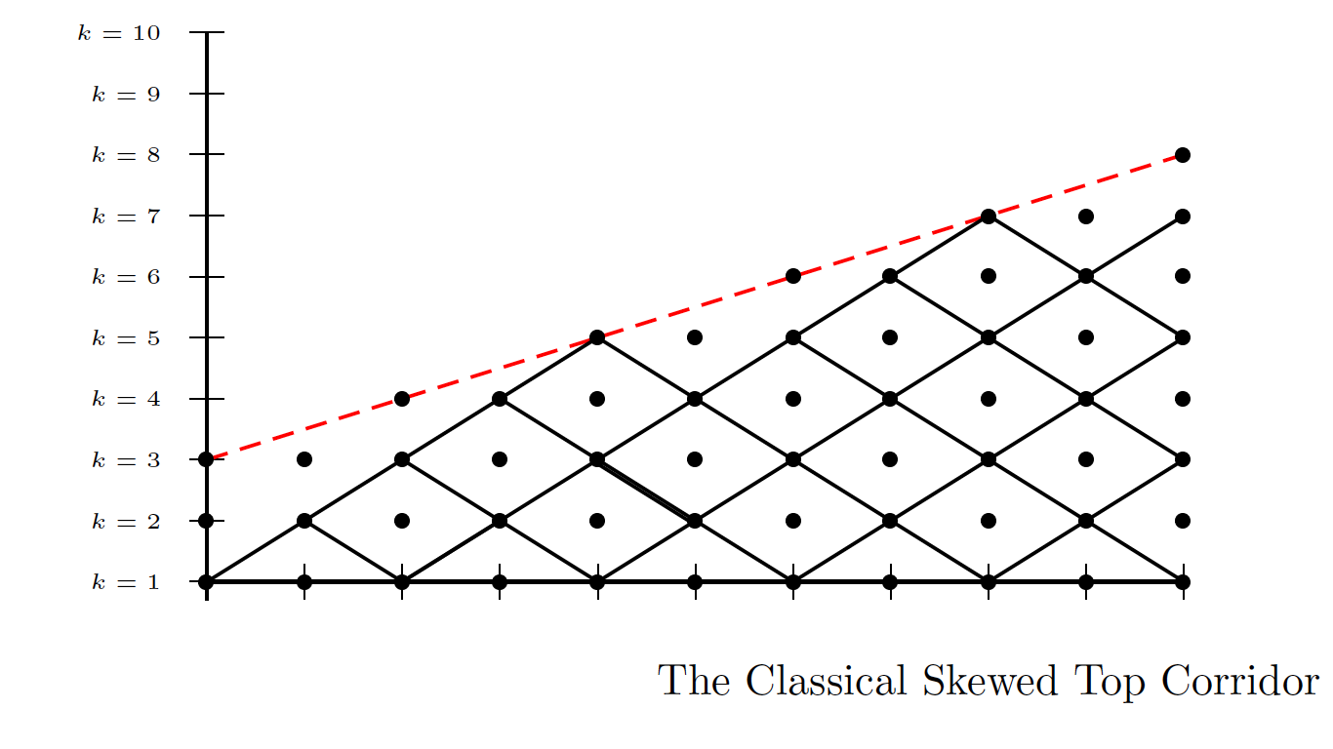
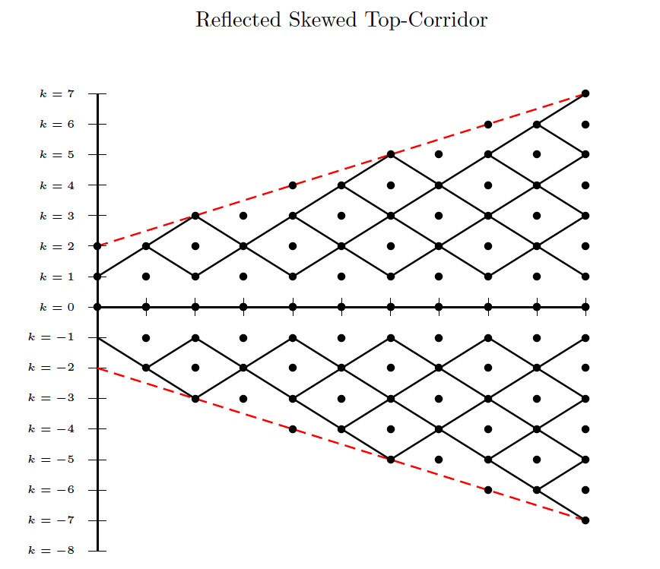
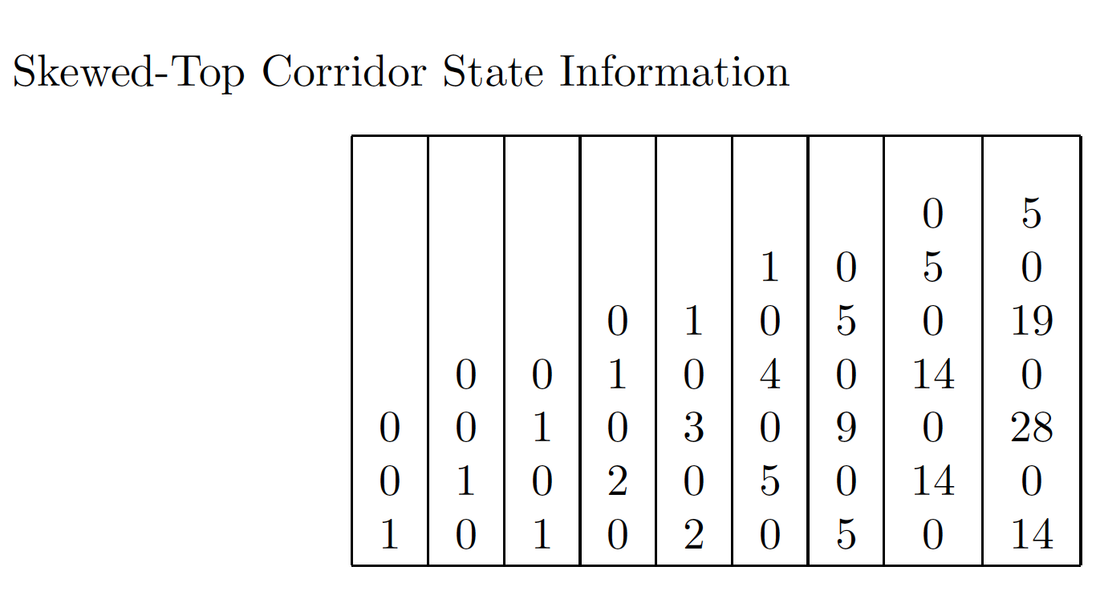
Toward an Understanding of Skewed Top Corridors
Joanne Wardell, Computer Science Department | Shaun Ault, Mathematics Department
Abstract and Research Questions
A lattice is the set of all points Z². The lattice paths that we study are the set of movements on a lattice with restrictions of up-right and down-right moves. The paths that we are studying reside within an upper and lower boundary. We call this structure a corridor.
In a classic corridor, the top and bottom boundary lines have a slope of zero. In a different model, we allow the upper boundary line to vary with a non-zero slope. We call this model the skewed-top corridor.
How does the data set differ in skewed-top corridors based on the variation of parameters?
What observations are there to be made about the varying data within this skewed-top model?
What mathematical relationships exist within the skewed-top corridors?
Corridor Generating Formula
Let V be a function accepting input from the set of natural numbers. It’s output lies within the set of points Z².
Let x and y be values that lie within the corridor.
A recursive formula for generating values in the corridor is:
V(x, y) = V(x-1, y-1) + V(x-1, y+1)
We’ve also noticed a relationship about the values in the corridors in certain restrictions:
2 ≤ k ≤ 2g, V(k+1, k) = k
Corridor Diagonal Sequences
Follow the diagonal sequences of numbers in a one of the corridors. One will notice various intriguing patterns that appear on the diagonal. Some patterns are obvious to spot and others are slightly more difficult to notice.
Some relationships that we’ve noticed on the diagonals are
Methodology
We wrote programs in Java and Python to generate and analyze the skewed-top corridor dataset. The following is pseudocode explaining the basic operations of our programs.
procedure create_grid
create work space with row+1 * col+1 entries
make all values zero
place start value
####create sentinel line####
for every column in corridor
for every row in corridor
if col modulo slope_run is 0
draw line
increase vertical position
increase horizontal position
end if
else
draw line
increase horizontal position
end else
####generate values####
for every column in corridor
for every row in corridor
corridor[row][col] = corridor[row-1][col-1] + corridor[row-1][col+1]
end for
end for
procedure calculate_diagonal_elements
Observations
Arithmetic sequences of n^{th} degree lie within the corridors and contribute to each other in various ways.
When generating the corridors, we fix 3 out of 4 of our initial conditions. With these conditions set, we call this a classical skewed top corridor. Below are some of the corridor structures generated with various fixed parameters.
Non-Classical Skewed-Top Corridors
Discussions and Conclusions
We’ve concluded that …
We hope to carry the results that we’ve found by fixing three of the four corridor parameters into corridors with several varying parameters.
The integer sequences that we’ve noticed are compelling and are not listed in the OEIS. We will further investigate the skewed-top corridor sequences and the information that they encode.
Classical Skewed Top Corridors 1 - 3

