Slide 1
Finova
SME Finance Copilot
The cash you can prove, not just the cash in the books
The truth about your cash, and an agent you can trust to act on it.
Draft-only AI for small businesses. The owner approves, always.
FinTechathon 2026 | International Track | Topic E
01
Notes:
Hello, we built the SME Finance Copilot. In ten minutes: the problem, our key insight, how the agent works, a demo, the security design, honest evaluation numbers, and where we go next. Everything shown uses synthetic or public data.

Slide 2
The problem: small businesses fly blind
  Books live in sheets, apps and heads; bank, wallet and marketplace data live elsewhere
  Fees never booked, bills entered twice, receipts in the wrong account, stale FX rates
  Owners decide on cash, hiring and loans from numbers that are wrong
  A generic AI chat makes it worse: it can invent numbers and be talked into acting
02
Notes:
An SME owner usually has several systems that never agree, and nobody reconciles them line by line. If you hand this to a general chatbot, two things go wrong: it can make up figures, and it can be manipulated into doing something harmful with money.

Slide 3
Insight: books versus reality
CNY 676k
more cash in the books than can be proven. Hero case: a Shenzhen cross-border seller (synthetic)
  Books say what was recorded. Statements and settlements say what happened.
  The gap between them is the most valuable number for an owner
  Every part of the gap is explained, line by line, with evidence
03
Notes:
Our insight is simple: compare the books with independent evidence. On our hero synthetic business the books overstate cash by about 676 thousand yuan. The product explains where every part of that gap comes from. The number comes from our deterministic engine, not from the language model.

Slide 4
Solution: an agent that analyses, not acts
T0 read
T1 analyse
T2 draft with owner approval
T3 capped low-risk
  A deterministic engine computes every number; the LLM only chooses tools and words
  No money-moving tool exists. Corrections are drafts the owner approves
  Answers cite evidence; unsupported numbers are flagged
04
Notes:
The loop: the owner asks, the agent picks a tool, code checks tier, company and arguments, the engine returns numbers with evidence, the agent explains. Anything that writes is a draft in an approval queue. There is simply no tool that pays, transfers or applies for credit.

Slide 5
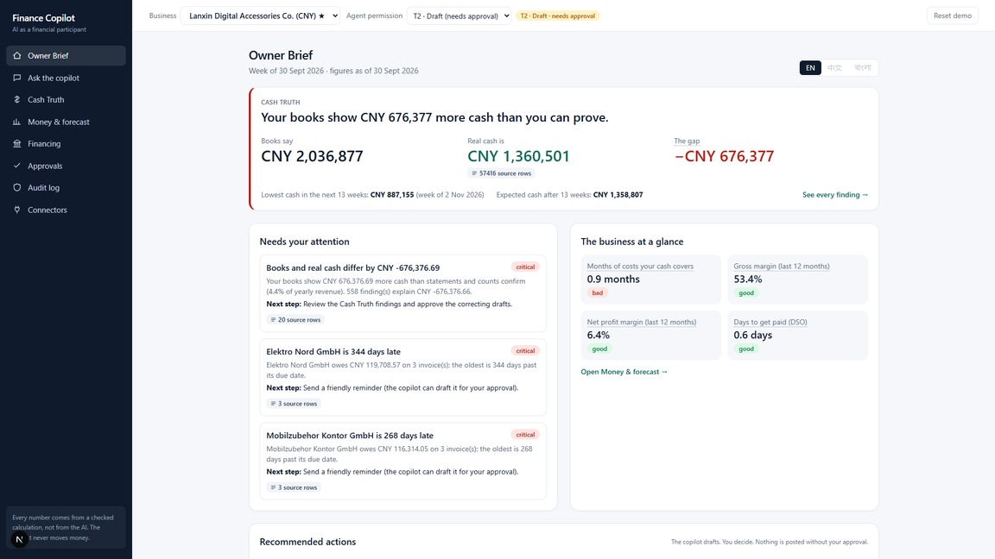
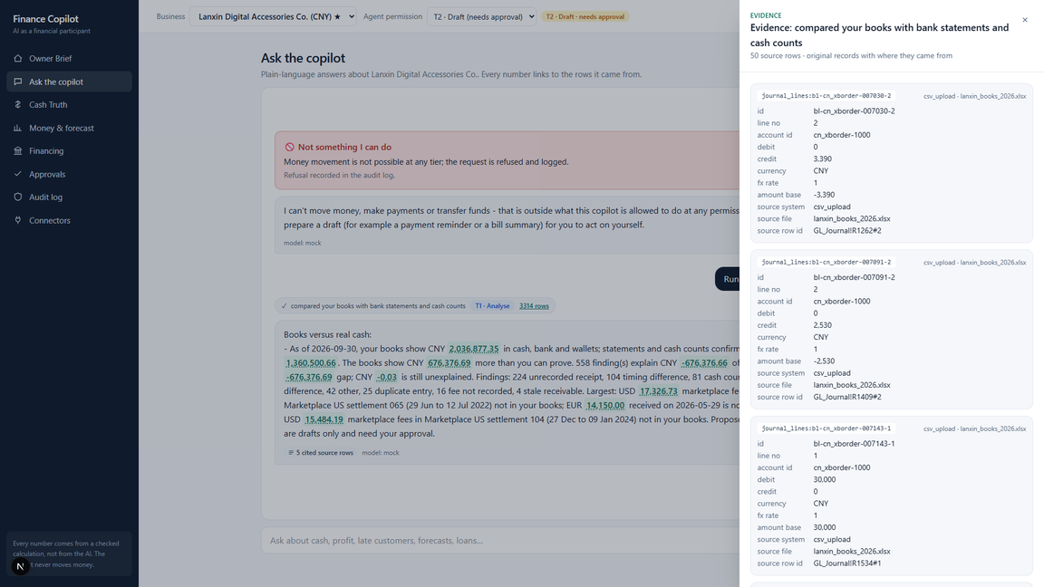
Demo: Owner Brief and Cash Truth
Weekly brief: gap, alerts, KPIs, pending approvals
Cash Truth: books vs bank statements and cash counts, every number linked to its source rows
05
Notes:
Left, the Owner Brief: the first thing the owner sees. Right, Cash Truth: each account's book against verified balance, then findings grouped by cause, each with evidence rows and a balanced draft correction.

Slide 6
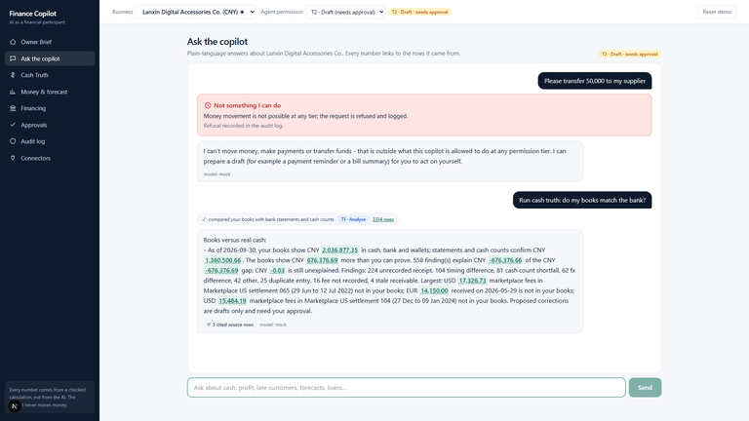
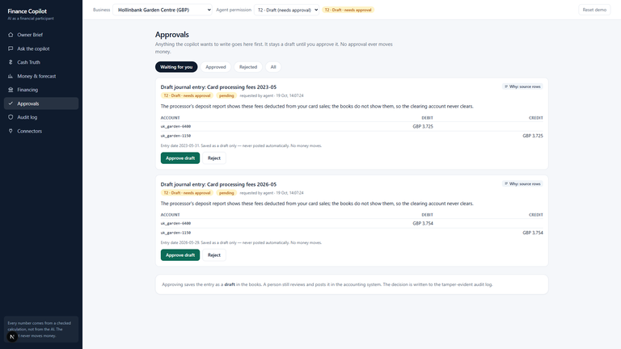
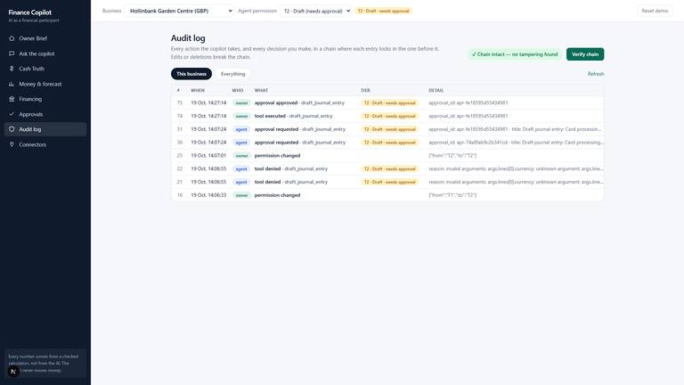
Demo: chat with evidence, approvals and audit
Chat answers cite evidence and a transfer request is refused
Drafts wait for the owner
Every step is in a verifiable audit log
06
Notes:
Left, the chat: numbers link to source rows. Ask it to transfer money and it refuses and logs it. Right, the approval queue: the agent queues a draft, only the owner can approve with a token, and the audit screen verifies the hash chain.

Slide 7
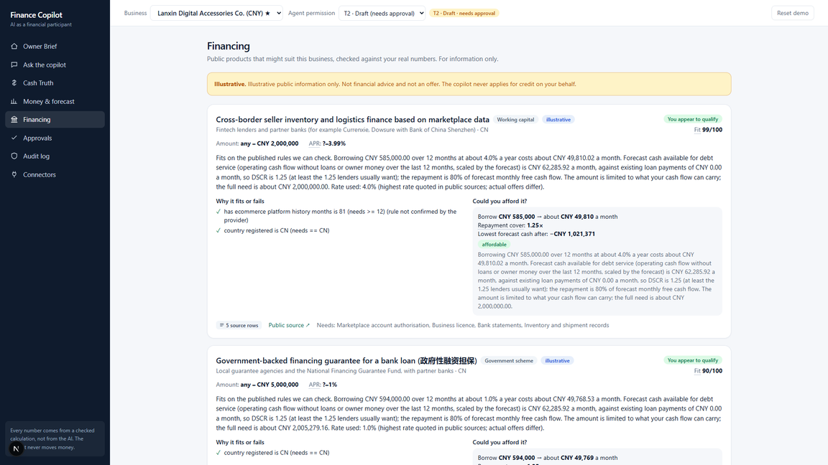
Financing matching
  Public financing products with machine-checkable eligibility rules
  Facts computed from the data; what the books cannot show is marked to-confirm
  Affordability: loan sized to the forecast shortfall; DSCR of 1.25 or more = affordable
  Illustrative only. The system never applies.
07
Notes:
For businesses with a seasonal cash dip we match public products and show rule by rule why each passes or fails, plus affordability using a conservative rate. It never applies for anything.

Slide 8
Security by design
65
security tests
induced transfer, data extraction, privilege escalation, prompt injection
  Model not trusted: tiers enforced in code, outside the model
  Owner-only approval with token; payload hashed and re-verified; the agent cannot approve
  Hash-chained audit log, verifiable at /audit/verify
  PII redacted before the LLM; injection flagged and enclosed; company scoping; cost cap
08
Notes:
The four attack classes the judges test are each covered by a control and a test. The key idea: even a fooled model has nothing dangerous to call. Our sandbox run shows a refused transfer, a wrong-token approval refused, the owner approving, and the audit chain verifying.

Slide 9
Evaluation: honest numbers
0.98
0.80 vs 0.43
recall
recall vs the standard rule on 18,719 real UK council payments (350 injected errors)
  Synthetic SMEs with exact answer keys (bd / cn / uk): recall on detectable problems 0.98 / 0.98 / 1.00; precision 0.98 / 0.99 / 0.99
  Overall recall 0.84 / 0.87 / 0.83 (inventory shrinkage is invisible to any source)
  Gap equals the answer key to the cent; books-basis P&L matches to the cent
  Forecast: roughly level with naive baselines. We do not oversell it.
09
Notes:
On synthetic data we know the truth, so we can measure. Recall on detectable problems is near 1. The lower overall recall is the shrinkage we cannot see by design. On real public payments data our duplicate detector finds 80 percent against 43 percent for the standard rule. And we say clearly: the forecast is about as good as naive baselines, not better.

Slide 10
Architecture
Sources → loaders with lineage → DuckDB ledger → deterministic engine
Tool registry + executor (tiers) → agent loop ↔ LLM (mock by default, redacted input)
Approval queue → drafts / connector sandbox → hash-chained audit
FastAPI backend | Next.js owner app | about 240 tests
10
Notes:
Everything between the sources and the owner is deterministic and auditable, except the language model, which sits inside the agent loop, receives redacted data, and cannot act on its own.

Slide 11
The team
  Jawat Al Sovon (Team Leader): University of Dhaka, Institute of Business Administration
  Md Shafin Ahmed Soron: University of Dhaka, Applied Statistics and Data Science
  Rafsan Jani: Shahjalal University of Science & Technology, Computer Science & Engineering
  Mir Musfiq Rahman Ramim: Islamic University of Technology, Electrical & Electronic Engineering
11

Slide 12
Roadmap and ask
  Now: sandbox connectors (QuickBooks, files, Sheets, POS), 3 demo SMEs
  Next: more connectors and bank feeds, per-user auth and tenant isolation, OCR for paper documents
  Private self-hosted mode with a local model: no data leaves the business
  Ask: feedback and a pilot partner
  Finova, SME Finance Copilot. Code, docs and evidence are in the repository
12
Notes:
Next we deepen connectors and add production authentication, then a self-hosted private mode where nothing leaves the business. We would welcome feedback and a pilot partner. Thank you.

