Slide 1

Benchmarking Keyword Spotting Architectures
across TensorFlow Lite and ONNX Runtime on a Raspberry Pi 5
Fatih Jawwad Al Mumtaz · Amirul Al Aziz
Faculty of Science and Technology, Universitas Darussalam Gontor, Indonesia
1 / 14

Slide 2

Outline
1 Background & motivation — why runtime choice matters for always-on voice
2 Models & method — four architectures, one frontend, rigorous protocol
3 Results — accuracy, latency, threads, energy, and the trade-off
4 Conclusion — what to pick, and why habit is not evidence
2 / 14

Slide 3
Why benchmark KWS on the Pi 5?
• Keyword spotting listens all day for a word or two — on a small board that means sub-millisecond latency and milliwatt power, with no internet to fall back on.
Everyone assumes TensorFlow Lite is fastest on Arm. That assumption is rarely tested head-to-head on 64-bit Arm, across CNNs, dense nets, and RNNs.
• On-device voice also matters for care settings: no cloud means usable in low-connectivity clinics and no health-speech privacy risk (SDG 3).
Question: does the default runtime deserve its default status?
3 / 14

Slide 4
What we test
Four models, three configs, one board: DS-CNN (22.6k) · DNN (88.4k) · LSTM (20.0k) · CRNN (56.8k) × TFLite fp32 / TFLite int8 / ONNX fp32, all on a Raspberry Pi 5.
Same everything else: identical 49×10 MFCC frontend, same 12-way head, same clips, same protocol.
Three contributions: (1) full training + export pipeline incl. fp32 reconstruction; (2) accuracy + latency on both tasks, plus thread sweep and PMIC energy; (3) proof the runtime gap does not generalize.
4 / 14

Slide 5
Four models, one frontend
Model | Params | Structure
DS-CNN (MLPerf ref.) | 22,604 | 10×4 conv (stride 2) + 4× depthwise/pointwise blocks + GAP + dense
DNN baseline | 88,396 | 490–128–128–64–12 dense, dropout 0.1 (lower-bound anchor)
LSTM | 19,980 | LSTM-64 unrolled over 49 steps + dense
CRNN | 56,844 | 2× 3×3 conv + 2× maxpool + GRU-64 + dense
• Same 49×10 MFCC in, same 12-way softmax out. DNN is deliberately the anchor — dense-only is not competitive at this budget, its low score is expected, not a bug.
5 / 14

Slide 6
The reference artifact was not fp32
Found: the official MLPerf kws_ref_model artifact is mixed-precision — int8 conv kernels, fp32 rest. Benchmarking it as “fp32” would poison the comparison.
Rebuilt: enumerated every tensor via the LiteRT API, dequantized kernels with ŵ = (q − z)·s, reassembled 9 fused conv–bias–ReLU blocks + GAP + dense in Keras.
Verified: max abs diff 7×10⁻³ on softmax, 100% argmax agreement over 1,000 frames — then exported clean fp32 TFLite + fp32 ONNX of identical structure.
All three artifacts (original, rebuilt TFLite, rebuilt ONNX) are benchmarked.
6 / 14

Slide 7
Full-int8 quantization, done properly
• New full-int8 DS-CNN via post-training quantization, calibrated on 1,000 training clips (seed 42) — 25% faster than the mixed-precision artifact at equal accuracy.
• Keras 3 emits dynamic tensor-list loops for RNNs that the TFLite converter cannot lower — exported with unroll=True, an identical-weight static graph both runtimes accept.
Cost is uneven: CNNs lose < 0.5 pt to int8; the LSTM loses 3.05 pts (subset) / 4.12 pts (full task) — recurrence wants quantization-aware training.
7 / 14

Slide 8
How we measured
Board: Pi 5 (BCM2712, 4× A76 @ 2.4 GHz), 8 GB RAM · Debian 64-bit · governor pinned to performance · LiteRT 2.1.6 vs ONNX Runtime 1.28.
Stats: 1,000 warmup + 1,000 timed passes, sequential, features precomputed · IQR outlier filter · 10k bootstrap 95% CIs.
Data: 4,074 clips (10 commands) + 12,005 clips (full 12-class) · thread sweep at 1/2/4 threads · PMIC energy (SoC only; DNN omitted, < 0.1 ms too fast to sample).
8 / 14

Slide 9
Accuracy holds up — except LSTM
Model | fp32 | int8 | Δ | fp32 | int8 | Δ
DS-CNN | 90.55% | 90.57% | +0.02 | 95.49% | 95.21% | −0.28
DNN | 79.63% | 79.65% | +0.02 | 72.65% | 71.90% | −0.75
LSTM | 90.48% | 87.43% | −3.05 | 88.84% | 84.72% | −4.12
CRNN | 92.56% | 92.17% | −0.39 | 92.08% | 91.60% | −0.48
• Left block: 10 commands (4,074 clips) · right block: full 12-class (12,005 clips). TFLite fp32 and ONNX fp32 agree on all clips (diff < 3×10⁻⁶) — runtimes are numerically interchangeable, speed is the whole story.
9 / 14

Slide 10
Latency flips by architecture
Model | TFLite fp32 | TFLite int8 | ONNX fp32 | ONNX / TFLite
DS-CNN | 0.211 ms | 0.127 ms | 0.170 ms | 0.81 — ONNX wins 19.2%
DNN | 0.016 ms | 0.007 ms | 0.029 ms | 1.81× — TFLite wins
LSTM | 0.372 ms | 0.157 ms | 0.778 ms | 2.09× — TFLite wins
CRNN | 0.259 ms | 0.102 ms | 0.361 ms | 1.40× — TFLite wins
int8 is 1.7–2.5× faster almost for free · ONNX wins only on depthwise convs.
10 / 14

Slide 11
Threads don’t flip it — and faster means cooler
Config | T=1 | T=2 | T=4
DS-CNN TFLite | 0.212 | 0.123 | 0.078
DS-CNN ONNX | 0.438 | 0.259 | 0.169
CRNN TFLite | 0.260 | 0.187 | 0.220
CRNN ONNX | 0.508 | 0.419 | 0.361
Model | PΔ (W) | t (ms) | E (mJ)
DS-CNN TFLite | 1.59 | 0.22 | 0.34
DS-CNN ONNX | 1.18 | 0.45 | 0.53
CRNN TFLite | 1.85 | 0.27 | 0.51
CRNN ONNX | 1.58 | 0.49 | 0.78
• Default ONNX quietly spawns 4 threads while TFLite runs 1 — pinned equally, TFLite still wins everywhere.
• Race-to-sleep wins: TFLite draws more power yet finishes ~2× faster, so energy drops ~35% (0.34 vs 0.53 mJ).
11 / 14

Slide 12
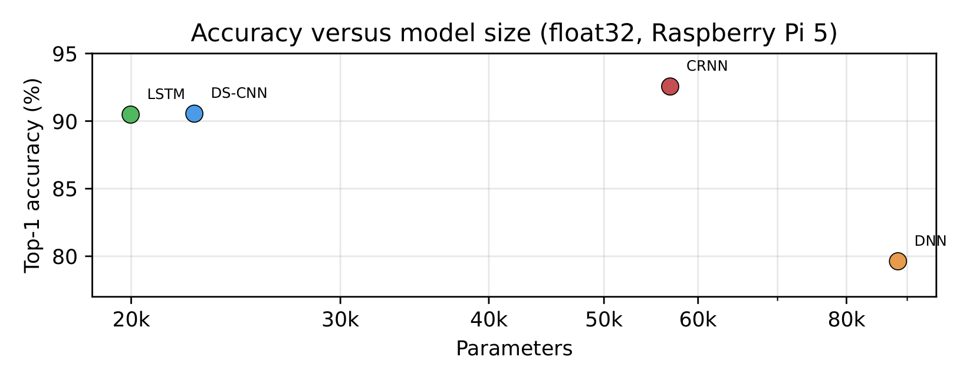
So which model do you ship?
Sweet spot: DS-CNN — 22.6k params, 95.5% full-task, 0.13 ms in int8.
Most accurate: CRNN — 92.6% subset at 56.8k params, 0.10 ms int8.
• LSTM is small but int8-unfriendly; DNN is just the anchor — big and weak.
Rule: pick the runtime by operator mix, not by habit.
12 / 14

Slide 13
Takeaways
Test both runtimes before you commit: ONNX wins only on DS-CNN depthwise convs; TFLite wins 1.4–2.1× on dense and recurrent.
Pin your threads: defaults lie — ONNX spawns 4, TFLite runs 1.
• Full int8 is nearly free for CNNs (1.7–2.5× faster, < 0.5 pt drop); LSTM needs QAT.
• Latency saves battery: finishing 2× faster cuts energy by about a third.
13 / 14

Slide 14
Thanks — questions welcome
Artifact, code, and data are open
github.com/jaweed3/kws-pi5-benchmark
DOI 10.5281/zenodo.23765521 · AGPLv3
Fatih Jawwad Al Mumtaz · fatihalmumtaz76@student.cs.unida.gontor.ac.id
Amirul Al Aziz · Faculty of Science and Technology, Universitas Darussalam Gontor
14 / 14

