Slide 1

AIBThings 2026 • Paper #465
Trust, But Verify
A Hybrid RAG System for Real-Time Detection and Correction of
LLM Hallucinations in Automotive Engineering
Jaweher Hichri & Dr. Sameh Mansour
Grand Valley State University, MI, USA

Slide 2

When LLMs Get Automotive Facts Wrong
Engineers increasingly use LLMs (GPT-4, Claude, LLaMA) to draft code, parse requirements, and check ADAS / standards compliance.
But LLMs hallucinate — they generate confident, fluent, and wrong output.
In a safety-critical domain, that isn't a nuisance — it's an ISO 26262 compliance risk.
“Vehicle.Motor.Velocity”
Invented VSS path — the real one is Vehicle.Speed
COVESA VSS 4.0
“ABS responds in 1 ms”
Real validated range is 50–150 ms
“ASIL Z”
Does not exist — only A, B, C, D are valid
ISO 26262:2018
The VSS example is reused in Sec. IV-A to construct our evaluation corpus; related VSS hallucinations in code generation are also reported by Pavel et al.
2

Slide 3

Two Gaps the Literature Hasn't Closed
Systematic review of 14 papers on LLM hallucination (2022–2026)
GAP A
GAP B
The Subdomain Gap
The Usability Gap
No unified benchmark evaluates LLM hallucinations across all four critical automotive subdomains at once:
No deployable, real-time tool actually detects, tests, AND fixes these errors.
• SelfCheckGPT: 1.5–4 s latency — too slow
• AST parsing: code only, not natural language
• Most tools flag errors but don't fix them
Mechanical
Electrical
Software / AD
Safety
3

Slide 4

What We Built
01
A structured literature review
exposing Gap A and Gap B across 14 recent papers
02
The Verifier
an end-to-end, real-time detect-and-correct pipeline — Chrome extension + Streamlit dashboard, built into the engineer's existing workflow
03
A cross-subdomain evaluation corpus
300 standards-traced cases across 4 subdomains — the first of its kind in automotive hallucination research
Not a new detection algorithm — a deployable mapping of a causal hallucination taxonomy onto a working, two-layer architecture.
4

Slide 5

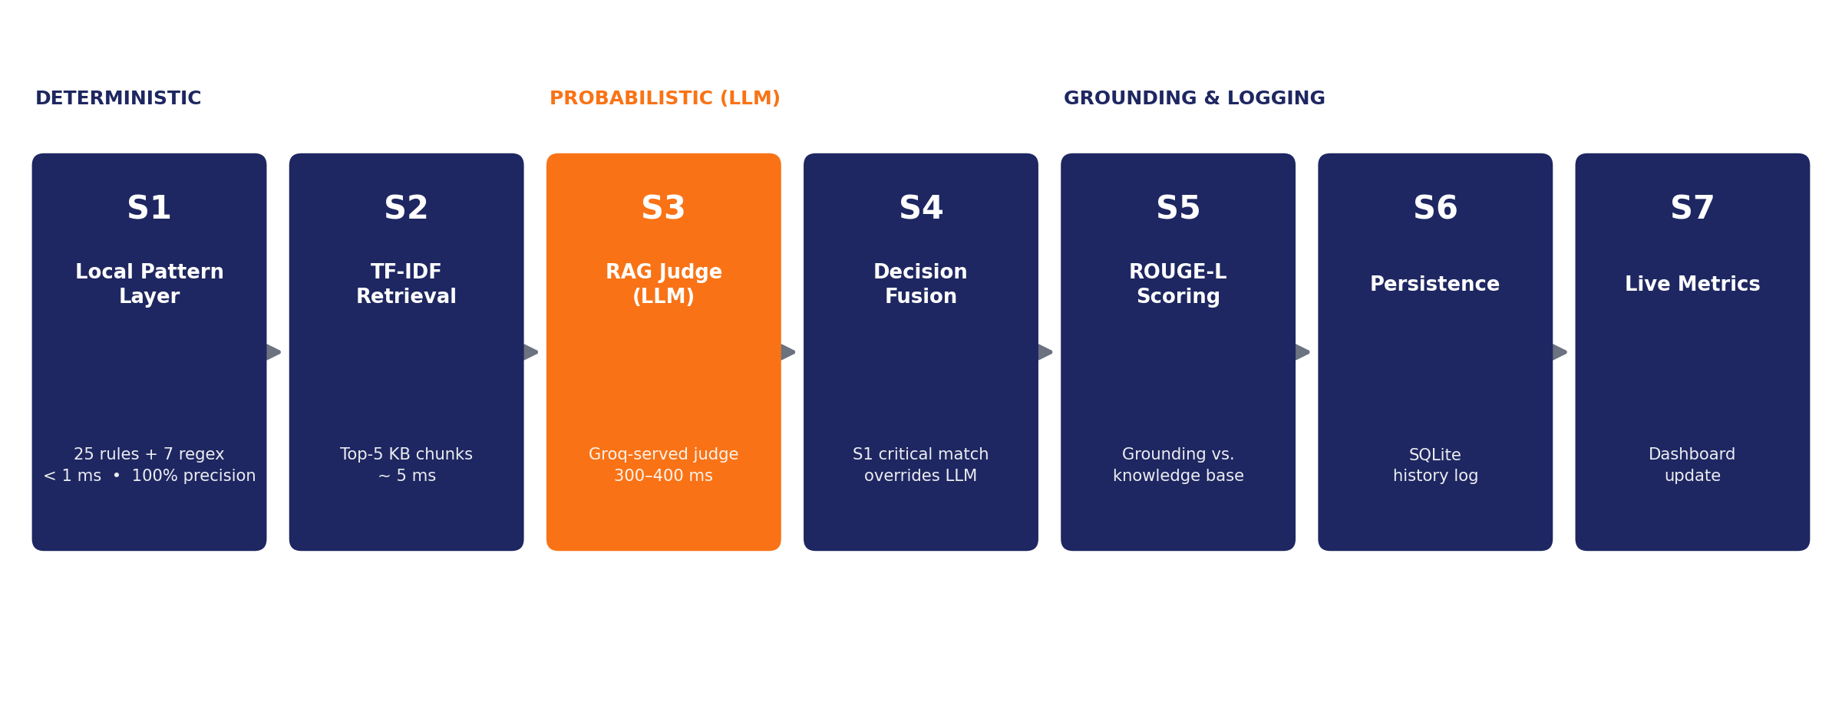
A Seven-Stage Hybrid Pipeline
Deterministic rules run first (S1–S2); the LLM judge (S3) only sees what survives them; a critical rule match always overrides the judge (S4).
5

Slide 6

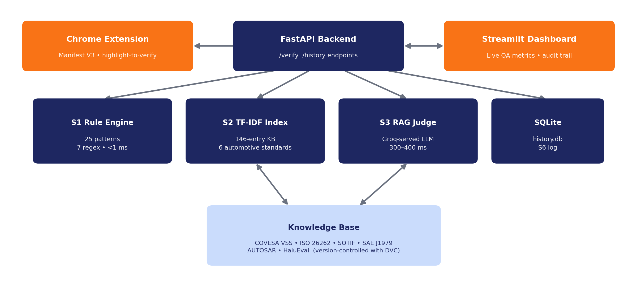
Grounded in Six Authoritative Sources
6

Slide 7

Ground Truth Fixed Before Any System Run
A common evaluation flaw: grading a system against its own risk score. Our corpus's labels are fixed by construction, before any system run — eliminating that circularity.
300
184 / 116
40%
test cases,
75 per subdomain
hallucinated vs.
correct control statements
calibrated alert
threshold
184 hallucinated = 140 clearly corrupted facts + 44 borderline / hedged-wording variants
Every label traces to one of six reference standards — auditable, not a single expert's unstructured judgment.
7

Slide 8

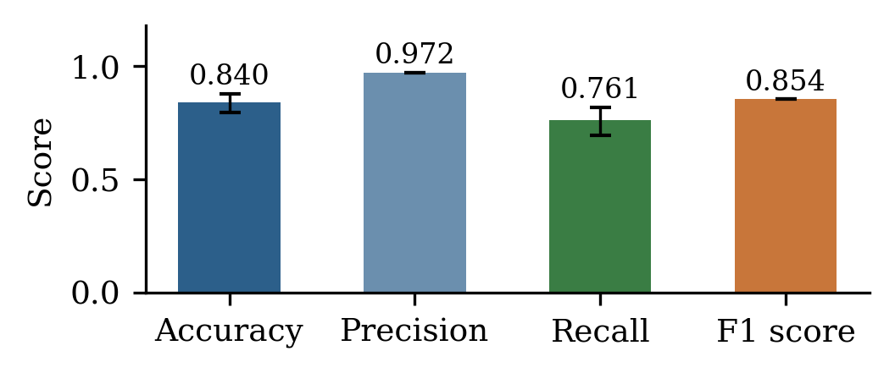
0.84 Accuracy, 0.76 Recall, Four False Alarms
140 / 184
hallucinations caught
4
false alarms, out of 116 correct statements
1.26 s
mean latency (deployed config.)
At the calibrated 40% alert threshold, n = 300, 95% Wilson confidence intervals.
8

Slide 9
Every Subdomain Covered — Layer by Layer
Per-subdomain accuracy (full system)
Ablation: does the hybrid design matter?
Mechanical
0.880
Electrical
0.787
Rules only (S1)
0.033 recall
Software / AD
0.813
perfect precision, zero false positives — but narrow
Safety
0.880
Full pipeline (S1 + S3)
0.761 recall
the LLM judge provides the large majority of detection coverage
9

Slide 10

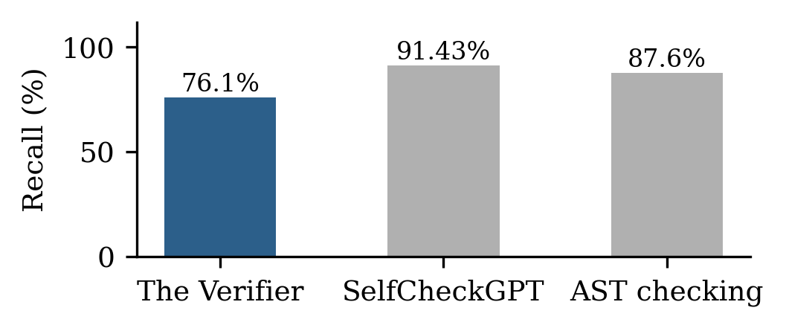
A Threshold Recalibration, Made Transparent
The judge's scoring rubric concentrates single-violation detections at 45%.
At the original 50% threshold: 0.060 recall (11 cases caught)
Recalibrated to 40%: 0.761 recall (140 cases caught)
Recall is lower than single-domain tools — but they don't cover four subdomains at once, and this is context, not a controlled re-run on the same data.
Reported as a transparent, fixable calibration effect — not hidden in the headline numbers.
10

Slide 11

What's Next
Limitations, stated plainly
Planned next
Corpus is constructed (fault-injected), not harvested from live LLM output
Labels from a single annotator — though each is auditable against a published standard
Knowledge base: 146 curated entries, a slice of the full standards
Dense retrieval (ChromaDB) to resist paraphrase evasion
A fine-tuned local LLaMA 8B — removing reliance on external cloud APIs
Pluggable private knowledge bases for OEM-specific guidelines
Extend the architecture to aerospace and medical devices
11

Slide 12

A Scalable Template for Trustworthy AI
Deterministic rules stop Data-Driven errors in under 1 ms, with zero false alarms
A retrieval-grounded LLM judge catches Reasoning-Driven errors and drafts standards-backed repairs
Operating entirely inside the engineer's existing workflow, in real time
0.840
0.972
0.761
0.854
Accuracy
Precision
Recall
F1
Thank you — Questions?
jaweherhichri07@gmail.com

