Slide 1




GVSU
GRAND VALLEY STATE UNIVERSITY
01
TITLE SLIDE
Trust, But Verify
Real-Time Detection & Correction of LLM Hallucinations in Automotive AI
M.S. Thesis Defense • Paper #465
Jaweher Hichri & Dr. Sameh Mansour
Grand Valley State University

Slide 2




GVSU
02
INTRODUCTION AND MOTIVATION
M.S. Thesis Defense • Paper #465
When AI Sounds Sure — But Isn't
Large language models are entering safety-critical engineering work. They can also be confidently wrong.
WRONG
WRONG
WRONG
Vehicle.Motor.Velocity
ABS Latency, Fabricated
ASIL Z
CORRECT
CORRECT
CORRECT
Vehicle.Speed
No such spec exists
Only A – D exist
35–60%
fewer hallucination errors with hybrid RAG systems like ours, compared to a language model alone
[Joshi, 2025]
02

Slide 3


GVSU
03
RESEARCH OBJECTIVES AND KEY CONTRIBUTIONS
M.S. Thesis Defense • Paper #465
Built on a Causal Taxonomy. Two Gaps Remain.
Ji et al., 2022
>
Huang et al., 2024
>
Data- / Reasoning-Driven
Intrinsic / Extrinsic
Factuality / Faithfulness
Causal — this work
Gap A
Gap B
The Subdomain Gap
The Usability Gap
03

Slide 4


GVSU
03
RESEARCH OBJECTIVES AND KEY CONTRIBUTIONS
M.S. Thesis Defense • Paper #465
Three Contributions
Literature Review
The Verifier
300-Case Corpus
14 papers
Extension + Dashboard
4 subdomains
04

Slide 5
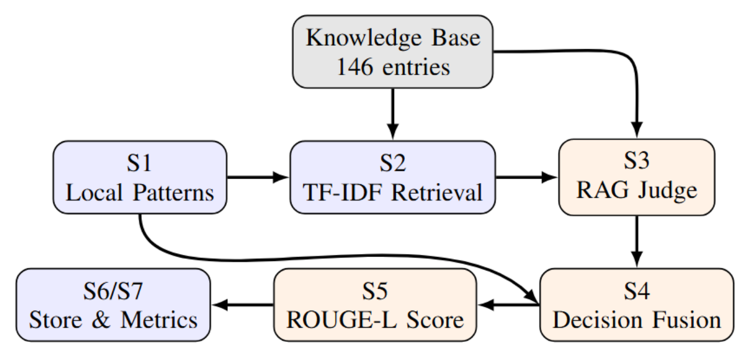
GVSU
04
MATERIALS AND METHODOLOGY
M.S. Thesis Defense • Paper #465
A Seven-Stage Hybrid Pipeline
S1
S2
S3
S4
< 1 ms
~ 5 ms
300–400 ms
Decision Fusion
100% precision — 25 rules + 7 regexes
TF-IDF retrieval, top-5 KB matches
LLM judge, model-agnostic (gpt-oss-120B via Groq)
A rule-layer match always overrides the judge
05

Slide 6
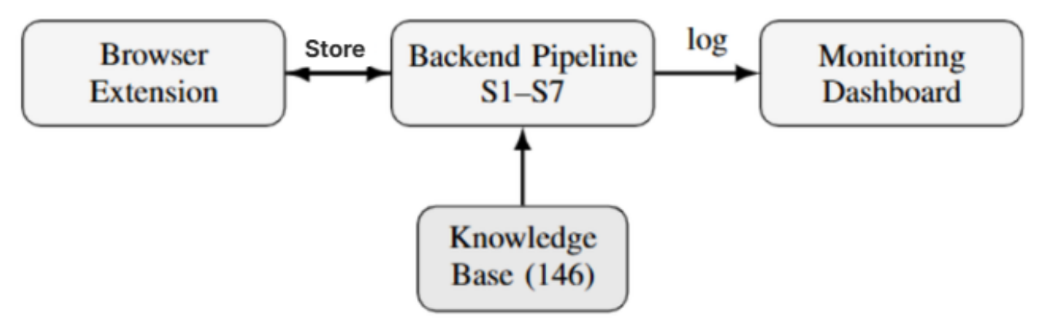
GVSU
04
MATERIALS AND METHODOLOGY
M.S. Thesis Defense • Paper #465
System Architecture
One FastAPI backend (Python 3.11, /verify and /history) sits between the Chrome extension and the Streamlit dashboard — the seven-stage pipeline it runs is grounded throughout by the 146-entry knowledge base, and every verdict is logged for the dashboard's live metrics.
06

Slide 7

GVSU
04
MATERIALS AND METHODOLOGY
M.S. Thesis Defense • Paper #465
Ground Truth, Fixed in Advance
300
75
total cases
per subdomain
184
116
Labels Fixed Before Any Run
hallucinated
correct controls
Independently auditable
07

Slide 8
GVSU
05
RESULTS AND DISCUSSION
M.S. Thesis Defense • Paper #465
Headline Results — All 300 Cases
0.840
0.972
0.761
0.854
Accuracy
Precision
Recall
F1 Score
140 / 184
4
1.26s
caught
false alarms
latency
08

Slide 9
GVSU
05
RESULTS AND DISCUSSION
M.S. Thesis Defense • Paper #465
Consistent Across Subdomains
Accuracy by Subdomain
Why the Hybrid Matters
Mechanical
0.880
Rules Only
0.033 recall
Safety
0.880
Software
0.840
Full Hybrid System
0.761 recall
Electrical
0.787
09

Slide 10


GVSU
05
RESULTS AND DISCUSSION
M.S. Thesis Defense • Paper #465
An Honest Calibration Finding
Limitations & Future Work
Threshold Recalibration
• Fault-injected, not live-harvested cases
50% → 11 caught
• Single-reviewer labels (standards-auditable)
40% → 140 caught
• 146-entry KB — a curated slice
Reported openly
Next: dense retrieval • local model • new domains
10

Slide 11
GVSU
05
RESULTS AND DISCUSSION
M.S. Thesis Defense • Paper #465
How The Verifier Compares
Both
categories
Verifiable
repair
< 2s
real-time
Automotive-
specific
SelfCheckGPT
✗
✗
✗
~
general check
detect only
1.5–4 s
ADAS only
AST Validation
✗
✓
–
✗
code only
code fixes
not reported
general code
Naïve RAG
–
–
–
✗
not reported
not reported
not reported
general purpose
The Verifier
✓
✓
✓
✓
Data + Reasoning
ROUGE-L scored
1.26 s mean
6 standards
SelfCheckGPT reports 91.43% recall, but on one subdomain (ADAS) at 1.5–4 s latency — a simpler, single-category task. Figures above are each measured on the original authors' own datasets, not a controlled re-run on our corpus; that re-run is planned future work.
11

Slide 12

GVSU
M.S. Thesis Defense • Paper #465
06
CONCLUSION AND FUTURE DIRECTIONS
Real-Time Trust,
Verified.
Rules for speed. A grounded LLM for judgment.
0.840
Accuracy
0.972
Precision
0.761
Recall
0.854
F1
12

Slide 13

07
Q&A
Thank You.
Questions and discussion welcome.
Jaweher Hichri
Grand Valley State University
13

