Slide 1
Advanced Claude Code
Turbo-charge Claude Code with Commands, Agents, hooks and Workflows
Jawhny Cooke
August 13, 2025

Slide 2

Motivation
Claude Code is capable of advanced development work, but only if you stop prompting it like a tool and start guiding it like a teammate

Slide 3
Core Components of Advanced Claude Code Patterns
Custom Slash Commands
frequently-used prompts as Markdown files that Claude Code can execute.
Organized by scope (project-specific or personal)
Support namespacing through directory structures
Agents
Specialized AI subagents in Claude Code for task-specific workflows
Improved context management
Invoked to handle specific types of tasks
Hooks
User-defined shell commands that execute at various points in Claude Code’s lifecycle.
Ensures certain actions always happen rather than relying on the Claude to choose to run them
Workflows

Slide 4
Custom Slash Commands Frequently-used prompts as Markdown files that Claude Code can execute.
Syntax:
/<command-name> [arguments]
Project Commands
Commands stored in your repository and shared with your team. When listed in /help, these commands show “(project)” after their description.
Location: .claude/commands/
Personal commands
Commands available across all your projects. When listed in /help, these commands show “(user)” after their description.
Location: ~/.claude/commands/

Slide 5
Advanced Slash Command Markdown Structure
Configuration & Context (Setup)
Execution & Logic
(Process)
Results & Integration (Output)
Frontmatter Metadata (YAML)
Core Objectives/Scope
Output Format/Deliverables
Role definition and argument parsing setup
What the command does and its boundaries
Structured templates for command results
Command Options
Command Title & Context
Methodology/Process
Available flags, parameters, and modes
Step-by-step process for initializing the agent and setting context
Step-by-step execution with code examples
Integration & Workflow
Strategy Configuration
Command Options
How it connects with other commands and phases
Extended thinking levels and parallel agent deployment
Actionable approaches with trade-offs and decision guidance
Best Practices & Metrics
Quality guidelines and success measurements

Slide 6
Subagents Pre-configured AI personalities that Claude Code can delegate tasks to.
Context Preservation
Each subagent operates in its own context, preventing pollution of the main conversation
Specialized Expertise
Subagents are fine-tuned with detailed instructions for specific domains
Reusability
Subagents can be used across different projects and shared with your team for consistent workflows
Flexible permissions
Subagents can have different tool access levels, allowing you to limit powerful tools to specific subagent types

Slide 7
Advanced Agent Markdown Structure
Identity & Setup
(Who & How)
Expertise & Methods
(What & Why)
Delivery & Quality
(Results & Standards)
Frontmatter Metadata (YAML)
Responsibilities
Output Format
Configuration that defines the agent's name, purpose, and available tools
Core duties and areas of ownership for the agent
Structured deliverable templates for consistent results
Activation Instructions
Domain-Specific Patterns/Framework
Best Practices
Step-by-step process for initializing the agent and setting context
Technical frameworks, methodologies, and best practices for the specialty
Quality guidelines and success metrics for the domain
Persona
Implementation Strategies
Examples
The agent's professional identity, expertise, and communication style
Actionable approaches with trade-offs and decision guidance
Real-world scenarios and reference implementations

Slide 8
Hooks User-defined shell commands that execute at various points in Claude Code’s lifecycle.
Deterministic
Deterministic control over Claude Code’s behavior
Repeatable
Hooks define actions always happen rather than relying on Claude to choose to run them
Event Driven
PreToolUse: Runs before tool calls (can block them)
PostToolUse: Runs after tool calls complete
Notification: Runs when Claude Code sends notifications
Stop: Runs when Claude Code finishes responding
Subagent Stop: Runs when subagent tasks complete

Slide 9
Workflows
Implementing the Explore, Plan, Code and Commit workflow

Slide 10
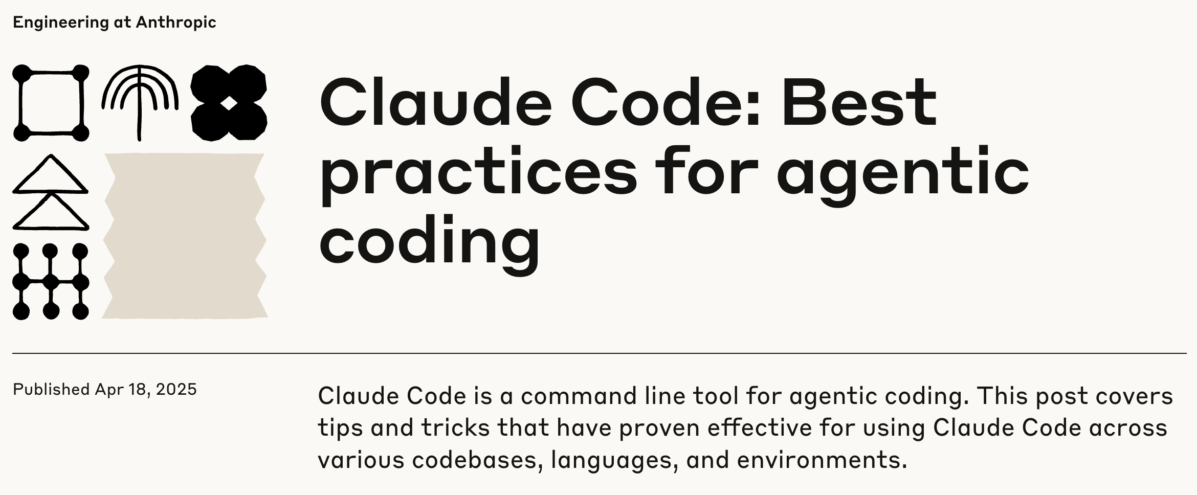

The Explore, Plan, Code, Commit Workflow
EXPLORE
PLAN
CODE
COMMIT

Slide 11
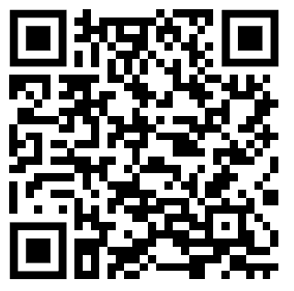
Explore Plan Code Commit. Claude Code Workflows In Action
https://github.com/jawhnycooke/advanced-claude-code-patterns

Slide 12
Explore Plan Code Commit. DEMO
https://github.com/jawhnycooke/advanced-claude-code-patterns

