Slide 1
Simulating El Niño impacts on Bolivian crops
Progress report — Phases 1 and 2 of the Tapiti gridded-DSSAT assessment
IFPRI · 5 October 2026
Tapiti: a Bolivia fork of Tokki, named after the tapití, Bolivia's native cottontail
Notes:
Progress report to the project lead. Phases 1 (inputs) and 2 (calibration) are complete; Phase 3 (historical ENSO assessment) starts next. All numbers in this deck are from the archived production run named in the manifest.

Slide 2
Why now: the season this El Niño will hit is being sown this month
• CPC El Niño Advisory (Sep 2026): >90% chance of a very strong event; Niño-1+2 at +3.4 °C, the eastern-Pacific signature of 1982/83, 1997/98 and 2015/16
• Campaña verano sows Sep–Dec: maíz and arroz from September, soya from November — the exposure window is Oct–Apr
• Deliverable 1 (weeks): a historical-analogue product — what happened to simulated and observed yields in past El Niño campaigns
• Deliverable 2 (separable): a forward estimate for 2026/27 driven by analogue weather and seasonal forecasts
The Tapiti hindcast, by the numbers
5
3,469
crops: soya, maíz, arroz, sorgo, trigo
5-arcmin grid cells
42
382k
campaigns, 1983/84 – 2024/25
DSSAT seasons per run
Weather per cell from NASA POWER (MERRA-2), soils from ISRIC SoilGrids + HC27, areas from MapSPAM 2020, calibration against INE departmental statistics 2012–2024.
IFPRI · Bolivia El Niño crop-impact assessment · progress report, 5 October 2026
2
Notes:
Timing drives the plan: a retrospective product in March 2027 describes a harvest that has already happened, so the historical analogue product comes first. The forward estimate is a second, separable stage.

Slide 3
Where we are: inputs and calibration done, ENSO assessment next
Phase 0
Phase 1
Phase 2
Phase 3
Phase 4
Scaffold
Inputs
Calibration
ENSO hindcast
Forward 2026/27
Fork Tokki → Tapiti; smoke test on real cells
Weather, soil, management, cultivars, unit table
Boundary conditions and yield levels vs INE
Composites by ENSO phase, 1983–2024
Analogue weather + seasonal forecasts
Complete
Complete
Complete
Starting now
Planned
What changed since the plan was written
• The tool is now Tapiti (github.com/jawoo/Tapiti): a renamed fork of Tokki with the US-only material removed, 9 commits of Bolivia-specific changes, every run archived with a manifest
• Two inherited assumptions had to be reworked before calibration made sense: how rice is grown, and when a season starts (slides 7–8)
• Soya — 1.4 Mha and the Santa Cruz economy — turns out to be the crop the water-balance model explains least (slide 12)
IFPRI · Bolivia El Niño crop-impact assessment · progress report, 5 October 2026
3
Notes:
Phase 2 is closed as a calibration round; it can be reopened if Phase 3 shows a specific weakness. Potato and quinoa remain out of scope (no module wired / no DSSAT module).

Slide 4
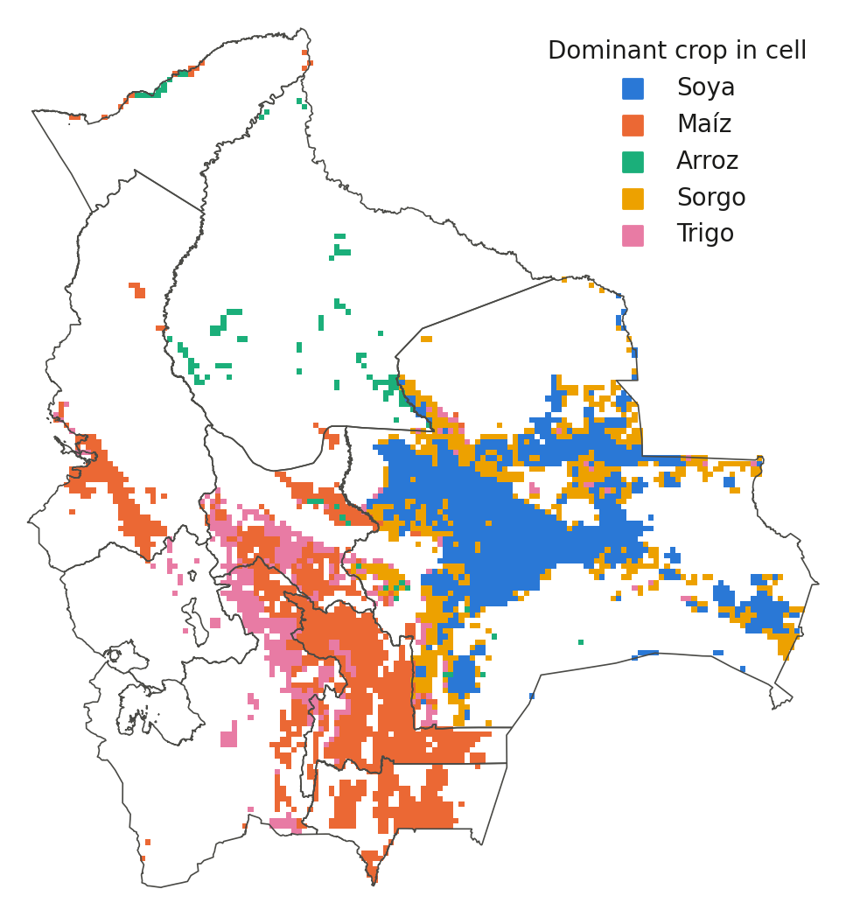
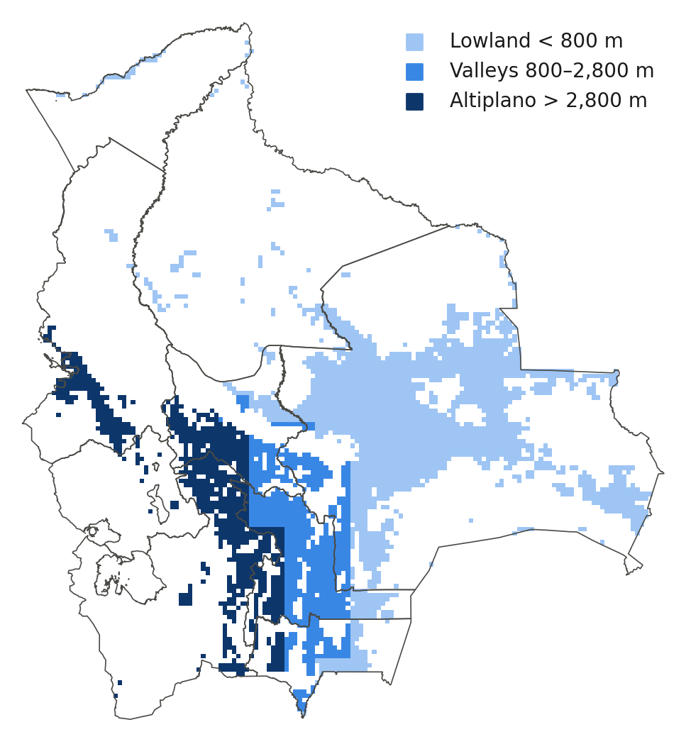
The spatial frame: 3,469 cells, five crops, three zones
• Cells with ≥25 ha of an in-scope crop in MapSPAM 2020
• Soya and sorgo in the Santa Cruz plain; maíz in the valleys; trigo valleys and Altiplano; arroz in Beni and the Norte Integrado
• Zone by cell elevation sets season, management class and cultivar
• 141 rice/soya records above 2,800 m dropped as MapSPAM allocation errors
Cells: MapSPAM 2020 harvested area ≥25 ha. Zones: cell-mean elevation from the NASA POWER DEM. Boundaries: geoBoundaries ADM1.
IFPRI · Bolivia El Niño crop-impact assessment · progress report, 5 October 2026
4
Notes:
MapSPAM totals match INE national areas (soya 1.39 Mha, maize 0.42, sorghum 0.44, wheat 0.18, rice 0.17). The municipal cross-check of MapSPAM against INE 2023-25 municipal data is still to do.

Slide 5
Phase 1 inputs: what was built and where it is weak
Component
What was built
Known weakness
Weather
NASA POWER (MERRA-2 0.5°) daily per cell, 1981–2026; 1981–83 radiation estimated from temperature range
Reanalysis rainfall in complex terrain; 0.5° grid vs 5-arcmin cells
Soil
ISRIC SoilGrids + HC27 profiles, the same library as the US work; 10 edge cells filled from neighbours
Rooting depth 200 cm everywhere; organic carbon drives mineralised N
Management
Zone × crop × season table from ANAPO, CIAT, INIAF, MDRyT, CIPCA, Censo 2013, FAOSTAT — sources documented figure by figure
No national survey; rows marked "fill" copy a neighbour; sowing windows capped by a model limit
Seasons
Dominant campaign per department from INE 2012–24: verano for soya/rice, invierno for Santa Cruz sorgo and trigo, verano for highland trigo
One season per crop per cell; soya invierno (23%) not simulated
Cultivars
Explicit per cell: Bolivia zone cultivars for maíz, arroz, sorgo; DSSAT generics for soya (MG 8) and trigo
Level-calibrated, not variety-specific; trigo uncalibrated (slide 9)
IFPRI · Bolivia El Niño crop-impact assessment · progress report, 5 October 2026
5
Notes:
Everything is reproducible from scripts in the workspace: prep/gen_weather_bolivia.py, build_soil_bolivia.py, build_unit_information_bolivia.py; sources in derived/SOURCES-management.md.

Slide 6
Tapiti: four inherited assumptions that did not transfer from the US
Rice was paddy
The wrong N column
Tokki wrote every rice run as transplanted, puddled, flooded paddy. Bolivian rice is ~90% direct-seeded secano. Tapiti adds an upland mode; rainfed rice now runs like any rainfed crop.
With the override on, Tokki applies the recommended N rate and never reads the farmer rate. A hindcast needs farmer practice.
riceSystem: upland
nitrogenRateSource: actual
Seasons started on 1 January
US cultivars
A verano crop sat behind ten months of bare fallow in which soil carbon mineralised 150–250 kg N/ha that nothing took up. Tapiti starts 60 days before sowing with explicit initial soil water and mineral N.
The US-calibrated maize generics have kernel number and fill rate 25–65% above stock DSSAT. Bolivia zone cultivars replace them for maíz, arroz and sorgo.
simulationStartDaysBeforePlanting: 60 · initialSoilWaterFraction: 0.5 · initialSoilN: 0.3/0.7 ppm
BOL LOWLAND · BOL VALLEYS · BOL ALTIPLANO · BOL SECANO · BOL GRANIFERO
Every switch defaults to upstream behaviour, so Tokki results stay reproducible from the same code.
IFPRI · Bolivia El Niño crop-impact assessment · progress report, 5 October 2026
6
Notes:
All four are config switches defaulting to upstream behaviour, so Tokki results are reproducible from the same code. The N-column finding also applies to the US production run.

Slide 7
Yield levels: from 2–2.5× too high to within 10% for three of five crops
Simulated ÷ observed national yield, dry matter, sowing years 2012–2024 (1.0 = INE level)
• What was wrong: the 1 January start, not the management table. Starting 60 days before sowing halved mineralised N and removed most of the bias on its own (60-cell sensitivity, 14 setups).
• Then cultivars: yield components set against INE by zone on department samples. Maíz is 1.19 nationally but ~1.0 in Santa Cruz, Tarija, Beni and Pando; the excess is in valley and Altiplano departments whose 1.0–1.3 t/ha the model does not reach down to.
• Trigo stays 1.7×: no genetic coefficient tested moves it. Blast, hail, frost and poor stands are the missing processes; handled as a bias factor, not hidden.
• Soya was right from the start (it fixes its own N) — which is why its level never moved.
IFPRI · Bolivia El Niño crop-impact assessment · progress report, 5 October 2026
7
Notes:
The sensitivity table is in PLAN.md 7.3. Initial mineral N is a strong lever once the fallow is short, and its unit matters: 1 ppm over a 2 m profile is about 27 kg N/ha. The adopted default is 0.3/0.7 ppm.

Slide 8
Year-to-year skill: the weather signal is live for the lowland crops
Correlation of simulated and INE national yield anomalies, 12–13 overlapping years
• Sorgo and trigo in Santa Cruz track INE at 0.76 and 0.71 — the invierno crops read the autumn rainfall right
• Arroz improved to 0.66; maíz slipped from 0.61 to 0.42 as its level was fixed — twelve years cannot say whether that is real, and valley and Altiplano maize carry almost no signal
• Soya is the weak crop (0.28) despite the right level — slide 12 explains why
• Caveat: twelve years is a short record; these correlations have wide intervals and say the mechanism is live, not that the model is validated
IFPRI · Bolivia El Niño crop-impact assessment · progress report, 5 October 2026
8
Notes:
Level calibration kept skill for rice, sorghum and wheat. Soya drifted down (0.37 to 0.28) with the shorter pre-season and maize from 0.61 to 0.42 across the two calibration rounds; a factorial on 300 Santa Cruz maize cells gave anomaly correlations of 0.30-0.41 for every combination of start date and cultivar, i.e. within the noise of 12 years. Phase 3 tests the anomaly response on the 42-year record against ENSO, not only against 12 years of INE.

Slide 9
Model against INE, 2012–2024: sorgo and maíz
Sorgo invierno is the cleanest test: sown Apr–Jun on residual moisture, its 2016 and 2021–22 collapses are reproduced. Maíz verano follows the same drought years (2015/16, 2023/24) with less fidelity in the valleys.
INE departmental series exist only from 2012; the 1984–2011 series needed for a longer validation has been requested.
IFPRI · Bolivia El Niño crop-impact assessment · progress report, 5 October 2026
9
Notes:
Sowing-year labels: a verano campaign sown in 2015 is 2015/16; invierno sorghum is labelled by its calendar year.

Slide 10
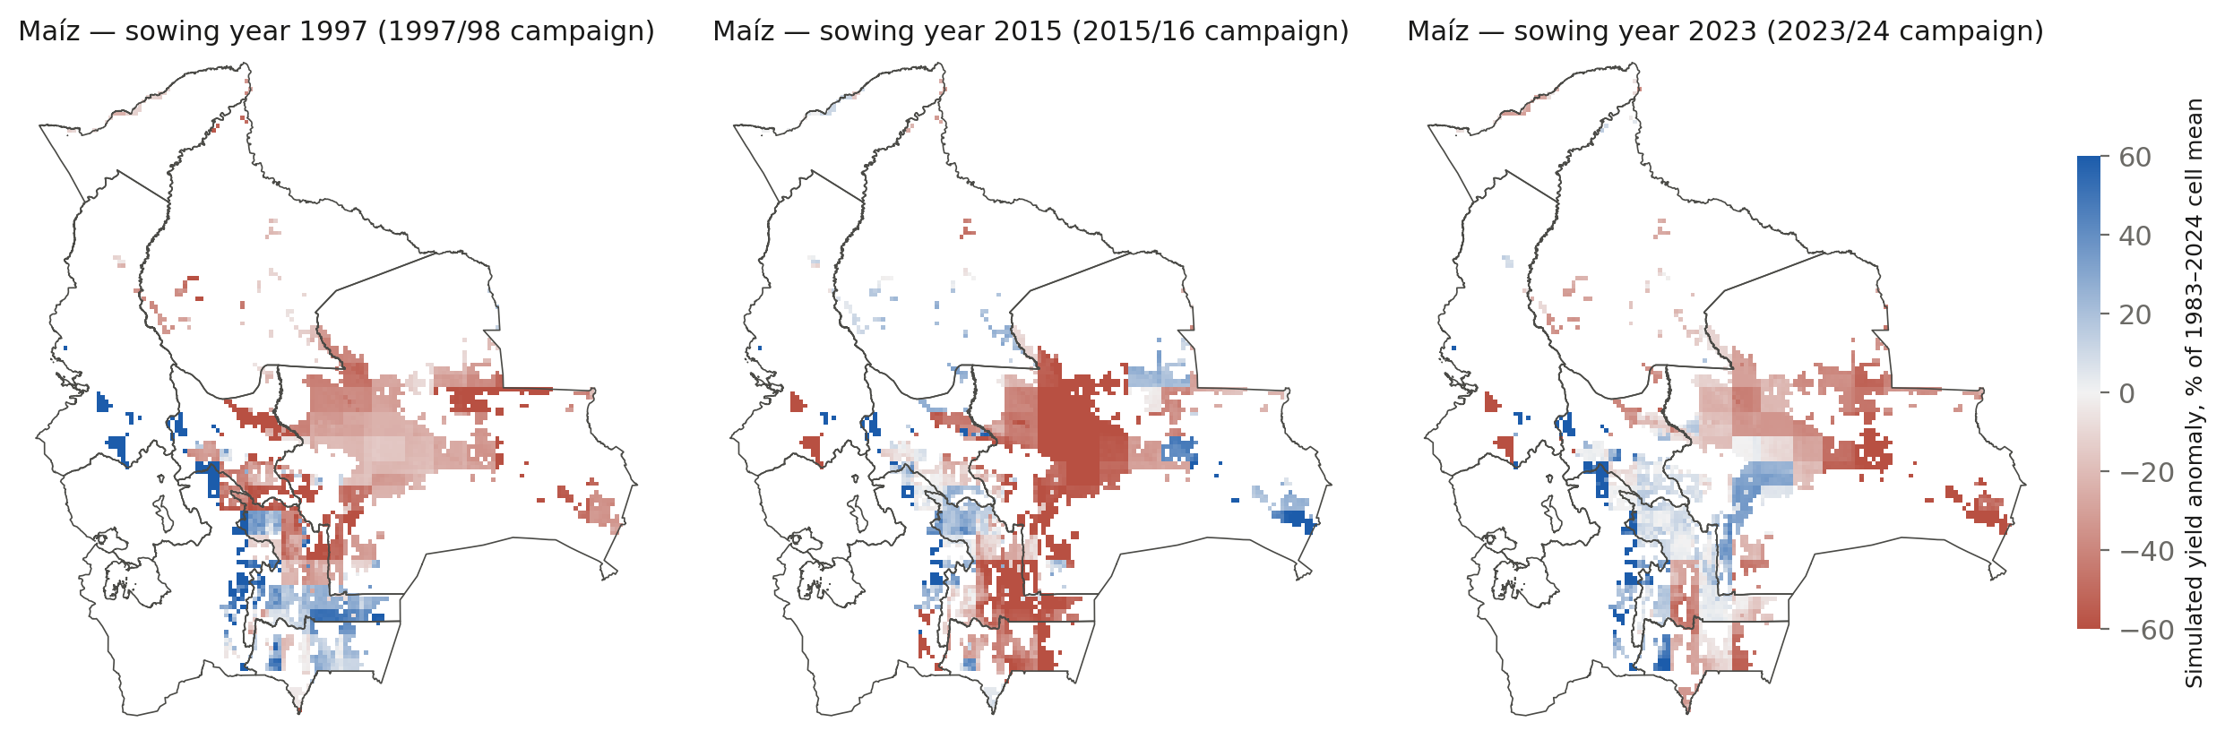
The model sees the El Niño droughts in the Santa Cruz plain
Simulated maíz yield anomaly per cell in the three strong eastern-Pacific El Niño campaigns since 1983. Santa Cruz loses 20–60%; the Altiplano and valleys show a weaker and sometimes opposite response, consistent with the literature's "drier highlands, wetter/variable lowlands" picture only in part — Phase 3 tests this properly, per crop and per zone.
IFPRI · Bolivia El Niño crop-impact assessment · progress report, 5 October 2026
10
Notes:
Anomalies are relative to each cell's own 1983–2024 mean. 1982/83 is outside the simulated record (weather starts 1981, sowing 1983).

Slide 11
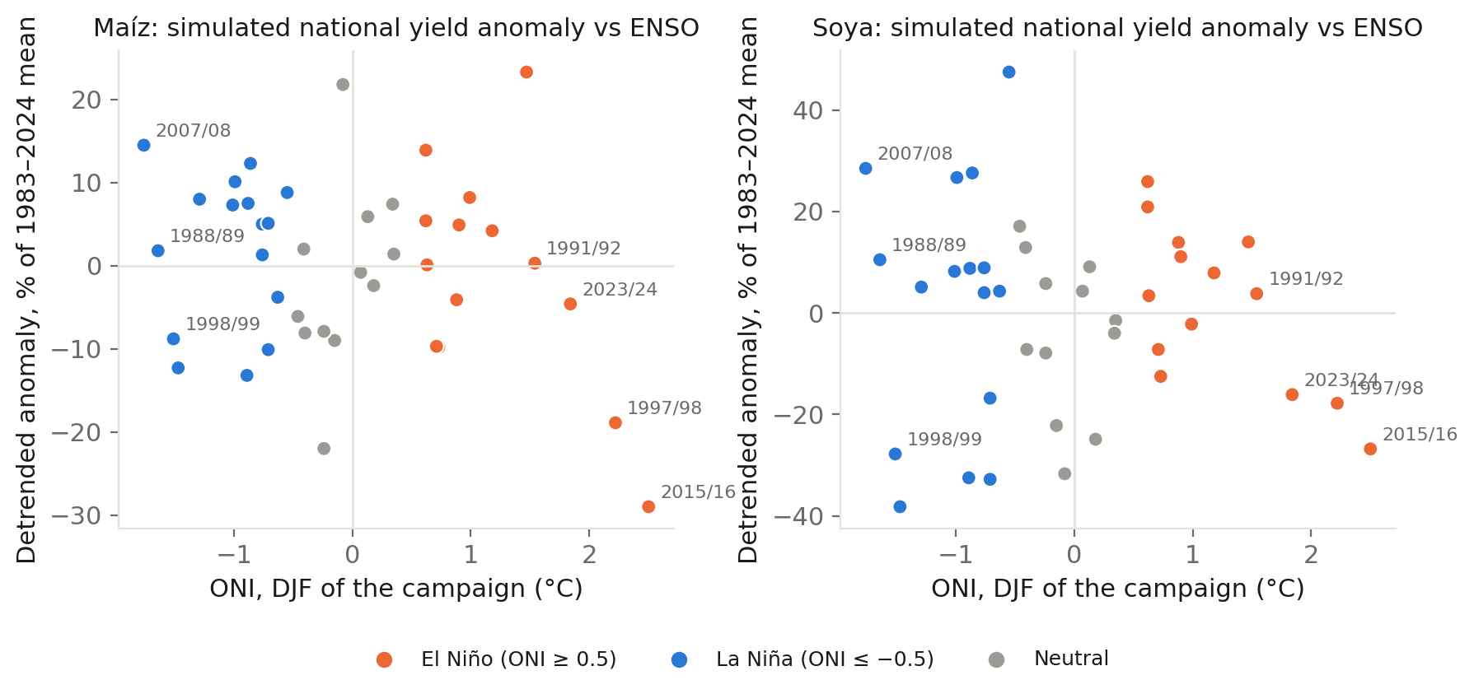
Preview: strong El Niño campaigns are the lowest simulated maíz years
Detrended national anomalies vs the DJF Oceanic Niño Index. Simulated soya carries a downward trend of 1.2% per year linked to rising maximum temperatures in the reanalysis, which INE does not show — a Phase 3 check before any composite is quoted.
IFPRI · Bolivia El Niño crop-impact assessment · progress report, 5 October 2026
11
Notes:
This is a preview, not the Phase 3 result: composites by ENSO phase with uncertainty, per crop and department, come next. Note the asymmetry: La Niña campaigns are mildly positive for maize (wetter Santa Cruz), strong El Niño strongly negative.

Slide 12
Soya: right level, wrong weather response — a structural limit
Correlation of Santa Cruz soya yield with Nov–Mar weather indicators, sowing years 2012–2023 (n = 12)
• Observed soya is indifferent to rainfall total and loses to heavy-rain days, dry spells and heat
• Simulated soya loves rainfall and gains from wet days; it gets dry spells and heat right
• Why: the water-balance model has no waterlogging or harvest-loss channel, and the deep HC27 profiles never saturate — a 1 m rooting depth and slow drainage did not change the sign
• For Phase 3: use the model for the drought and heat channels and add a statistical excess-rain term fitted on the INE overlap, reported separately and labelled as such
IFPRI · Bolivia El Niño crop-impact assessment · progress report, 5 October 2026
12
Notes:
Twelve points; indicative, not significant. The conclusion is about mechanism, not sample size: the lowland El Niño impact on soya runs through excess water, which DSSAT handles poorly, as the plan said from the start.

Slide 13
What these results cannot say
No area response
No floods, hail, frost damage, pests
Reanalysis weather in the Andes
DSSAT simulates yield on planted area. Farmers plant less or switch crop after a failed onset; that channel is often larger than the yield channel and is outside this framework.
Excess-rain losses in the lowlands and hail/frost in the highlands are systematically under-estimated; wheat and soya show it.
MERRA-2 at 0.5° in complex terrain; Altiplano maize fails in 42% of simulated seasons, partly real, partly resolution.
Levels are calibrated, anomalies are not
No potato or quinoa
Twelve years of validation
Relative anomalies (% of normal) are the defensible output; absolute tonnes are not.
The Altiplano, where the El Niño drought story is usually told, is represented by valley maíz and highland trigo only.
INE departmental data run 2012–2024; every skill number here has a wide interval.
IFPRI · Bolivia El Niño crop-impact assessment · progress report, 5 October 2026
13
Notes:
These are the limitations the plan listed before Phase 1 started; the calibration work sharpened rather than removed them.

Slide 14
Next: the historical ENSO assessment, then the 2026/27 estimate
Phase 3 — ENSO hindcast (1–2 weeks)
Phase 4 — 2026/27 (2–3 weeks)
Decisions and requests
• Classify the 42 campaigns by ONI and by the Niño-1+2 eastern-Pacific signature
• Composite simulated anomalies by phase, per crop × department × zone, with bootstrap intervals
• Side by side with INE 2012–2024 and with the SENAMHI station rainfall, kept as independent evidence
• Detrend and document the simulated soya trend before quoting anything
• Statistical excess-rain term for soya
• Analogue resampling: drive the 2026/27 season with 1997/98, 2015/16, 2023/24 weather on the actual sowing calendar
• Seasonal-forecast-driven variant via the C3S path (ECMWF/NCEP/JMA ensembles SENAMHI already holds)
• Monthly updates as the season unfolds: observed-to-date + forecast forward
• INE departmental series 1984–2011 (only 2012–2024 in hand)
• SENAMHI/INIAF counterpart for station data and seasonal forecasts
• Potato (SUBSTOR) for the Altiplano: 1–2 weeks of module work — worth it before Phase 4?
• Municipal cross-check of MapSPAM against INE 2023–25
IFPRI · Bolivia El Niño crop-impact assessment · progress report, 5 October 2026
14
Notes:
Phase 3 is the first deliverable and a coherent product on its own. The potato question is the one scope decision that changes the Altiplano story.

Slide 15
Everything is reproducible and archived
• Code: github.com/jawoo/Tapiti (branch bolivia) — 9 Bolivia-specific commits, every switch defaults to upstream behaviour
• Workspace: PLAN.md (decisions and findings), DATA-INVENTORY.md, HANDOFF.md, derived/ (inputs, sources, sensitivity tables), runs/ (every production run with manifest, config and summaries)
• This deck: Phase 2 reference run 20261004-2232_v8_calib-round2, figures regenerated by analysis/deck_figures.py
Notes:
Contact: the IFPRI Bolivia ENSO team.

