Slide 1

Machine Learning Made Easy with AutoML Frameworks
Shane Milton

Slide 2
Hi, I’m Shane
Husband and Dad
Problem Solver
Christian
Educator and Mentor
Student
Geek
Colt’s Fan
Cloud Developer & Architect
In IT since 1996
Developer+ since 2003
Web Focus
Azure Focus
Machine Learning for 2 years
Many years in the Energy & Health Industries
Quantum Aspirations

Slide 3


Hi, I’m Shane
Have had ML systems in production for ~2 years
Have had AutoML in
production for ~2 months
Not a Data Scientist
Not a Machine Learning Expert

Slide 4

Camera Icon
Top 3 slides with info you will want when you try this for the first time yourself!
(Not this slide)

Slide 5
What We’ll Talk About
Machine Learning & AutoML Overview
C# Demo using ML.NET’s AutoML
Python Demo using auto-sklearn
Python Demo using tpot
More Resources

Slide 6
Two Primary* Machine Learning Problem Types
Classifications
Regressions
Identifies a classification based on attributes.
  Will it be warmer than 65°?
  Will the Colts win by at least 25 pts?
  Will the plane be late?
  Is the person an introvert or extravert?
  Is this animal a dog?
  *Others exist
Predicts unknown future values based on attributes.
  What will the temperature be tomorrow?
  How many points will the Colts score?
  What time will the plane land?
  How introverted is the person?

Slide 7
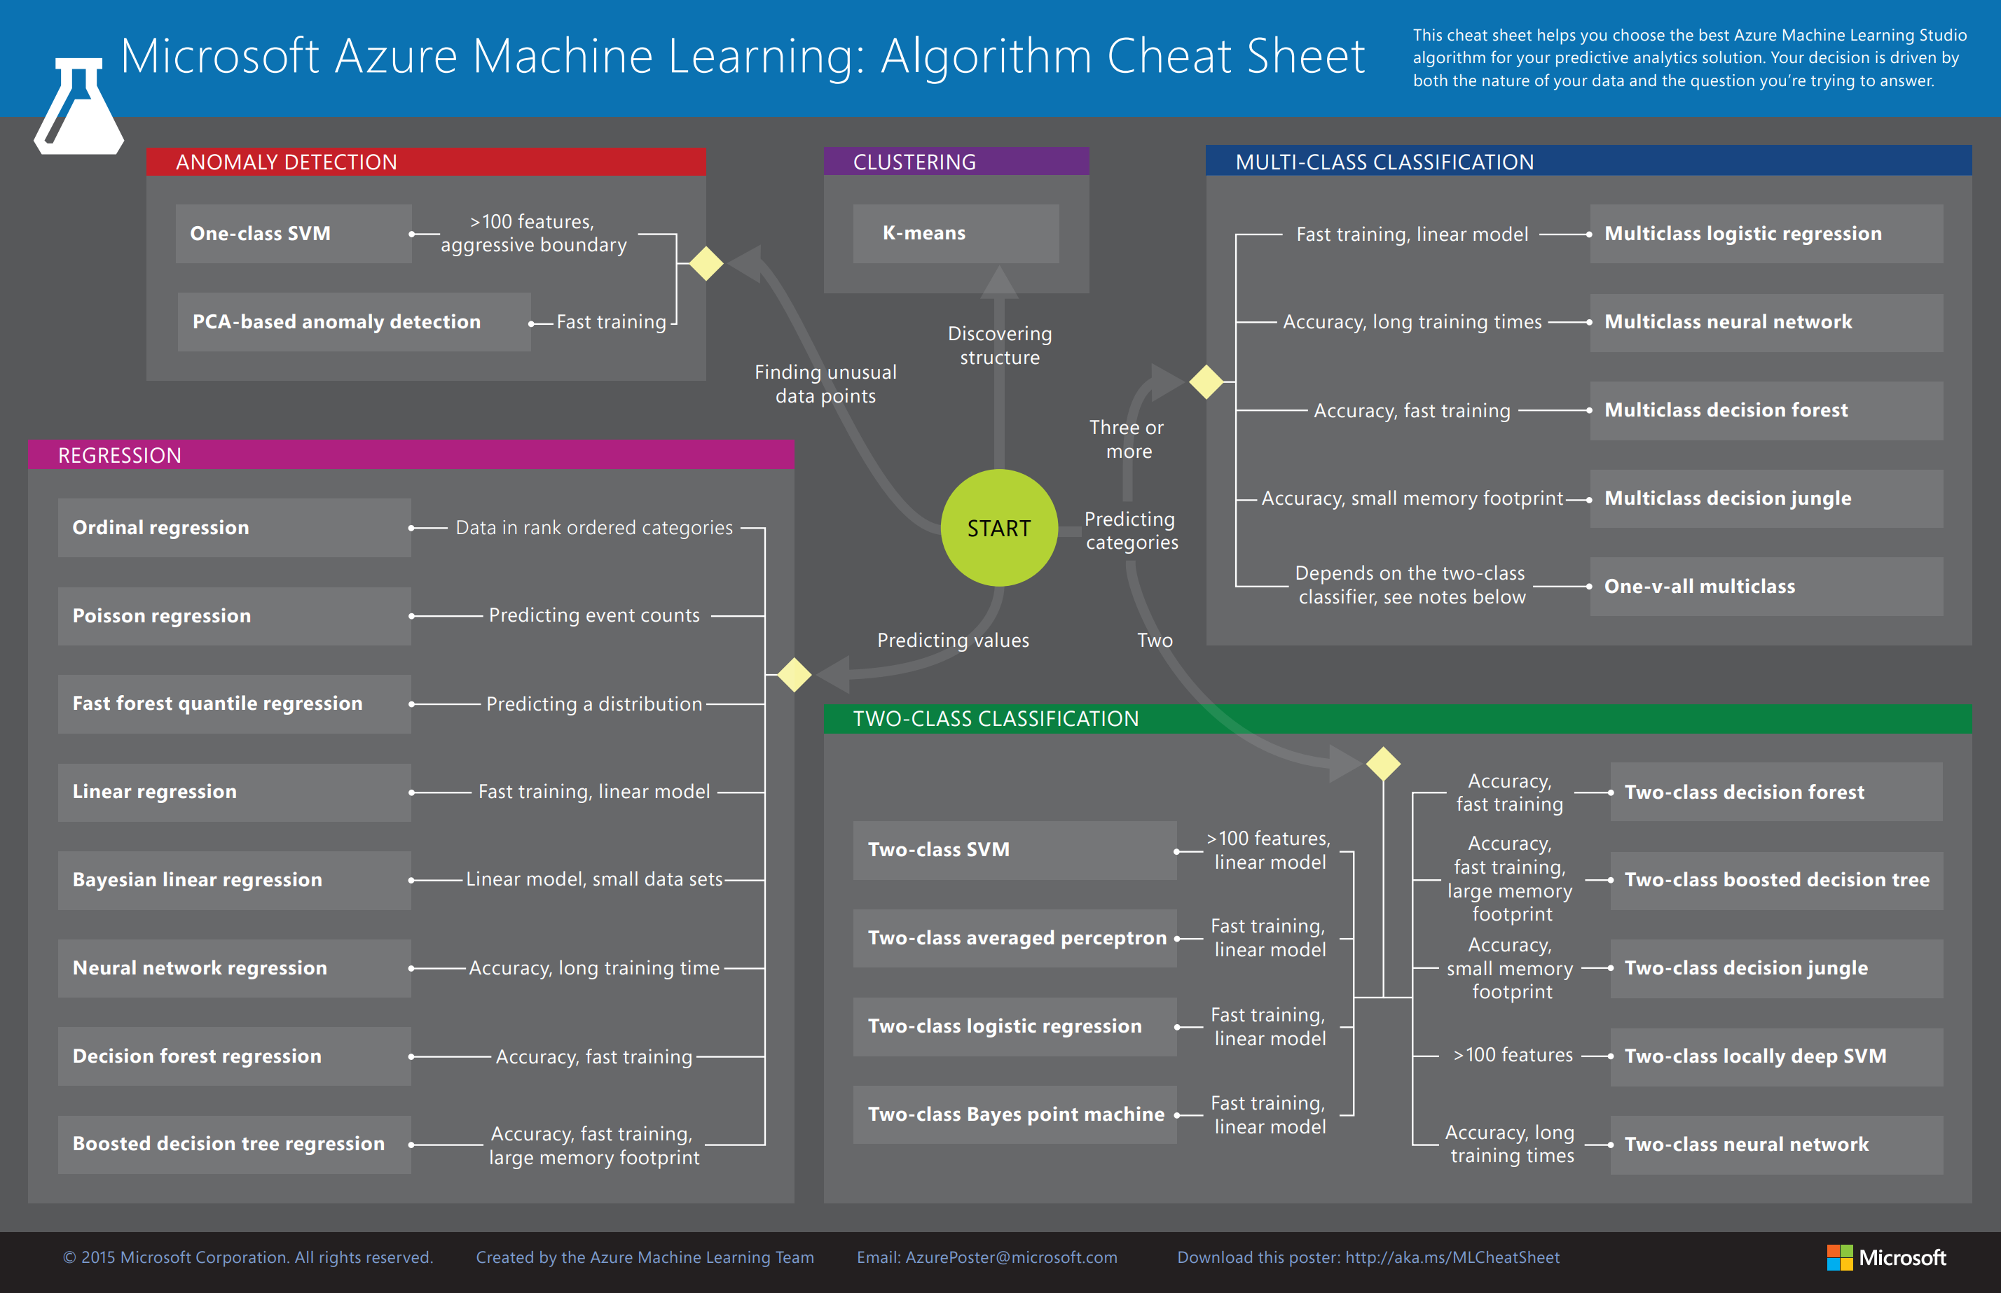

Slide 8
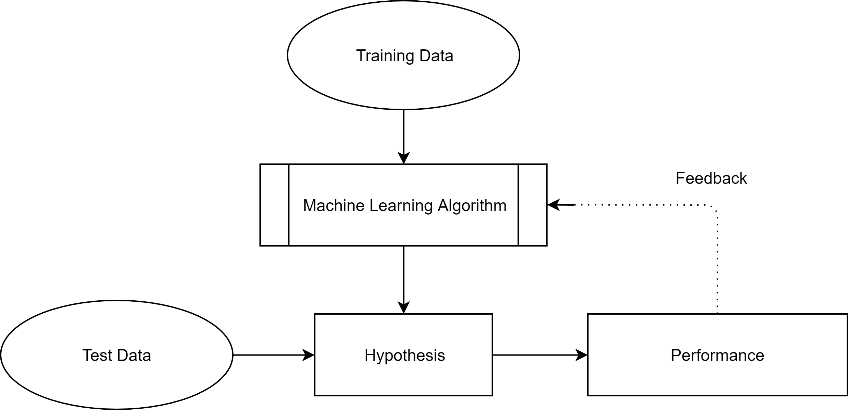
Basic Machine Learning Architecture

Slide 9
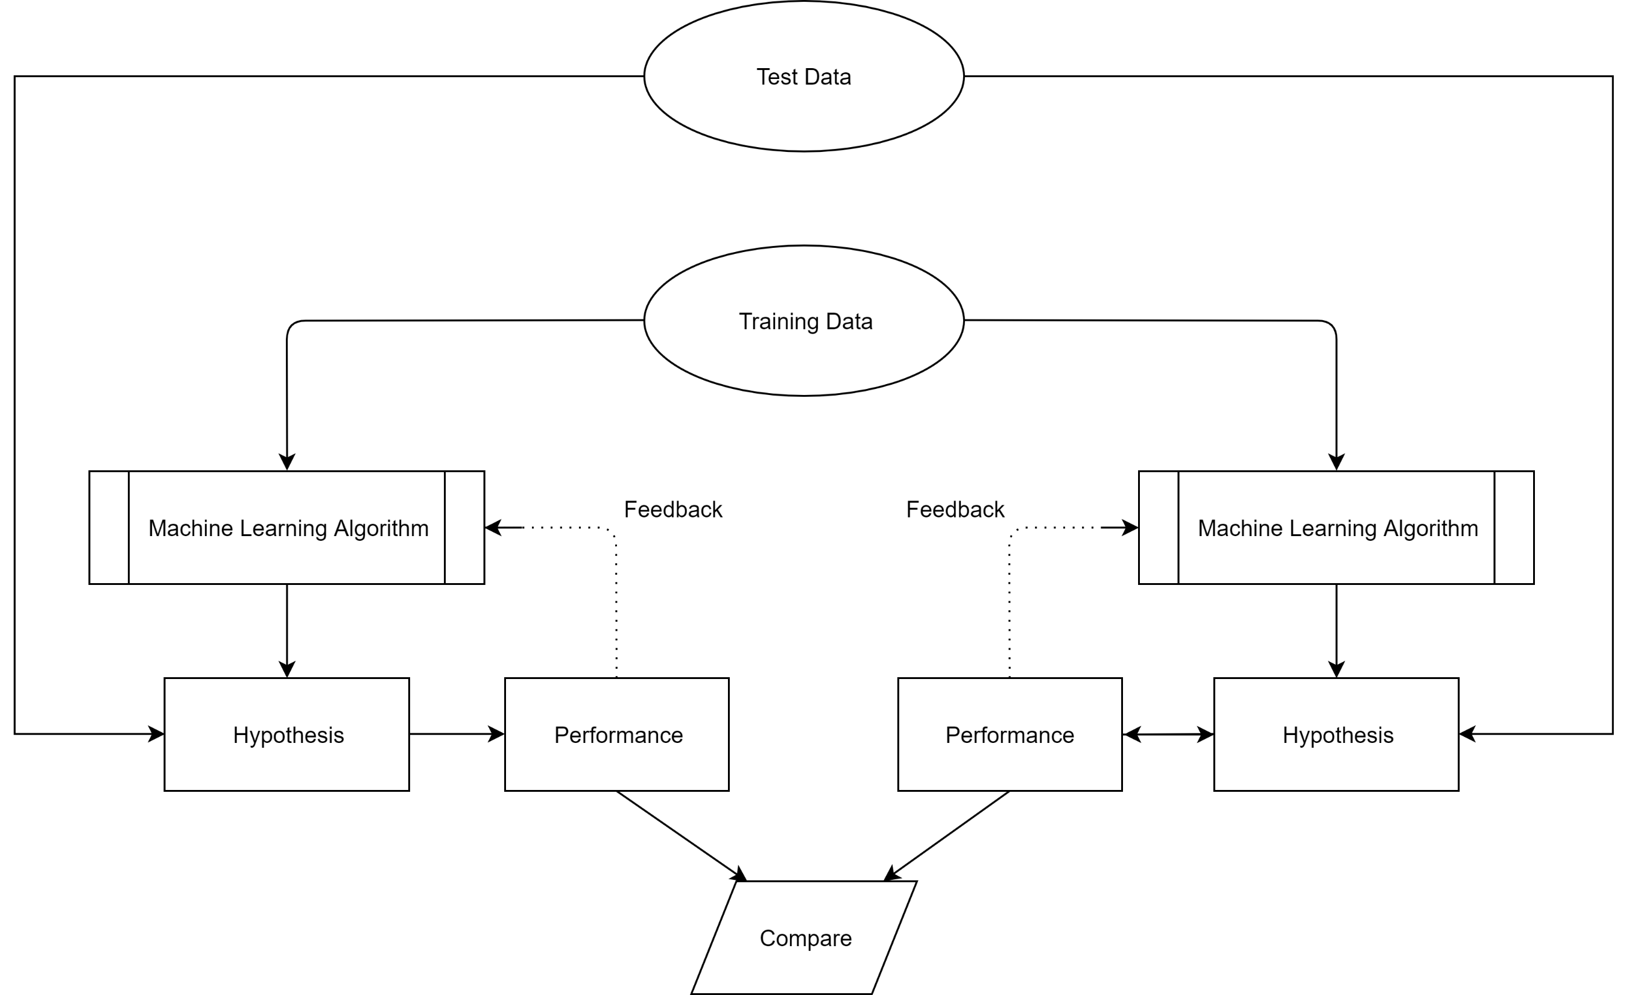
Comparing Multiple Algorithms

Slide 10
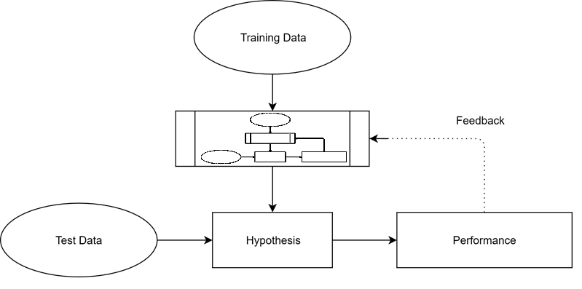
AutoML Architecture

Slide 11
AutoML is a Type of Framework
Like ORMs are a type of framework for databases and data
Everybody seems to put “AutoML” in the branding of their implementation
Not to be confused with Machine Learning frameworks, although sometimes they’re bundled to be one and the same

Slide 12
Machine Learning SDLC (abbreviated)
Prepare
Prepare Training Data
Select & Clean Data (lots of Data Science goes into this)
This is arguably the most important and difficult part!
Design & Train
Design & Train Models
Algorithms (lots more Data Science)
Lots of time can be spent here, both human and computational
Deploy & Consume
Deploy & Consume Models
You take a Trained Model and deploy it for consumption
I usually deploy as a REST service

Slide 13
AutoML
Machine Learning SDLC (abbreviated)
Prepare
Prepare Training Data
Select & Clean Data (lots of Data Science goes into this)
This is arguably the most important and difficult part!
Design & Train
with AutoML
Design & Train Models
Algorithms (lots more Data Science)
Some Lots of time can be spent here, both human & computational
Deploy & Consume
Deploy & Consume Models
You take a Trained Model and deploy it for consumption
I usually deploy as a REST service
Just give a computer some time and let it figure it out by itself

Slide 14
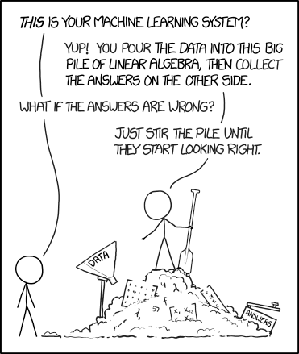
Magic?
Source: https://xkcd.com/1838/

Slide 15
Too good to be true?
Yes and no.
Can Data Scientists do better?
Yes, probably, eventually. $$$
Are you a Data Scientist?
Probably not.

Slide 16
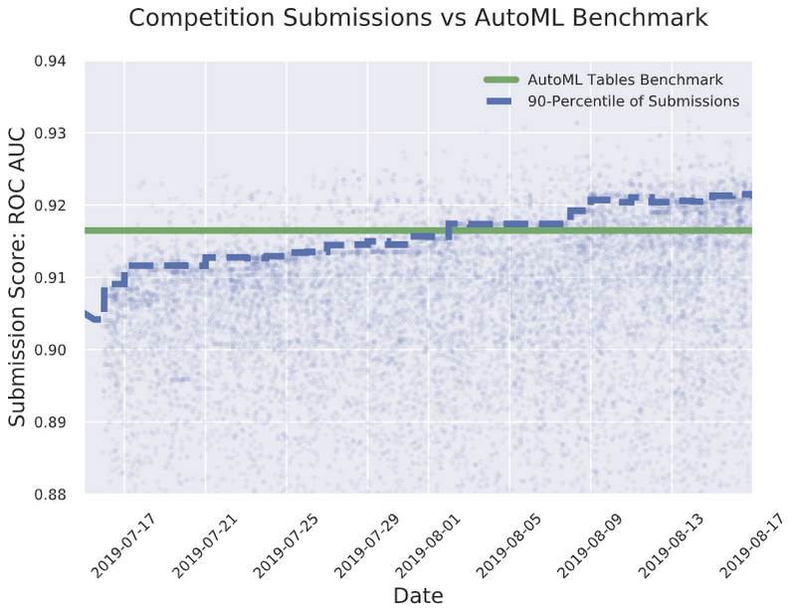
Too good to be true?
https://cloud.google.com/blog/products/ai-machine-learning/bringing-google-automl-to-3-million-data-scientists-on-kaggle

Slide 17
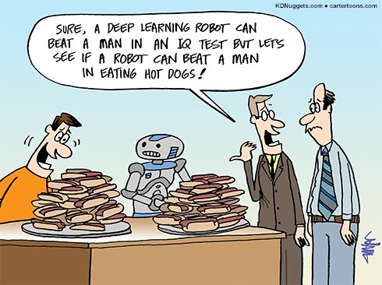
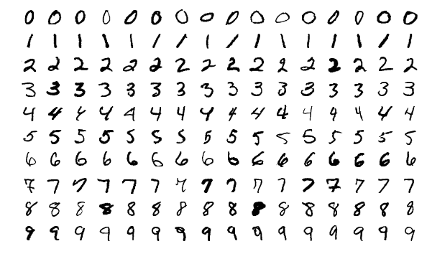
Demos
Source: https://www.kdnuggets.com/2015/07/cartoon-humans-ahead-deep-learning.html
MNIST Data: ~70,000 hand-written digits (numbers)
https://github.com/jaxidian/IndySA_AutoML

Slide 18
AutoML Architecture

Slide 19
AutoML Frameworks
Google AutoML: https://cloud.google.com/automl/
ML.NET (framework and core): https://github.com/dotnet/machinelearning
auto-sklearn (python): https://github.com/automl/auto-sklearn
Azure ML: https://ml.azure.com/
TPOT (python): https://github.com/EpistasisLab/tpot
Many more!
These are some I’ve used, not necessarily the best or most popular

Slide 20
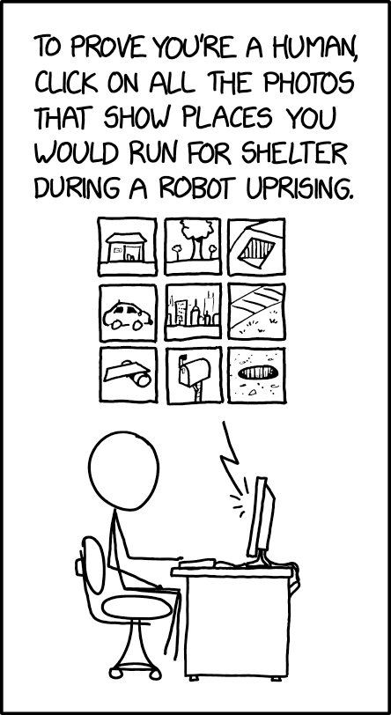
Any Other Questions?
https://github.com/jaxidian/IndySA_AutoML
Source: https://xkcd.com/2228/

