Slide 1
Conditions and native equations
Use this equation only when x is nonnegative.
$y=\frac{x+1}{2}$
The numerator includes x plus 1.

Slide 2
Repeated content
Read each condition before substituting values.
Read each condition before substituting values.
$r=\sqrt{x^{2}+1}$

Slide 3
Input and output values
Case | Input x | Output y
A | 1 | 1
B | 3 | 2
Table 1 records invented values for the same equation.

Slide 4
Merged sample labels
Sample | Trial | Value
Sample A | 1 | 0.25
 | 2 | 0.75
Sample A applies to both trials.

Slide 5
Ordered steps in columns
1. Read the condition.
3. Substitute the value.
2. Choose the equation.
4. Check the result.

Slide 6
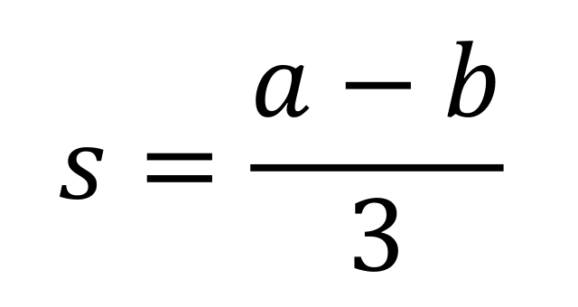
Pictured equation and explanation
Figure 1 defines s using a minus b over 3.
Reversing a and b changes the sign of s.

