Slide 1

ACADEMIC PROJECT · ACADEMIC YEAR 2026–2027
SKINOVATE-AI
Understand Your Skin. Personalize Your Care.
AI-ASSISTED PERSONALIZED SKINCARE SYSTEM
SANIKA GOWDA (FAI24019) · JACKSON ABRAHAM (FAI24021)
ELPHINSTONE COLLEGE, MUMBAI
Notes:
Good morning, members of the panel. We are Sanika Gowda and Jackson Abraham from Elphinstone College. Today we present Skinovate-AI, an academic concept for an AI-assisted personalized skincare platform designed to bridge consumer confusion with structured, accessible skin intelligence.

Slide 2
Why is finding the right skincare so difficult?
Individual variation
Ingredient complexity
Skin concerns and barriers differ per person; generalized mass-market advice fits few individuals.
Formulations are hard to evaluate without chemistry context, resulting in barrier irritation and wasted spend.
Trend-driven purchasing
Fragmented routines
Viral social media cycles promote hyper-targeted actives without assessing personal suitability.
Routines are confusing to build; users lack structured tracking systems to measure genuine skin tolerance or progress over time.
"People don't need more skincare products. They need skincare that understands them."
Notes:
Consumers today are overwhelmed by trial-and-error skincare. Social media algorithms push products without understanding individual barriers, leading to irritation and financial waste. Skinovate-AI is built around the premise that consumers do not need more products—they need clarity and personalized guidance.

Slide 3





Introducing Skinovate-AI
One intelligent companion. A more personalized skincare journey.
Skinovate-AI Platform
AI-assisted Skin Analysis
Customized AM/PM Routines
Personalized Skin Profiles
Product Recommendations
CONCEPT ARCHITECTURE · NON-DIAGNOSTIC EDUCATIONAL FRAMEWORK
Notes:
Skinovate-AI organizes seven core capabilities around the individual user: computer-vision assisted skin analysis, adaptive profiling, ingredient intelligence, customized dual-phase routines, and daily progress logging. It is conceptualized as an integrated, non-clinical companion for informed skincare choices.

Slide 4
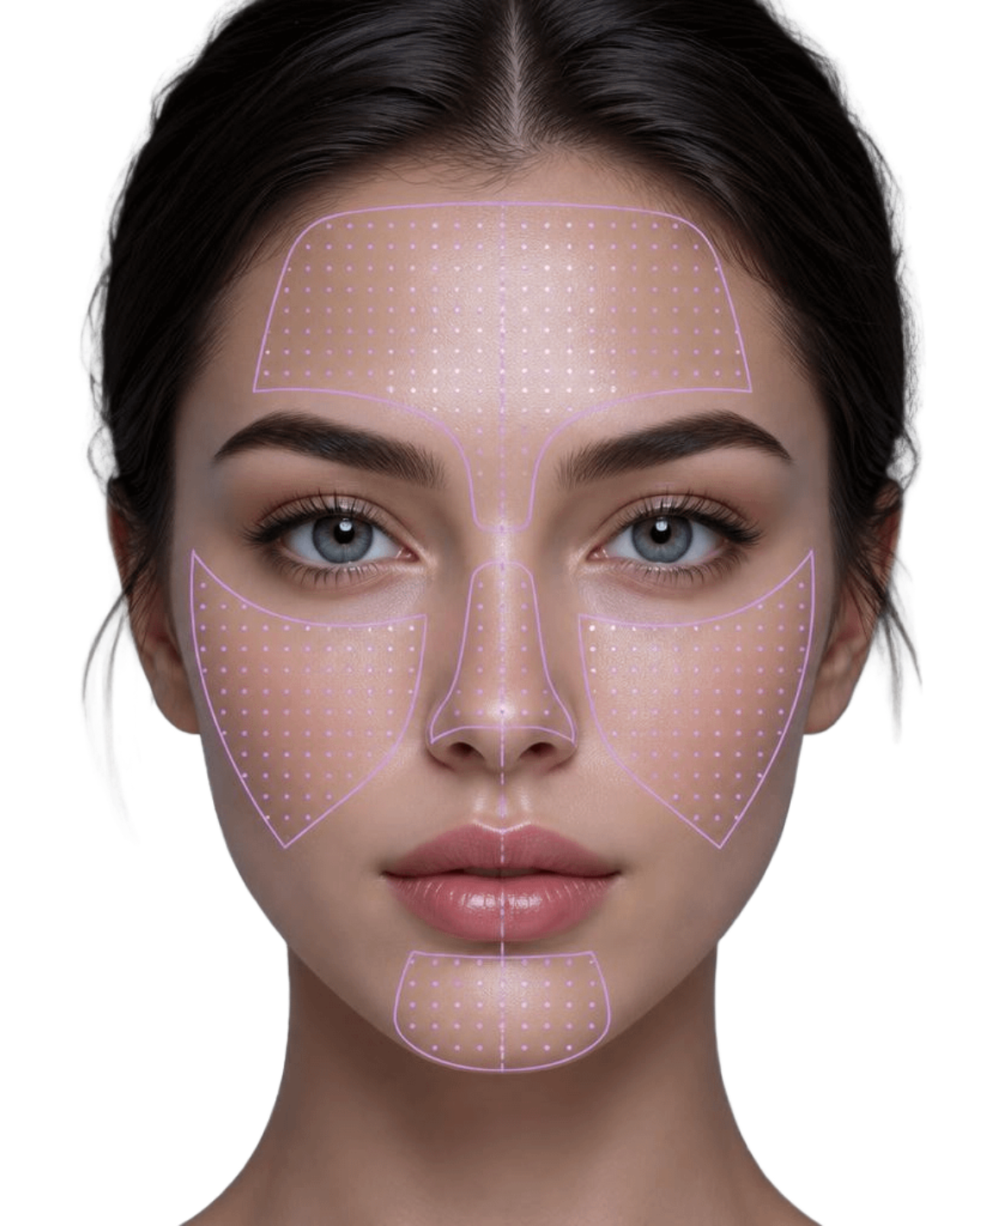
Your skin, understood beyond the surface
Capture: User uploads or captures a clear, well-lit, neutral facial image.
Examine: Envisioned vision algorithms look at visible textural patterns, redness, and oil distribution across facial zones.
Identify concerns: Acne-like blemishes, uneven tone, dryness, oiliness, and fine lines.
Understand context: Skin profile, sensitivity, lifestyle, sun exposure, and personal skincare goals.
Present insights: Understandable, plain-language observations and guidance without diagnostic or medical claims.
Facial image → AI-assisted examination → Skin insights → Personalized guidance
Concept only: Skinovate-AI is an educational assistive system, not a clinically validated diagnostic medical device.
Forehead · cheeks · nose · chin · under-eye
Notes:
Our visual pipeline examines surface characteristics across five distinct facial zones—forehead, cheeks, nose, chin, and under-eye. Crucially, the system pairs computer-vision pattern observation with lifestyle context, framing all output strictly as educational guidance rather than medical diagnosis.

Slide 5
Every skin is different. Every routine should be too.
Personalization begins with understanding the person behind the skin.
Skin types: oily, dry, combination, normal, sensitive. Considered: concerns, sensitivities and exclusions, age range, lifestyle, sun exposure, climate, goals.
PROFILE A · OIL-PRONE & CONGESTED
PROFILE B · DRY & BARRIER-COMPROMISED
Active Clarifying Profile
Barrier Recovery Profile
Skin type: Oily / Combination
Target concerns: Acne-related concerns, clogged pores, T-zone shine, post-blemish marks
Formulation priority: Non-comedogenic, lightweight gel textures
Key actives: Salicylic acid, Niacinamide
Sensitivities: Fragrance-free preference
Skin type: Dry / Sensitive
Target concerns: Flaking, tight sensation, erythema, dehydration
Formulation priority: Rich emollient creams, humectants
Key actives: Ceramides, Hyaluronic acid, Panthenol
Sensitivities: Essential oils and drying alcohol excluded
ILLUSTRATIVE USER PERSONAS · INPUT PROFILE WEIGHTING ALGORITHM
Notes:
Here we see two distinct profiles generated by the system. User A needs pore-clearing, sebum-regulating support with light gel matrices, whereas User B requires barrier reconstruction with ceramides and zero fragrance. Skinovate-AI ensures these users never receive identical recommendations.

Slide 6

Find products that match your skin's needs
INGREDIENT | PRIMARY ACTION | TARGET COMPATIBILITY
NIACINAMIDE | Strengthens barrier and balances sebum | All skin types · Congestion
HYALURONIC ACID | Attracts and binds atmospheric moisture | Dehydrated & Dry profiles
SALICYLIC ACID | Lipophilic BHA for pore exfoliation | Oily & Blemish-prone
VITAMIN C | Potent antioxidant for tone radiance | Uneven tone & Photo-aging
CERAMIDES | Replenishes essential lipid matrix | Compromised barrier & Sensitive
PANTHENOL | Pro-vitamin B5 soothing humectant | Reactive & Irritated skin
SUGGESTIONS ARE EDUCATIONAL BENCHMARKS, NOT MEDICAL PRESCRIPTIONS
Notes:
Our ingredient intelligence module evaluates formulations against an evidence-based compatibility taxonomy. Rather than relying on marketing claims, it assesses molecular functions—such as BHAs for lipid penetration or ceramides for intercellular matrix repair—to match specific user requirements.

Slide 7
Your daily skincare, simplified
A better routine starts with the right steps, not more steps.
PHASE 01 · MORNING REGIMEN
PHASE 02 · EVENING REGIMEN
Protect & Defend
Repair & Restore
Gentle Cleanser — Purifies surface oils without stripping the lipid barrier.
Targeted Treatment Serum, where appropriate — Antioxidant protection (e.g., Vitamin C or Niacinamide).
Lightweight Hydrator — Moisture retention suited to ambient humidity.
Broad-Spectrum SPF 50+ — Crucial daily defense against UVA/UVB photo-damage.
Thorough Cleanse — Removes micro-pollutants, excess sebum, and sunscreen.
Active Treatment, where appropriate — Cellular turnover or barrier agents (e.g., Retinoids, BHA).
Barrier Recovery Cream — Ceramide and peptide replenishment during overnight rest.
Considers ingredient compatibility; builds consistent habits without overcomplication.
STEP ORDER PRESERVES INGREDIENT EFFICACY AND PREVENTS CONFLICTING ACTIVES
Notes:
Routine discipline is structured into two clean phases. The morning focus is strictly defense and barrier protection with broad-spectrum photoprotection. The evening phase shifts to cellular recovery and active repair, eliminating unnecessary multi-step clutter.

Slide 8
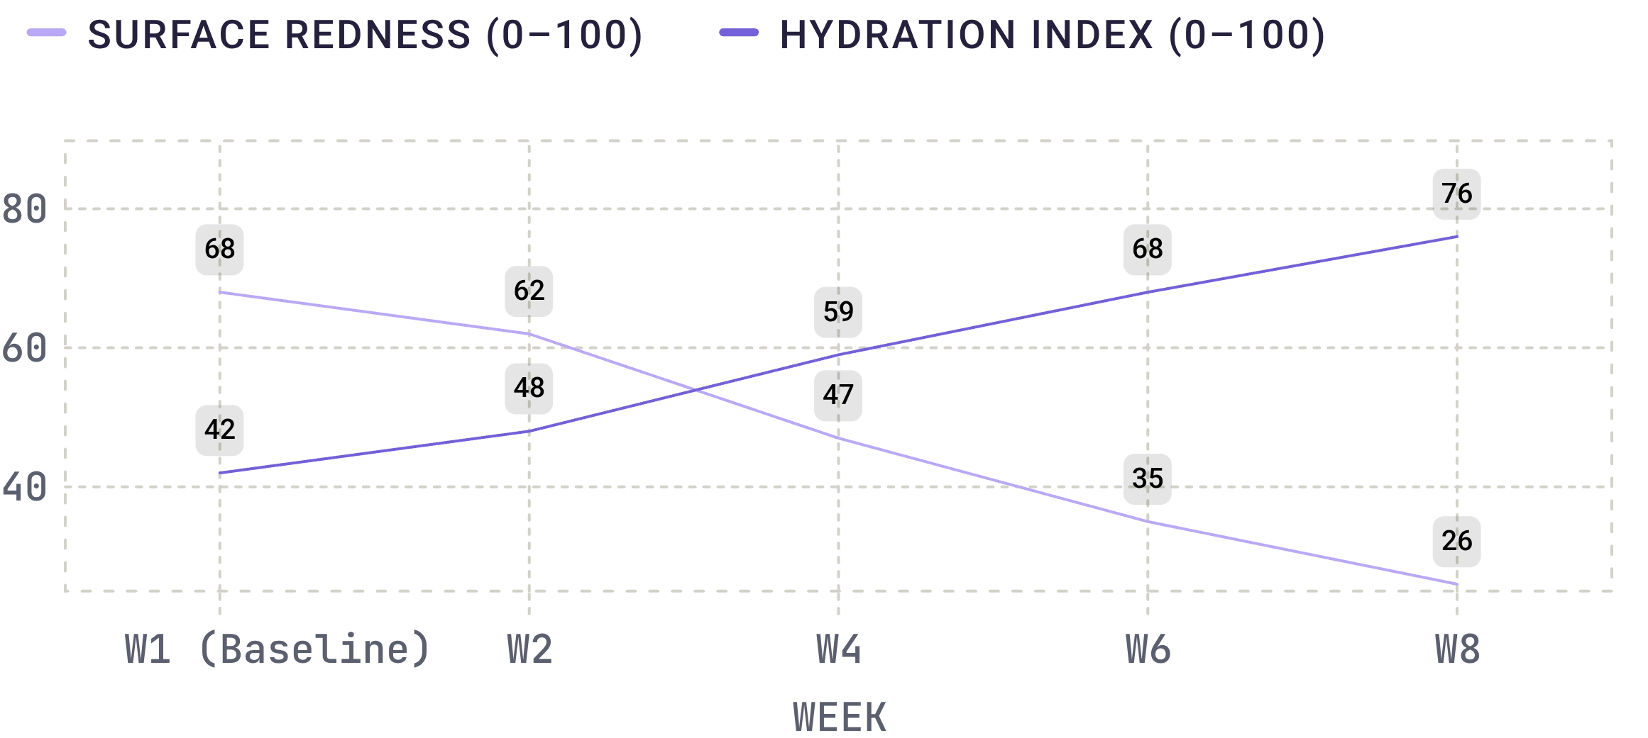
Your skincare journey, tracked over time
LONGITUDINAL JOURNAL
Users log routine consistency and photograph progress under uniform conditions.
OBSERVED OUTCOMES
Tracking captures steady hydration gains and reduced visible irritation over eight weeks of habit adherence.
ILLUSTRATIVE EVALUATION TELEMETRY · COHORT SAMPLE LOGGING
Notes:
Skincare results take weeks to materialize. Our longitudinal skin journal enables users to track hydration levels, routine consistency, and visible surface changes. This illustrative graph shows how objective logging helps users evaluate product efficacy over an eight-week cycle.

Slide 9
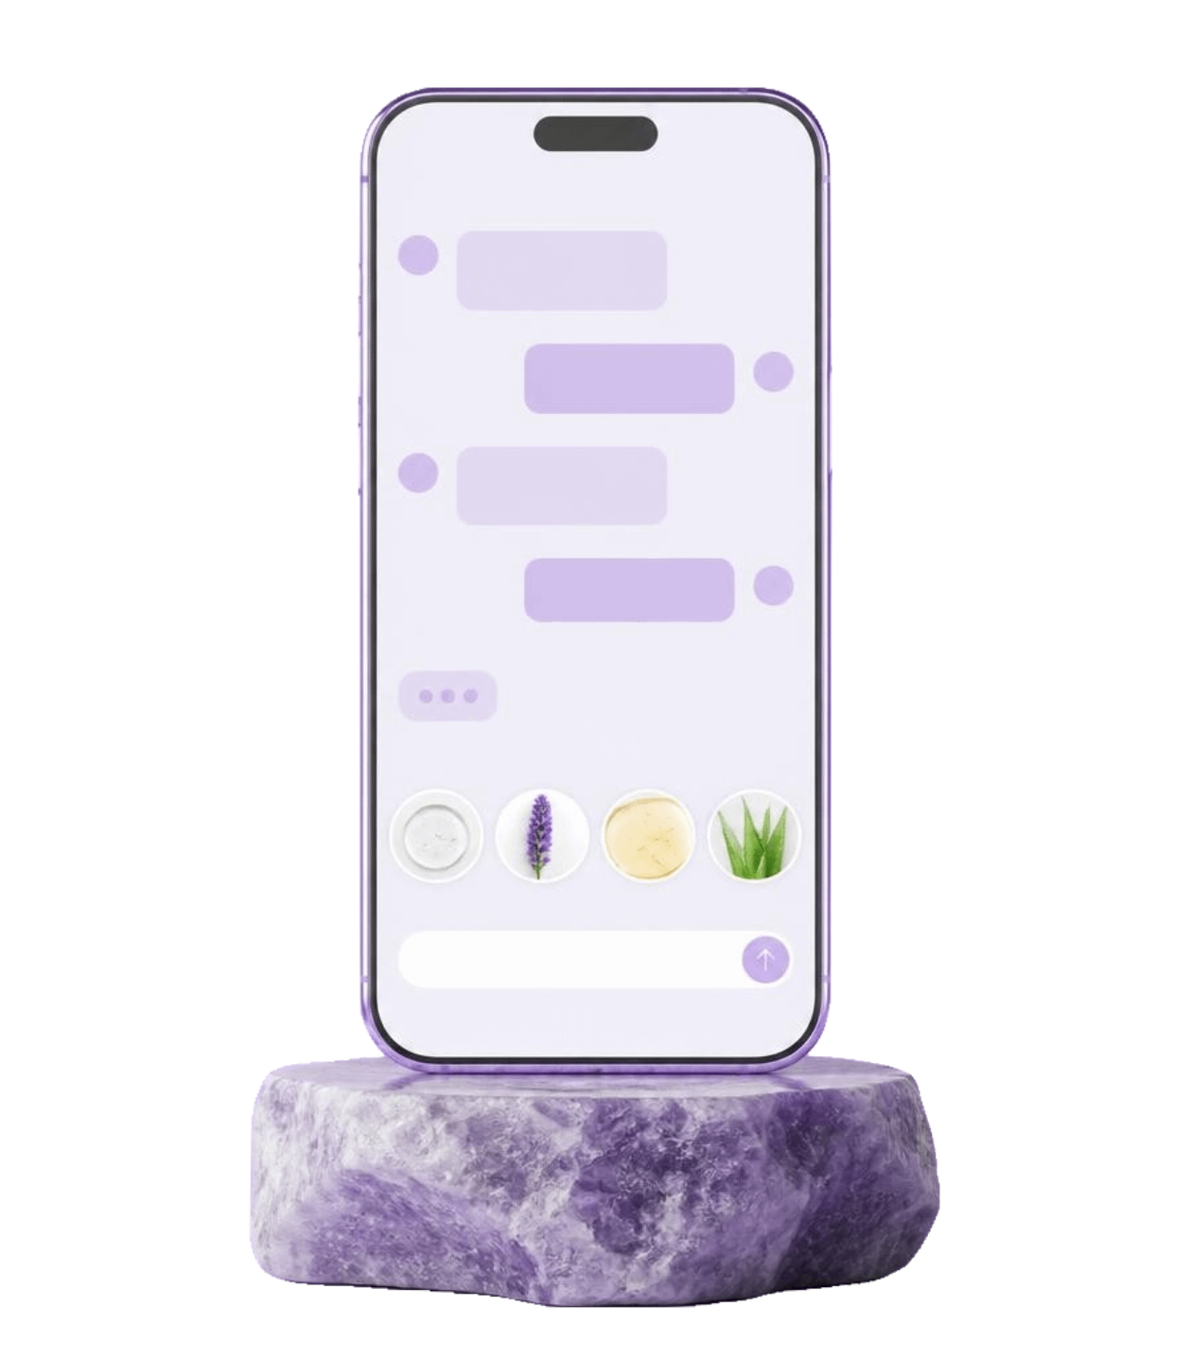
Your personal skincare guide, available anytime
INTERACTIVE CONVERSATIONAL ASSISTANT
USER QUERY
“Can I use niacinamide in my morning routine?”
SKINOVATE-AI ASSISTANT
“Niacinamide is commonly used in morning skincare routines. It can be combined with several hydrating ingredients. Remember to finish your morning routine with sunscreen.”
Today's assistant is educational and rule-based; generative AI conversation is a future possibility.
Illustrative concept
Notes:
The assistant answers everyday questions, explains ingredients simply, and explains AM and PM routines. It discusses general ingredient compatibility, suggests habit improvements, and points to professional advice when needed. Today's assistant is educational and rule-based; generative AI conversation is a future possibility.

Slide 10

Making personalized skincare smarter
PROJECT OUTCOMES & ROADMAP
Benefits
Informed decisions, personalized guidance, ingredient understanding, organized routines, better awareness, consistent journaling, one experience.
Future
Generative AI conversations, improved computer-vision analysis, smarter recommendations, secure facial-image storage, richer progress insights, native Android app, multilingual access.
Educational guidance only, not medical diagnosis or prescription.
UNDERSTAND YOUR SKIN · EMPOWER YOUR ROUTINE · ELEVATE YOUR CARE
SKINOVATE-AI · THANK YOU · Questions & Answers
Notes:
To conclude, Skinovate-AI brings personalized guidance, ingredient understanding, organized routines and progress awareness into one experience. Future possibilities include generative AI conversations, improved computer vision, smarter recommendations, secure facial-image storage, richer progress insights, a native Android app and multilingual access. This is educational guidance, not a medical diagnosis or prescription. Thank you; we welcome your questions.

