Slide 1
Investment Strategy Optimization Presentation
- Jay P. Asodariya

Slide 2
Framing the Problem
Goal: Optimize an investment strategy by selecting stocks that provide the highest potential returns while managing risk.
Approach: We use stock market data (prices, volumes, and other factors) to filter and rank the best stocks for investment.
We considered this as an unsupervised Learning Problem : Extracting insights from data.
Eg : Discover patterns, relationships and structures.

Slide 3
Approach Overview
The optimization process involves multiple steps:
1. Data preprocessing (e.g., calculating rolling averages of stock data).
2. Feature Engineering for adding some additional features in our dataset.
3. Factor analysis to evaluate stock risk/return ratios.
4. KMeans clustering to group stocks based on similar characteristics.

Slide 4
Workflow
Collect and prepare data.
Develop a hypothesis for strategy
Coding the model
Backtest the strategy

Slide 5
Unsupervised Learning in Trading
Unlike supervised learning, where the model is trained to make predictions, unsupervised learning focuses on extracting insights from data.
How it is applied in trading ?
Clustering
Dimensionality Reduction
Portfolio Optimization
Analomy Detection

Slide 6
What’s done in the project
Collection of stock data.
Calculate different technical indicators and features for each stock
Aggregate on monthly level and filter for each month only top 150 most liquid stocks.
Calculate the monthly return for different time horizons to add to features.
Download Fama-French Factors and calculate rolling factor betas for each stock.
For each month fit a K-means clustering model to group similar assets based on their features.
For each month, select assets based on the cluster and form a portfolio based on efficient frontier max sharpe ratio portfolio optimization.
Get stocks to buy along with its weight.
NOTE : our stock list is most recent, which means that there may be a survivorship bias in the list, in reality we need to use survivorship free data.

Slide 7
Technical Indicators
1. Garman-Klass Volatility
Purpose: Estimates stock volatility using high, low, open, and close prices.
Benefit: Provides a more comprehensive volatility measure than simple close-to-close volatility.
2. Relative Strength Index (RSI)
Purpose: Measures momentum to indicate whether a stock is overbought or oversold.
Range: 0-100, with readings above 70 indicating overbought conditions and below 30 indicating oversold.
3. Bollinger Bands (BB)
Purpose: Measures volatility using a moving average and bands set at two standard deviations above and below the price.
4. Average True Range (ATR)
Purpose: Measures volatility by analyzing the range between high and low prices, normalized using standard deviation.
Benefit: Provides insights into stock price volatility trends.
5. Moving Average Convergence Divergence (MACD)
Purpose: Shows the relationship between two moving averages of a stock's price.
Calculation: Normalized using standard deviation to identify momentum.
6. Dollar Volume
Purpose: Measures liquidity by calculating the dollar amount of trading volume.

Slide 8
Filtering top 150 stocks
Selected top 150 stocks, based on their liquidity, measured by dollar volume.
dollar volume= (close × volume)​ / 1e6.
This provides an estimate of the liquidity of a stock (i.e., how much money flows in and out of the stock).
We calculate the dollar volume (closing price multiplied by trading volume) for each stock and apply a 5-year rolling average to smooth out short-term fluctuations.
Stocks are then ranked by their liquidity, and the top 150 stocks are selected each month based on their dollar volume.
This approach ensures that only highly liquid stocks, which are easier to trade, are considered, providing a more stable and reliable dataset.

Slide 9
Calculating Monthly Returns as Features
Objective: Compute stock returns over different time periods (lags) to capture time series patterns like momentum.
Returns Calculation : Calculated percentage change using “.pct_change(lag)” for 1,2,3,6,9 and 12 months.
Clipped extreme values between the 5th and 95th percentiles to remove outliers and stabilize the data.
Adjusted the returns using a transformation that smooths returns across different lags.
Assumptions:
Momentum is captured through varying time horizons.
Removing outliers reduces noise, improving feature stability.
This method creates useful return features for both short-term and long-term analysis.

Slide 10
Accessing Fama-French factors and calculating rolling factor beta
Objective: Estimate the exposure of assets to common risk factors using the Fama-French five-factor model and rolling linear regression.
Fama-French Factors:
Five factors: Market Risk (Mkt-RF), Size (SMB), Value (HML), Profitability (RMW), and Investment (CMA).
These factors explain asset returns and help assess the risk/return profile of portfolios.
Factor Data Access:
Used pandas-datareader to download historical Fama-French factor returns.
Resampled the data monthly and merged it with the stock return data to calculate exposures.
Rolling Factor Betas:
Applied RollingOLS linear regression on historical stock returns against Fama-French factors.
Calculated factor betas (coefficients) for each stock over a rolling window of 24 months to capture time-varying exposure to these factors.
Assumptions:
10 observations per stock: Only stocks with at least 10 months of data were considered valid for regression.
Rolling window: A 24-month rolling window was used to estimate factor betas dynamically over time.
This process integrates factor exposures into stock data, enabling models to incorporate both historical returns and risk factor sensitivities.

Slide 11
Machine Learning Strategy - K-Means Clustering
Objective:
Group similar assets based on their features using K-Means Clustering for each month.
Approach:
K-Means Clustering:
We cluster stocks based on predefined features and initialize centroids using their RSI values.
The number of clusters is selected using the elbow method.
Key Points:
RSI-based Centroids: We initialize clusters using RSI values of 30, 45, 55, and 70 to capture momentum.
Monthly Clustering: The clustering is done monthly to capture time-based variations in asset behavior.

Slide 12
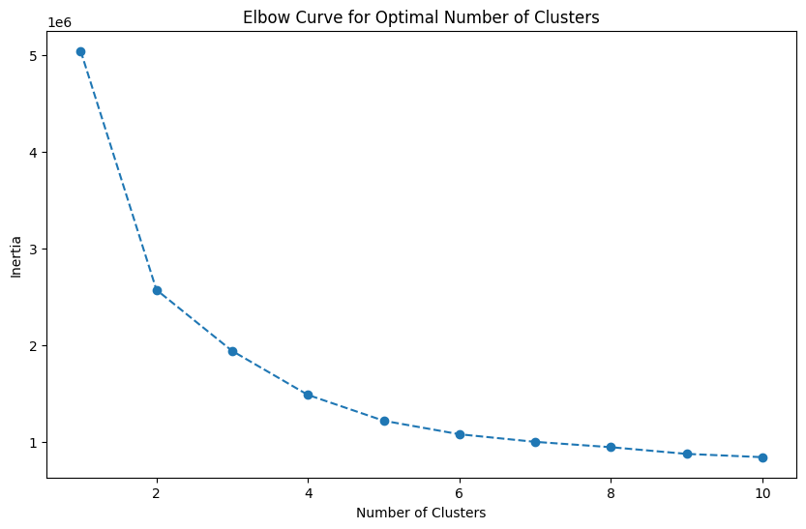
Selecting Optimal Number of Clusters - Elbow Method
Elbow Curve:
Plot the inertia (sum of squared distances to the nearest cluster center) for different cluster numbers.
Identify the "elbow point" where increasing clusters does not significantly reduce inertia.
Here, as seen in figure 1, we chose K = 4.
Key Points:
Max Clusters Considered: A range of up to 10 clusters is explored.
Figure 1 : Elbow Curve for selecting optimal value of K.

Slide 13
Portfolio Selection Using Clusters
Objective:
Form a portfolio by selecting assets based on their cluster assignment.
Approach:
Cluster Selection:
Based on the hypothesis that momentum is persistent, stocks clustered around the RSI 70 centroid are selected for the following month.
Only stocks in Cluster 3 are included, assuming they will continue to outperform.
Key Points:
Momentum Hypothesis: Stocks near RSI 70 are likely to keep performing well.
Portfolio Construction: The portfolio is built from stocks in Cluster 3, which reflects high momentum.

Slide 14
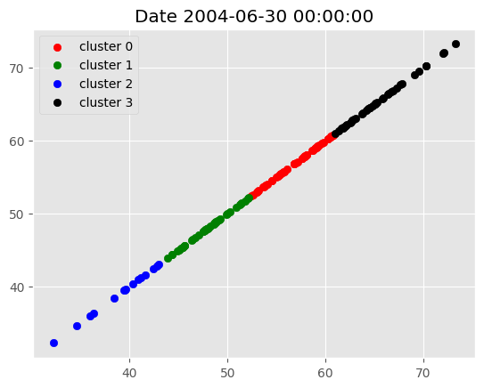
Cluster Visualization Example
Figure 2 : Example for selecting cluster based on RSI value as feature.

Slide 15
Portfolio Optimization with Efficient Frontier
Objective:
Optimize portfolio weights using the Efficient Frontier to maximize the Sharpe ratio.
Approach:
Efficient Frontier:
We use the Efficient Frontier technique to find the best combination of stocks that maximizes returns for a given level of risk.
The optimization process is powered by the PyPortfolioOpt library, which helps in determining how much of each stock to include in the portfolio.
Maximizing the Sharpe Ratio:
The Sharpe ratio is a commonly used metric that evaluates the performance of an investment by adjusting for its risk.
Maximizing the Sharpe ratio means finding the optimal mix of stocks that gives us the highest return for the least amount of risk.
Key Constraints:
1-Year Lookback: Portfolio optimization uses the last 1 year of stock prices.
Weight Bounds: Stock weights are constrained to be between half of equal weight and 10% of the portfolio.

Slide 16
Handling Failed Optimization
Objective:
Manage cases where Sharpe ratio optimization fails for a given month.
Approach:
Fallback Strategy:
If Sharpe ratio optimization fails, apply equally weighted allocations for that month’s portfolio.
This ensures that the portfolio remains diversified, even if the optimization does not succeed.
Key Points:
Diversification: The fallback equally-weighted strategy guarantees no stock is overly represented.
Resilient Approach: This method ensures that the portfolio is always constructed, even under suboptimal conditions.

Slide 17
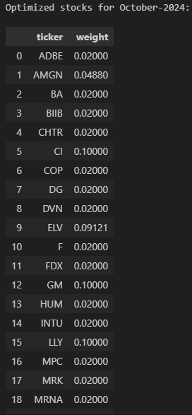
Visualizing Optimized Portfolio with Stocks and Weights
This part of the process allows the user to input a specific month and year, and the system will show the stocks that are selected for that month, along with how much of the portfolio was allocated to each stock. This helps visualize which stocks were favored in the optimized portfolio for a given period.
It gives output as the stock name and the % of its weight to be included in our portfolio.
Figure 3, shows the output for the stocks of October-2024.
Figure 3: Sample Output

Slide 18
Model Trade-offs and Prioritization
Trade-off Between Model Sophistication and Simplicity
K-Means vs. More Complex Clustering Methods:
Chosen: K-Means is computationally efficient and provides interpretable results, suitable for the scale of stock market data.
Trade-off: More sophisticated methods (e.g., Gaussian Mixture Models) might have provided more nuanced clusters but at the cost of interpretability and speed. K-Means offered a balance between simplicity and effectiveness, especially when clustering large datasets.
Efficient Frontier vs. Advanced Optimization Techniques:
Chosen: The Efficient Frontier, combined with PyPortfolioOpt, strikes a balance between computational simplicity and powerful optimization.
Trade-off: While advanced optimization methods (e.g., neural networks for portfolio optimization) could potentially enhance returns, they introduce complexity and reduce the model’s interpretability, which is crucial in financial decisions.

Slide 19
Prioritization of Stability and Interpretability
Simplicity Over Complexity:
We favored models like K-Means and Efficient Frontier because they are well-understood and trusted in the financial industry.
This allowed for a clear interpretation of results, making it easier to communicate insights and decisions to stakeholders.
Focus on Robustness:
The models were chosen for their robustness in dynamic environments like financial markets.
We emphasized stability by using rolling windows and clipping outliers, ensuring that the model is not overly sensitive to short-term market noise.

