Slide 1
We are Presenting
>> Current And Upcoming Trends In Our Technology
>> Our Strengths and Weaknesses
Jay Patel
Python – Full-Stack Developer
Akshay Pitroda
Python – Full-Stack Developer

Slide 2
Self Introduction
My Name is Jay Patel and I am from Valsad,Gujarat.
I have done my graduation in BE. Civil and currently I am pursuing as an Full Stack Web Development Course at Tops Technologies, Ahmedabad.
Jay Patel
Python – Full-Stack Developer

Slide 3
Self Introduction
My Name is Akshay Pitroda and I am from Dholera , Gujarat.
I have done my graduation in B.com and Master’s in MBA – Marketing.
Currently I am pursuing as an Full Stack Web Development Course at Tops Technologies, Ahmedabad.
Akshay Pitroda
Python – Full-Stack Developer

Slide 4

Introduction About Information Technology (IT)

Slide 5

What is Web Development
Making websites and apps
Designing how they look and work
Making them work on phones and computers
Keeping them fast and safe
Using tools to manage content
Working on the parts users see
Working on the parts users don't see
Making sure everything works well

Slide 6
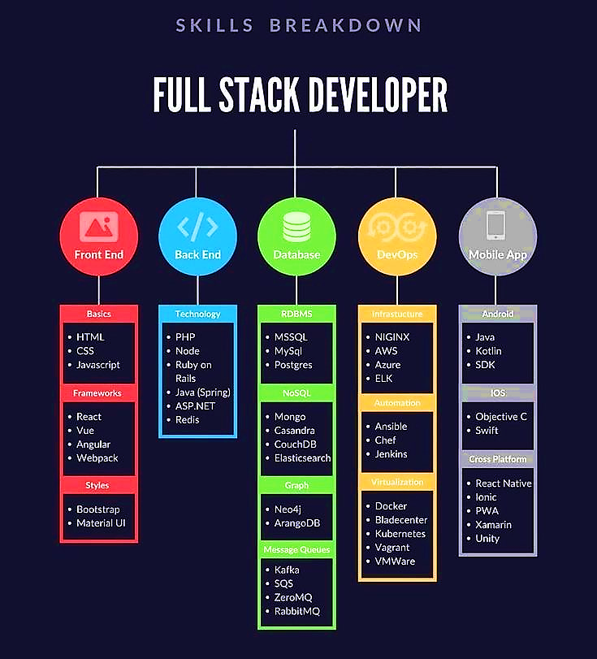

Slide 7


Slide 8
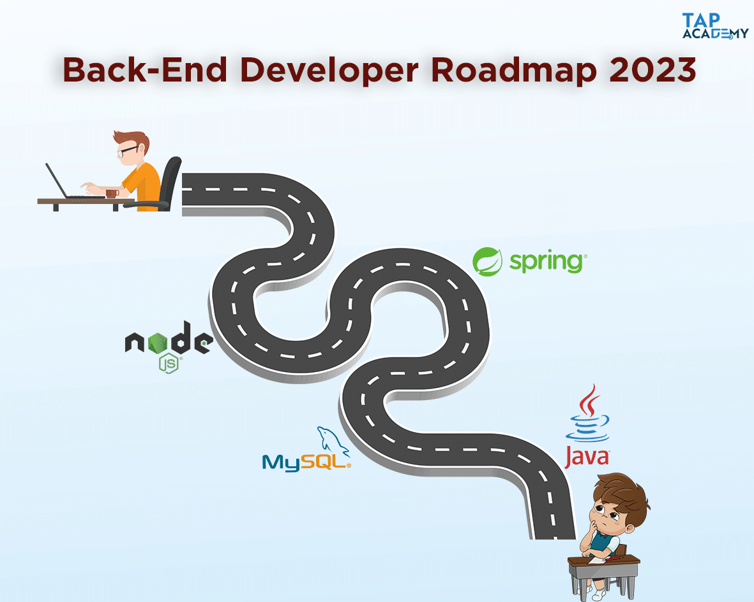
BACK-END DEVELOPER ROADMAP

Slide 9
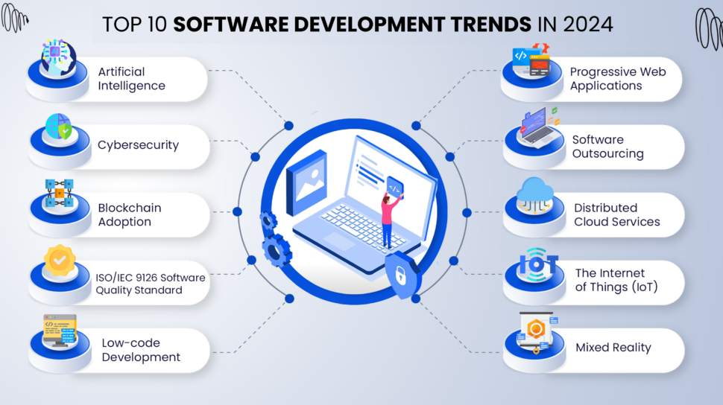
Current & Upcoming Trends in Web Development

Slide 10
Strengths & Weaknesses
Strengths
Highly Motivated
Creative
Flexible
Empathetic
Organised
Weakness
Procrastination
Impatient
Not able to deny
Over-thinking
Jay Patel
Python – Full-Stack Developer

Slide 11
Strengths & Weaknesses
Strengths
Believe in Creativity
Ability to Justify
Leadership Skill
Strategy Planner
Self-motivation
Negotiation skills
Weakness
Do not Follow Schedule
Being Helpful to others
Lack of Concentration
Communication Error
Talk Depth to the Topic
Akshay Pitroda
Python – Full-Stack Developer

Slide 12
Identify your Weaknesses
Acknowledge your weaknesses
Learn from Failure
Try to schedule your daily work
Work on Mental Health as well as Physical health
Don’t hesitate to ask anything
Stay Positive
How to Overcome
from Weaknesses

Slide 13
Thanking Note
“ Every Setback Is A Setup For A Comeback In Your Career Journey ”
Thank You

