Slide 1
2CSDE86 Application Development Frameworks (ADF)
Lecture-3
Django Project Structure, Django Apps Structure
7th CSE
Daiwat Vyas & Dvijesh Bhatt

Slide 2
Disclaimer
Some of the content in the ppt is taken from various online sources and reference books and after referring it was considered for including it in the ppt slides.

Slide 3
Pre-requisite for this session
Students should have already installed Python, vscode and setup Django on their system.
A file named ADF Lab-2 04 August 2021 was already sent for Lab task on 04 August 2021, and it had all step by step procedure mentioned for installing Python, vscode and setting up Django in their system.

Slide 4
Django Project Structure
When you create a Django project, the Django framework itself creates a root directory of the project with the project name on it.
It contains some files and folder, which provide the very basic functionality to your website and on that strong foundation you will be building your full scaled website.
By root directory, we mean about the directory which contains your manage.py file.

Slide 5
Django Project Structure (contd…)
Additional files like db.sqlite, which is a database file may be present when we will be migrating your project.
Django root directory is the default app which Django provides you.
It contains the files which will be used in maintaining the whole project.
The name of Django root directory is the same as the project name you mentioned in django-admin startproject [projectname].
This root directory is the project’s connection with Django.

Slide 6
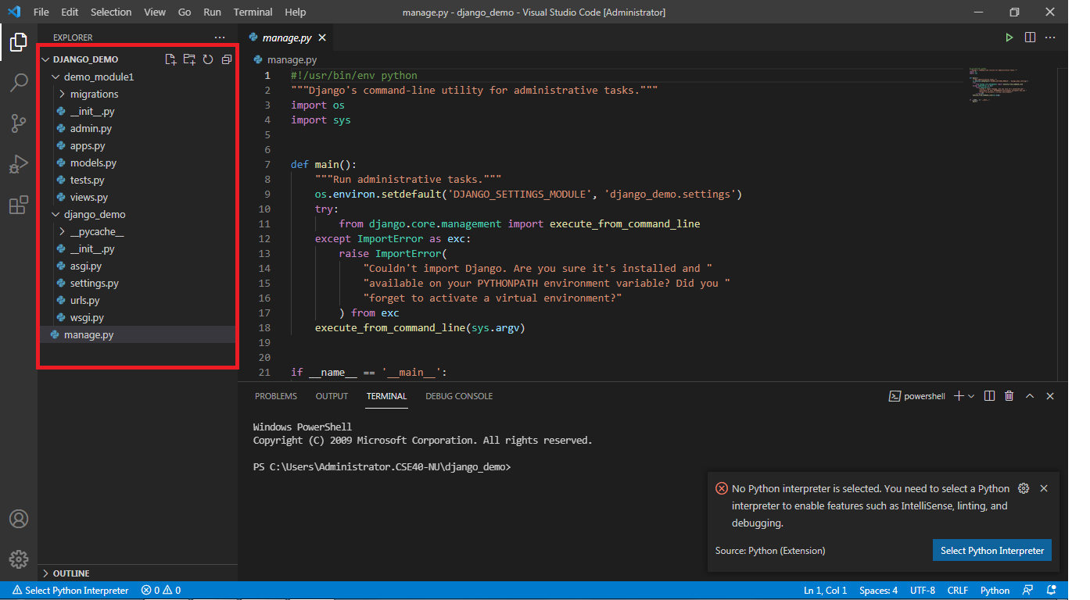
Django Project Structure (contd…)

Slide 7
Django Project Structure (contd…)
manage.py
This file is used basically as a command-line utility and for deploying, debugging, or running our web application.
This file contains code for runserver, or makemigrations or migrations, etc. that we use in the shell.
There is no need to make any changes to the file.

Slide 8
Django Project Structure (contd…)
manage.py
The file contains the code for starting the server, migrating and controlling the project through command-line.
This file provides all the functionality as with the django-admin and it also provides some project specific functionalities

Slide 9
Django Project Structure (contd…)
manage.py
runserver: This command is used to run the server for our web application.
Migrate: This is used for applying the changes done to the models into the database. That is if we make any changes to the database then we use migrate command.
This is used the first time we create a database.

Slide 10
Django Project Structure (contd…)
manage.py
Makemigration: this is done to apply new migrations that have been carried out due to the changes in the database.
It is the command for integrating your project with files or apps you have added in it.
This command will actually check for any new additions in your project and then add that to the same.

Slide 11
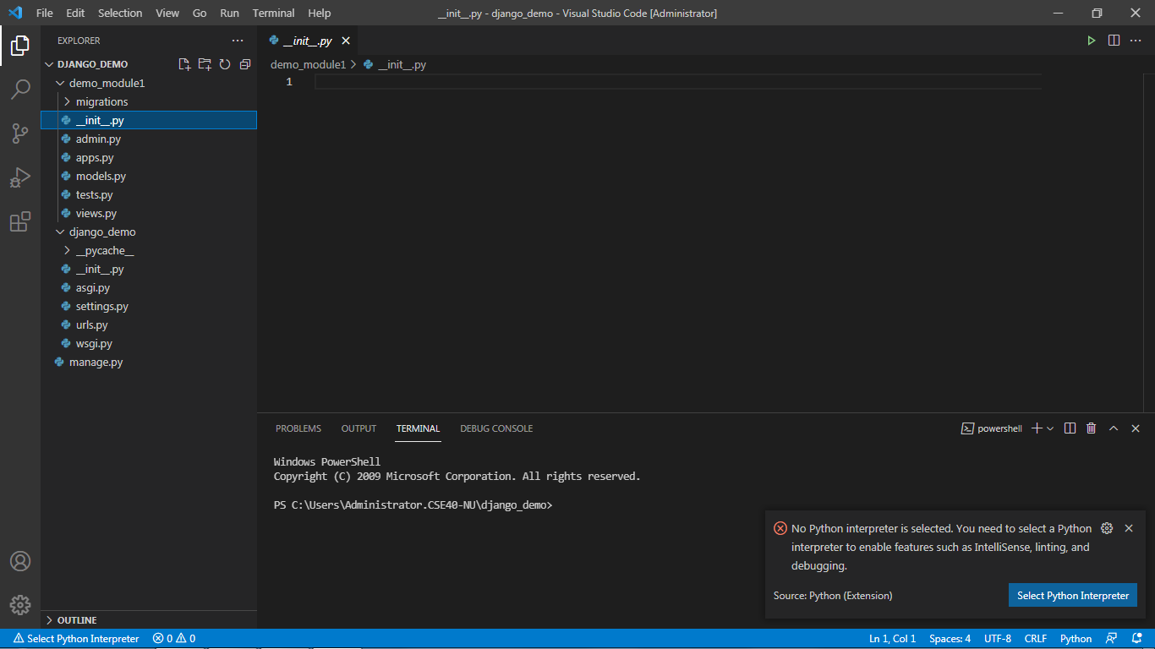
Django Project Structure (contd…)
_init_.py
This file remains empty and is present their only to tell that this particular directory(in this case django_project) is a package.
There is no need to make any changes to the file.
The function of this file is to tell the Python interpreter that this directory is a package and involvement of this __init.py_ file in it makes it a python project.

Slide 12
Django Project Structure (contd…)
_init_.py
This file remains empty and is present their only to tell that this particular directory(in this case django_project) is a package.
There is no need to make any changes to the file.
The function of this file is to tell the Python interpreter that this directory is a package and involvement of this __init.py_ file in it makes it a python project.

Slide 13
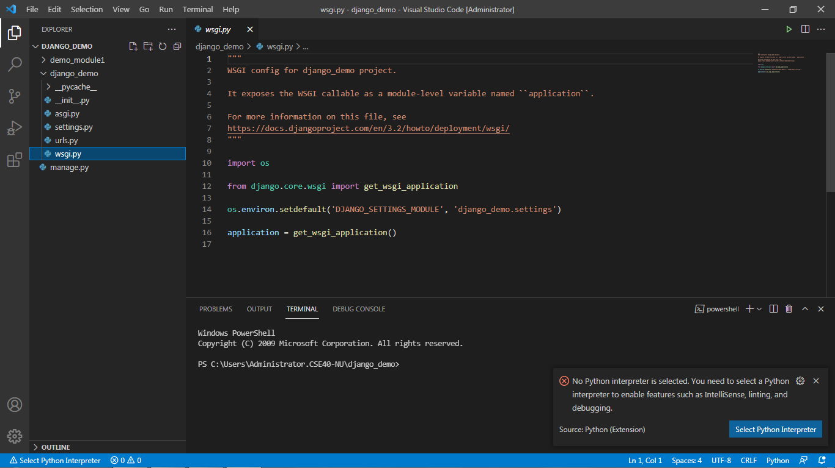
Django Project Structure (contd…)
wsgi.py

Slide 14
Django Project Structure (contd…)
wsgi.py
This file mainly concerns with the WSGI server and is used for deploying your applications on to servers like Apache etc.
WSGI, short for Web Server Gateway Interface can be thought of as a specification that describes how the servers interact with web applications.
There is no need to make any changes to the file.

Slide 15
Django Project Structure (contd…)
wsgi.py
Django is based on python which uses WSGI server for web development.
This file is mainly concerned with that and we will not be using this file much.
wsgi is still important though if you want to deploy the applications on Apache servers or any other server because Django is still backend and you will need its support with different servers.
But you need not to worry because for every server there is a Django middleware out there which solves all the connectivity and integration issues and you just have to import that middleware for your server, it’s very simple.

Slide 16
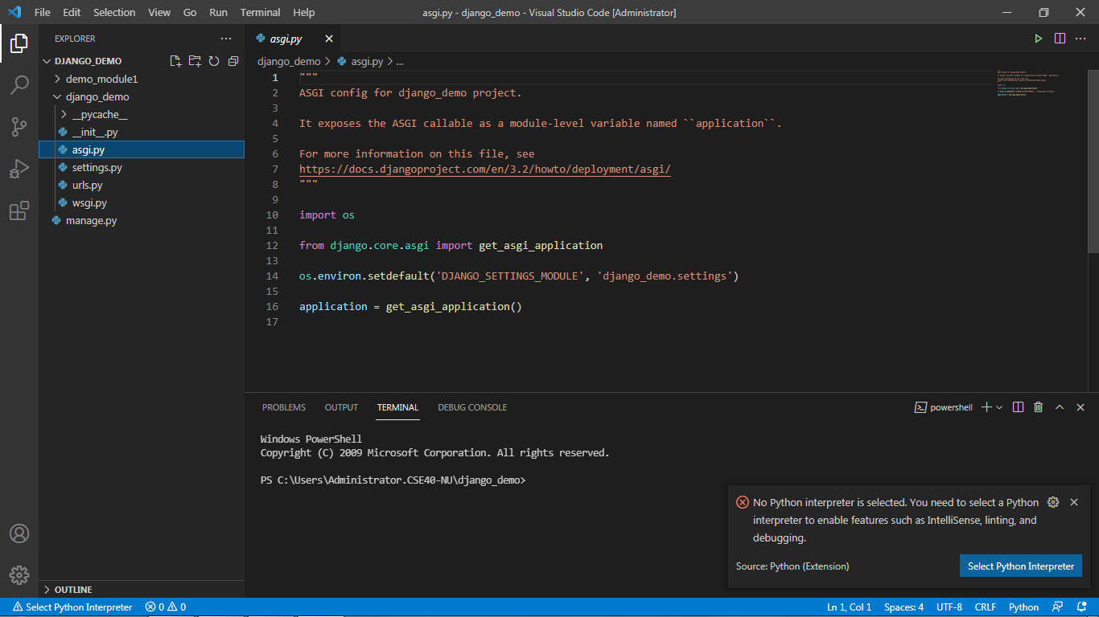
Django Project Structure (contd…)
asgi.py

Slide 17
Django Project Structure (contd…)
asgi.py
In the newer versions of Django, you will also find a file named as asgi.py apart from wsgi.py. ASGI can be considered as a succeeder interface to the WSGI.
ASGI, short for Asynchronous Server Gateway interface also has the work similar to WSGI but this is better than the previous one as it gives better freedom in Django development.
That’s why WSGI is now being increasingly replaced by ASGI.
There is no need to make any changes to the file.

Slide 18
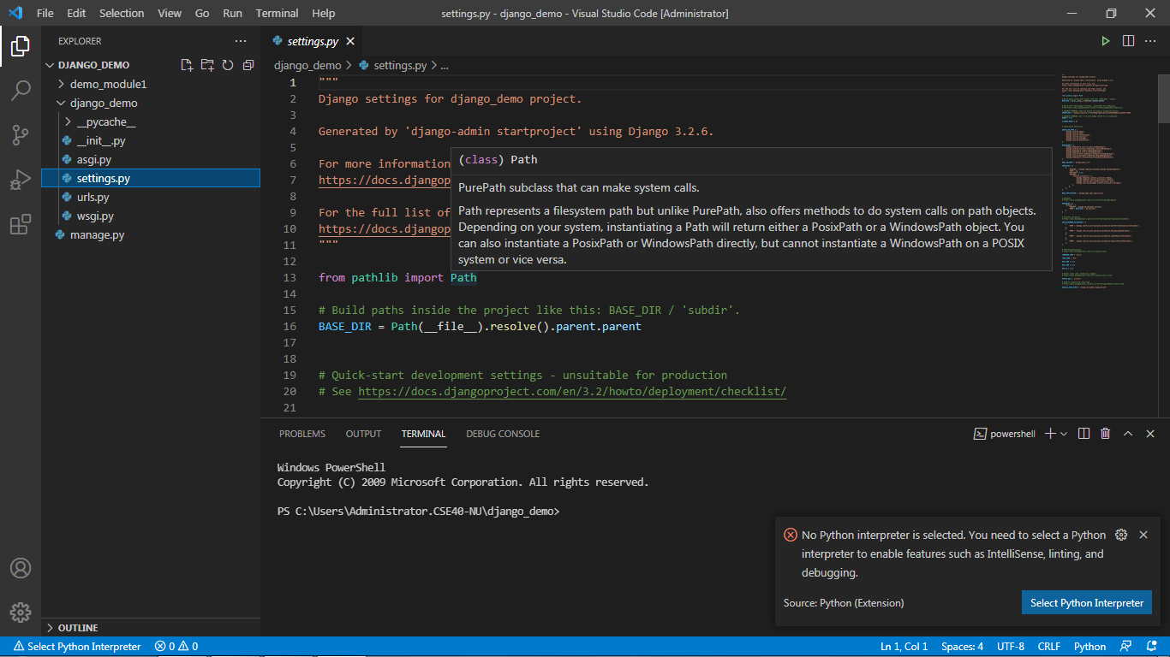
Django Project Structure (contd…)
settings.py

Slide 19
Django Project Structure (contd…)
settings.py
The settings.py is the main file where we will be adding all our applications and middleware applications.
As the name suggests this is the main settings file of the Django project.
This file contains the installed applications and middleware information which are installed on this Django project.
Every time you install a new app or custom application you will be adding that in this file.

Slide 20
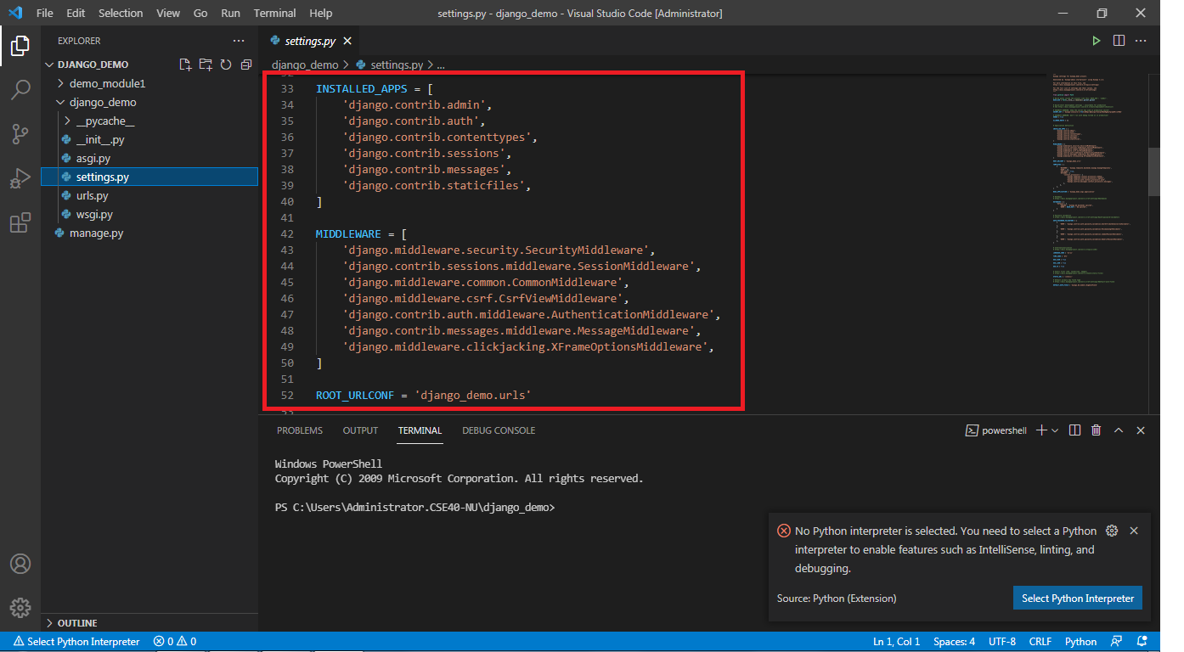
Django Project Structure (contd…)
settings.py

Slide 21
Django Project Structure (contd…)
settings.py
You can see that there are some pre-installed applications. (Refer image in previous slide to this slide)
These applications are by default there to provide all the basic functionality you will ever need for your website like Django admin app

Slide 22
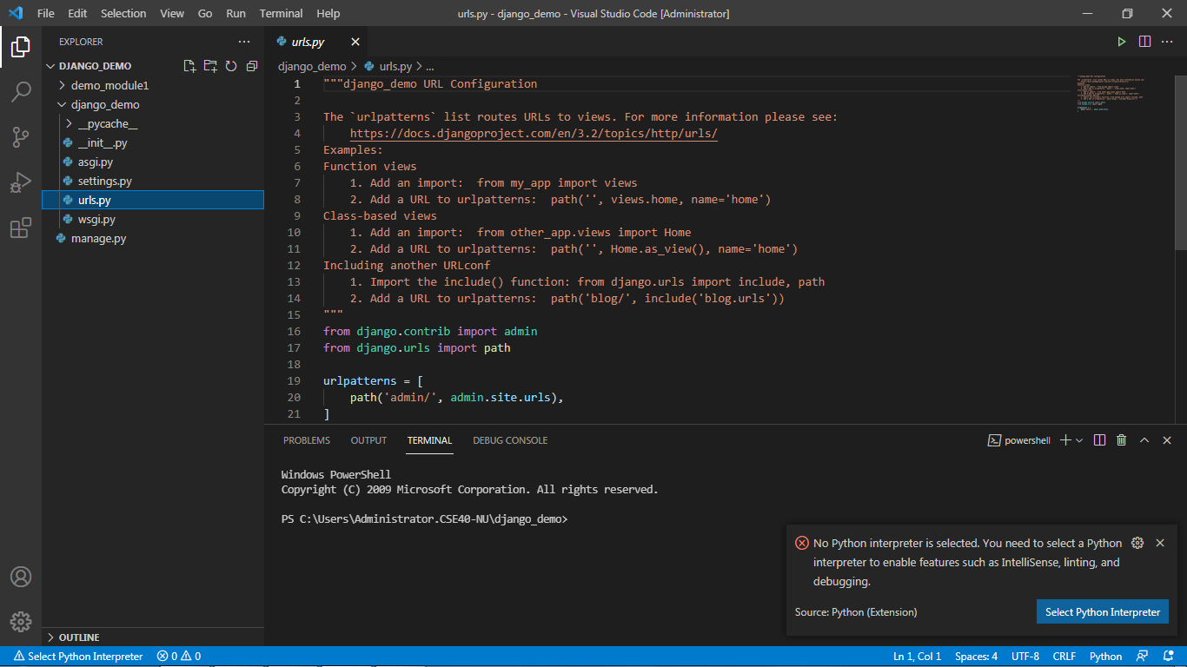
Django Project Structure (contd…)
urls.py

Slide 23
Django Project Structure (contd…)
urls.py
urls.py file contains the project level URL information.
URL is universal resource locator and it provides you with the address of the resource (images, webpages, web-applications) and other resources for your website.
The main purpose of this file is to connect the web-apps with the project. Anything you will be typing in the URL bar will be processed by this urls.py file. Then, it will correspond your request to the designated app you connected to it

Slide 24
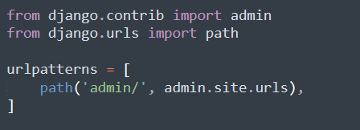
Django Project Structure (contd…)
urls.py
Here this file by default adds one URL to the admin app. The path () takes two arguments.
1st is the URL to be searched in the URL bar on the local server and 2nd is the file you want to run when that URL request is matched, the admin is the pre-made application and the file is URL’s file of that app.
This file is the map of your Django project.

Slide 25
Django Project Structure (contd…)
urls.py
It is used to provide the addresses of the resources (like image, website, etc) that are present there on the internet.

Slide 26
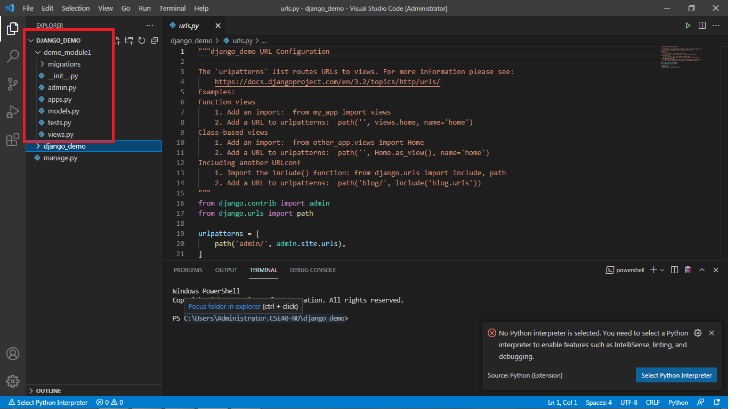
Django App Structure

Slide 27
Django App Structure (contd…)
Django uses the concept of Projects and apps for managing the codes and presents them in a readable format.
A Django project contains one or more apps within it, which performs the work simultaneously to provide a smooth flow of the web application.
For example, a real-world Django e-commerce site will have one app for user authentication, another app for payments, and a third app for item listing details: each will focus on a single functionality.

Slide 28
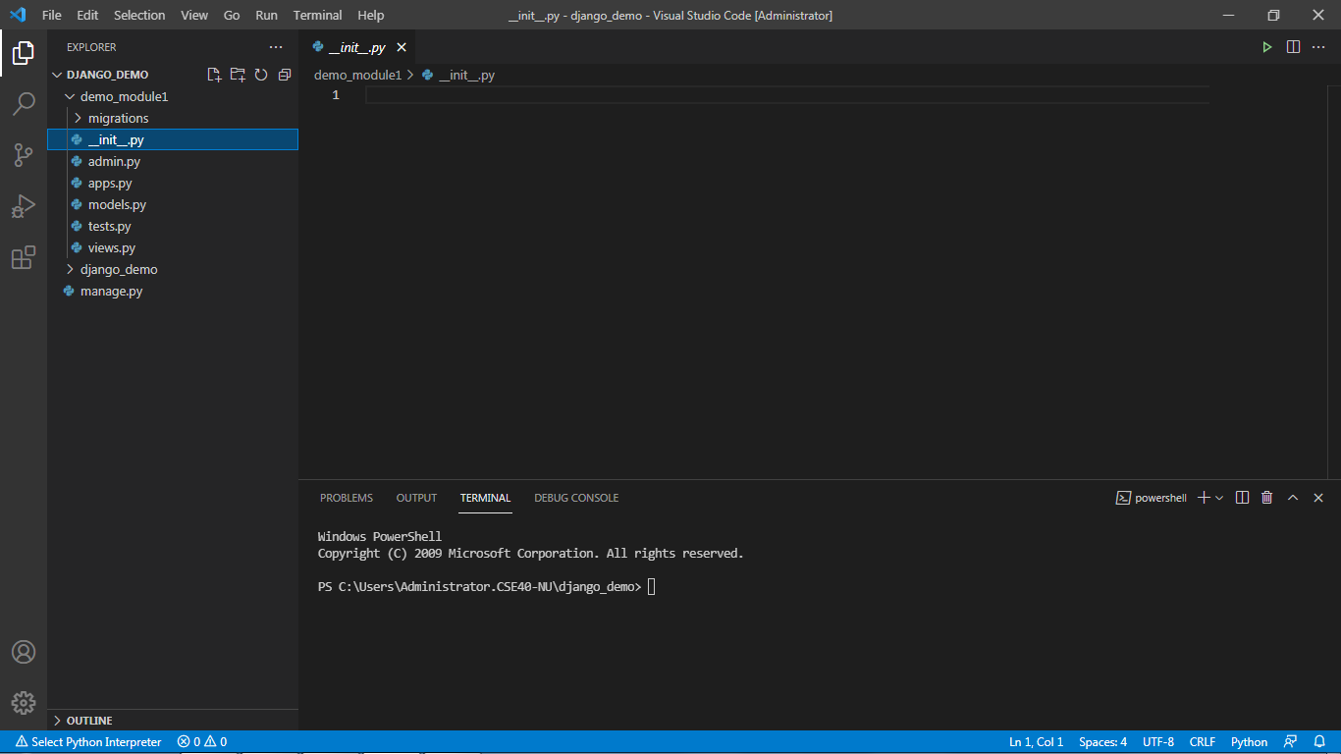
Django App Structure (contd…)
_init_.py
This file has the same functionality just as in the _init_.py file in the Django project structure.
It remains empty and is present just to indicate that the specific app directory is a package.
There is no need to make any changes to the file.

Slide 29
Django App Structure (contd…)
_init_.py
This file has the same functionality just as in the _init_.py file in the Django project structure.
It remains empty and is present just to indicate that the specific app directory is a package.
There is no need to make any changes to the file.

Slide 30
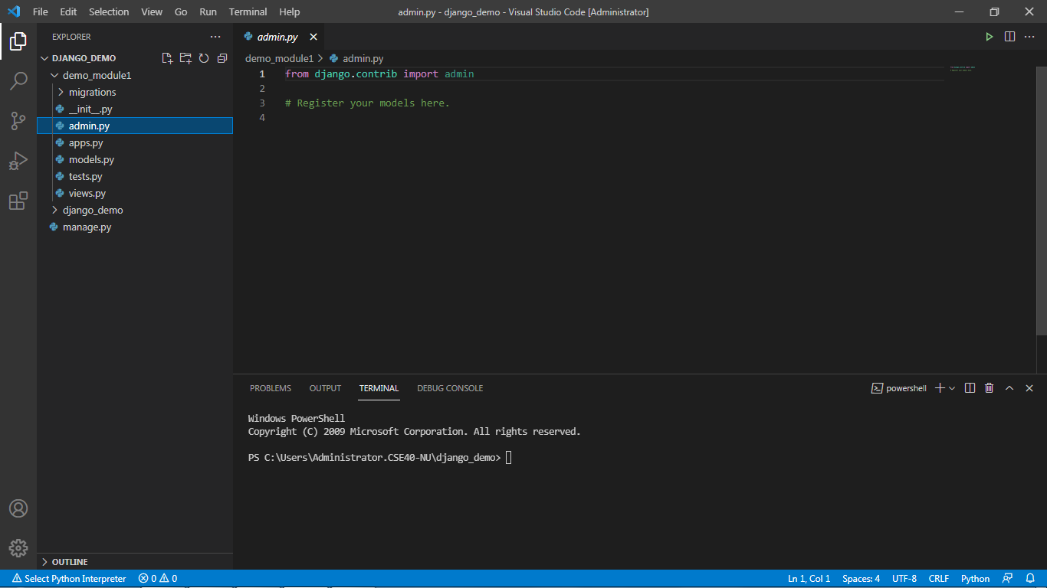
Django App Structure (contd…)
admin.py
Admin.py file is used for registering the Django models into the Django administration.
It is used to display the Django model in the Django admin panel. It performs three major tasks:
a. Registering models
b. Creating a Superuser
c. Logging in and using the web application
We will learn more about the admin panel in the next sessions.

Slide 31
Django App Structure (contd…)
admin.py
Admin.py file is used for registering the Django models into the Django administration.
It is used to display the Django model in the Django admin panel. It performs three major tasks:
a. Registering models
b. Creating a Superuser
c. Logging in and using the web application
We will learn more about the admin panel in the next sessions.

Slide 32
Django App Structure (contd…)
admin.py
The models that are present have a superuser/admin who can control the information that is being stored.

Slide 33
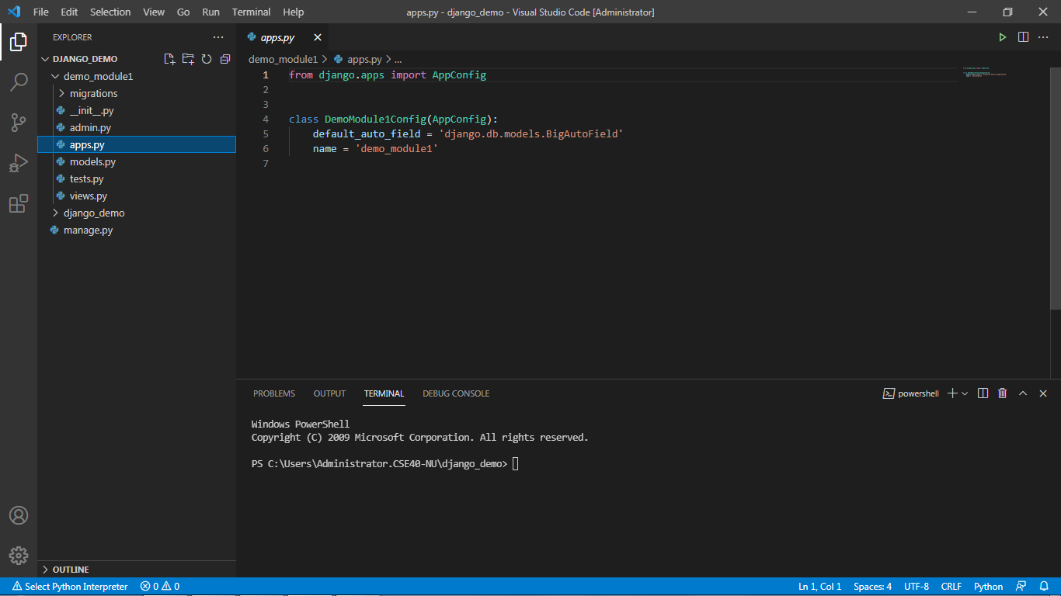
Django App Structure (contd…)
apps.py

Slide 34
Django App Structure (contd…)
apps.py
apps.py is a file that is used to help the user include the application configuration for their app.
Users can configure the attributes of their application using the apps.py file.
However, configuring the attributes is a rare task a user ever performs, because most of the time the default configuration is sufficient enough to work with.
The default configuration is sufficient enough in most of the cases and hence we won’t be doing anything in the beginning with this file.

Slide 35
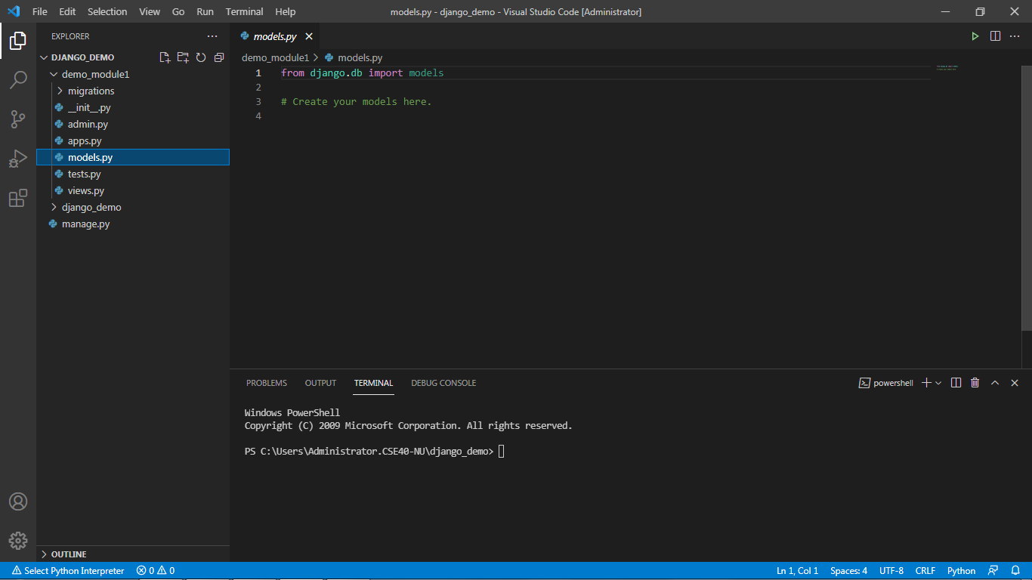
Django App Structure (contd…)
models.py

Slide 36
Django App Structure (contd…)
models.py
Models.py represents the models of web applications in the form of classes. It is considered the most important aspect of the App file structure.
Models define the structure of the database. It tells about the actual design, relationships between the data sets, and their attribute constraints.
This file contains the models of our web applications (usually as classes).
Models are basically the blueprints of the database we are using and hence contain the information regarding attributes and the fields etc of the database.

Slide 37
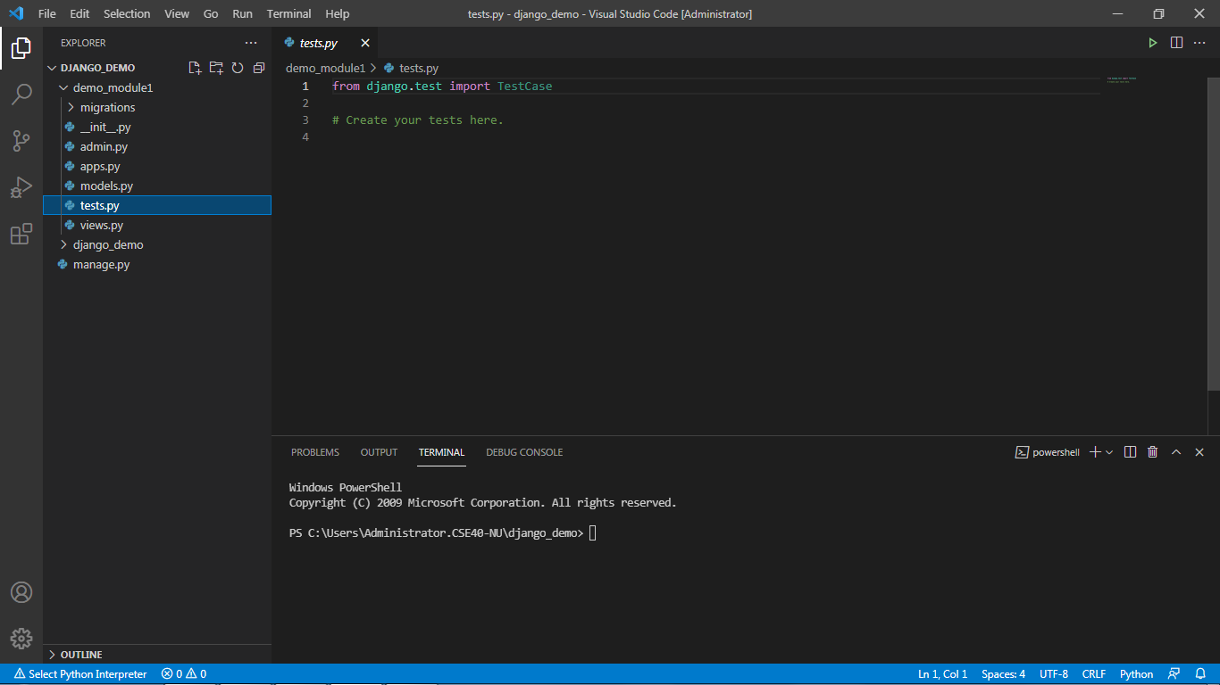
Django App Structure (contd…)
tests.py

Slide 38
Django App Structure (contd…)
tests.py
It allows the user to write test code for their web applications. It is used to test the working of the app.
This file contains the code that contains different test cases for the application. It is used to test the working of the application.

Slide 39

Django App Structure (contd…)
views.py

Slide 40
Django App Structure (contd…)
views.py
Views are also an important part when we talk about the Django app structure.
Views provide an interface through which a user interacts with a Django web application. It contains all the views in the form of classes.
it contains all the Views(usually as classes). Views.py can be considered as a file that interacts with the client. Views are a user interface for what we see when we render a Django Web application.

Slide 41
Summary
All the files we have discussed above are within every Django application you create.
The main aim of these files is to provide you with backend support.
However, the settings.py and urls.py are the two main files we will be working with.
Making changes to these files will bring unique functionalities to the web application you create.

