Slide 1

Image Forgery Detection
Amrutha A - 1BG20AI015
Chandana S - 1BG20AI027
Jayasri A - 1BG20AI043
Guide: Prof. Nagarathna C R (Assistant professor)

Slide 2
Abstract
Detecting altered versions of a picture from the original is the method of detecting image forgeries. The task of detecting image counterfeiting is crucial in the field of digital image processing. With the rising usage of digital imagery in a variety of industries, including forensics, journalism, and scientific research, the number of manipulated and fabricated images has skyrocketed. In addition to preventing the spread of incorrect information and fake news, they must protect the authenticity of photos. The detection of picture forgeries, however, is fraught with technological difficulties, including the requirement for reliable and accurate image features, the capacity to differentiate between various types of image alteration, and effective algorithms that can analyze enormous quantities of digital images. To meet these problems, the field of computer vision and image processing must create novel and sophisticated techniques.

Slide 3
Motivation
The growth and use of digital images in various industries such as forensics, journalism and scientific research has increased the number of manipulated and forged images. New and advanced editing tools and techniques have made it easier to manipulate images without leaving traces, which can lead to negative impact for individuals and society as a whole.
Need for reliable and efficient forgery detection techniques has become more important than ever. They are required to protect the authenticity of images and prevent the spread of misinformation and fake news.
This can impact various fields like law enforcement, media, healthcare, etc. But, there are many technical challenges associated with detecting image forgery, such as the need for robust and accurate image features, the ability to distinguish between different types of image manipulations, and efficient algorithms which can process large volumes of digital images. These challenges require the development of innovative and complex techniques in the field of computer vision and image processing.

Slide 4
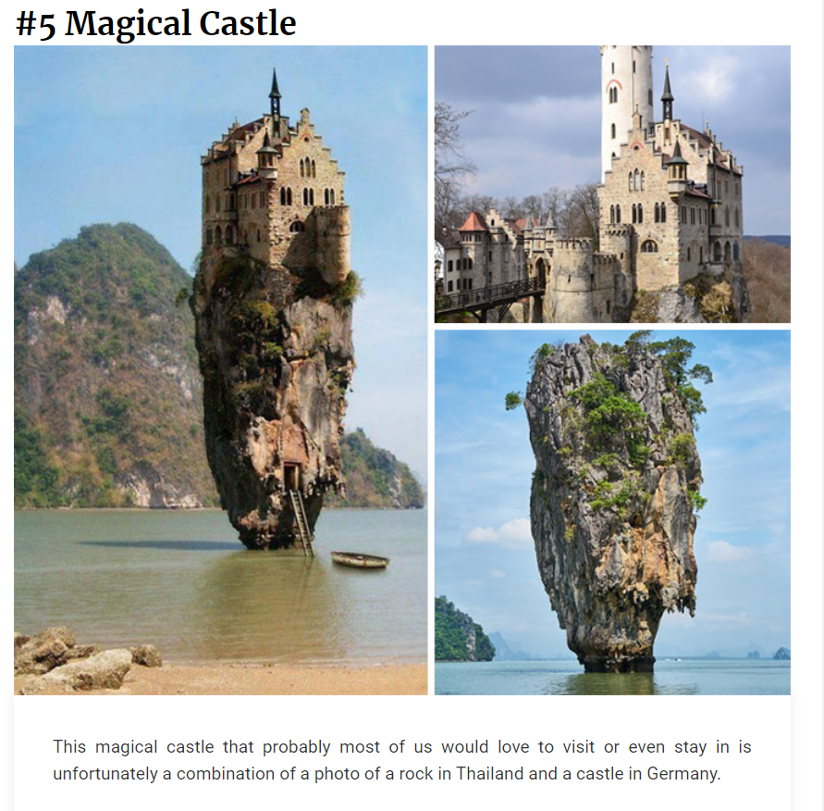
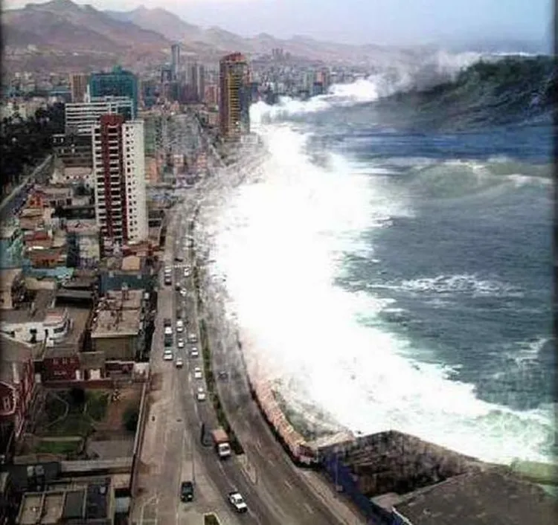
This image claims to show the 2004 Tsunami in Asia but is an image taken on the coast of Chile with the waves Photoshopped in
The above image is a combination of a photo of a rock in Thailand and a castle in Germany.

Slide 5
Introduction
The increasing use of digital images in various fields like forensic investigation, criminal investigation, surveillance systems, intelligence system, legal services, medical imaging and many more have led to a rise in image forgery, which can be done easily using software or editing tools.
Image forgery can have serious consequences, such as the erosion of trust in visual imagery and the use of manipulated images as material evidence in various proceedings^{[19]}. Several image forgery techniques like splicing, copy-move and removal are used^{[5]}.
With the rapid development of advanced image manipulation techniques, images can be edited easily without leaving any visual clues^{[15]}. Excellent forgeries are so tricky that they are not noticeable to the naked eye and don’t reveal traces of tampering^{[18]}.
Therefore, the importance and relevance of digital image forensics has led to establishment of different techniques for detection in image forensics.

Slide 6
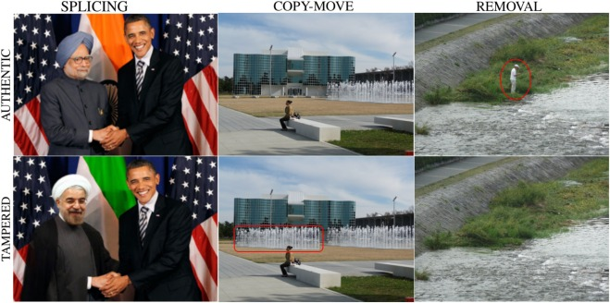
Common Types of Image Forgery Detection

Slide 7
Literature Survey
The existing methods of image forgery detection uses the following
Pre-processing techniques - image normalisation, image compression^{[5]} , image resizing[14], superpixel segmentation^{[6]}, conversion to grayscale images^{[2][20]}.
Feature extraction techniques - CNN^{[5][12][10][4]}, LCA^{[17],}SURF^{[6][11]}.
Classification techniques - Binary classification^{[8]}, SVM^{[5][16][13][1]} and ELM^{[14]}.
Datasets - Dresden^{[8][17]}, FAU^{[5][6]}, CASIA^{[7][3][18][13][1]} and MICC-F2000^{[12][10]}
The detailed survey of the existing methods are tabulated in the following slides.

Slide 8
Sl no. | Year | Title | Journal Name | Feature extraction technique | Dataset | Methodology applied | Accuracy
1 | 2021 | Image Splicing-Based Forgery Detection Using Discrete Wavelet Transform and Edge Weighted Local Binary Patterns^{[13]} | Security and Communication Networks | Discrete Wavelet Transform (DWT) and Edge Weighted Local Binary Patterns (EW-LBP) | DVMM, CASIA v1.0 and CASIA v2.0, Columbia | Deep Learning (CNN), DWT | 98.95%
2 | 2022 | Hybrid features and semantic reinforcement network for image forgery detection^{[7]} | Springer | Rotating residual units | NIST16, COVERAGE, CASIA | Hybrid features and semantic reinforcement network (HFSRNet) | 98.9%
3 | 2022 | Salient keypoint-based copy–move image forgery detection^{[15]} | Australian Journal of Forensic Sciences | Scale-Invariant Feature Transform (SIFT) and KAZE algorithms | CoMoFoD and MICC-F220 | SIFT and KAZE | 97.90%
4 | 2022 | An efficient approach for copy-move image forgery detection using convolutional neural network^{[12]} | Springer | CNN architecture | MICC-F2000 | deep learning classifier model (CNN) | 97.52%

Slide 9
Sl no. | Year | Title | Journal Name | Feature extraction technique | Dataset | Methodology applied | Accuracy
5 | 2018 | Medical Image Forgery Detection for Smart Healthcare^{[1]} | IEEE access | Multi-resolution regression filter | CASIA1 ,CASIA 2 | Scale Invariant feature transform (SIFT), Extreme learning | 97.4% and 98.2%
6 | 2020 | Exposing splicing forgery in realistic scenes using deep fusion network^{[4]} | Elsevier | Deep fusion network that combines the outputs of multiple CNN models | Splicing forged pictures | Deep fusion network | 97%
7 | 2020 | Gradient-Based Illumination Description for Image Forgery Detection^{[9]} | IEEE | 2-D lighting environment | ALOI, COCO, SDO-1, IEEE IFS-TC Challenge, OpenImages Splices (OIS) | Physics-based forensic descriptor | 97%
8 | 2019 | Detecting Fake Images on Social Media using Machine Learning^{[16]} | International Journal of Advanced Computer Science and Applications (IJACSA) | Colour histogram, edge detection, and texture analysis | Images extracted from Instagram application | Convolutional Neural Network | 97%

Slide 10
Sl no. | Year | Title | Journal Name | Feature extraction technique | Dataset | Methodology applied | Accuracy
9 | 2021 | Dual branch convolutional neural network for copy move forgery detection^{[10]} | Research gate | CNN architecture | MICC F-2000 | Convolutional neural network | 96-97%
10 | 2023 | A fast copy-move image forgery detection approach on a reduced search space^{[19]} | Springer | Discrete cosine transform (DCT) | Self generated dataset and BMP images from public dataset | overlapping block-based passive forensic scheme | 96.14%
11 | 2019 | An Image Copy-Move Forgery Detection Method Based on SURF and PCET^{[6]} | IEEE Access | SURF and PCET | GRIP, FAU and SBU-CM16 | Copy-move forgery detection (CMFD) method based on speeded-up robust feature (SURF) and polar complex exponential transform (PCET) | 96%
12 | 2022 | Design of Automated Deep Learning-Based Fusion Model for Copy-Move Image Forgery Detection^{[14]} | Hindawi | DenseNet | Benchmark datasets (MNIST, CIFAR-10) | deep learning-based fusion model for detecting and localising copy-move forgeries (DLFM-CMDFC) | 95.42% and 96.94%

Slide 11
Sl no. | Year | Title | Journal Name | Feature extraction technique | Dataset | Methodology applied | Accuracy
13 | 2020 | Image forgery detection using image similarity^{[2]} | Springer | Steerable pyramid decomposition technique | CoMoFoD | Blind detection method | 95.9%
14 | 2021 | Image splicing detection technique based on Illumination-Reflectance model and LBP^{[18]} | Springer | Local Binary Pattern (LBP) | CASIA v2.0, Digital Image Forensics | Deep Learning (CNN) and Wavelet transform to detect the spliced image | 93.79%
15 | 2021 | Image Forgery Detection Using Singular Value Decomposition with Some Attacks^{[20]} | Springer | Biorthogonal Wavelet Transform (BWT) with singular value decomposition (SVD) | Image forensics | Copy-move based image forgery detection using Improved Relevance Vector Machine | 92.22%
16 | 2020 | Robust forgery detection for compressed images using CNN supervision^{[5]} | Elsevier | CNN | CMI(Dresden dataset) | convolutional neural networks (CNN) | 90%

Slide 12
Sl no. | Year | Title | Journal Name | Feature extraction technique | Dataset | Methodology applied | Accuracy
17 | 2020 | A Full-Image Full-Resolution End-to-End-Trainable CNN Framework for Image Forgery Detection^{[8]} | IEEE Access | Patch-wise processing | Dresden/ FAU, DSO-1, Korus, NC2017, MFC2018, MFC2019 | Convolutional Neural Networks (CNN) | 85.1%
18 | 2018 | Accurate and Efficient Image Forgery Detection Using Lateral Chromatic Aberration^{[17]} | IEEE | Lateral Chromatic Aberration | Dresden Image Database | Lateral Chromatic Aberration | 84%
19 | 2021 | A novel copy-move forgery detection algorithm via two-stage filtering^{[11]} | Elsevier | Speeded Up Robust Features (SURF) and Scale Invariant Feature Transform (SIFT) algorithms | IMD, CoMoFoD, CMHD | Two-Staged Filtering (TSF) | 82%
20 | 2020 | Image splicing forgery detection combining coarse to refined convolutional neural network and adaptive clustering^{[3]} | Information Sciences, Elsevier | Cascaded convolutional neural network (C2RNet) | COLUMB, CASIA, FORENSICS | Coarse-to-refined Convolutional Neural Network (C2RNet) | 8% higher than R-CNN

Slide 13
Gaps Identified
Present techniques doesn’t detect the overlapping of forged regions and also the detection of subtle forged regions.
Many image forgery papers use small datasets that do not reflect the variety of real-world images. This limits the ability to generalise new images.
Some image forgery detection models are not transparent in their decision-making process, making it difficult to understand how they are making their detections.

Slide 14
Methodology
The method used in this paper combines a error level analysis (ELA) and convolution neural network (CNN) . ELA is a widely used method for locating altered areas of an image based on variations in the error levels brought on by compression. On the other hand, CNNs have great feature extraction capabilities for image analysis.
Principles of ELA:
ELA is a forensic method for examining photos at various levels of compression. It is predicated on the idea that a picture's compression level is not constant, and that portions that have undergone modification will have a different compression level than the remainder of the image. The original image and a compressed version of the same image are compared by ELA to determine how well it performs.
Principles of CNN:
CNN's underlying idea is convolution, which involves combining several filters with the input image in order to extract features. The image is then classified using the retrieved features.

Slide 15
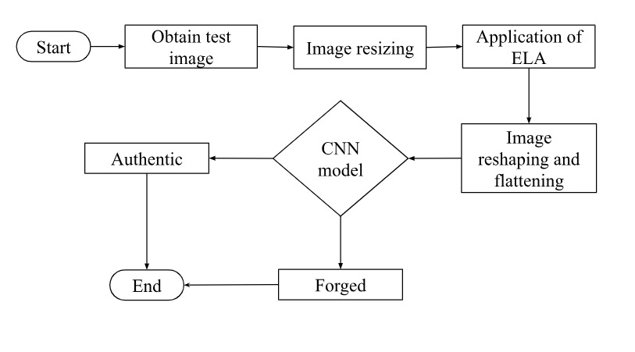
Architecture Model

Slide 16
Data Set Description
CASIA 2 - It contains 7492 authentic and 5125 forged color images with different sizes and 5163 ground truth images. The image formats comprise JPEG, PNG, BMP, and TIF. Size of the images vary for each image. https://www.kaggle.com/datasets/sophatvathana/casia-dataset?resource=download)

Slide 17
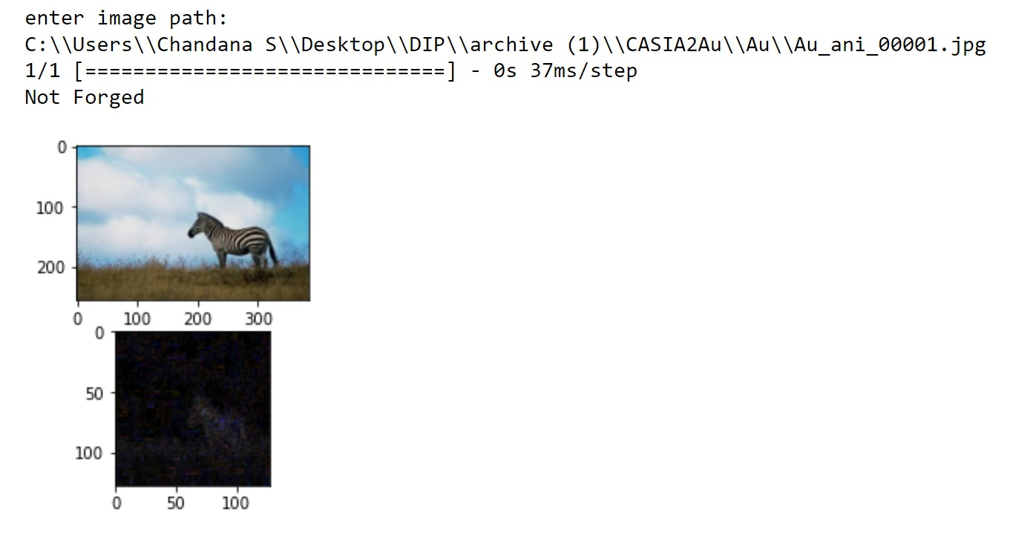
Results

Slide 18
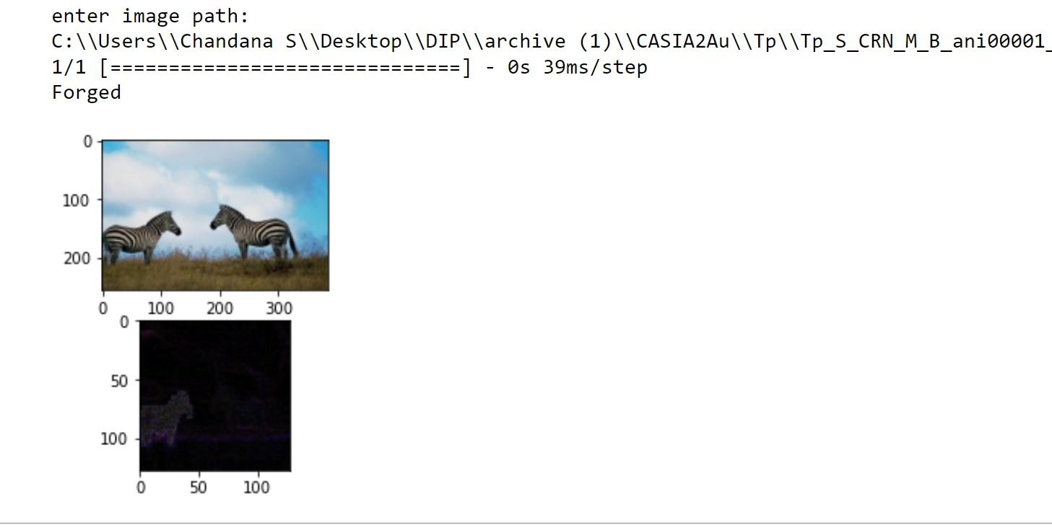

Slide 19
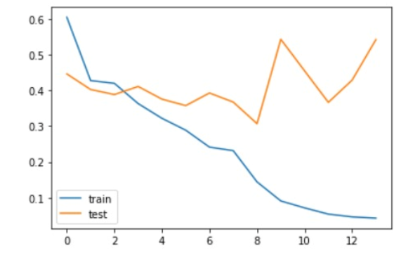
Proposed Solution
The proposed approach successfully determined the ELA between the original and scaled images. The features retrieved from the ELA were used to train the CNN model, which also produced results with great accuracy. The model's effectiveness is assessed based on its precision, recall, and accuracy. The highest accuracy obtained by the model is 97.18% on the training data and 87.75% on the test data.
The average performance measures for training data are as follows:
Recall score: 0.9825
Precision score: 0.9620563035495716
Accuracy score: 0.971875
Variation in Loss for train and test

Slide 20
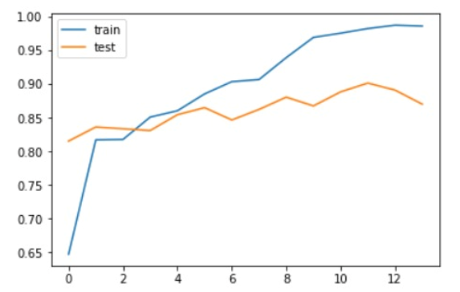
The average performance measures for test data are as follows:
Recall score: 0.86
Precision score: 0.8911917098445595
Accuracy score: 0.8775
Variation in Accuracy for train and test

Slide 21
References
[1] A. Ghoneim, G. Muhammad, S. U. Amin and B. Gupta, "Medical Image Forgery Detection for Smart Healthcare," in IEEE Communications Magazine, vol. 56, no. 4, pp. 33-37, April 2018, doi: 10.1109/MCOM.2018.1700817.
[2] alZahir, S., Hammad, R. “Image forgery detection using image similarity.” Multimed Tools Appl 79, 28643–28659 (2020). https://doi.org/10.1007/s11042-020-09502-4
[3] Bin Xiao, Yang Wei, Xiuli Bi, Weisheng Li, Jianfeng Ma, “Image splicing forgery detection combining coarse to refined convolutional neural network and adaptive clustering”, Information Sciences, Volume 511, 2020, Pages 172-191, ISSN 0020-0255, https://doi.org/10.1016/j.ins.2019.09.038.
[4] Bo Liu, Chi-Man Pun, “Exposing splicing forgery in realistic scenes using deep fusion network”, Information Sciences, Volume 526, 2020, Pages 133-150, ISSN 0020-0255, https://doi.org/10.1016/j.ins.2020.03.099.
[5] Boubacar Diallo, Thierry Urruty, Pascal Bourdon, Christine Fernandez-Maloigne, “Robust forgery detection for compressed images using CNN supervision”, Forensic Science International: Reports, Volume 2, 2020, 100112, ISSN 2665-9107, https://doi.org/10.1016/j.fsir.2020.100112.
[6] C. Wang, Z. Zhang, Q. Li and X. Zhou, "An Image Copy-Move Forgery Detection Method Based on SURF and PCET," in IEEE Access, vol. 7, pp. 170032-170047, 2019, doi: 10.1109/ACCESS.2019.2955308.
[7] Chen, H., Chang, C., Shi, Z. et al. “Hybrid features and semantic reinforcement network for image forgery detection”. Multimedia Systems 28, 363–374 (2022). https://doi.org/10.1007/s00530-021-00801-w
[8] F. Marra, D. Gragnaniello, L. Verdoliva and G. Poggi, "A Full-Image Full-Resolution End-to-End-Trainable CNN Framework for Image Forgery Detection," in IEEE Access, vol. 8, pp. 133488-133502, 2020, doi: 10.1109/ACCESS.2020.3009877.
[9] F. Matern, C. Riess and M. Stamminger, "Gradient-Based Illumination Description for Image Forgery Detection," in IEEE Transactions on Information Forensics and Security, vol. 15, pp. 1303-1317, 2020, doi: 10.1109/TIFS.2019.2935913.

Slide 22
[10] Goel, N, Kaur, S, Bala, R. “Dual branch convolutional neural network for copy move forgery detection”. IET Image Process. 2021; 15: 656– 665. https://doi.org/10.1049/ipr2.12051
[11] Jixiang Yang, Zhiyao Liang, Yanfen Gan, Junliu Zhong, “A novel copy-move forgery detection algorithm via two-stage filtering”, Digital Signal Processing, Volume 113, 2021, 103032, ISSN 1051-2004, https://doi.org/10.1016/j.dsp.2021.103032.
[12] Koul, S., Kumar, M., Khurana, S.S. et al. “An efficient approach for copy-move image forgery detection using convolution neural network”. Multimed Tools Appl 81, 11259–11277 (2022). https://doi.org/10.1007/s11042-022-11974-5
[13] Muhammad Hameed Siddiqi, Khurshed Asghar, Umar Draz, Amjad Ali, Madallah Alruwaili, Yousef Alhwaiti, Saad Alanazi, M. M. Kamruzzaman, and Usman Habib. 2021. “Image Splicing-Based Forgery Detection Using Discrete Wavelet Transform and Edge Weighted Local Binary Patterns”. Sec. and Commun. Netw. 2021 (2021). https://doi.org/10.1155/2021/4270776
[14] N. Krishnaraj, B. Sivakumar, Ramya Kuppusamy, Yuvaraja Teekaraman, Amruth Ramesh Thelkar, "Design of Automated Deep Learning-Based Fusion Model for Copy-Move Image Forgery Detection", Computational Intelligence and Neuroscience, vol. 2022, Article ID 8501738, 13 pages, 2022. https://doi.org/10.1155/2022/8501738
[15] Nitish Kumar & Toshanlal Meenpal (2022) “Salient keypoint-based copy–move image forgery detection”, Australian Journal of Forensic Sciences, DOI: 10.1080/00450618.2021.2016964
[16] Njood Mohammed AlShariah and Abdul Khader Jilani Saudagar, “Detecting Fake Images on Social Media using Machine Learning” International Journal of Advanced Computer Science and Applications(IJACSA), 10(12), 2019. http://dx.doi.org/10.14569/IJACSA.2019.0101224
[17] O. Mayer and M. C. Stamm, "Accurate and Efficient Image Forgery Detection Using Lateral Chromatic Aberration," in IEEE Transactions on Information Forensics and Security, vol. 13, no. 7, pp. 1762-1777, July 2018, doi: 10.1109/TIFS.2018.2799421.
[18] Patrick Niyishaka and Chakravarthy Bhagvati. 2021. “Image splicing detection technique based on Illumination-Reflectance model and LBP”. Multimedia Tools Appl. 80, 2 (Jan 2021), 2161–2175. https://doi.org/10.1007/s11042-020-09707-7
[19] Paul, S., Pal, A.K. “A fast copy-move image forgery detection approach on a reduced search space”. Multimed Tools Appl (2023). https://doi.org/10.1007/s11042-022-14224-w
[20] Rathore, N.K., Jain, N.K., Shukla, P.K. et al. “Image Forgery Detection Using Singular Value Decomposition with Some Attacks”. Natl. Acad. Sci. Lett. 44, 331–338 (2021). https://doi.org/10.1007/s40009-020-00998-w

