Slide 1
CMPS 4252
Project
#e06666ff
#fdbd98ff
#ff6c6cff
#ffbbaaff
#dd7e6bff
#ffe599ff
Rene Sanchez & Jadah Castillo

Slide 2
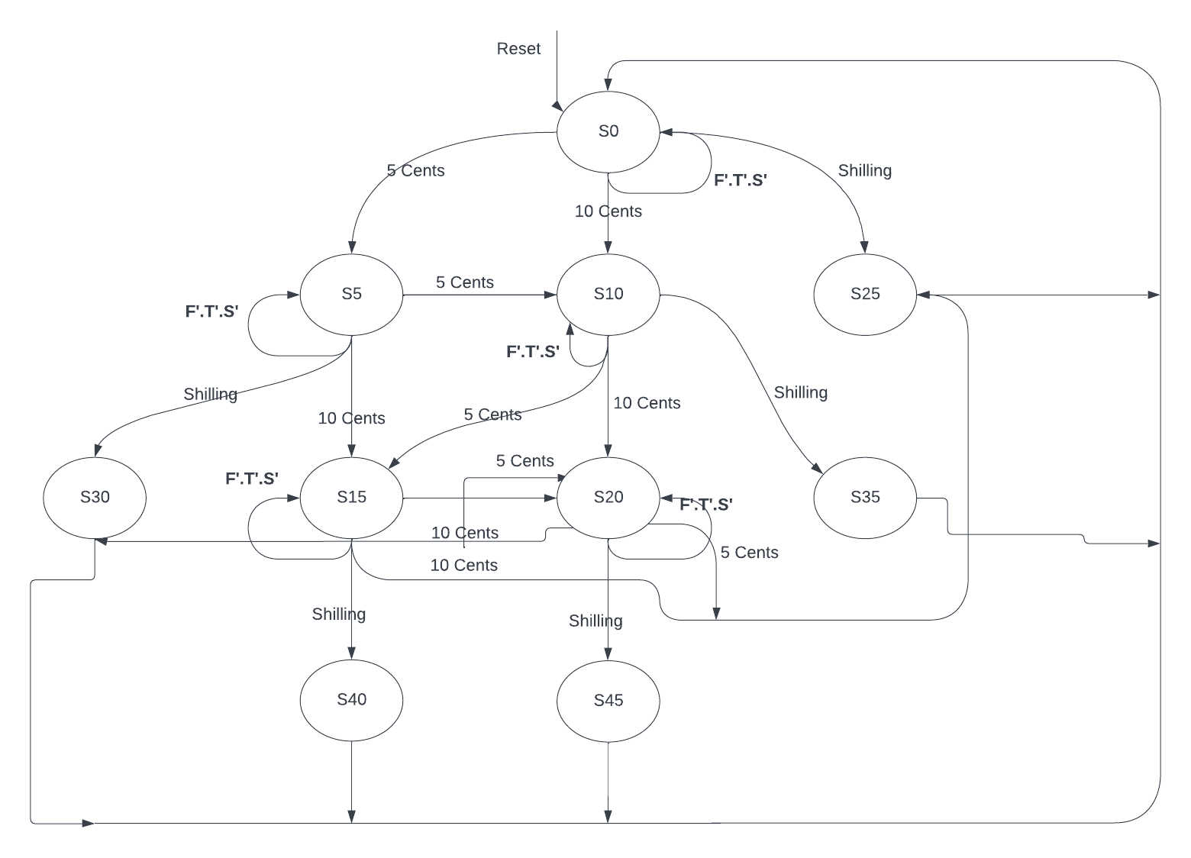
The modified FSM

Slide 3
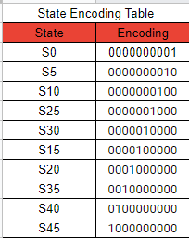
State Encoding Table

Slide 4
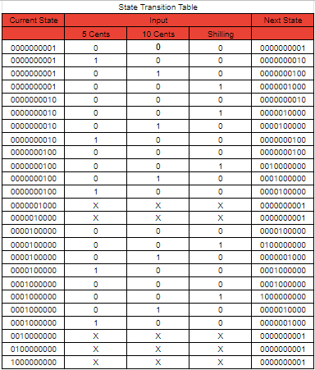
State Transition Table
- Simplified

Slide 5
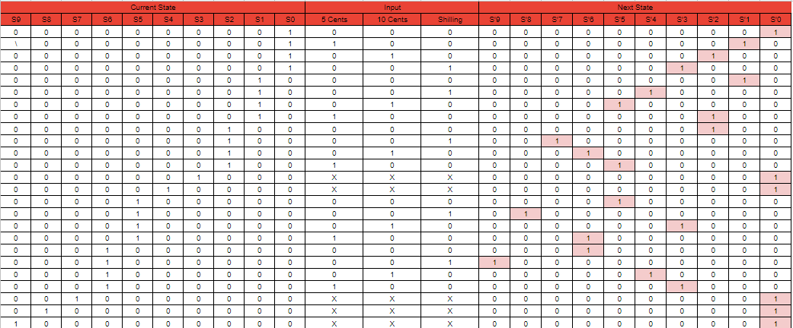
State Transition Table - Extended

Slide 6
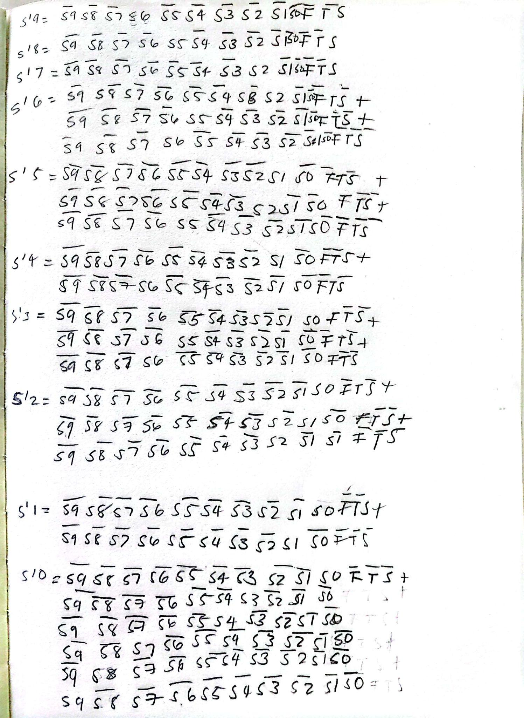
Equations for this Table

Slide 7
Equations for this Table
S'0 = S0F’T’S’+S3+S4+S7+S8+S9
S'1 = S0S+S1F’T’S’
S'2 = S0T+S1F+S2F’T’S’
S'3 = S0F+S5T+S6F
S'4 = S1S+S6T
S’5 = S1T+S2F+S5F’T’S’
S'6 =S2T+S5F+S6F’T’S’
S'7 =S2S
S'8 =S5S
S'9 =S6S

Slide 8
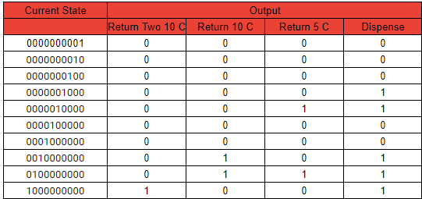
Output Table- Simplified

Slide 9
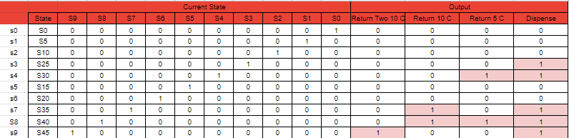
Output Table- Extended

Slide 10
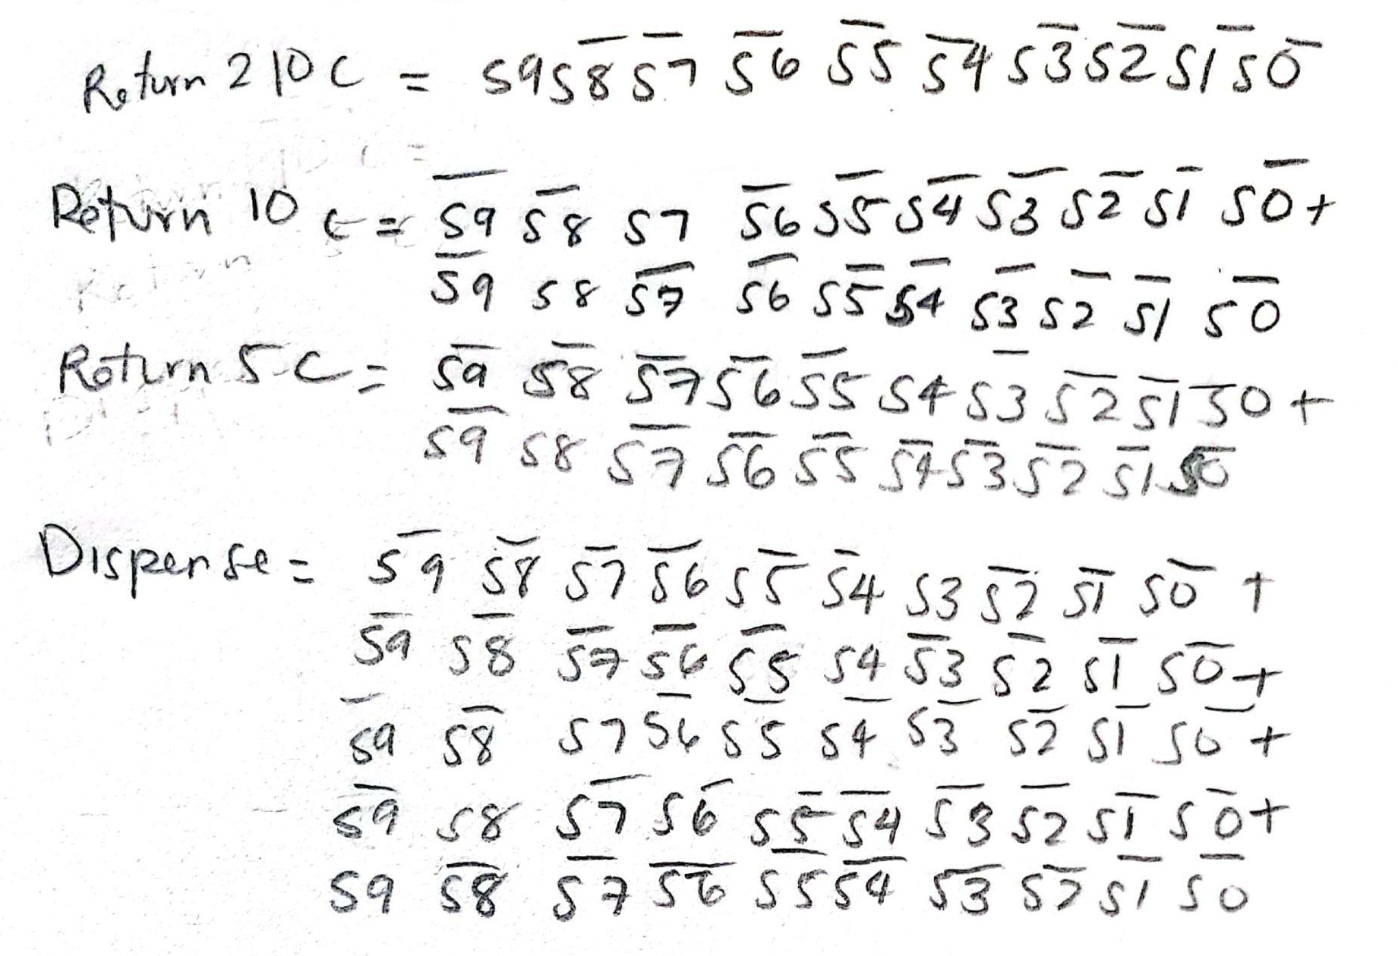
Equations for this Table

Slide 11
Equations for this Table
Return two 10 c = S9
Return 10 c = S7 + S8
Return 5 c = S4 + S8
Dispense = S3 + S4 + S7 + S8 + S9

Slide 12
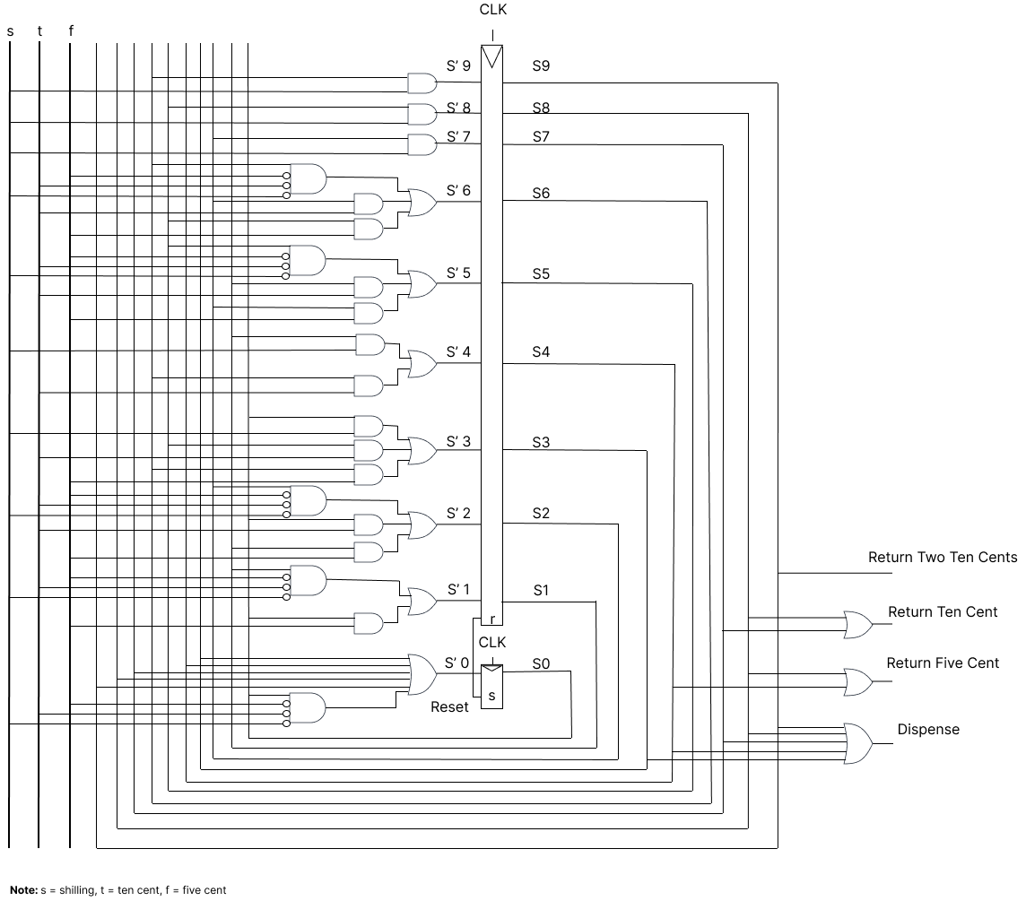
Circuit Diagram

