Slide 1
Laravel

Slide 2
Installation
Install composer via https://getcomposer.org/download/
Create laravel application using composer
CMD : composer create-project laravel/laravel example-app
Run application
CMD : php artisan server

Slide 3
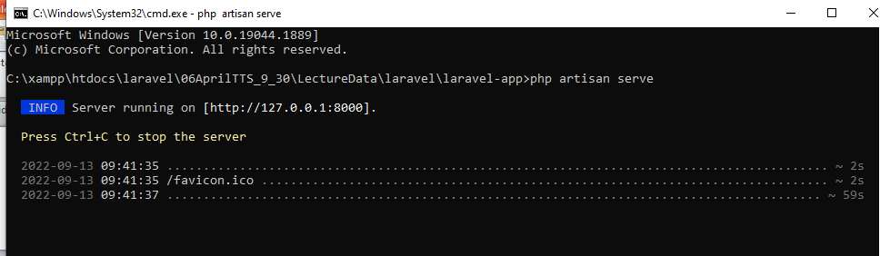

Slide 4
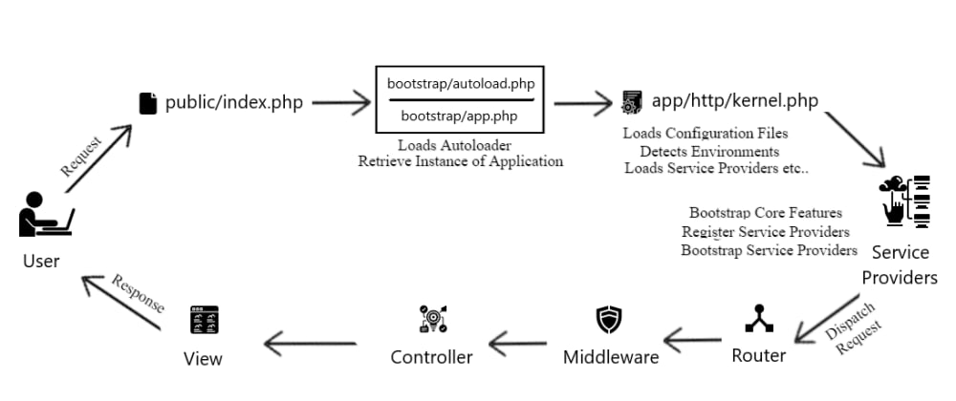
Laravel life Cycle

Slide 5
Laravel Application Structure
The application structure in Laravel is basically the structure of folders, sub-folders and files included in a project. Once we create a project in Laravel, we get an overview of the application structure as shown in the image here.
The snapshot shown here refers to the root folder of Laravel namely laravel-project. It includes various sub-folders and files. The analysis of folders and files, along with their functional aspects is given below

Slide 6
Php artisan make:auth
composer require laravel/ui
php artisan ui bootstrap –auth
npm install && npm run dev

Slide 7
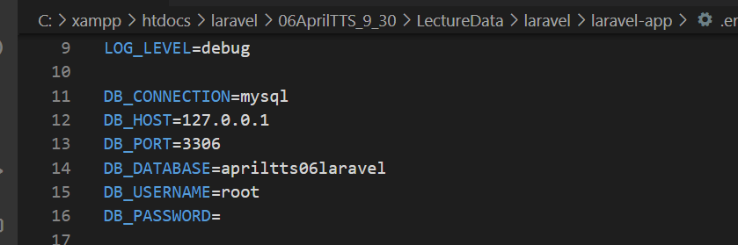
For Database Connection
.env file database name

Slide 8
Migration
Create new table
php artisan make:migration create_products_table
Make changes in existing table
php artisan make:migration update_products_table --table=products
run migration
php artisan:migrate
For rollback
php artisan migrate:rollback

Slide 9
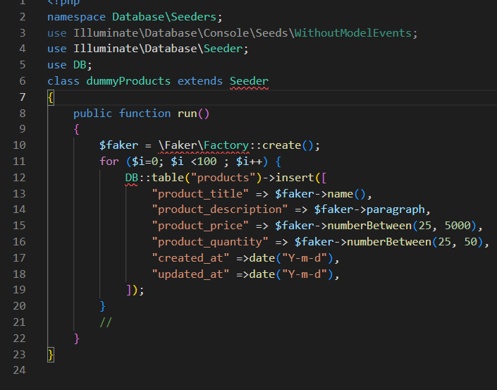
Seeder
php artisan make:seeder UserSeeder
For Executing Seed
php artisan db:seeder --class=UserSeeder

