Slide 1
Laravel

Slide 2
Installation
Install composer via https://getcomposer.org/download/
Create laravel application using composer
CMD : composer create-project laravel/laravel example-app
Run application
CMD : php artisan server

Slide 3
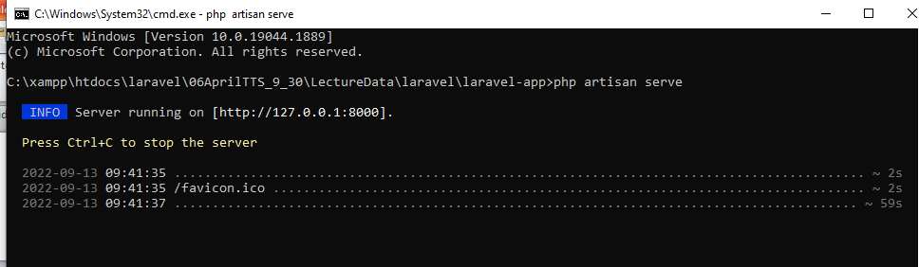

Slide 4
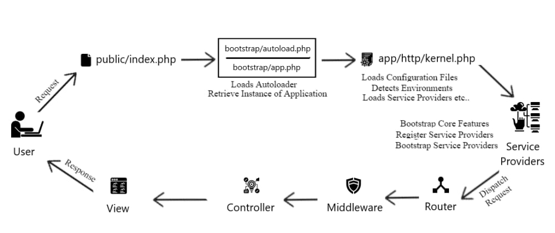
Laravel life Cycle

Slide 5
Laravel Application Structure
The application structure in Laravel is basically the structure of folders, sub-folders and files included in a project. Once we create a project in Laravel, we get an overview of the application structure as shown in the image here.
The snapshot shown here refers to the root folder of Laravel namely laravel-project. It includes various sub-folders and files. The analysis of folders and files, along with their functional aspects is given below

Slide 6
Php artisan make:auth
composer require laravel/ui
php artisan ui bootstrap –auth
npm install && npm run dev

Slide 7
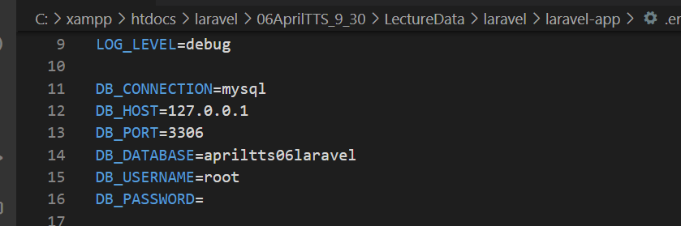
For Database Connection
.env file database name

Slide 8
Migration
Create new table
php artisan make:migration create_products_table
Make changes in existing table
php artisan make:migration update_products_table --table=products
run migration
php artisan:migrate
For rollback
php artisan migrate:rollback

Slide 9
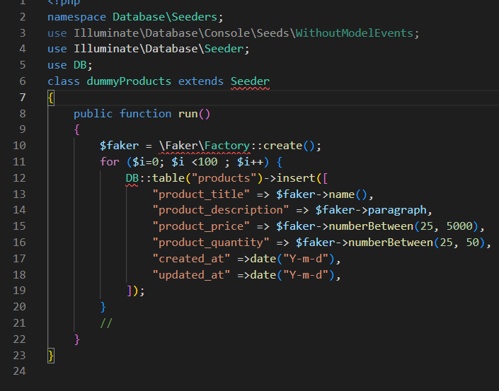
Seeder
php artisan make:seeder UserSeeder
For Executing Seed
php artisan db:seeder --class=UserSeeder

Slide 10
Create Custom Command Laravel
With the help of console we are able to create our own commands like here we are going to create a command for creating traits
Step 1 : CMD
php artisan make:command TraitMakeCommand
then you have this command in app/Console/Commands

Slide 11
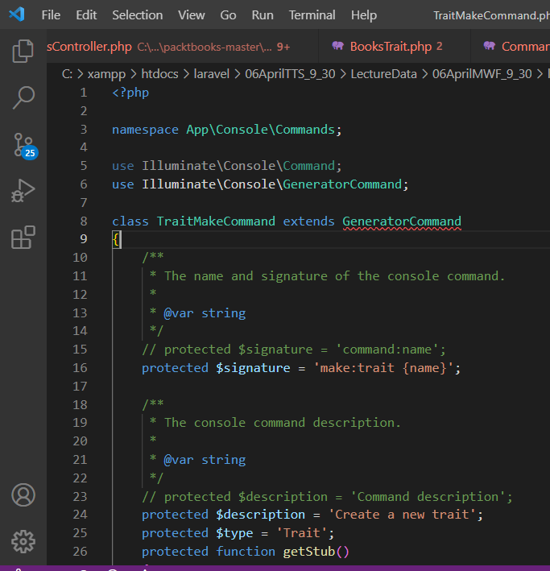
app/Console/Commands
laravel-app\app\Console\Commands

Slide 12
Replace
Remove
so instead:
use Illuminate\Console\Command; class TraitMakeCommand extends Command{
you should have this:
use Illuminate\Console\GeneratorCommand; class TraitMakeCommand extends GeneratorCommand{
Add

Slide 13
Commands/stubs
then, delete __construct() and handle() methods cause you are not gonna need them.
You need to create a file in app/Console/Commands/stubs called traits.stub which is going to be the base for your trait:
<?php namespace TraitNamespace; trait {{class}} { // }

Slide 14
laravel-app\app\Console\Commands\TraitMakeCommand.php
<?php
namespace App\Console\Commands;
use Illuminate\Console\Command;
use Illuminate\Console\GeneratorCommand;
class TraitMakeCommand extends GeneratorCommand
{
protected $signature = 'make:trait {name}';
protected $description = 'Create a new trait';
protected $type = 'Trait';
protected function getStub()
{
return __DIR__ . '\stubs\traits.stub';
}
protected function getDefaultNamespace($rootNamespace)
{
return $rootNamespace . '\Http\Traits';
}
}

Slide 15
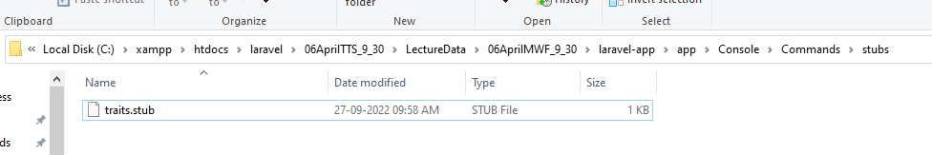
laravel-app\app\Console\Commands\stubs\traits.stub
Create a stub file for command line
Laravel stubs are helper modules that enable us to customize the default Artisan generated classes . For example, when you need to send data to a database, you are supposed to indicate fields that are ＄fillable or ＄guarded .

Slide 16
laravel-app\app\Console\Commands\stubs\traits.stub
<?php
namespace TraitNamespace;
trait {{class}}
{
//
}

Slide 17
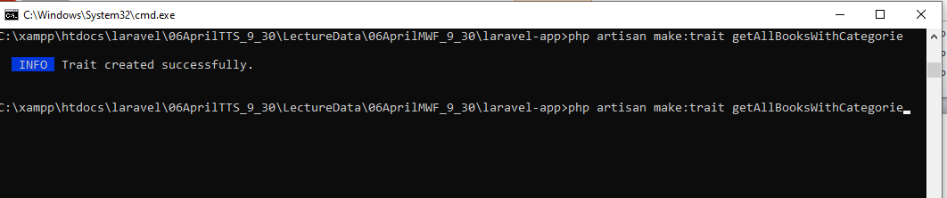
Ready for the Work

