Slide 1
LIFECYCLE HOOKS

Slide 2
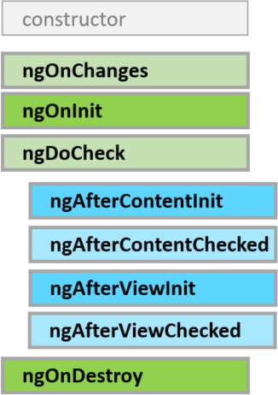
A component has a lifecycle managed by Angular.
Angular creates it, renders it, creates and renders its children, checks it when its data-bound properties change, and destroys it before removing it from the DOM.
Angular offers lifecycle hooks that provide visibility into these key life moments and the ability to act when they occur.
A directive has the same set of lifecycle hooks, minus the hooks that are specific to component content and views.

