Slide 2
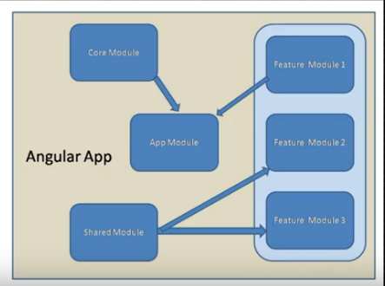

Slide 3
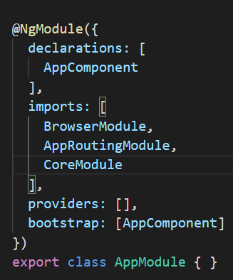
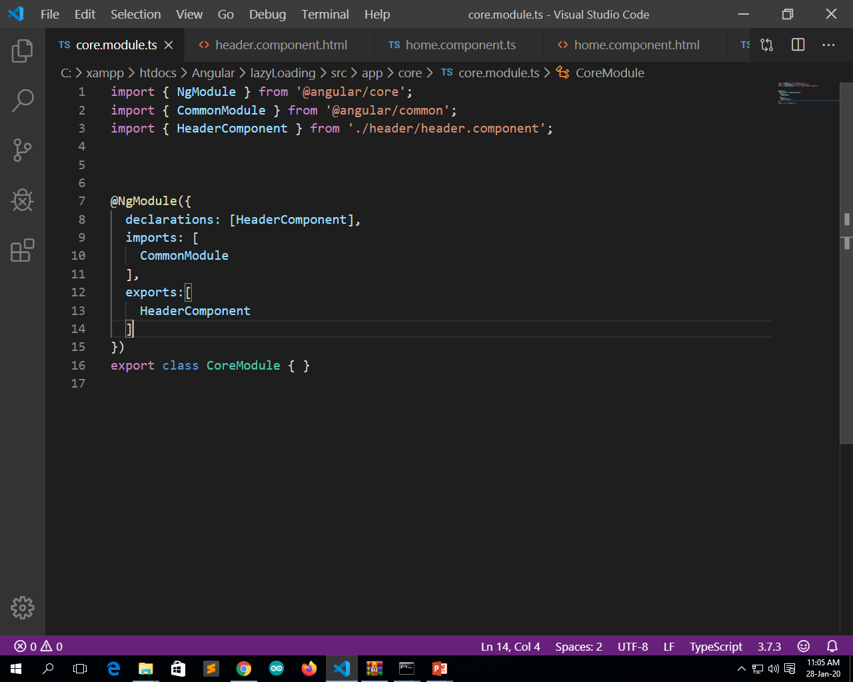
Create a core module
ng g m core
Now need to inject core module in imports array in app.module.ts
app.module.ts
core.module.ts

Slide 4
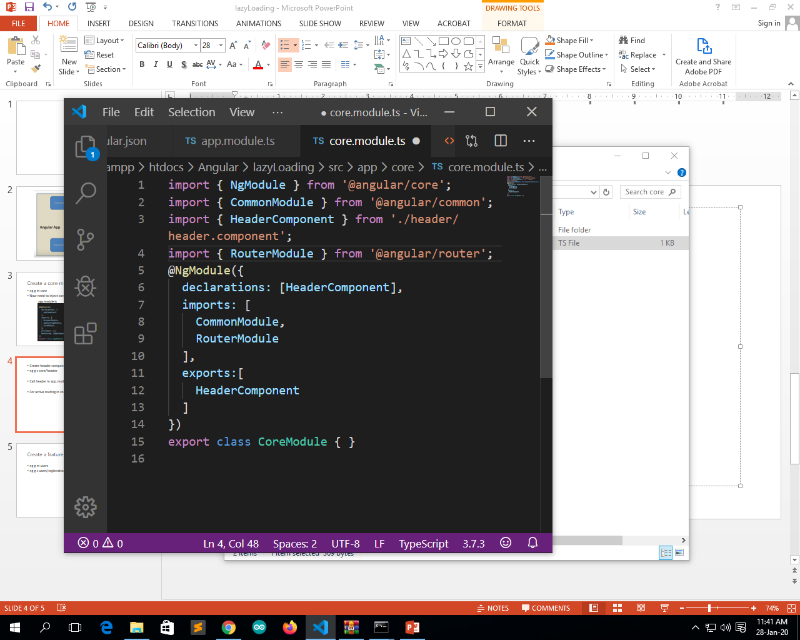
Create header component in core module
ng g c core/header
Call header in app.module
For active routing in core module core.module.ts

Slide 5
Create a frature module
ng g m users
ng g c users/registration –skipTests=true
Import user module in our app.module
Create route for the same

Slide 6
For lazyrouting
Copy app-routing.module.ts and paste is to feature module we use users module as feature module
Rename it as user-routing.module.ts
Rename class name too.
Make changes in

Slide 7
New users-routing.module.ts
import { NgModule } from '@angular/core';
import { Routes, RouterModule } from '@angular/router'; import { RegistrationComponent } from './registration/registration.component';
const routes: Routes = [
{path:"", component:RegistrationComponent}
]; @NgModule({
imports: [RouterModule.forChild(routes)],
exports: [RouterModule]
})
export class UsersRoutingModule { }

Slide 8
New users.module.ts
@NgModule({
declarations: [RegistrationComponent, LoginComponent],
imports: [ CommonModule,
RouterModule,
CoreModule,
UsersRoutingModule ],
exports:[ RegistrationComponent]
})
export class UsersModule { }

