Slide 1
Case study: How to retain casual riders?
Presented by: Jay Arora

Slide 2
Agenda
Problem to solve
Data Sources
Summary of Analysis
Recommendations

Slide 3
Problem
Design marketing strategies aimed at convert Cyclistic’s casual riders into annual members

Slide 4
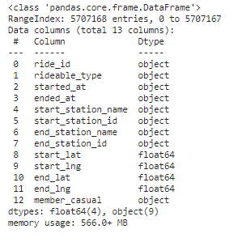
Data Sources
Cyclistic Bike Trip Data
Latest 12 months of historial bike trip data. From March 2023 to Feb 2024.
More than 5.000.000 entries

Slide 5
Analysis

Slide 6
# 1 Casual’ rides are longer
(minutes) | Member | Casual
Mean | 12.73 | 28.28
Median | 8.5 | 11.9
Mode | 4.8 | 6.13

Slide 7
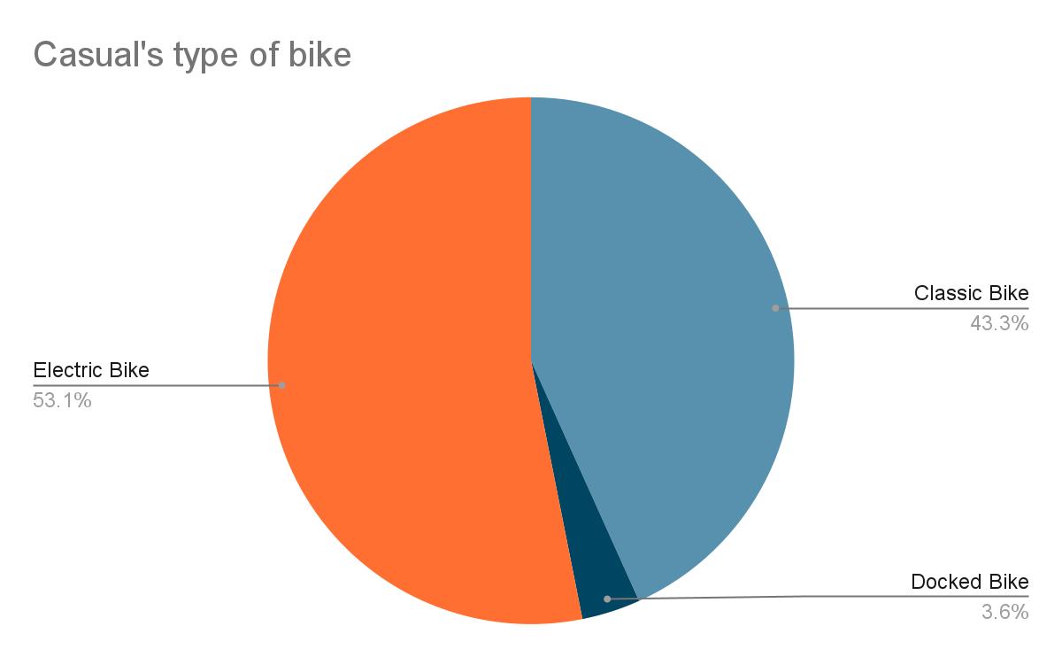
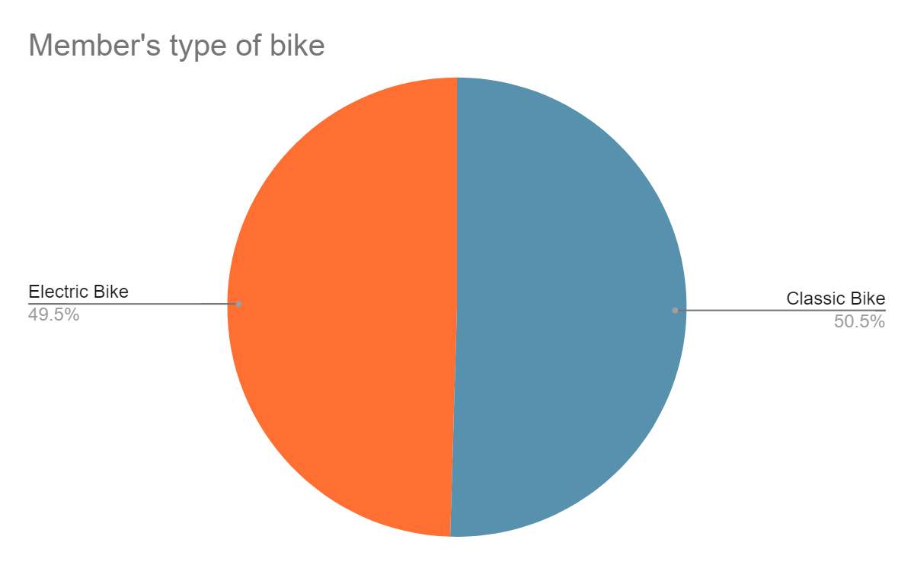
# 2 Casuals ride electric bikes more often

Slide 8
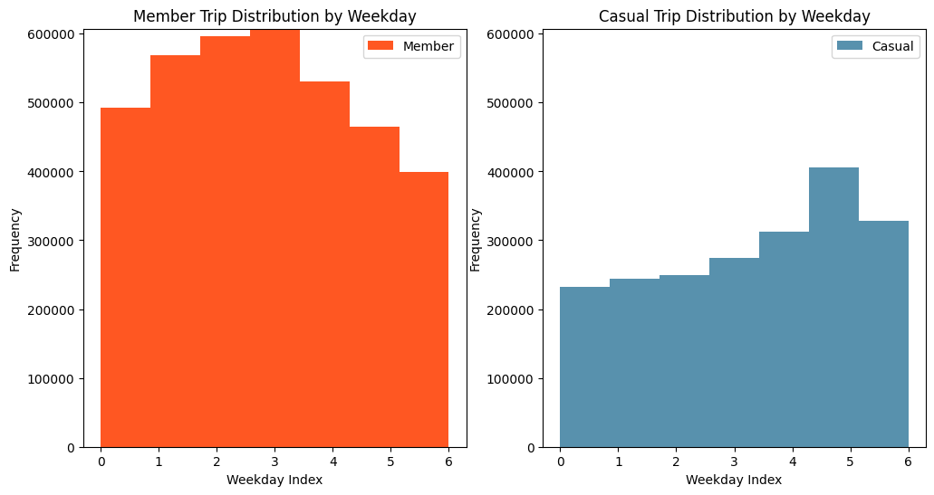
# 3 Casuals ride more in the weekends

Slide 9
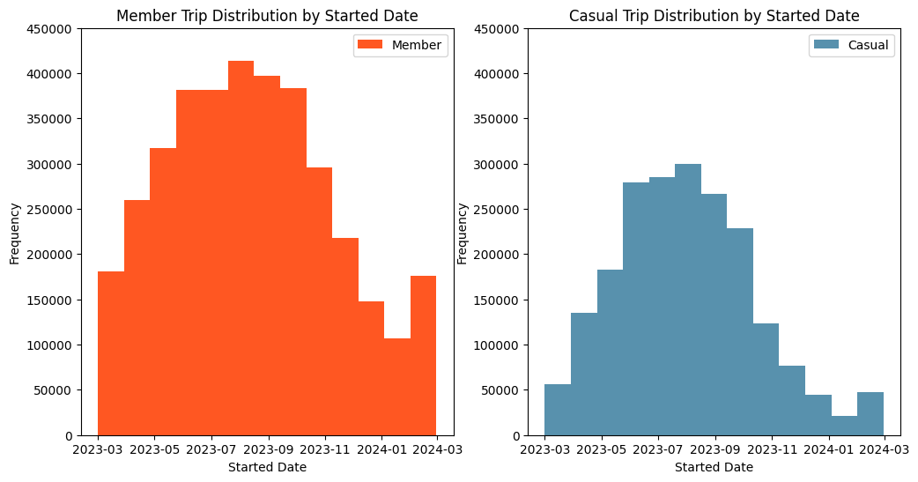
# 4 All users ride more in Summer/Spring

Slide 10
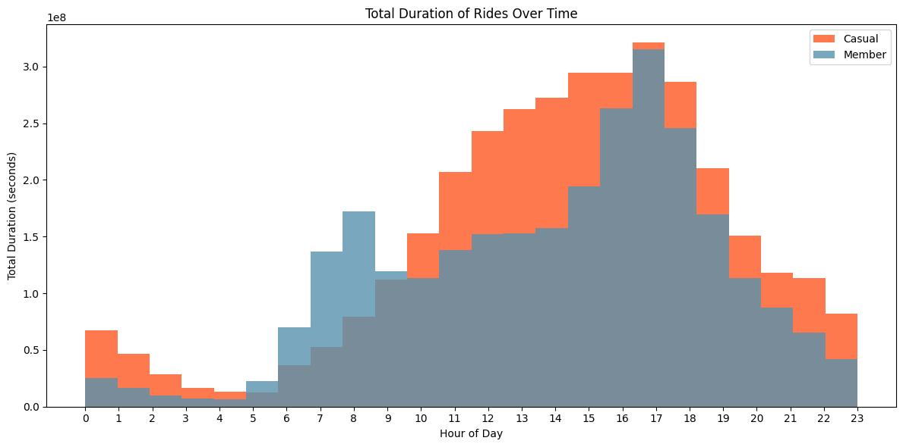
# 5 Members for commuting, Casuals for leisure.

Slide 11
How can these conclusiones help us to convert casual riders into annual members?
Recommendations
# Ads campaigns of commuters in cloudy, busy days.
People associate these bike-sharing services with free time and sunny days thanks, partially, to their campaigns. We suggest a campaign focusing on how Cyclistic saves you time from traffic jams and waiting for the bus. Changing the narrative.
# Offers in Autumn
After the Summer peak of casual users, launching a 3-month or 6-month promotion to retain those riders throughout autumn or even winter.

