Slide 1
Telecommunications Customer Churn Analysis
Standard Business Case Study
7,043 Customers | California

Slide 2
Executive Summary
• Churn represents a meaningful share of customers
• Contract type and pricing are primary churn drivers
• High-value customers are disproportionately churning
• Targeted retention can significantly improve revenue

Slide 3
Business Context & Problem Statement
The company operates in a competitive telecom market.
Problem:
Customer churn threatens revenue stability.
Objective:
Identify churn drivers and recommend retention strategies.

Slide 4
Data Collection & Preparation
• Customer churn dataset (demographics, services, contracts)
• 7,043 customers in California
Preparation steps:
• Cleaned missing values
• Engineered features (Customer Value)
• Prepared data for analysis and visualization

Slide 5
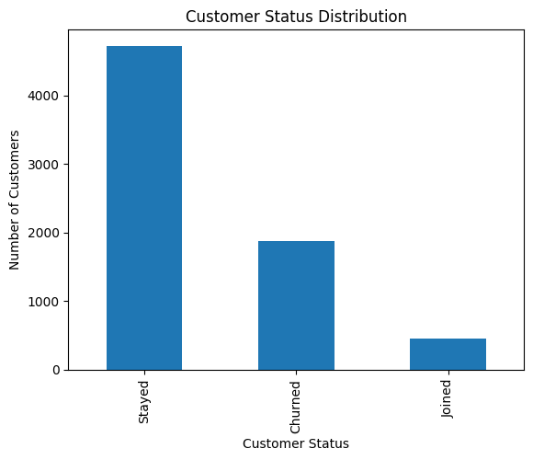
EDA: Customer Status
Churn accounts for a significant portion of the customer base.

Slide 6
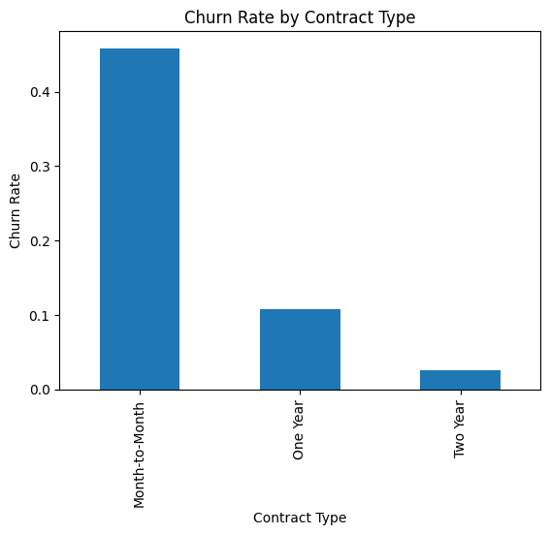
EDA: Contract Type & Churn
Month-to-month contracts show the highest churn rates.

Slide 7
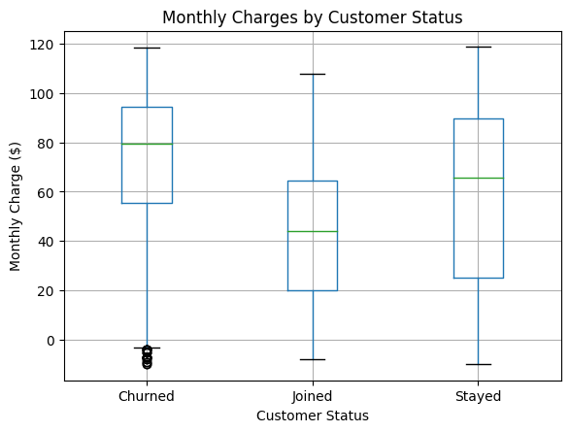
EDA: Pricing & Churn
Churned customers pay higher monthly charges.

Slide 8
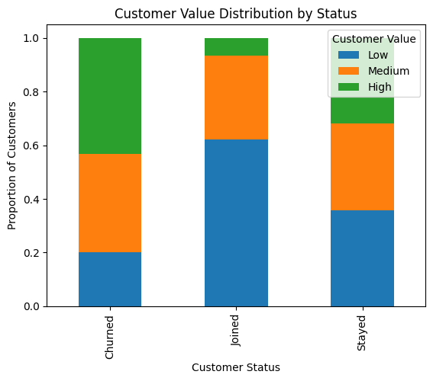
Key Finding: High-Value Customers
High-value customers are disproportionately represented among churned users.

Slide 9
Key Findings & Insights
• Contract length is the strongest churn driver
• Early-tenure customers are most vulnerable
• Pricing pressure increases churn risk
• High-value customer loss drives revenue risk

Slide 10
Recommendations & Expected Impact
Recommendations:
• Incentivize long-term contracts
• Improve early customer onboarding
• Offer targeted pricing & bundles
• Protect high-value customers
Expected Impact:
• Lower churn
• Higher customer lifetime value
• Improved revenue stability

