Slide 1
Designing Interacting Objects with UNO
By Jadyn Dangerfield
Midwestern State University Computer Science Department

Slide 2
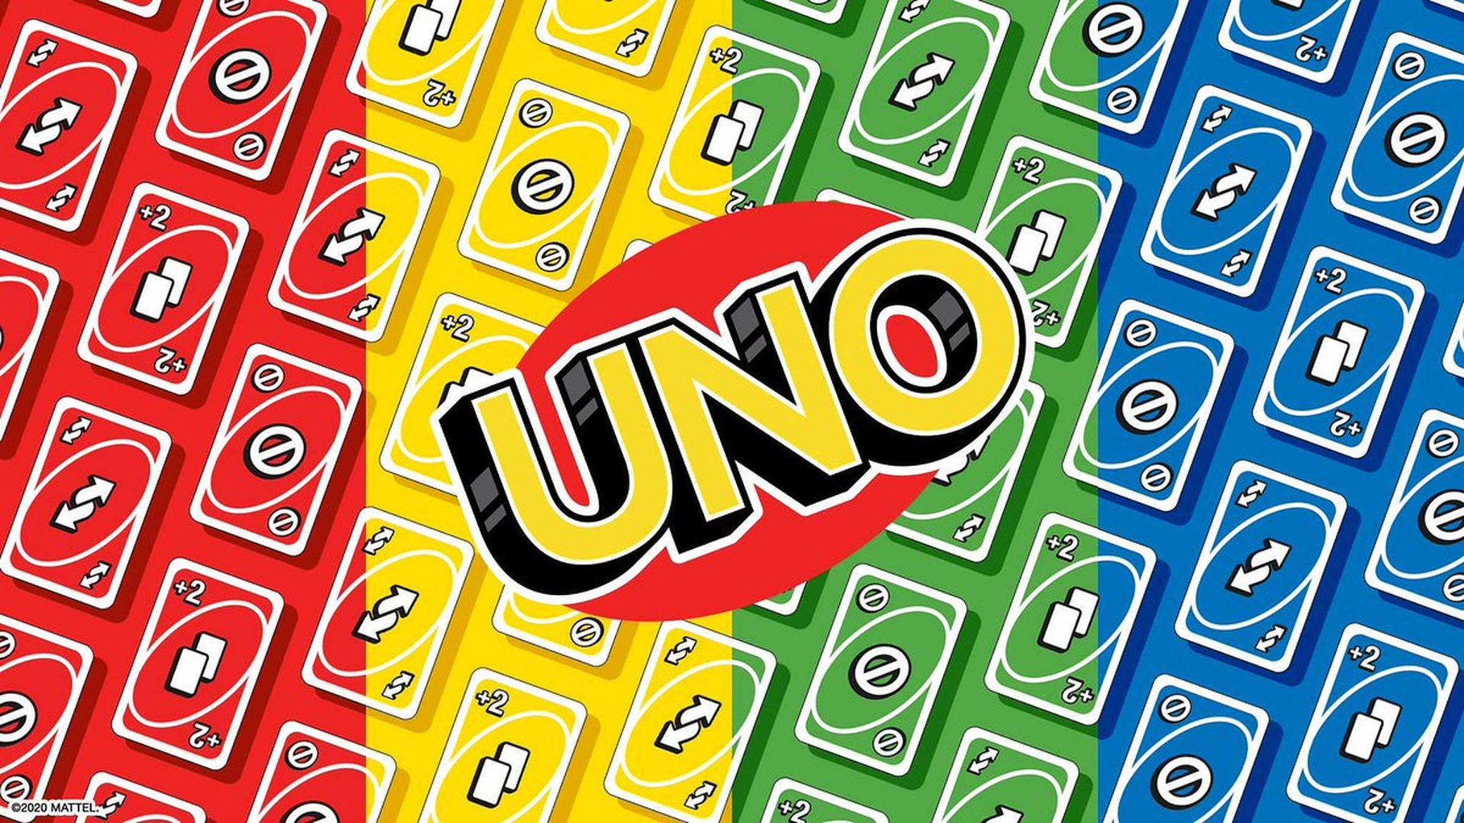
Scenario

Slide 3
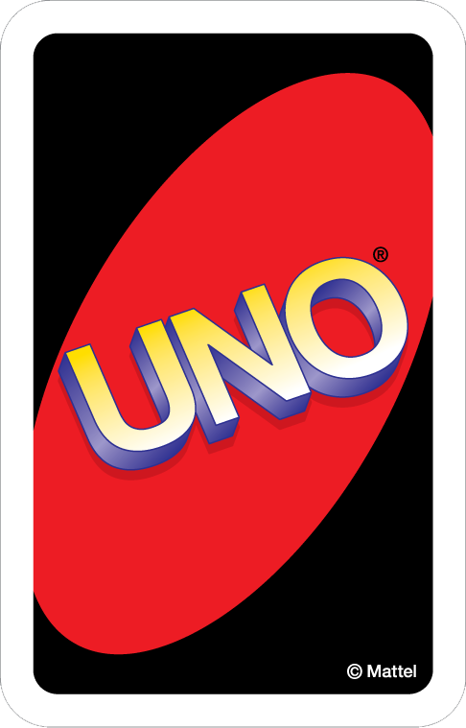
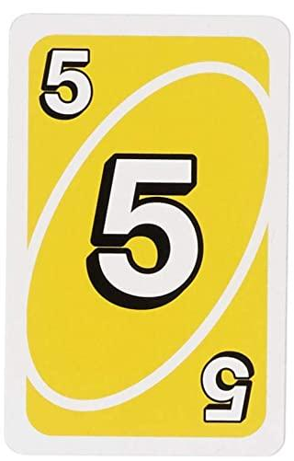
Game Rules
Objective
The first player to play all the cards in their hand wins!
QUICK TIPS
A player must call “UNO!” before playing their second to last card
Call “UNO OUT!” when your last card is played.
Set Up
Deal 7 cards to each player
Place the remaining cards face down, this will be the DRAW PILE
Draw one card from the DRAW PILE and put int next to it
This is the DISCARD PILE
Let’s Play!
Match the card on top of the DISCARD PILE
Color, number, and symbols are matches
Wild and Wild Draw Four cards can be played on any color
If you can’t play a card, draw 1 card from the DRAW PILE
You can only play one card at a time

Slide 4
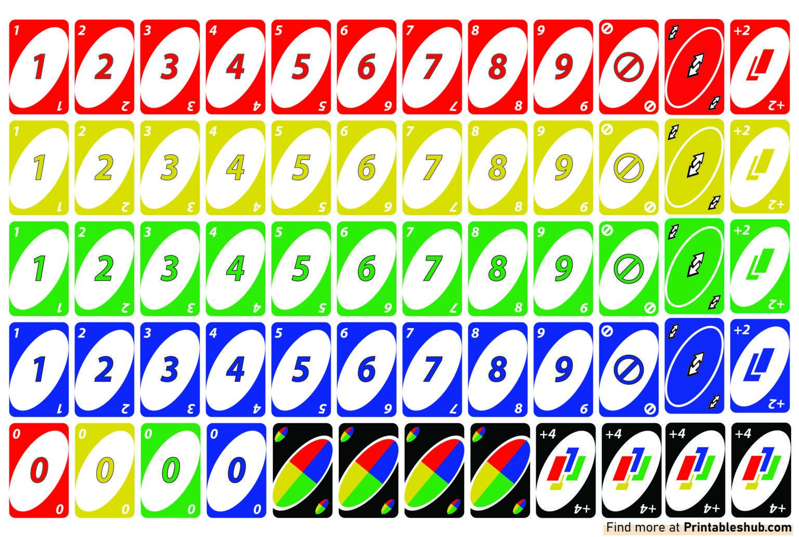
Game Cards
108 total cards
76 Number cards
19 of each color
1 number zero and 2 sets of cards numbered 1-9.
24 Action cards (skip, reverse, plus two)
6 total of each color
1 of each action card
8 Wild cards
4 Wild cards
4 Wild Plus Four cards

Slide 5
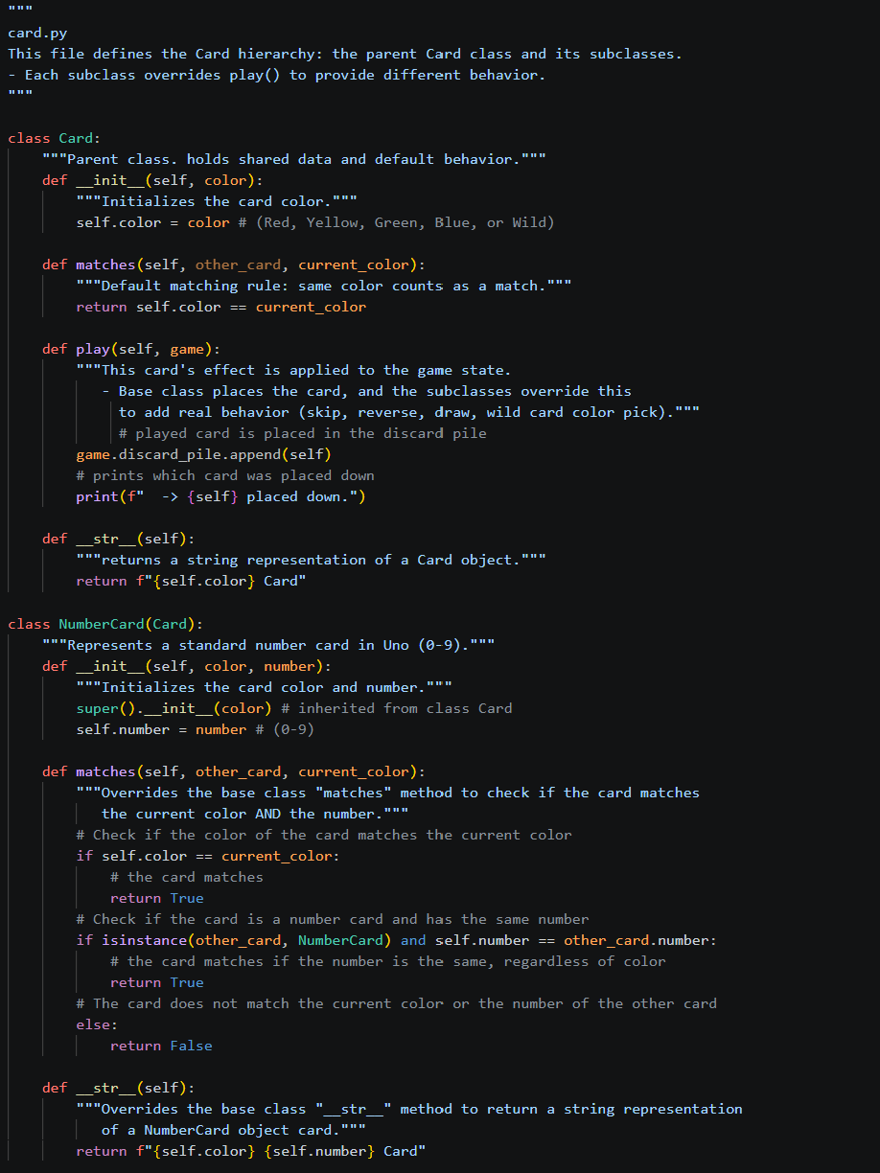
card.py
Defines she Card class hierarchy
The parent class within this file is class Card which holds all of the shared data and default behavior. The methods include:

Slide 6
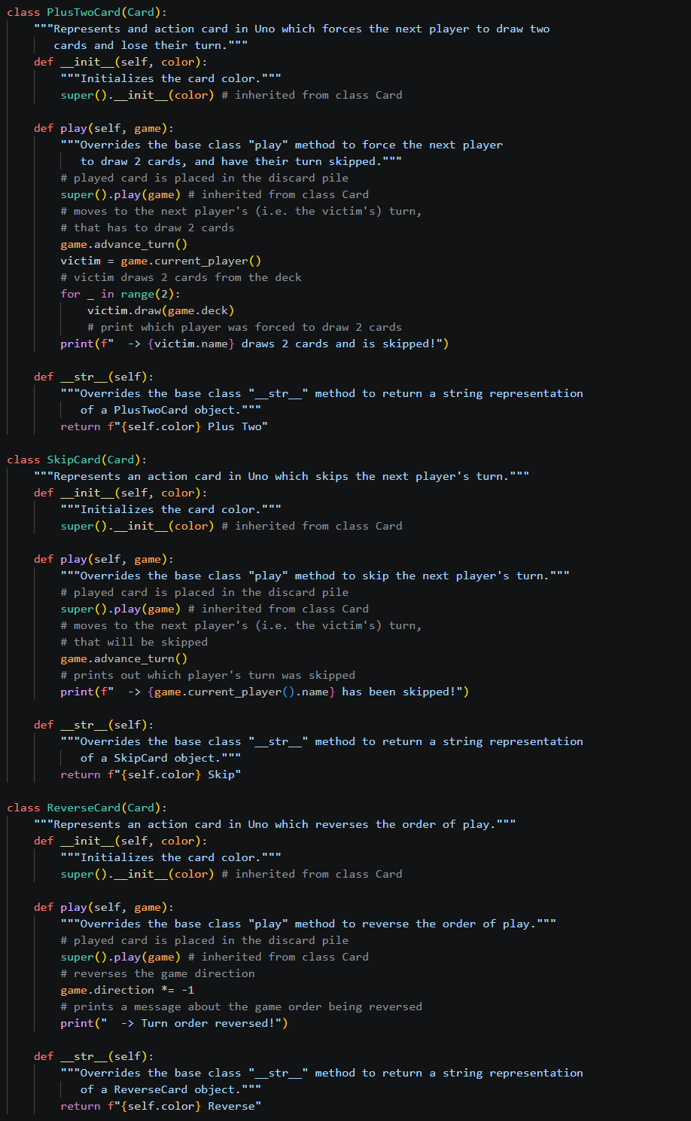
card.py
Defines she Card class hierarchy
The parent class within this file is class Card which holds all of the shared data and default behavior. The methods include:

Slide 7
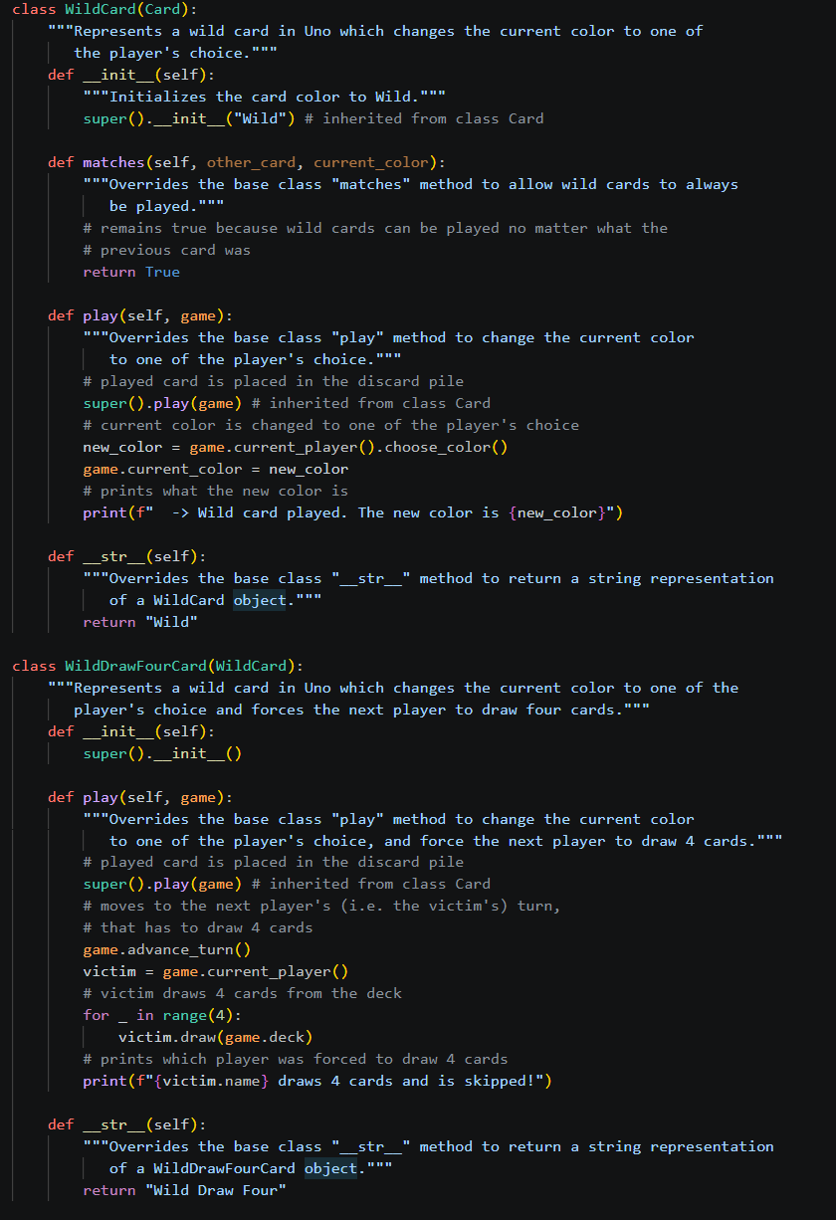
card.py
Defines she Card class hierarchy
The parent class within this file is class Card which holds all of the shared data and default behavior. The methods include:

Slide 8
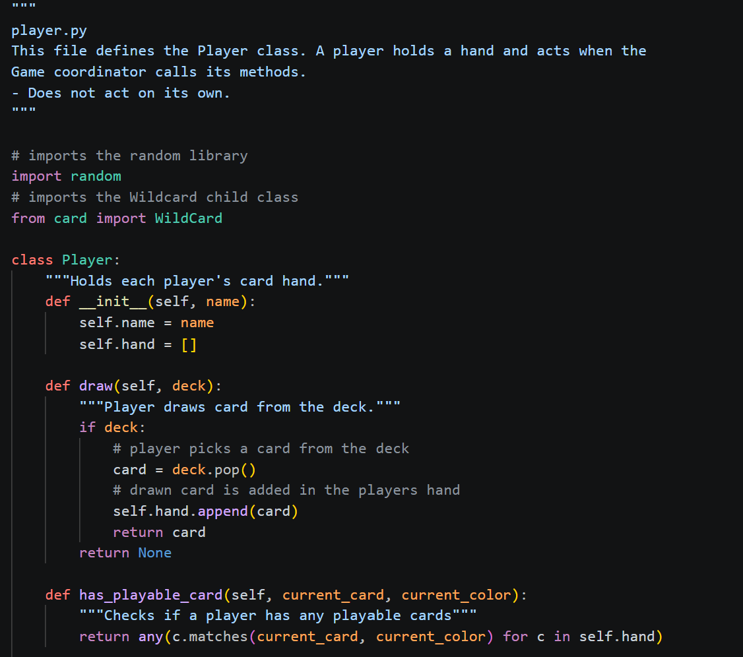
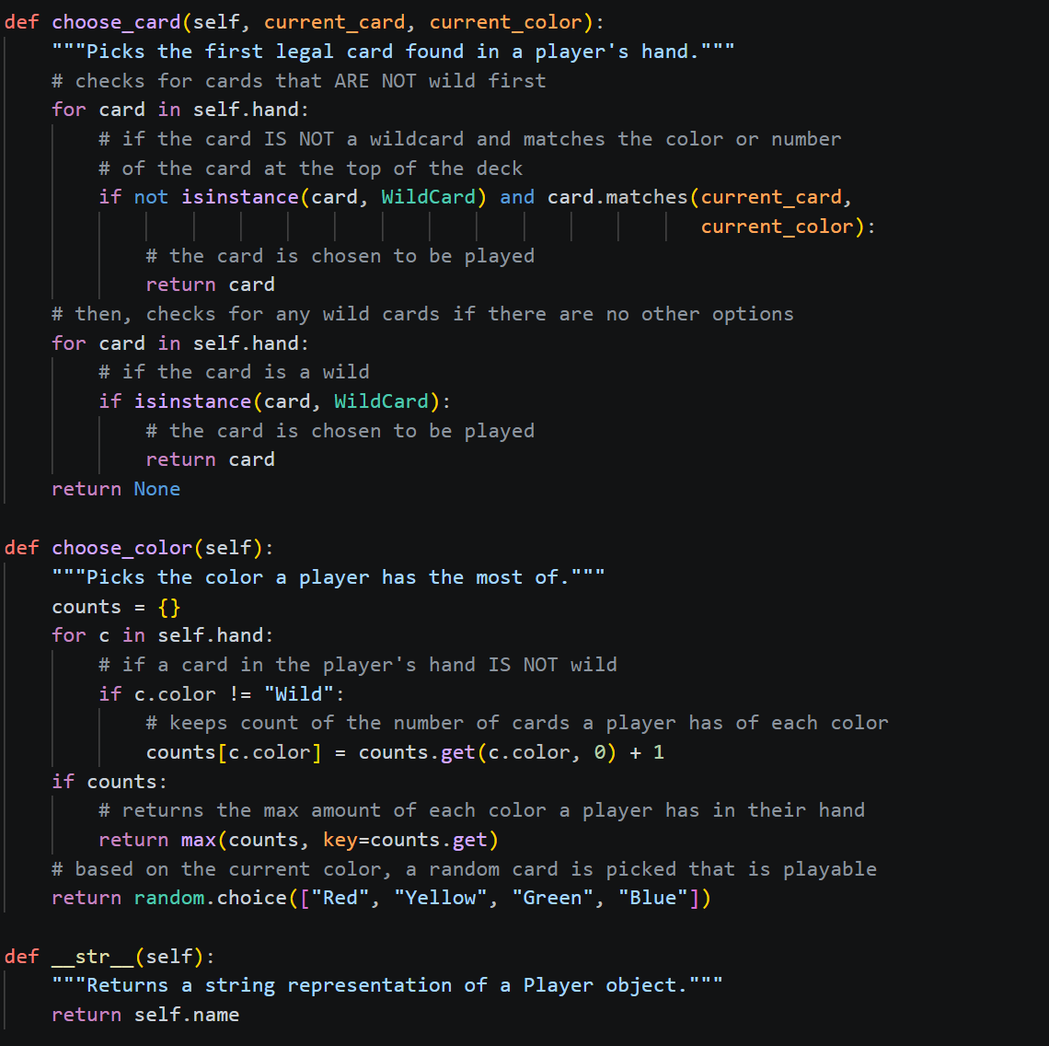
player.py
Defines she Player class
A Player object holds a hand and only acts when the Game coordinator calls its methods, so it doesn’t act on its own. The only class within this file is class Player which holds each player’s card hand. The methods include:

Slide 9
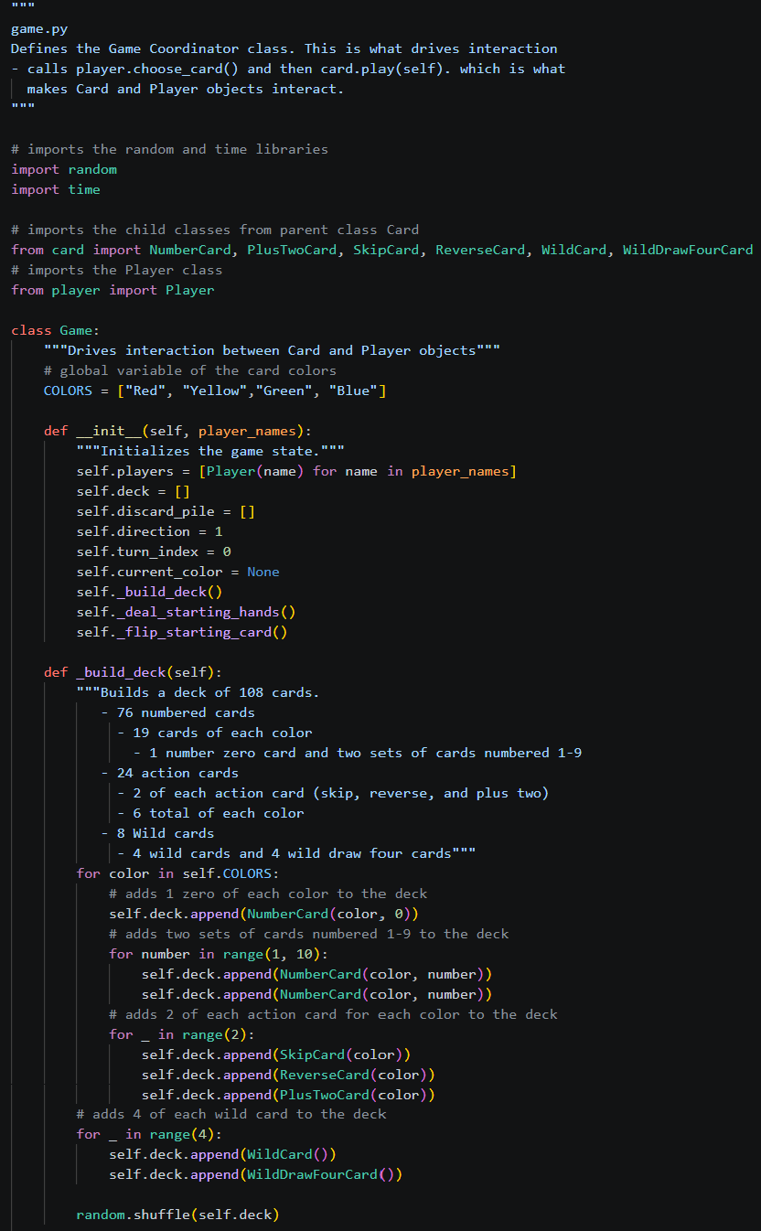
game.py
Defines she Game class
This is what drives interaction between Card and Player objects. The methods include:

Slide 10
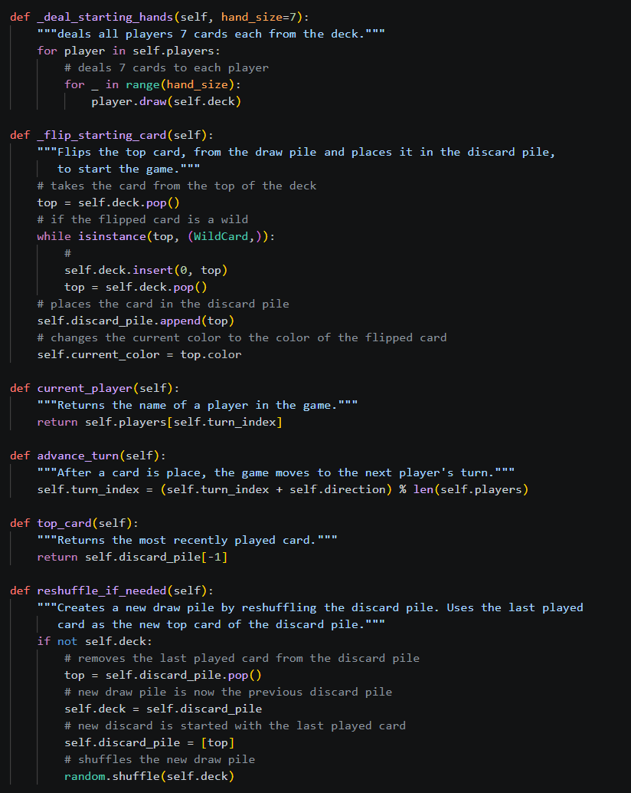
game.py
Defines she Game class
This is what drives interaction between Card and Player objects. The methods include:

Slide 11
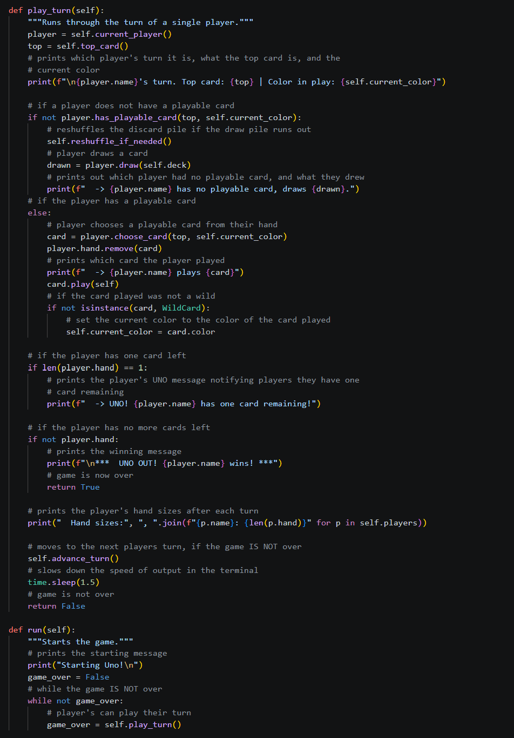
game.py
Defines she Game class
This is what drives interaction between Card and Player objects. The methods include:

Slide 12
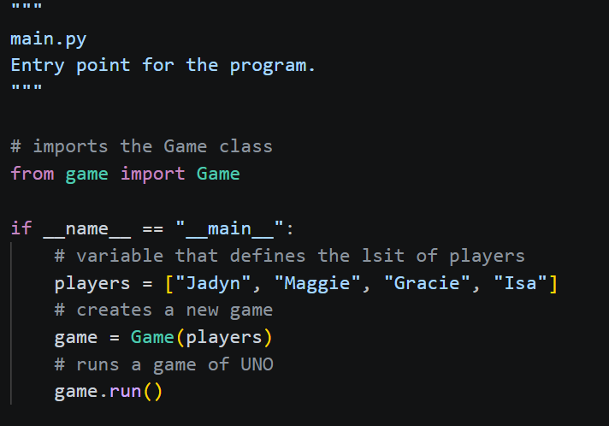
main.py
The main entry point of the game

Slide 13
Object Interaction
Game is the coordinator and entry point (the if __name__ == "__main__" block). It never lets Player or Card objects act on their own. It calls player.choose_card(), then card.play(self), which is where the real object-to-object interaction happens (a DrawTwoCard reaching into another Player's hand and calling draw() on it).

Slide 14


Slide 15
Resources
Uno. “Original Uno Rules.” Original Uno Rules, 2009, https://www.unorules.com. Accessed 14 September 2026.
Uno. “UNO Cards－UNO!™ – the Official UNO mobile game.” UNO!, 29 12 2017, https://www.letsplayuno.com/news/guide/20181213/30092_732567.html. Accessed 14 September 2026.

