Slide 1
Final Review_01
Instructor: Dr. Wei (Lisa) Li
Department of Computer Science, GSU

Slide 2
Running Time Analysis
Ignore all the constants which are dependent on machine and programming languages.
Analyze limiting behavior of complexity when the input size increases, i.e., n → ∞
O(1) < O(log n) < O(n) < O(n log n) < O(n²) < O(n³) < O(2^{n})

Slide 3
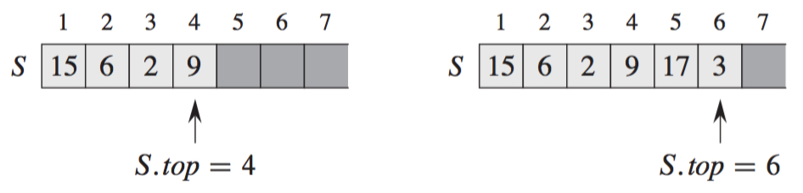
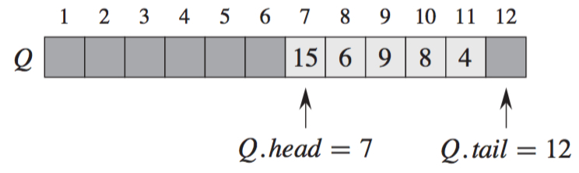
Data Structure
Stack: first in last out (FILO)
Queue: first in first out (FIFO)

Slide 4
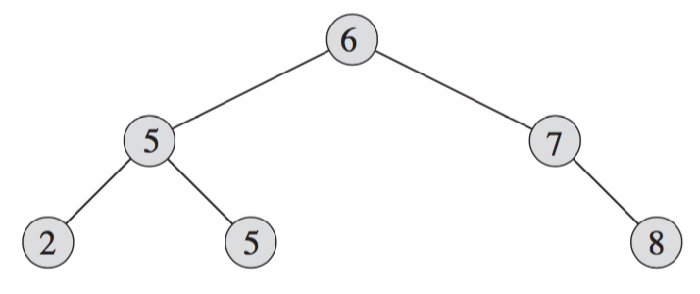
Binary Search Tree
Property:
Left Child ≤ Parent ≤ Right Child
Operations: search, insertion, deletion

Slide 5
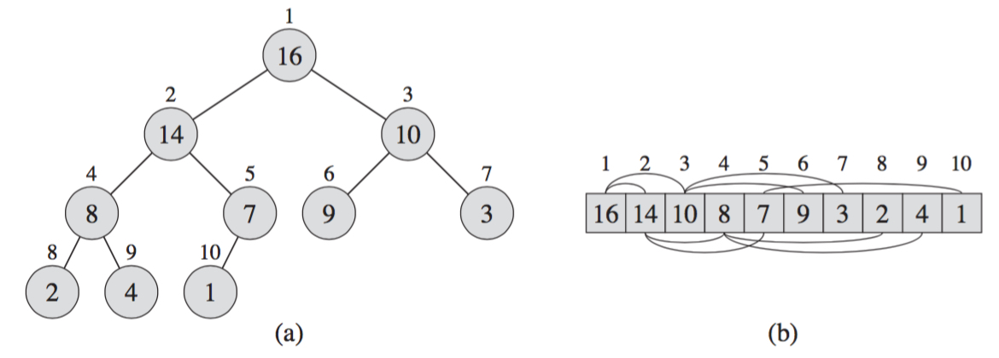
Max Heap
Binary Tree Structure:
Parent(i): i/2 if i is even; (i-1)/2, otherwise
Children(i): left child 2i and right child 2i+1
Child ≤ Parent
Operations: Max-Heapify, Insertion, Deletion, Build-Heap

Slide 6
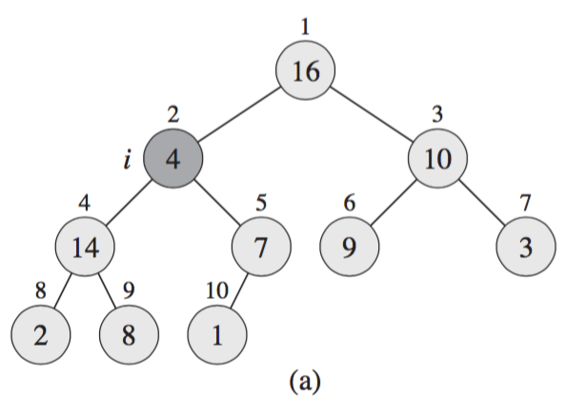
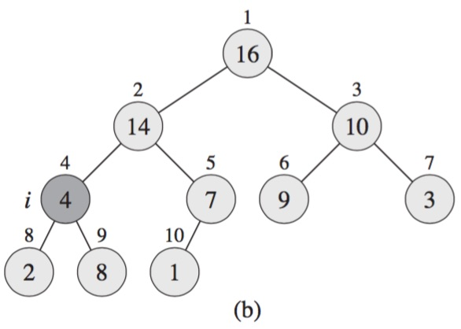
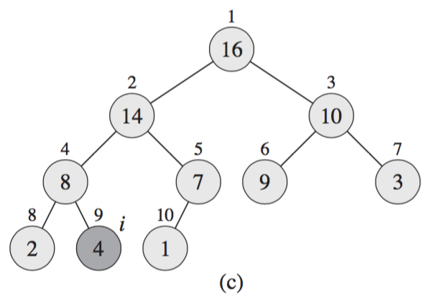
Max-Heapify (A, i)
Float down the violating value in max heap: O(h)=O(log n)

Slide 7
Divide-and-Conquer
Divide: partition the problem into sub-problems of the same type of the original problem
Conquer: find the solutions to sub-problems
Combine: merge the solutions of sub-problems into one for the original problem
A divide-and-conquer algorithm displays in a recursive form, and solves the problem in a bottom-up manner.

Slide 8
Merge Sort
Problem: sort a sequence number in a non-decreasing order
Input:
Output:
Key Idea:
Merge-Sort(A, p, r)
if p < r
q = floor[(p+r)/2] //divide into two small parts
Merge-Sort(A, p, q) //separately sort two small parts
Merge-Sort(A, q+1, r)
Merge(A, p, q, r) //combine two small parts

Slide 9
Merge Subsequences
Two Subsequences:
X[1, 2, …, m] and Y[1, 2, …, n]
Merge Procedure:
i =1, j = 1
for k = 1 to m+n do
if X[i] < Y[j]
Z[k] = X[i], i = i+1
else
Z[k] = Y[j], j = j+1
Time Complexity: O(m+n)

Slide 10
Example: Merge Subsequences
X={1, 4} and Y={2, 3, 6}
i
i
i
i
i
{1, 4}
{2, 3, 6}
{1, 4}
{2, 3, 6}
{1, 4}
{2, 3, 6}
{1, 4}
{2, 3, 6}
{1, 4}
{2, 3, 6}
j
j
j
j
j
Z={1}
Z={1, 2}
Z={1, 2, 3}
Z={1, 2, 3, 4}
Z={1, 2, 3, 4, 6}

Slide 11
Example: Merge Sort
5 2 4 7 1 3 2 6
Divide
Process
1 3 2 6
5 2 4 7
5 2
4 7
1 3
2 6
5
2
4
7
1
3
2
6

Slide 12
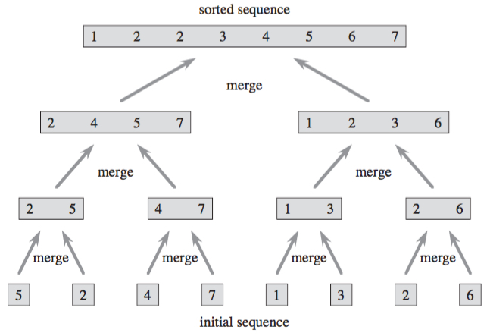
Example: Merge Sort (cont.)
Merge
Process

Slide 13
Quicksort
Key Idea:
Given a list A, partition A into two parts A1 and A2, where all the elements ∈ A1 ≤ those ∈ A2, and then recursively sort each part. Quicksort(A, 1, n) is called to sort n elements.
Quicksort(A, p, r):
if p < r
Then q = Partition(A, p, r) //divide list A
Quicksort(A, p, q-1) //conquer left part
Quicksort(A, q+1, r) //conquer right part

Slide 14
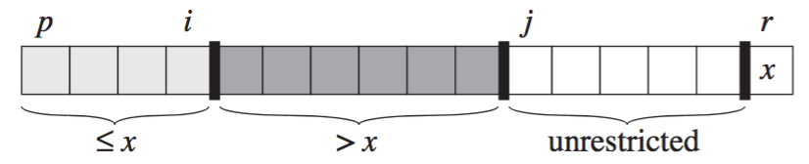
Key Idea of Partition
Four Regions:
Index p: points to the first position of sequence
Index r: points to the last position of sequence
Index i: points to the last position of part “≤ x”, indicating the region boundary
Index j: points to currently scanning position

Slide 15
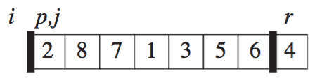
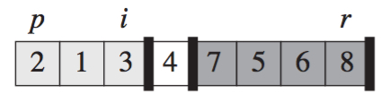
Partition (A, p, r)
Partition A from A[p] to A[r] with pivot A[r]
Result:
If p ≤ k ≤ i, A[k] ≤ pivot A[r]
If i + 1 ≤ k ≤ j – 1, A[k] > pivot A[r]
x = A[r]
i = p - 1
for j = p to r – 1
if A[j] ≤ x
i = i +1
exchange A[i] with A[j] //move smaller number forward
exchange A[i+1] with A[r] //move pivot to the middle position
return (i+1)

Slide 16
Example: Partition(A, p, r)
Initially, x = A[r] = 4, i = p -1, and j = p. None of the elements have been placed in either of the first two partitions.

Slide 17
Example: Partition(A, p, r)
1st Iteration, j = p, A[j] = 2 < 4. Then i = i + 1 = p, A[i] is exchanged with A[j] ( i == j).

Slide 18
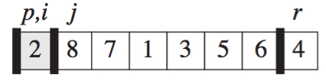
Example: Partition(A, p, r)
2nd Iteration, j = p + 1, A[j] = 8 > 4. Nothing is moved.

Slide 19
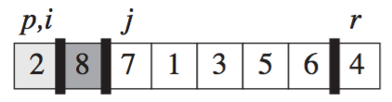
Example: Partition(A, p, r)
3rd Iteration, j = p + 2, A[j] = 7 > 4. Nothing is moved.

Slide 20
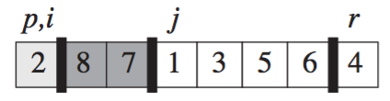
Example: Partition(A, p, r)
4th Iteration, j = p + 3, A[j] = 1 < 4. Then, i = i + 1 = p + 1, A[i] is exchanged with A[j] (values 1 and 8 are swapped).

Slide 21
Example: Partition(A, p, r)
4th Iteration, j = p + 3, A[j] = 1 < 4. Then, i = i + 1 = p + 1, A[i] is exchanged with A[j] (values 1 and 8 are swapped).
1
8

Slide 22
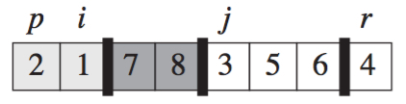
Example: Partition(A, p, r)
5th Iteration, j = p + 4, A[j] = 3 < 4. Then, i = i + 1 = p + 2, A[i] is exchanged with A[j] (values 3 and 7 are swapped).

Slide 23
Example: Partition(A, p, r)
5th Iteration, j = p + 4, A[j] = 3 < 4. Then, i = i + 1 = p + 2, A[i] is exchanged with A[j] (values 3 and 7 are swapped).
3
7

Slide 24
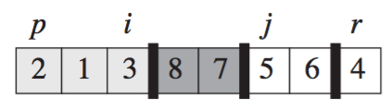
Example: Partition(A, p, r)
6th Iteration, j = p + 5, A[j] = 5 > 4. Nothing is moved.

Slide 25
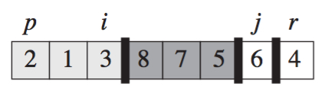
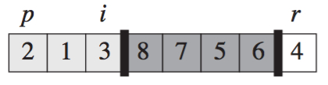
Example: Partition(A, p, r)
7th Iteration, j = p + 6, A[j] = 6 > 4. Nothing is moved. Also, j == r – 1, iteration ends.

Slide 26
Example: Partition(A, p, r)
Finally, exchange pivot A[r] and A[i+1] (values 4 and 8 are swapped).

Slide 27
Greedy Algorithm
Problem Statement
Identify the objective (e.g., maximize or minimize)
Find out the constraints of the problem
Major Steps
Select a best choice from the set of available choices
Check whether the selected choice satisfies constraints
Iteratively repeat Steps 1 and 2 until no choice can be selected

Slide 28
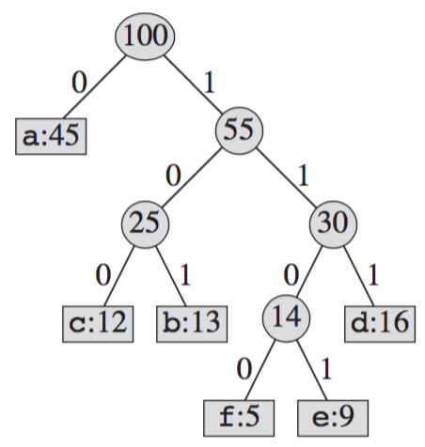

Huffman Codes
At each round, merge two least-frequent nodes
A new node who is the parent of the two merged nodes is generated
Frequency of the new node is the sum of the frequencies of the two nodes that were merged.

Slide 29
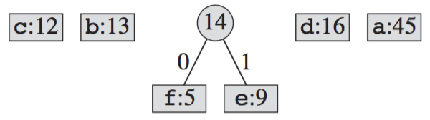
Huffman Tree Construction
At each round, merge two least-frequent nodes
A new node who is the parent of the two merged nodes is generated
Frequency of the new node is the sum of the frequencies of the two nodes that were merged.

Slide 30
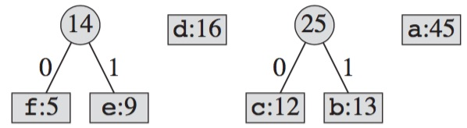
Huffman Tree Construction

Slide 31
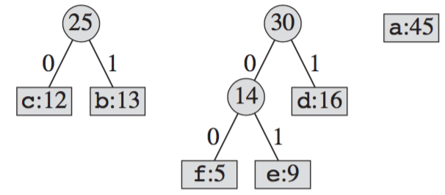
Huffman Tree Construction

Slide 32
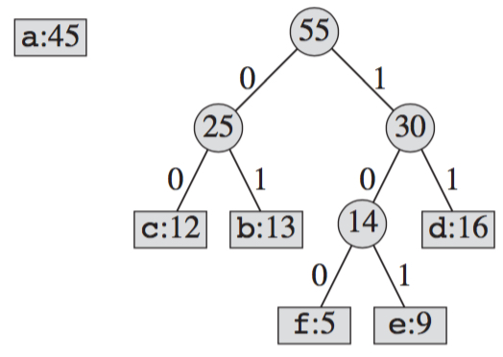
Huffman Tree Construction

Slide 33
Huffman Tree Construction

