Slide 1
Final Review_02
Instructor: Dr. Wei (Lisa) Li
Department of Computer Science, GSU

Slide 2
Representation of Graph
Graph G=(V, E):
V = V(G): vertices;
E = E(G): edges (connecting pairs of vertices)
1
2
3
4
5

Slide 3
Depth-First Search
Methodically discover all vertices and edges
Visit adjacent vertices of most recently discovered vertex v
Trace back once all neighbors of vertex v were visited
Procedure of DFS
All vertices are White
For each vertex v do, if u is white then Visit(v)
Color v Gray
For each u adjacent to v do if u is White then Visit(u)
Color u Black //all neighbors have been visited
a
b
c
d
e
f
g
h

Slide 4
Example: Depth-First Search
a
b
c
d
e
f
g
h

Slide 5
Example: DFS (cont.)
Visit
Trace back
a
b
c
d
e
f
g
h
Stack
a

Slide 6
Example: DFS (cont.)
Visit
Trace back
a
b
c
d
e
f
g
h
Stack
a b

Slide 7
Example: DFS (cont.)
Visit
Trace back
a
b
c
d
e
f
g
h
Stack
a b e

Slide 8
Example: DFS (cont.)
Visit
Trace back
a
b
c
d
e
f
g
h
Stack
a b e g

Slide 9
Example: DFS (cont.)
Visit
Trace back
a
b
c
d
e
f
g
h
Stack
a b e g f

Slide 10
Example: DFS (cont.)
Visit
Trace back
a
b
c
d
e
f
g
h
Stack
a b e g f

Slide 11
Example: DFS (cont.)
Visit
Trace back
a
b
c
d
e
f
g
h
Stack
a b e g

Slide 12
Example: DFS (cont.)
Visit
Trace back
a
b
c
d
e
f
g
h
Stack
a b e

Slide 13
Example: DFS (cont.)
Visit
Trace back
a
b
c
d
e
f
g
h
Stack
a b

Slide 14
Example: DFS (cont.)
Visit
Trace back
a
b
c
d
e
f
g
h
Stack
a b

Slide 15
Example: DFS (cont.)
Visit
Trace back
a
b
c
d
e
f
g
h
Stack
a

Slide 16
Example: DFS (cont.)
Visit
Trace back
a
b
c
d
e
f
g
h
Stack
a d

Slide 17
Example: DFS (cont.)
Visit
Trace back
a
b
c
d
e
f
g
h
Stack
a d

Slide 18
Example: DFS (cont.)
Visit
Trace back
a
b
c
d
e
f
g
h
Stack
a

Slide 19
Example: DFS (cont.)
Visit
Trace back
a
b
c
d
e
f
g
h
Stack
a

Slide 20
Example: DFS (cont.)
Visit
Trace back
a
b
c
d
e
f
g
h
Stack

Slide 21
Example: DFS (cont.)
Visit
Trace back
a
b
c
d
e
f
g
h
Stack
c

Slide 22
Example: DFS (cont.)
Visit
Trace back
a
b
c
d
e
f
g
h
Stack
c

Slide 23
Example: DFS (cont.)
Visit
Trace back
a
b
c
d
e
f
g
h
Stack
c

Slide 24
Example: DFS (cont.)
Visit
Trace back
a
b
c
d
e
f
g
h
Stack
c h

Slide 25
Example: DFS (cont.)
Visit
Trace back
a
b
c
d
e
f
g
h
Stack
c h

Slide 26
Example: DFS (cont.)
Visit
Trace back
a
b
c
d
e
f
g
h
Stack
c

Slide 27
Example: DFS (cont.)
Visit
Trace back
a
b
c
d
e
f
g
h
Stack

Slide 28
Breadth-First Search
BFS discovers all vertices at distance k before any vertices at distance k+1.
Initialization
assigns ∞ to all vertices: w(v)= ∞
color all white
Color s gray, w(s)=0, enqueue s in Q
For the head u of Q
dequeue Q to get u
for each v adjacent to u, //visit each neighbor first
dolor v gray
d[v]=d[u]+1
enqueue v in Q
color u black

Slide 29
Example: BFS
r
s
t
u
∞
∞
∞
∞
∞
∞
∞
∞
v
w
x
y
Queue

Slide 30
Example: BFS (cont.)
r
s
t
u
∞
0
∞
∞
∞
∞
∞
∞
v
w
x
y
Queue
s

Slide 31
Example: BFS (cont.)
Visit
r
s
t
u
1
0
∞
∞
∞
1
∞
∞
v
w
x
y
Queue
r w

Slide 32
Example: BFS (cont.)
Visit
r
s
t
u
1
0
∞
∞
2
1
∞
∞
v
w
x
y
Queue
w v

Slide 33
Example: BFS (cont.)
Visit
r
s
t
u
1
0
2
∞
2
1
2
∞
v
w
x
y
Queue
v t x

Slide 34
Example: BFS (cont.)
Visit
r
s
t
u
1
0
2
∞
2
1
2
∞
v
w
x
y
Queue
t x

Slide 35
Example: BFS (cont.)
Visit
r
s
t
u
1
0
2
3
2
1
2
∞
v
w
x
y
Queue
x u

Slide 36
Example: BFS (cont.)
Visit
r
s
t
u
1
0
2
3
2
1
2
3
v
w
x
y
Queue
u y

Slide 37
Example: BFS (cont.)
Visit
r
s
t
u
1
0
2
3
2
1
2
3
v
w
x
y
Queue
y

Slide 38
Example: BFS (cont.)
Visit
r
s
t
u
1
0
2
3
2
1
2
3
v
w
x
y
Queue

Slide 39
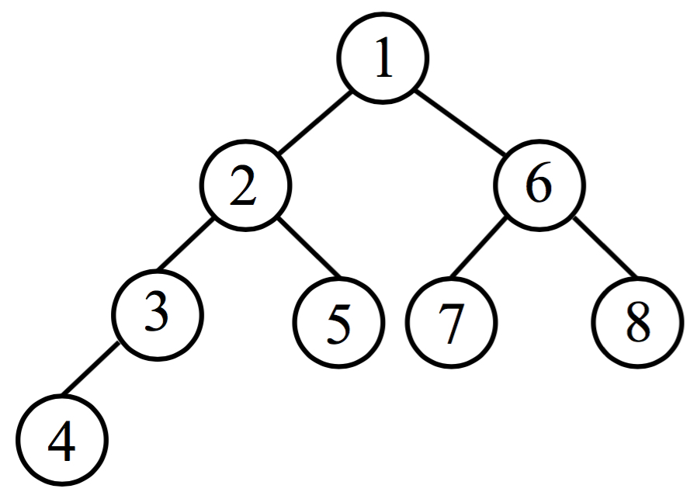
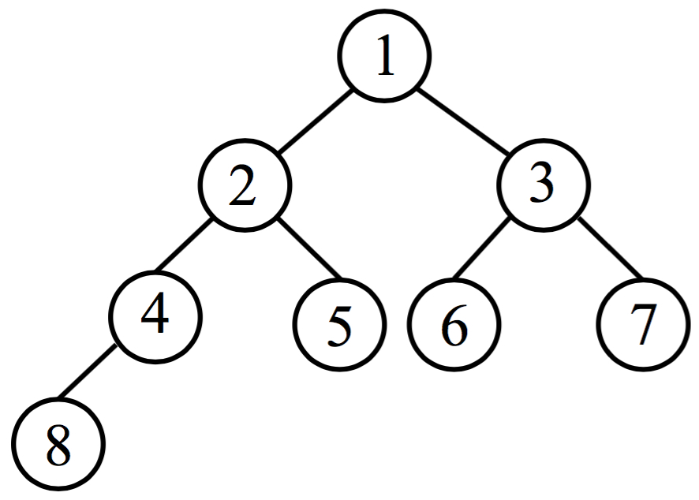
DFS vs. BFS
Traversal Order:
DFS explores as far as possible along each branch before backtracking
BFS discovers all vertices at distance k before those at distance k+1
DFS Order
BFS Order

Slide 40
DFS vs. BFS (cont.)
Tree Structure
DFS tree: long and stringy
BFS tree: short and bushy
r
s
t
u
r
s
t
u
v
w
x
y
v
w
x
y
DFS Tree
BFS Tree

Slide 41
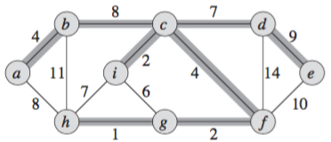
Minimum Spanning Tree
MST (G)
tree: acyclic subgraph of G
spanning: spans (connects) all the vertices of G
has the minimum total weight = sum of edge weight
is not unique

Slide 42
Prim’s MST Algorithm
V: set of vertices in graph G
V_{T}: set of vertices in MST
Process:
Initially, let V_{T} = Φ
Select an arbitrary vertex, e.g. s, to start a tree
While V_{T} ≠ V
Select an edge e(u, v) such that u in V_{T}, v in V-V_{T}, and w(e) is minimum among all such edges
//choose an edge with connected vertex in a greedy manner
Endwhile

Slide 43
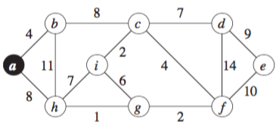
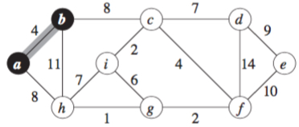
Example
Starting with node a
Choose edge e(a, b)

Slide 44
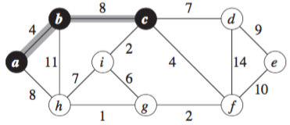
Example (cont.)
Choose edge e(b, c)

Slide 45
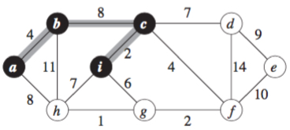
Example (cont.)
Choose edge e(c, i)

Slide 46
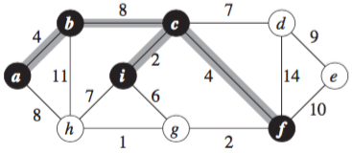
Example (cont.)
Choose edge e(c, f)

Slide 47
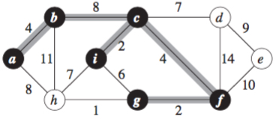
Example (cont.)
Choose edge e(f, g)

Slide 48
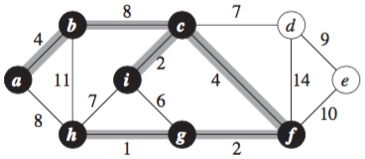
Example (cont.)
Choose edge e(g, h)

Slide 49
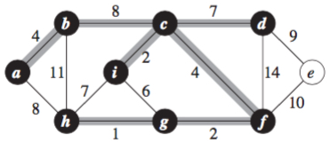
Example (cont.)
Choose edge e(c, d)

Slide 50
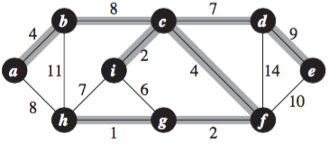
Example (cont.)
Choose edge e(d, e)

Slide 51
Shortest-Paths Problems
Graph G(V, E)
V = {v₀, v₁, v₂, …, v_{n}}: set of vertices
w(v_{i}, v_{j}): weight of edge e(v_{i}, v_{j})
p(v₀, v₁, v₂, …, v_{k}): a path from v₀ to v_{k}
w(p) = w(v₀, v₁) + w(v₁, v₂) + … + w(v_{k-1}, v_{k}): weight of path p
Problems:
Single-Source Shortest-Paths: find a shortest path from a source s to every vertex v in V.
Single-Destination Shortest-Path: find a shortest path to a destination d from every vertex v in V.
Single-Pair Shortest-Path: find a shortest path from source s to destination d.

Slide 52
Dijkstra’s Shortest Paths
Combines BFS and Prim’s algorithm
Better than BFS since non-negative weights
For each v ∈ V
do d[v] ← ∞ and d[s] ← 0 // initiation
V’ ← ∅
For each u ∈ V
Let u in V-V’ and d[u] is minimum
//select a local shortest path
V’ ← V’ U {u}
For each v adjacent to u do
d[v] ← min{d[v], d[u]+w(u,v)}
//update shortest paths for each neighboring vertex

Slide 53
d
∞
b
3
17
c
e
∞
13
∞
9
∞
12
6
11
7
22
a
12
f
∞
14
0
8
8
10
∞
4
∞
20
For each v ∈ V
do d[v] ← ∞ and d[s] ← 0
V’ ← ∅
∞
i
g
10
h
1
8
∞
j

Slide 54
d
∞
b
3
17
c
e
12
13
∞
9
∞
12
6
11
7
22
a
12
f
∞
14
0
8
8
10
∞
4
∞
20
For each u ∈ V
Let u in V-V’ and d[u] is minimum
//select a local shortest path
V’ ← V’ U {u}
For v adjacent to u do
d[v] ← min{d[v], d[u]+w(u,v)}
//update shortest paths
8
i
g
10
h
1
8
∞
j

Slide 55
d
∞
b
3
17
c
e
12
13
∞
9
∞
12
6
11
7
22
a
12
f
∞
14
0
8
8
10
28
4
∞
20
For each u ∈ V
Let u in V-V’ and d[u] is minimum
//select a local shortest path
V’ ← V’ U {u}
For v adjacent to u do
d[v] ← min{d[v], d[u]+w(u,v)}
//update shortest paths
8
i
g
10
h
1
8
∞
j

Slide 56
d
∞
b
3
17
c
e
12
13
25
9
∞
12
6
11
7
22
a
12
f
∞
14
0
8
8
10
19
4
∞
20
For each u ∈ V
Let u in V-V’ and d[u] is minimum
//select a local shortest path
V’ ← V’ U {u}
For v adjacent to u do
d[v] ← min{d[v], d[u]+w(u,v)}
//update shortest paths
8
i
g
10
h
1
8
∞
j

Slide 57
d
∞
b
3
17
c
e
12
13
25
9
∞
12
6
11
7
22
a
12
f
27
14
0
8
8
10
19
4
23
20
For each u ∈ V
Let u in V-V’ and d[u] is minimum
//select a local shortest path
V’ ← V’ U {u}
For v adjacent to u do
d[v] ← min{d[v], d[u]+w(u,v)}
//update shortest paths
8
i
g
10
h
1
8
29
j

Slide 58
d
∞
b
3
17
c
e
12
13
25
9
∞
12
6
11
7
22
a
12
f
27
14
0
8
8
10
19
4
23
20
For each u ∈ V
Let u in V-V’ and d[u] is minimum
//select a local shortest path
V’ ← V’ U {u}
For v adjacent to u do
d[v] ← min{d[v], d[u]+w(u,v)}
//update shortest paths
8
i
g
10
h
1
8
29
j

Slide 59
d
28
b
3
17
c
e
12
13
25
9
34
12
6
11
7
22
a
12
f
27
14
0
8
8
10
19
4
23
20
For each u ∈ V
Let u in V-V’ and d[u] is minimum
//select a local shortest path
V’ ← V’ U {u}
For v adjacent to u do
d[v] ← min{d[v], d[u]+w(u,v)}
//update shortest paths
8
i
g
10
h
1
8
29
j

Slide 60
d
28
b
3
17
c
e
12
13
25
9
34
12
6
11
7
22
a
12
f
27
14
0
8
8
10
19
4
23
20
For each u ∈ V
Let u in V-V’ and d[u] is minimum
//select a local shortest path
V’ ← V’ U {u}
For v adjacent to u do
d[v] ← min{d[v], d[u]+w(u,v)}
//update shortest paths
8
i
g
10
h
1
8
29
j

Slide 61
d
28
b
3
17
c
e
12
13
25
9
34
12
6
11
7
22
a
12
f
27
14
0
8
8
10
19
4
23
20
For each u ∈ V
Let u in V-V’ and d[u] is minimum
//select a local shortest path
V’ ← V’ U {u}
For v adjacent to u do
d[v] ← min{d[v], d[u]+w(u,v)}
//update shortest paths
8
i
g
10
h
1
8
29
j

Slide 62
d
28
b
3
17
c
e
12
13
25
9
34
12
6
11
7
22
a
12
f
27
14
0
8
8
10
19
4
23
20
For each u ∈ V
Let u in V-V’ and d[u] is minimum
//select a local shortest path
V’ ← V’ U {u}
For v adjacent to u do
d[v] ← min{d[v], d[u]+w(u,v)}
//update shortest paths
8
i
g
10
h
1
8
29
j

Slide 63
d
28
b
3
17
c
e
12
13
25
9
34
12
6
11
7
22
a
12
f
27
14
0
8
8
10
19
4
23
20
For each u ∈ V
Let u in V-V’ and d[u] is minimum
//select a local shortest path
V’ ← V’ U {u}
For v adjacent to u do
d[v] ← min{d[v], d[u]+w(u,v)}
//update shortest paths
8
i
g
10
h
1
8
29
j

Slide 64
d
28
b
3
17
c
e
12
13
25
9
34
12
6
11
7
22
a
12
f
27
14
0
8
8
10
19
4
23
20
For each u ∈ V
Let u in V-V’ and d[u] is minimum
//select a local shortest path
V’ ← V’ U {u}
For v adjacent to u do
d[v] ← min{d[v], d[u]+w(u,v)}
//update shortest paths
8
i
g
10
h
1
8
29
j

Slide 65
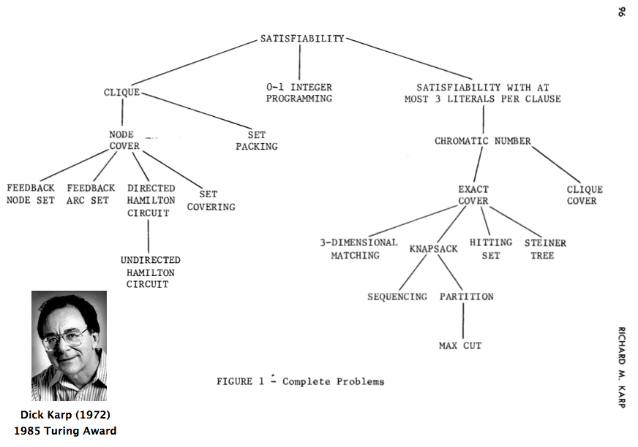
Karp’s 21 NPC Problems

Slide 66
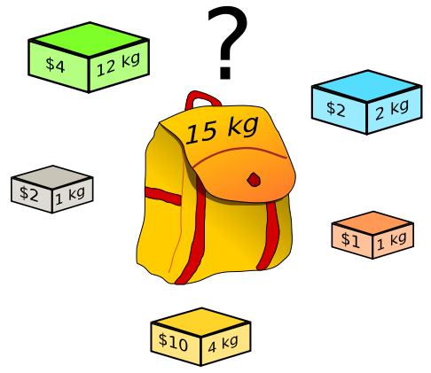
0-1 Knapsack Problem
Given: n items with profit P=(p₁, p₂, …, p_{n}) and weight W=(w₁, w₂, …, w_{n}), and a knapsack with capacity C.
Goal: fill in the knapsack such that
The total profit is maximized
The total weight does exceed the capacity
Hardness
0-1 programming
NP-complete problem

Slide 67
Vertex Cover
Vertex Cover:
The set of vertices which has at least one endpoint in each edge
Minimum Vertex Cover (MVC):
The size of a vertex cover is minimum
Min Vertex Cover is NPC
If C is vertex cover, then V - C is an independent set
red independent set
blue vertex cover

Slide 68
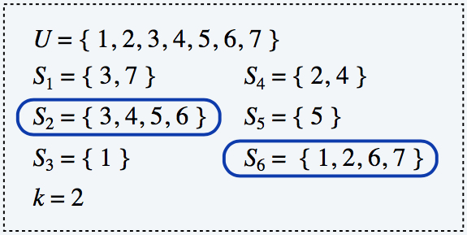
Set Cover
Given a set X of elements, a collection S₁, S₂, ..., S_{m} of subsets of X, the union of S₁, S₂, ..., S_{m} is equal to X, i.e, X = S₁ U S₂ U, …, U S_{m}
Set cover problem: find a set cover that has the minimum size
Applications:
m available pieces of software.
Set X of n capabilities that we would like our system to have.
The i-th piece of software provides the set S_{i} ⊆ X of capabilities.
Goal: achieve all n capabilities using fewest pieces of software.

Slide 69
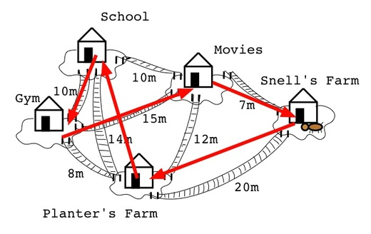
Traveling Salesman Problem
G is an undirected graph with edge cost c(u, v) > 0.
A tour of G is a simple cycle that includes every vertex of G.
The cost of a tour is the sum of the edge costs on the tour.
The traveling salesperson problem is to find a tour of minimum cost.

Slide 70
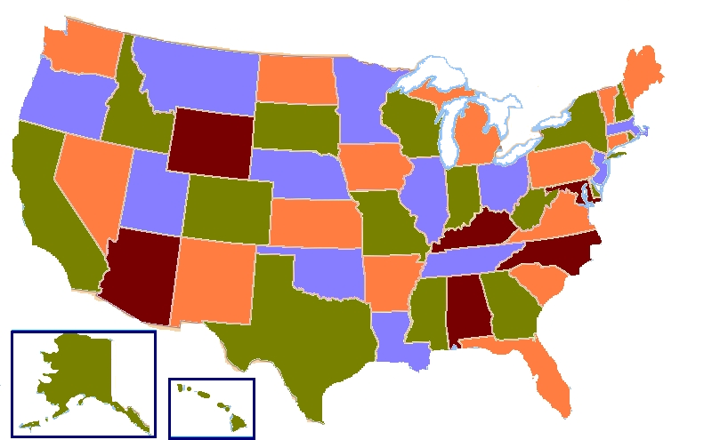
Graph Coloring
Given an undirected graph G, can the nodes be colored in k colors so that no adjacent nodes have the same color?
A Four-Coloring Map of USA

Slide 71
Final Exam
Schedule:
Time: 13:30 – 16:00, Tuesday, 12/05
Place: Classroom
Policies:
Calculator and paper materials (e.g., lecture slides, notes, textbook) are allowed.
Electronic devices (including smart phone, smart tablet, computer) are prohibited
Tips:
Summarize key points and organize notes to save time.
Do spend much time on any one problem, and skip the one that is difficult to you.
Double-check after finishing the paper.

