Slide 1
Dynamic Programming_2
Instructor: Dr. Wei (Lisa) Li
Department of Computer Science, GSU

Slide 2
DP Steps
Characterize the structure of an optimal solution
Define the recursive function of an optimal solution
Compute the values of optimal solutions for subproblems
Construct an optimal solution from computed information

Slide 3
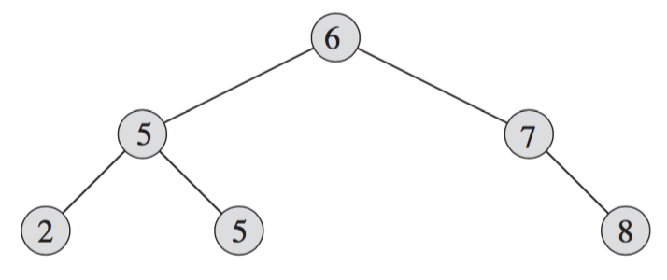
Binary Search Tree
Structure:
Parent
Left Child
Right Child
Property: left child ≤ parent ≤ right Child
Operations: search, insertion, deletion

Slide 4
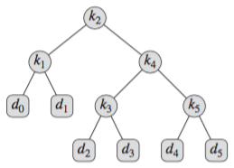

Example
Probabilities of Keys
p_{i}: probability of key k_{i}
q_{i}: probability of dummy key d_{i}
(Sum of all p_{i} and all q_{i}) = 1

Slide 5
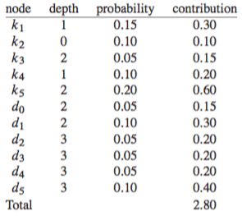
Search Cost
Cost of a search = number of nodes visited
= depth of the node + 1
Expected cost of a search = (depth of the node + 1) x probability
Total cost C(T) = Σ_{1≤i≤n} p_{i} x (depth(k_{i})+1) + Σ_{0≤i≤n} q_{i} x (depth(d_{i})+1)

Slide 6
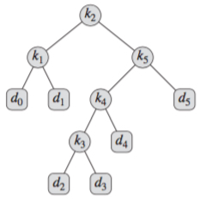
Minimum Search Cost
Search Cost C(T₁) = 2.8
Search Cost C(T₂) = 2.75

Slide 7
Optimal Binary Search Tree
Minimize the number of nodes visited in all searches
→ Minimum Search Cost

Slide 8
Structure Properties
T: a binary search tree for keys k₁, k₂, …, k_{n}
T’: a subtree in T and contains keys k_{i}, k_{i+1}, …, k_{j} (1≤ i≤ j ≤ n)
→
If T is optimal, T’ is also optimal.

Slide 9
Recursive Function
The whole tree T: keys k_{i}, k₂, …, k_{j} with root at k_{r}
Left subtree L for keys k_{i}, k₂, …, k_{r-1}
Right subtree R for keys k_{r+1}, k_{r+2}, …, k_{j}
w(i, j) = sum of probabilities in tree k_{i}, k₂, …, k_{j}
Probability of a tree T = left + root + right
w(i, j) = w(i, r-1) + p_{r} + w(r+1, j)
w(i, j) = w(i, j-1) + p_{j} + q_{j} when i ≤ j = r
w(i, i-1) = q_{i-1} // only one dummy node

Slide 10
Recursive Function
The whole tree T: keys k_{i}, k₂, …, k_{j} with root at k_{r}
Left subtree L for keys k_{i}, k₂, …, k_{r-1}
Right subtree R for keys k_{r+1}, k_{r+2}, …, k_{j}
w(i, j) = sum of probabilities in tree k_{i}, k₂, …, k_{j}
Probability of a tree T = left + root + right
w(i, j) = w(i, r-1) + p_{r} + w(r+1, j)
w(i, j) = w(i, j-1) + p_{j} + q_{j} when i ≤ j = r
w(i, i-1) = q_{i-1} // only one dummy node

Slide 11
Recursive Function
The whole tree T: keys k_{i}, k₂, …, k_{j} with root at k_{r}
Left subtree L for keys k_{i}, k₂, …, k_{r-1}
Right subtree R for keys k_{r+1}, k_{r+2}, …, k_{j}
w(i, j) = sum of probabilities in tree k_{i}, k₂, …, k_{j}
Probability of a tree T = left + root + right
w(i, j) = w(i, r-1) + p_{r} + w(r+1, j)
w(i, j) = w(i, j-1) + p_{j} + q_{j} when i ≤ j = r
w(i, i-1) = q_{i-1} // only one dummy node

Slide 12
Recursive Function (cont.)
w(i, j) = sum of probabilities in tree k_{i}, k₂, …, k_{j}
w(i, j) = w(i, r-1) + p_{r} + w(r+1, j)
C(i, j) = search cost for keys k_{i}, k₂, …, k_{j}
C(i, j) = p_{r}
+ [C(i, r-1)+w(i, r-1)]
+ [C(r+1, j)+w(r+1, j)]
= [p_{r}+w(i, r-1)+w(r+1, j)] + C(i, r-1) + C(r+1, j)
= w(i, j) + C(i, r-1) + C(r+1, j)
// visiting path is increased by 1 when a subtree is put in a tree

Slide 13
Recursive Function (cont.)
w(i, j) = w(i, r-1) + p_{r} + w(r+1, j)
C(i, j) = w(i, j) + C(i, r-1) + C(r+1, j)
C(i, i-1) = w(i, i-1) = q_{i-1} // only one dummy node
Optimal Solution
If j = i – 1: C(i, j) = q_{i-1} // only a dummy node
If i ≤ j: C(i, j) = min_{i≤r≤j} {w(i, j) + C(i, r-1) + C(r+1, j)}

Slide 14
Example
Two keys k1 < k2 and three corresponding dummy nodes d0<d1<d2.
The probabilities are shown as follows:
p1=0.2, p2=0.4;
q0=0.1, q1=0.2, q2=0.1.
How to construct an optimal binary search tree?
k1
k2
d0
d1
d2

Slide 15
Answer
w(1,0) = q0 = 0.1
w(1,1) = w(1,0) + p1 + q1 = 0.5
w(1,2) = w(1,1) + p2 + q2 = 1
w(2,2) = w(2,1) + p2 + q2 = 0.7
w(3,2) = q2 = 0.1
C(1,0) = q0 = 0.1
C(2,1) = q1 = 0.2
C(3,2) = q2 = 0.1
C(1,1) = w(1,1) + C(1,0) + C(2,1) = 0.8
C(2,2) = w(2,2) + C(2,1) + C(3,2) = 1

Slide 16
Answer (cont.)
C(1, 2)
If r = 1, C(1,2) = w(1,2) + C(1,0) + C(2,2) = 2.1
If r = 2, C(1,2) = w(1,2) + C(1,1) + C(3,2) = 1.9
k1
k2
d0
k2
k1
d2
d1
d2
d0
d1
Root = k1
Root = k2

