Slide 1
Graph Algorithm_1
Instructor: Dr. Wei (Lisa) Li
Department of Computer Science, GSU

Slide 2
Representation of Graph
Graph G=(V, E):
V = V(G): vertices;
E = E(G): edges (connecting pairs of vertices)
1
2
3
4
5

Slide 3
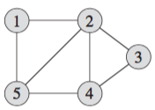
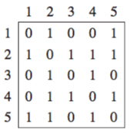
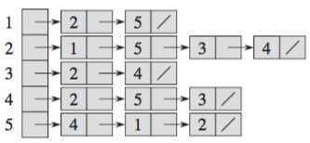
Representation of Graph (cont.)
Representations of Undirected Graph:
Adjacency List
Adjacency Matrix
Adjacency List
Adjacency Matrix

Slide 4
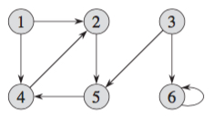
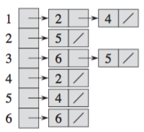
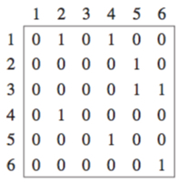
Representation of Graph (cont.)
Representations of Directed Graph:
Adjacency List
Adjacency Matrix
Adjacency List
Adjacency Matrix

Slide 5
Attributes of Graph
Weight of Edge (u, v)
Out Degree of Vertex: sum of corresponding row
In Degree of Vertex: sum of corresponding column

Slide 6
Depth-First Search
Methodically discover all vertices and edges
Visit adjacent vertices of most recently discovered vertex v
Trace back once all neighbors of vertex v were visited
Procedure of DFS
All vertices are White
For each vertex v do, if u is white then Visit(v)
Color v Gray
For each u adjacent to v do if u is White then Visit(u)
Color u Black //all neighbors have been visited
a
b
c
d
e
f
g
h

Slide 7
Example: Depth-First Search
a
b
c
d
e
f
g
h

Slide 8
Example: DFS (cont.)
Visit
Trace back
a
b
c
d
e
f
g
h
Stack
a

Slide 9
Example: DFS (cont.)
Visit
Trace back
a
b
c
d
e
f
g
h
Stack
a b

Slide 10
Example: DFS (cont.)
Visit
Trace back
a
b
c
d
e
f
g
h
Stack
a b e

Slide 11
Example: DFS (cont.)
Visit
Trace back
a
b
c
d
e
f
g
h
Stack
a b e g

Slide 12
Example: DFS (cont.)
Visit
Trace back
a
b
c
d
e
f
g
h
Stack
a b e g f

Slide 13
Example: DFS (cont.)
Visit
Trace back
a
b
c
d
e
f
g
h
Stack
a b e g f

Slide 14
Example: DFS (cont.)
Visit
Trace back
a
b
c
d
e
f
g
h
Stack
a b e g

Slide 15
Example: DFS (cont.)
Visit
Trace back
a
b
c
d
e
f
g
h
Stack
a b e

Slide 16
Example: DFS (cont.)
Visit
Trace back
a
b
c
d
e
f
g
h
Stack
a b

Slide 17
Example: DFS (cont.)
Visit
Trace back
a
b
c
d
e
f
g
h
Stack
a b

Slide 18
Example: DFS (cont.)
Visit
Trace back
a
b
c
d
e
f
g
h
Stack
a

Slide 19
Example: DFS (cont.)
Visit
Trace back
a
b
c
d
e
f
g
h
Stack
a d

Slide 20
Example: DFS (cont.)
Visit
Trace back
a
b
c
d
e
f
g
h
Stack
a d

Slide 21
Example: DFS (cont.)
Visit
Trace back
a
b
c
d
e
f
g
h
Stack
a

Slide 22
Example: DFS (cont.)
Visit
Trace back
a
b
c
d
e
f
g
h
Stack
a

Slide 23
Example: DFS (cont.)
Visit
Trace back
a
b
c
d
e
f
g
h
Stack

Slide 24
Example: DFS (cont.)
Visit
Trace back
a
b
c
d
e
f
g
h
Stack
c

Slide 25
Example: DFS (cont.)
Visit
Trace back
a
b
c
d
e
f
g
h
Stack
c

Slide 26
Example: DFS (cont.)
Visit
Trace back
a
b
c
d
e
f
g
h
Stack
c

Slide 27
Example: DFS (cont.)
Visit
Trace back
a
b
c
d
e
f
g
h
Stack
c h

Slide 28
Example: DFS (cont.)
Visit
Trace back
a
b
c
d
e
f
g
h
Stack
c h

Slide 29
Example: DFS (cont.)
Visit
Trace back
a
b
c
d
e
f
g
h
Stack
c

Slide 30
Example: DFS (cont.)
Visit
Trace back
a
b
c
d
e
f
g
h
Stack

Slide 31
Properties of DFS
Depth First Forest: multiple DFS trees
a
b
c
d
e
f
g
h

Slide 32
Running Time of DFS
Runtime of DFS = O(V+E)
Visiting Vertices: operations of push and pop on stack; once per vertex O(V)
Exploring Edges: operations of scanning adjacency list; once per edge O(E)
a
b
c
d
e
f
g
h

Slide 33
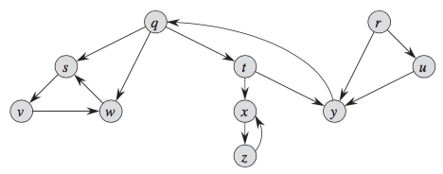
Exercise
Show how DFS works on the following graph.

