Slide 1
Graph Algorithm_2
Instructor: Dr. Wei (Lisa) Li
Department of Computer Science, GSU

Slide 2
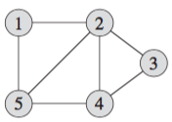
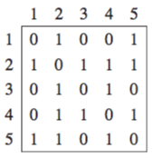
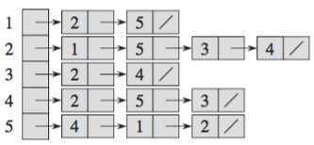
Representation of Graph
Representations of Undirected Graph:
Adjacency List;
Adjacency Matrix
Adjacency List
Adjacency Matrix

Slide 3
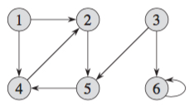
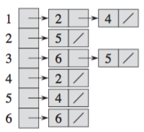
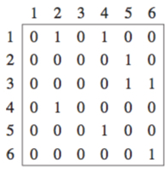
Representation of Graph (cont.)
Representations of Directed Graph:
Adjacency List;
Adjacency Matrix
Adjacency List
Adjacency Matrix

Slide 4
Breadth-First Search
BFS discovers all vertices at distance k before any vertices at distance k+1.
Initialization
assigns ∞ to all vertices: d(v)= ∞
color all white
Color s gray, d(s)=0, enqueue s in Q
For the head u of Q
dequeue Q to get u
for each v adjacent to u, //visit each neighbor first
color v gray
d[v]=d[u]+1 //compute the distance to the starting point
enqueue v in Q
color u black

Slide 5
Example: BFS
r
s
t
u
∞
∞
∞
∞
∞
∞
∞
∞
v
w
x
y
Queue

Slide 6
Example: BFS (cont.)
r
s
t
u
∞
0
∞
∞
∞
∞
∞
∞
v
w
x
y
Queue
s

Slide 7
Example: BFS (cont.)
Visit
r
s
t
u
1
0
∞
∞
∞
1
∞
∞
v
w
x
y
Queue
r w

Slide 8
Example: BFS (cont.)
Visit
r
s
t
u
1
0
∞
∞
2
1
∞
∞
v
w
x
y
Queue
w v

Slide 9
Example: BFS (cont.)
Visit
r
s
t
u
1
0
2
∞
2
1
2
∞
v
w
x
y
Queue
v t x

Slide 10
Example: BFS (cont.)
Visit
r
s
t
u
1
0
2
∞
2
1
2
∞
v
w
x
y
Queue
t x

Slide 11
Example: BFS (cont.)
Visit
r
s
t
u
1
0
2
3
2
1
2
∞
v
w
x
y
Queue
x u

Slide 12
Example: BFS (cont.)
Visit
r
s
t
u
1
0
2
3
2
1
2
3
v
w
x
y
Queue
u y

Slide 13
Example: BFS (cont.)
Visit
r
s
t
u
1
0
2
3
2
1
2
3
v
w
x
y
Queue
y

Slide 14
Example: BFS (cont.)
Visit
r
s
t
u
1
0
2
3
2
1
2
3
v
w
x
y
Queue

Slide 15
Running Time of BFS
Running-time = O(V+E)
Operations of enqueuing and dequeuing: once per vertex O(V)
Operations of scanning adjacency list: once per edge O(E)
r
s
t
u
1
0
2
3
2
1
2
3
Queue
v
w
x
y

Slide 16
Properties of BFS
Shortest-path tree
BFS trees
Keep predecessors and get the shortest path
The final weight is the minimum distance
r
s
t
u
1
0
2
3
2
1
2
3
v
w
x
y

Slide 17
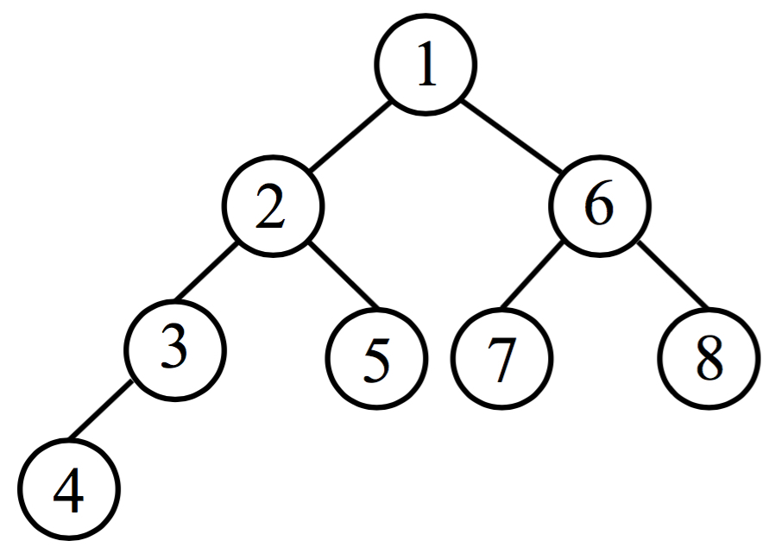
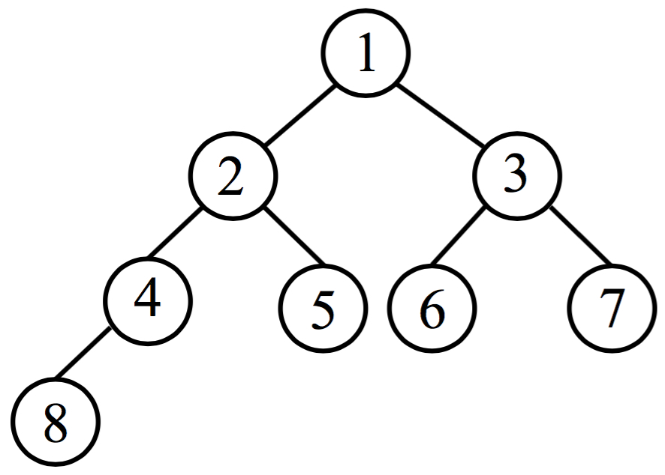
DFS vs. BFS
Traversal Order:
DFS explores as far as possible along each branch before backtracking
BFS discovers all vertices at distance k before those at distance k+1
DFS Order
BFS Order

Slide 18
DFS vs. BFS (cont.)
Implementation
DFS utilizes stack to trace visiting order (first visit last trace back)
BFS utilizes queue to trace visiting order (visit from near to far)
r
s
t
u
v
w
x
y

Slide 19
DFS vs. BFS (cont.)
Tree Structure
DFS tree: long and stringy
BFS tree: short and bushy
r
s
t
u
r
s
t
u
v
w
x
y
v
w
x
y
DFS Tree
BFS Tree

Slide 20
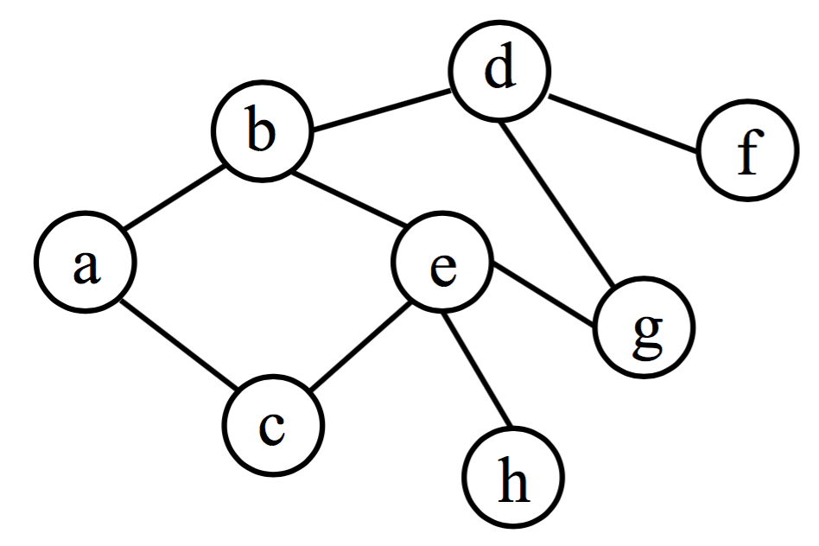
Exercise
Perform DFS and BFS on the following graph.

