Slide 1
Minimum Spanning Tree
Instructor: Dr. Wei (Lisa) Li
Department of Computer Science, GSU

Slide 2
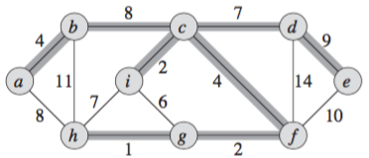
Minimum Spanning Tree
MST (G)
tree: acyclic subgraph of G
spanning: spans (connects) all the vertices of G
has the minimum total weight = sum of edge weight
is not unique

Slide 3
Minimum Spanning Tree (cont.)
MST (G)
tree: acyclic subgraph of G
spanning: spans (connects) all the vertices of G
has the minimum total weight = sum of edge weight
is not unique
✗

Slide 4
Construction of MST
Key Idea:
At each round, select an edge in a greedy manner and terminate when all vertices are spanned.
Greedy Algorithms:
Prim’s MST Algorithm
Kruskal’s MST Algorithm

Slide 5
Prim’s MST Algorithm
V: set of vertices in graph G
V_{T}: set of vertices in MST
Process:
Initially, let V_{T} = Φ
Select an arbitrary vertex, e.g. s, to start a tree
While V_{T} ≠ V
Select an edge e(u, v) such that u in V_{T}, v in V-V_{T}, and w(e) is minimum among all such edges
//choose an edge with connected vertex in a greedy manner
Endwhile

Slide 6
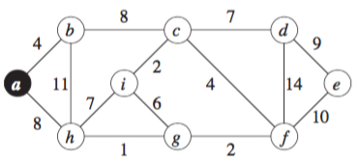
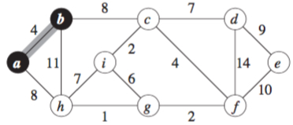
Example
Starting with node a
Choose edge e(a, b)

Slide 7
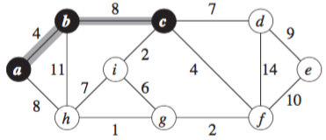
Example (cont.)
Choose edge e(b, c)

Slide 8
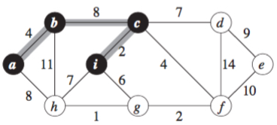
Example (cont.)
Choose edge e(c, i)

Slide 9
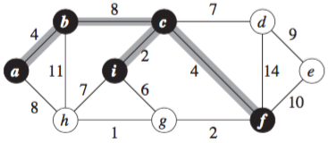
Example (cont.)
Choose edge e(c, f)

Slide 10
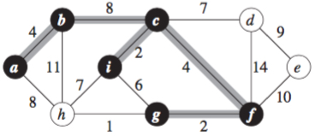
Example (cont.)
Choose edge e(f, g)

Slide 11
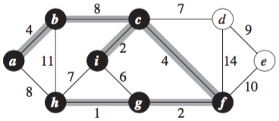
Example (cont.)
Choose edge e(g, h)

Slide 12
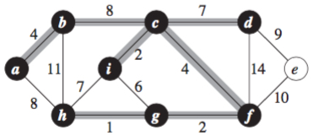
Example (cont.)
Choose edge e(c, d)

Slide 13
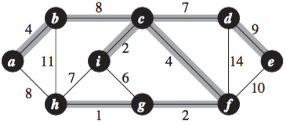
Example (cont.)
Choose edge e(d, e)

Slide 14
Kruskal’s MST Algorithm
E = {e₁, e₂, …, e_{m}}: set of edges in graph G
E_{T}: set of edges in MST
V_{T}: set of vertices in MST
Process:
Initially, let V_{T} = {v₁, v₂, ..., v_{n}} and E_{T} = Φ
Sort edges in E such that e₁ ≤ e₂ ≤ e₃ … ≤ e_{m}
For i = 1 to m // IEI
if E_{T} U {e_{i}} does not creat a cycle
//greedily choose an edge
E_{T} = E_{T} U {e_{i}}
Endfor

Slide 15
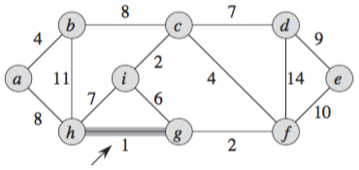
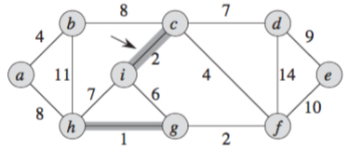
Example
Edge e(h, g) has smallest weight
Choose edge e(c, i)

Slide 16
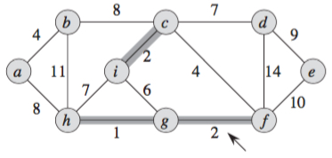
Example (cont.)
Choose edge e(g, f)

Slide 17
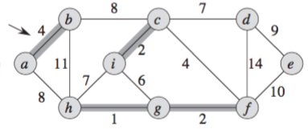
Example (cont.)
Choose edge e(a, b)

Slide 18
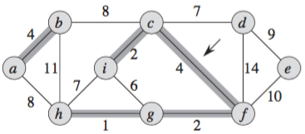
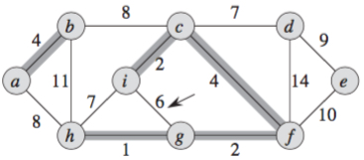
Example (cont.)
Adding edge e(g, i) will
create a cycle
×

Slide 19
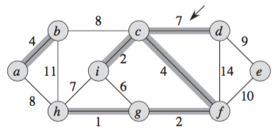
Example (cont.)
×
Choose edge e(c, d)
×

Slide 20
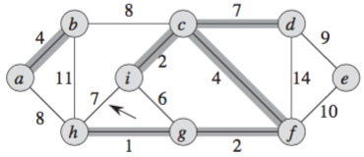
Example (cont.)
×
Adding edge e(h, i) will
create a cycle
×
×

Slide 21
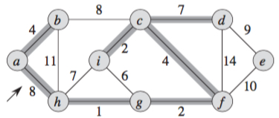
Example (cont.)
×
×
Choose edge e(a, h)
×
×

Slide 22
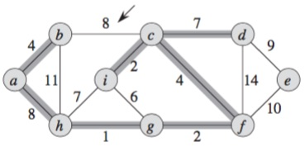
Example (cont.)
×
×
Adding edge e(b, c) will
create a cycle
×
×
×

Slide 23
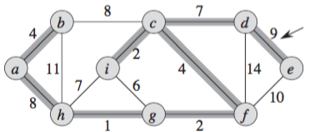
Example (cont.)
×
×
×
×
Choose edge e(d, e)
×
×

Slide 24
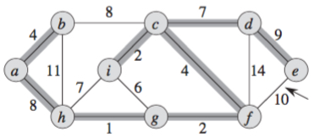
Example (cont.)
×
×
×
Adding edge e(e, f) will
create a cycle
×
×
×
×

Slide 25
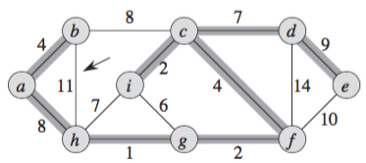
Example (cont.)
×
×
×
×
Adding edge e(b, h) will
create a cycle
×
×
×
×
×

Slide 26
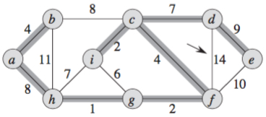
Example (cont.)
×
×
×
×
×
Adding edge e(d, f) will
create a cycle
×
×
×
×
×
×

Slide 27
Prim’s vs. Kruskal’s
Prim’s: edge selection from connected component to new vertex set (vertices of new added edge are not in the same vertex set)
Kruskal’s: edge selection between two connected components (check cycle after each selection)

