Slide 1
Single-Source Shortest Paths
Instructor: Dr. Wei (Lisa) Li
Department of Computer Science, GSU

Slide 2
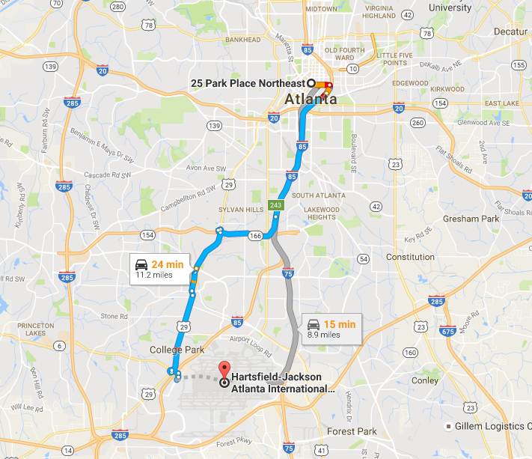
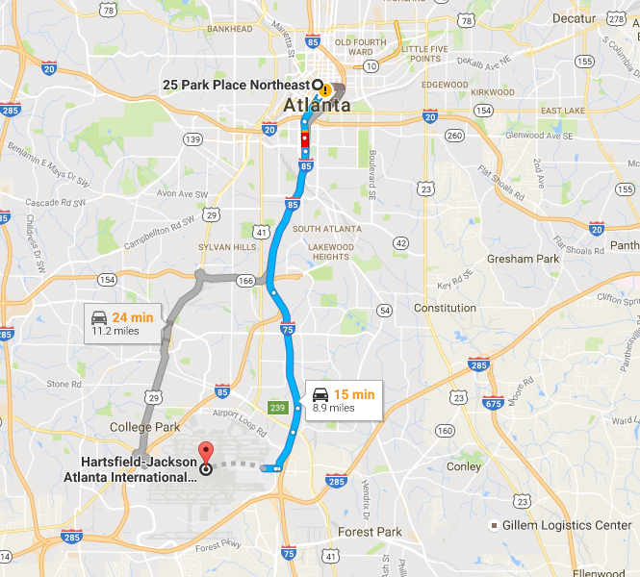
Which path do you prefer?

Slide 3
Shortest-Paths Problems
Graph G(V, E)
V = {v₀, v₁, v₂, …, v_{n}}: set of vertices
w(v_{i}, v_{j}): weight of edge e(v_{i}, v_{j})
p(v₀, v₁, v₂, …, v_{k}): a path from v₀ to v_{k}
w(p) = w(v₀, v₁) + w(v₁, v₂) + … + w(v_{k-1}, v_{k}): weight of path p
Problems:
Single-Source Shortest-Paths: find a shortest path from a source s to every vertex v in V.
Single-Destination Shortest-Path: find a shortest path to a destination d from every vertex v in V.
Single-Pair Shortest-Path: find a shortest path from source s to destination d.

Slide 4
Shortest Paths
Predecessor subgraph for restoring shortest paths
Shortest-paths tree rooted at source s
Subpath of a shortest path is a shortest path
Triangle Inequality:
δ(u,v) ≤ δ(u,x) + δ(x,v)
Well defined: some paths may not exist if there is a negative-weight cycle in graph
u
v
x
<0

Slide 5
Bellman-Ford Algorithm (cont.)
BFS-based algorithm, shortest paths (tree) easy to reconstruct.
Initially, for each v ∈ V, d[v] ← ∞ and d[s] ← 0
Relaxation
for i =1,...,|V|-1 do
for each edge (u,v) ∈ E do
d[v] ← min{d[v], d[u]+w(u,v)}
//update local shortest paths for each vertex
Negative cycle checking
for each v ∈ V do
if d[v]> d[u] + w(u,v) then no solution //negative weight cycle
Finally, d[v] = actual shortest-path weight δ(s,v)

Slide 6
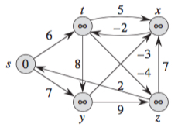
Example: Bellman-Ford
for each v ∈ V do
d[v] ← ∞ and d[s] ← 0
//initiation

Slide 7
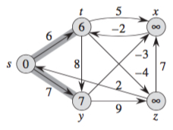
Example: Bellman-Ford (cont.)
for i =1,...,|V|-1 do
for each edge (u,v) ∈ E do
d[v] ← min{d[v], d[u]+w(u,v)}
//update local shortest paths
for each vertex

Slide 8
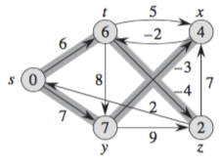
Example: Bellman-Ford (cont.)
for i =1,...,|V|-1 do
for each edge (u,v) ∈ E do
d[v] ← min{d[v], d[u]+w(u,v)}
//update local shortest paths
for each vertex

Slide 9
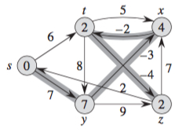
Example: Bellman-Ford (cont.)
for i =1,...,|V|-1 do
for each edge (u,v) ∈ E do
d[v] ← min{d[v], d[u]+w(u,v)}
//update local shortest paths
for each vertex

Slide 10
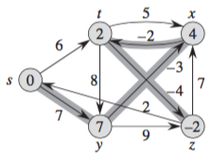
Example: Bellman-Ford (cont.)
for i =1,...,|V|-1 do
for each edge (u,v) ∈ E do
d[v] ← min{d[v], d[u]+w(u,v)}
//update local shortest paths
for each vertex

Slide 11
Dijkstra’s Shortest Paths
Combines BFS and Prim’s algorithm
Better than BFS since non-negative weights
For each v ∈ V
do d[v] ← ∞ and d[s] ← 0 // initiation
V’ ← ∅
For each u ∈ V
Let u in V-V’ and d[u] is minimum
//select a local shortest path
V’ ← V’ U {u}
For each v adjacent to u do
d[v] ← min{d[v], d[u]+w(u,v)}
//update shortest paths for each neighboring vertex

Slide 12
d
∞
b
3
17
c
e
∞
13
∞
9
∞
12
6
11
7
22
a
12
f
∞
14
0
8
8
10
∞
4
∞
20
For each v ∈ V
do d[v] ← ∞ and d[s] ← 0
V’ ← ∅
∞
i
g
10
h
1
8
∞
j

Slide 13
d
∞
b
3
17
c
e
12
13
∞
9
∞
12
6
11
7
22
a
12
f
∞
14
0
8
8
10
∞
4
∞
20
For each u ∈ V
Let u in V-V’ and d[u] is minimum
//select a local shortest path
V’ ← V’ U {u}
For v adjacent to u do
d[v] ← min{d[v], d[u]+w(u,v)}
//update shortest paths
8
i
g
10
h
1
8
∞
j

Slide 14
d
∞
b
3
17
c
e
12
13
∞
9
∞
12
6
11
7
22
a
12
f
∞
14
0
8
8
10
28
4
∞
20
For each u ∈ V
Let u in V-V’ and d[u] is minimum
//select a local shortest path
V’ ← V’ U {u}
For v adjacent to u do
d[v] ← min{d[v], d[u]+w(u,v)}
//update shortest paths
8
i
g
10
h
1
8
∞
j

Slide 15
d
∞
b
3
17
c
e
12
13
25
9
∞
12
6
11
7
22
a
12
f
∞
14
0
8
8
10
19
4
∞
20
For each u ∈ V
Let u in V-V’ and d[u] is minimum
//select a local shortest path
V’ ← V’ U {u}
For v adjacent to u do
d[v] ← min{d[v], d[u]+w(u,v)}
//update shortest paths
8
i
g
10
h
1
8
∞
j

Slide 16
d
∞
b
3
17
c
e
12
13
25
9
∞
12
6
11
7
22
a
12
f
27
14
0
8
8
10
19
4
23
20
For each u ∈ V
Let u in V-V’ and d[u] is minimum
//select a local shortest path
V’ ← V’ U {u}
For v adjacent to u do
d[v] ← min{d[v], d[u]+w(u,v)}
//update shortest paths
8
i
g
10
h
1
8
29
j

Slide 17
d
∞
b
3
17
c
e
12
13
25
9
∞
12
6
11
7
22
a
12
f
27
14
0
8
8
10
19
4
23
20
For each u ∈ V
Let u in V-V’ and d[u] is minimum
//select a local shortest path
V’ ← V’ U {u}
For v adjacent to u do
d[v] ← min{d[v], d[u]+w(u,v)}
//update shortest paths
8
i
g
10
h
1
8
29
j

Slide 18
d
28
b
3
17
c
e
12
13
25
9
34
12
6
11
7
22
a
12
f
27
14
0
8
8
10
19
4
23
20
For each u ∈ V
Let u in V-V’ and d[u] is minimum
//select a local shortest path
V’ ← V’ U {u}
For v adjacent to u do
d[v] ← min{d[v], d[u]+w(u,v)}
//update shortest paths
8
i
g
10
h
1
8
29
j

Slide 19
d
28
b
3
17
c
e
12
13
25
9
34
12
6
11
7
22
a
12
f
27
14
0
8
8
10
19
4
23
20
For each u ∈ V
Let u in V-V’ and d[u] is minimum
//select a local shortest path
V’ ← V’ U {u}
For v adjacent to u do
d[v] ← min{d[v], d[u]+w(u,v)}
//update shortest paths
8
i
g
10
h
1
8
29
j

Slide 20
d
28
b
3
17
c
e
12
13
25
9
34
12
6
11
7
22
a
12
f
27
14
0
8
8
10
19
4
23
20
For each u ∈ V
Let u in V-V’ and d[u] is minimum
//select a local shortest path
V’ ← V’ U {u}
For v adjacent to u do
d[v] ← min{d[v], d[u]+w(u,v)}
//update shortest paths
8
i
g
10
h
1
8
29
j

Slide 21
d
28
b
3
17
c
e
12
13
25
9
34
12
6
11
7
22
a
12
f
27
14
0
8
8
10
19
4
23
20
For each u ∈ V
Let u in V-V’ and d[u] is minimum
//select a local shortest path
V’ ← V’ U {u}
For v adjacent to u do
d[v] ← min{d[v], d[u]+w(u,v)}
//update shortest paths
8
i
g
10
h
1
8
29
j

Slide 22
d
28
b
3
17
c
e
12
13
25
9
34
12
6
11
7
22
a
12
f
27
14
0
8
8
10
19
4
23
20
For each u ∈ V
Let u in V-V’ and d[u] is minimum
//select a local shortest path
V’ ← V’ U {u}
For v adjacent to u do
d[v] ← min{d[v], d[u]+w(u,v)}
//update shortest paths
8
i
g
10
h
1
8
29
j

Slide 23
d
28
b
3
17
c
e
12
13
25
9
34
12
6
11
7
22
a
12
f
27
14
0
8
8
10
19
4
23
20
For each u ∈ V
Let u in V-V’ and d[u] is minimum
//select a local shortest path
V’ ← V’ U {u}
For v adjacent to u do
d[v] ← min{d[v], d[u]+w(u,v)}
//update shortest paths
8
i
g
10
h
1
8
29
j

Slide 24
Bellman-Ford vs. Dijkstra
Edge Weight:
Bellman-Ford can detect negative-weight cycle.
Dijkstra only deals with non-negative edge weights.
Key Idea:
Bellman-Ford is based on BFS.
Dijkstra resembles both BFS and Prim’s algorithm
Running Time:
Dijkstra is faster than Bellman-Ford

