Slide 1
Stable Matching
Instructor: Dr. Wei (Lisa) Li
Department of Computer Science, GSU

Slide 2
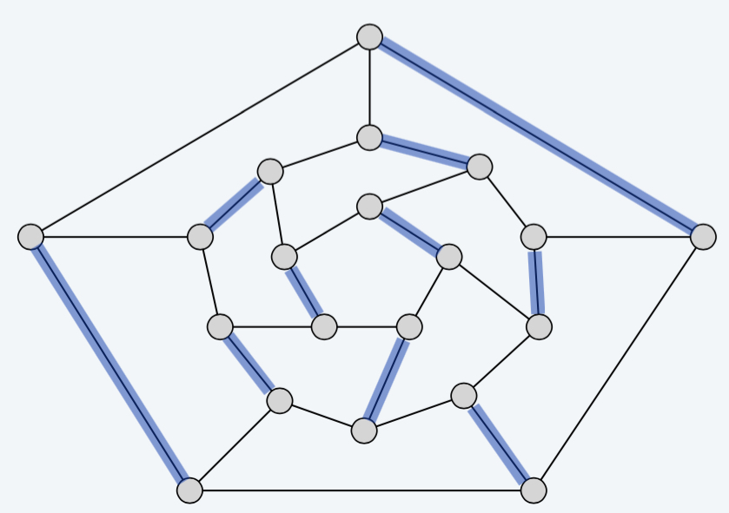
Matching
G(V, E): an undirected graph
Matching M
a subset of E
for each node v in V, at most one edge of M is incident on v

Slide 3
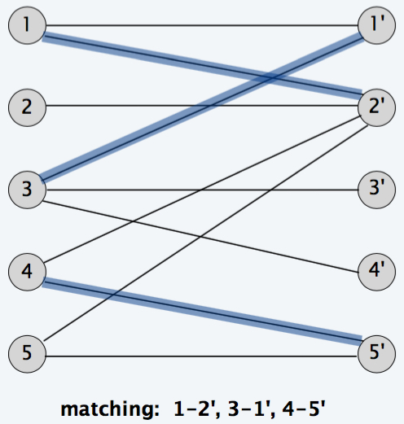
Bipartite Matching
Bipartite Graph G(V, E): V = L U R
Bipartite matching: given a bipartite graph G = (L ∪ R, E), find a matching M.
L
R

Slide 4
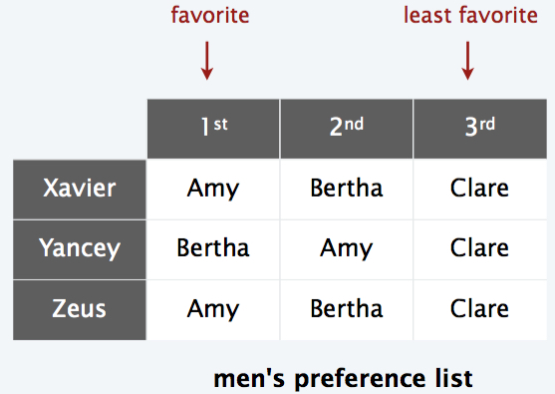
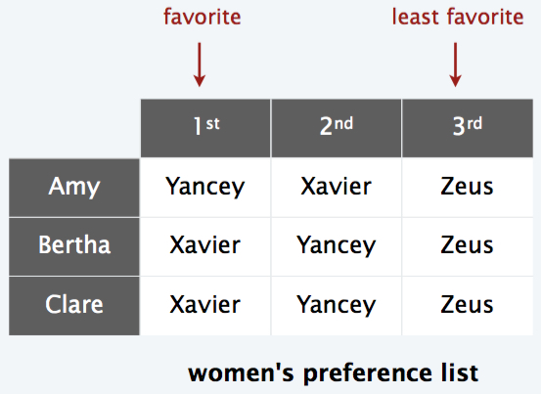
Stable Matching Problem
Given a set of n men and a set of n women, find a "suitable" matching
Participants rank members of opposite sex
Each man lists women in order of preference from best to worst
Each woman lists men in order of preference from best to worst

Slide 5
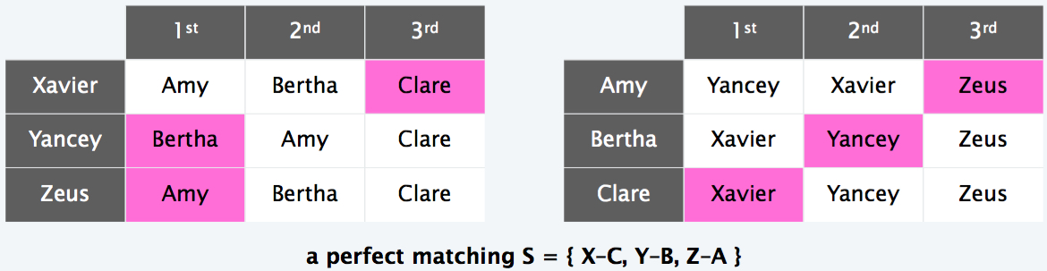
Perfect Matching
Perfect Matching S:
A bipartite matching M for G(L U R, E)
Each v in L is matched
Each u in R is matched

Slide 6
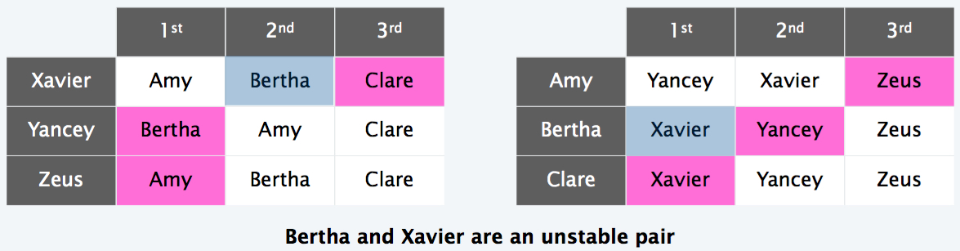
Unstable Pairs
Definition: given a matching S, man m and woman w are unstable if:
m prefers w to his current partner
w prefers m to her current partner.
Key point: an unstable pair m–w could each improve partner by joint action.

Slide 7
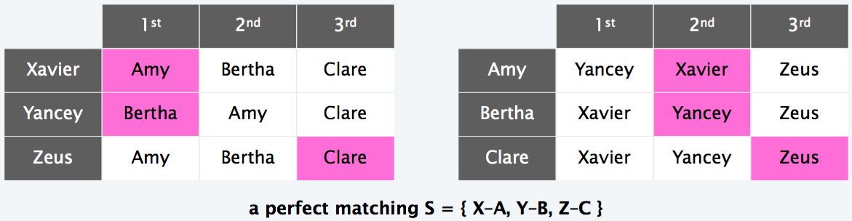
Stable Matching
Definition: a stable matching is a perfect matching with no unstable pairs.
A Stable Matching S={ X-A, Y-B, Z-C}

Slide 8
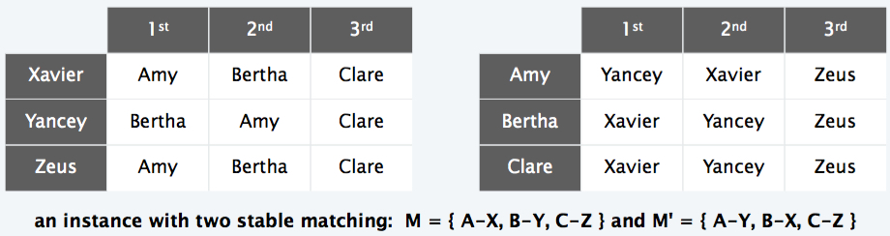
Solutions
May exist more than one stable matching

Slide 9
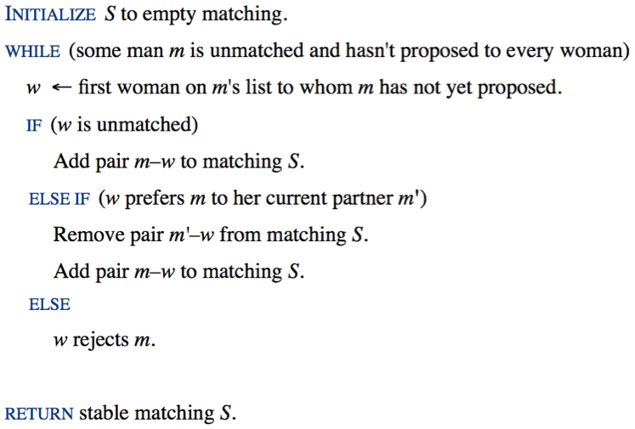
Gale-Shapley Deferred Acceptance Algorithm

Slide 10
Matching Students to Schools
Problem: given a set of preferences among hospitals and med-school students, design a self-reinforcing admissions process.
Unstable pair: student x and hospital y are unstable if:
x prefers y to its assigned hospital
y prefers x to one of its admitted students
Stable assignment: assignment without unstable pairs
Natural and desirable condition
Individual self-interest prevents any hospital–student side deal

Slide 11
Matching Students to Schools (cont.)
Problem: given a set of preferences among hospitals and med-school students, design a self-reinforcing admissions process.
Solution:
Map hospitals to “men”
Map students to “women”
Apply stable matching algorithm

Slide 12
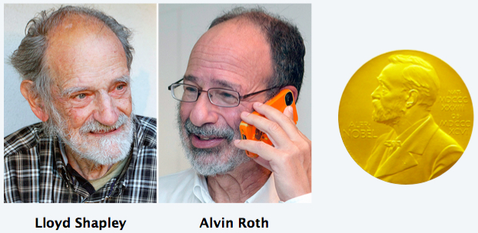
2012 Nobel Prize in Economics
Lloyd Shapley: Stable matching theory and Gale-Shapley algorithm.
Alvin Roth: Applied Gale-Shapley to matching new doctors with hospitals, students with schools, and organ donors with patients.
https://www.youtube.com/watch?v=n3z7lbm3PLY

Slide 14
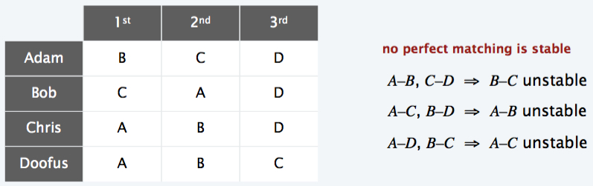
Stable Roommate Problem
Stable roommate problem.
2n people
Each person ranks others from 1 to 2n – 1
Assign roommate pairs so that no unstable pairs

